Slide 1
About this template
Use this template with the Living Donation Business Case Toolkit and ROI calculator to create a pitch for your C-suite or financial leadership
CONTENTS
Background Slides: 2-14, highlight your program’s (and community’s) need for growth by illustrating the benefits of living donor kidney transplantation
Growth Opportunity: 15-27, to “pitch” great strategy(ies) that will grow your program by outlining your center’s current state & opportunities
Return on Investment: 28-34, showcase the return on investment (impact of the requested investment(s)) by incorporating ROI calculator output
You are welcome to edit all slides. Please retain the NKF acknowledgment statement.
Zoom out to see instructions in yellow boxes on the side of the slides.

Slide 2
A Business Case for
Growing Living Donation
Your logo here (optional)

Slide 3

Contents
Why Living Donor Kidney Transplant?
Our Growth Opportunity
Return on Investment

Slide 4
Achieving the Triple Aim in ESRD Care
Preemptive Transplant is the Answer
(and Living Donor Transplantation is the Solution)
Improve Health
Lower Cost
Better Care

Slide 5
Why Transplant?
End Stage Renal Disease Basics
Incidence and Prevalence
Cost

Slide 6
37 MILLION
people are living with Chronic Kidney Disease (CKD)
are living with End-Stage
Kidney Disease (ESKD)
808,000+
are on the transplant
waitlist
90,000+
12
people die daily on the kidney Waitlist
received a kidney
in 2024
Only 27,426

Slide 7
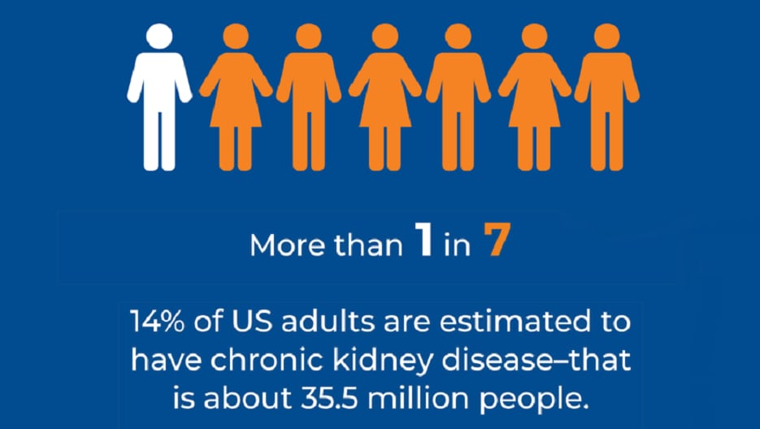
The CKD Diagnosis Problem
37 million living in the us with CKD
As many as 90% of people with CKD do not even know they have it.
Most people get diagnosed at late stages, when the opportunity for interventions to slow progression/improve outcomes have passed.
CKD is a known risk multiplier
In earlier stages, death from CVD is more likely than kidney failure
Adults older than 65 living with CKD are 6x more likely to diet from CVD than develop kidney failure
Individuals with social risk factors are disproportionately impacted.
As CKD progresses, cost of care increases while quality of life diminishes.
https://www.cdc.gov/kidney-disease/php/data-research/index.html
Honeycutt AA, et al. J Am Soc Nephrol. 2013;24(9):1478-1483.
Rossing, P, et al. Am J Med. 2022;135(5):576-580

Slide 8


Patients with ESRD can survive on dialysis
(but many don’t)
Less than 50% of dialysis patients are still alive after five years
Low Five-Year Survival
High Complications
Patients with ESRD have a 30-day readmission risk of 31.1%, higher than any group targeted in Medicare’s Hospital Readmissions Reduction Program (HRRP)
Dialysis
Heart Disease
10-20x increased risk, highest in the first 2 weeks.
<50%
Leukemia
61%
Vascular Disease
In 25-45%
Lymphoma
87%
Cognitive Impairment
In 67% of those on dialysis, half severe
Breast Cancer
91%
Kolbrink NDT 2023. Abdel Kader CJASN 2009. Bonventre CJASN 2019. Wolgram JASN 2019. Goto CJASN 2019. Aoko Ann Vasc Dis 2017; McCausland CJASN. Gallagher DM, Zhao C, Goldstein BA. Kidney Med. 2022.
Notes:
Kolbrink NDT 2023. Abdel Kader CJASN 2009. Bonventre CJASN 2019. Wolgram JASN 2019. Goto CJASN 2019. Aoko Ann Vasc Dis 2017; McCausland CJASN. Gallagher DM, Zhao C, Goldstein BA. A Readmission Risk Model for Hospitalized Patients Receiving Dialysis: Evaluation of Predictive Performance. Kidney Med. 2022 Jun 24;4(8):100507. doi: 10.1016/j.xkme.2022.100507. PMID: 36061368; PMCID: PMC9437601.
Used with permission from Dr. Eliot Heher, Square Knot Health

Slide 9
Kidney disease, especially ESRD, is costly
Medicare
Commercial Payors & Self-Insured Employers
$50.8 billion per year,
for patients age >65, with disability, or on dialysis >30 months
$87 billion per year for
care of milder kidney disease
$14 billion per year,
or ~$19,000/month x 30 months
4–5x commercial insurers pay dialysis rates 4–5x than of Medicare
Notes:
In addition to the health, quality of life, and equity barriers, the simple fact is that the high costs of ESRD must be urgently addressed.
ESRD costs Medicare well over 130 billion dollars per year.
Patients with ESRD also have the highest 30-day readmission risk of any targeted Medicare group at over 30%.
These costs negatively impact the healthcare system in many different ways.

Slide 10
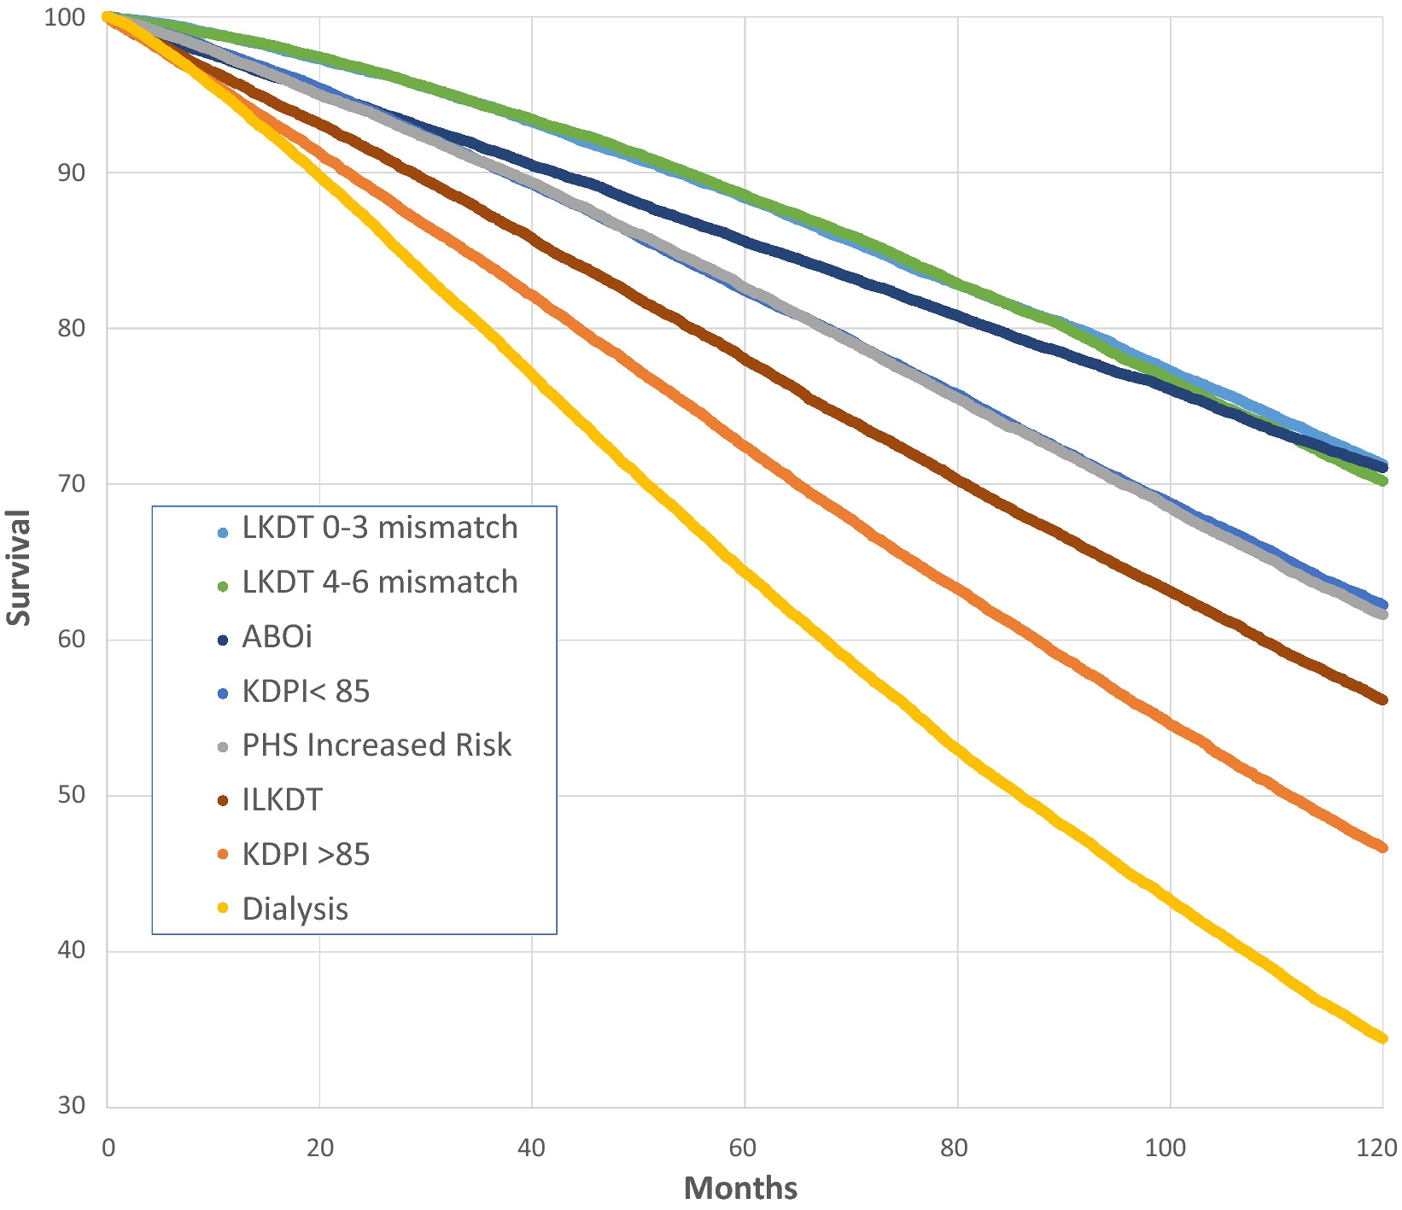
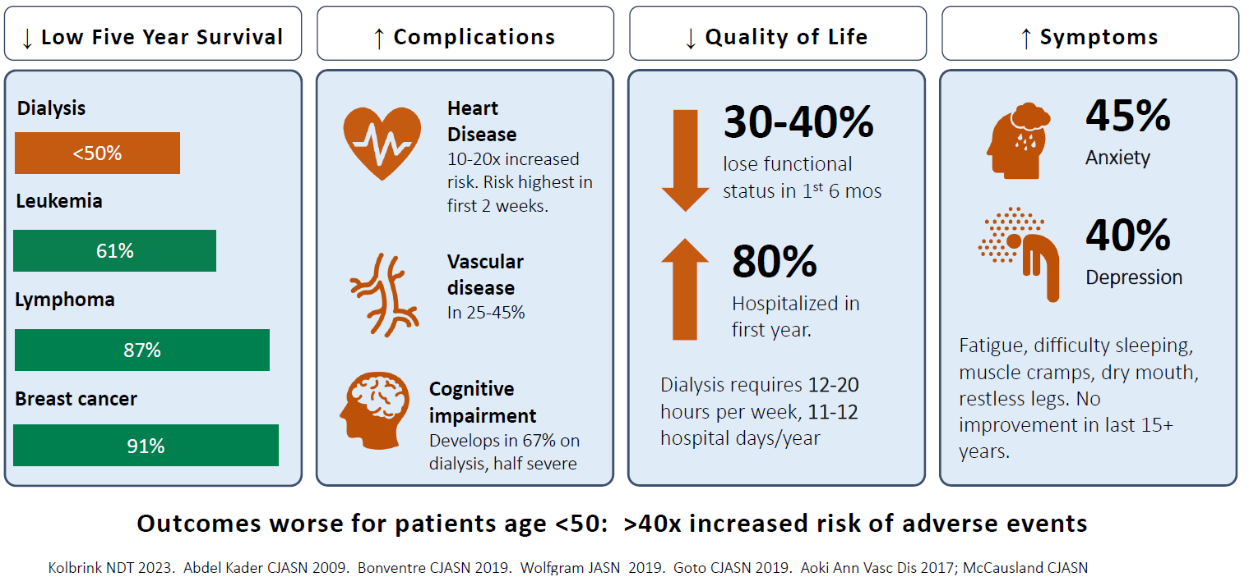
Transplant is a clinically and financially superior treatment
Greater patient survival and quality of life improvements are well established
Recipients achieve average quality of life scores similar to healthy individuals, especially living donor transplant recipients
Modern transplant techniques
Dialysis
Wolfe RA, McCullough KP, Leichtman AB. Predictability of survival models for waiting list and transplant patients: calculating LYFT. Am J Transplant. 2009;9(7):1523‐1527.
Wolfe RA, Ashby VB, Milford EL, et al. Comparison of mortality in all patients on dialysis, patients on dialysis awaiting transplantation, and recipients of a first cadaveric transplant. N Engl J Med. 1999;341(23):1725‐1730.
Notes:
CLINICAL SLIDE – skip if not needed.
By contrast, transplant offers a chance at a longer, healthier, and more normal life that is well established in literature.
Transplant patients achieve QOL scores similar to health individuals, especially if they receive a kidney from a living donor
Kidney transplant is cost effective compared to dialysis and achieves those savings within 3 to 14 years. Well-matched living donor kidney transplants have the most economic and health benefits for patients.
Wolfe RA, McCullough KP, Leichtman AB. Predictability of survival models for waiting list and transplant patients: calculating LYFT. Am J Transplant. 2009;9(7):1523‐1527.
Wolfe RA, Ashby VB, Milford EL, et al. Comparison of mortality in all patients on dialysis, patients on dialysis awaiting transplantation, and recipients of a first cadaveric transplant. N Engl J Med. 1999;341(23):1725‐1730.
Kolbrink NDT 2023. Abdel Kader CJASN 2009. Bonventre CJASN 2019. Wolgram JASN 2019. Goto CJASN 2019. Aoko Ann Vasc Dis 2017; McCausland CJASN.

Slide 11
Financial impact of kidney transplant
Kidney transplant compared to maintenance dialysis is cost effective due to substantial survival gains*
*Assuming a threshold of $100,000 per QALY
Transplant achieves cost savings within 3 to 14 years, depending on the quality of the organ
Well-matched living donor kidney transplants achieve economic benefits of $250,00 to $1.45 million each
Whiting JF, Woodward RS, Zavala EY, et al. Economic cost of expanded criteria donors in cadaveric renal transplantation: analysis of Medicare payments. Transplantation. 2000;70(5):755‐760.
Iqbal MM, Rahman N, Alam M, Deb Nath PK, Waheed S, Islam K, Mokarram Hossain R, Chowdhury AA. Quality of Life Is Improved in Renal Transplant Recipients Versus That Shown in Patients With Chronic Kidney Disease With or Without Dialysis. Exp Clin Transplant. 2020 Jan;18(Suppl 1):64-67. doi: 10.6002/ect.TOND-TDTD2019.P11. PMID: 32008498.
QALY: https://pubmed.ncbi.nlm.nih.gov/29451350/
Matas AJ, Schnitzler M. Payment for living donor (vendor) kidneys: a cost-effectiveness analysis. Am J Transplant. 2004;4(2):216‐221.

Slide 12



Access to kidney transplant is highly limited
562,484 people on dialysis in 2022
90,000+ people on the waitlist
Just over 27,000 people received a transplant in 2024, with only 23% coming from living donors
Dialysis: 2022 USRDS, https://usrds-adr.niddk.nih.gov/2022/end-stage-renal-disease/1-incidence-prevalence-patient-characteristics-and-treatment-modalities
Waitlist: as of 1/14/2025- OPTN, https://optn.transplant.hrsa.gov/data/
Transplant: 2024 - OPTN, https://insights.unos.org/OPTN-metrics/
Notes:
Sources: USRDS, UNOS

Slide 13
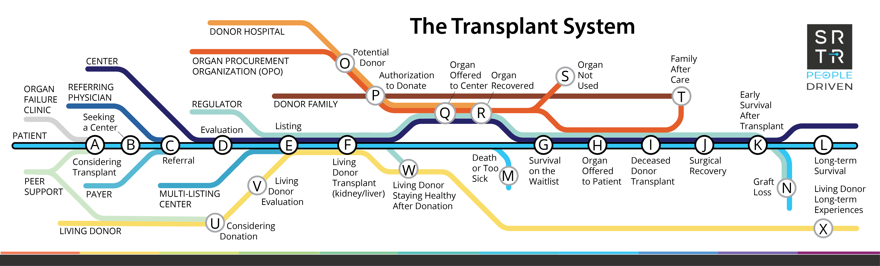
Getting a transplant is an extremely complex process
Graphic created under the Task 5 Initiative by the Scientific Registry of Transplant Recipients.
Notes:
Unfortunately, there many steps and barriers along the way to transplant, including:
Not knowing that transplant is an option
Not being referred to a transplant center to start the process
Difficulty completing the evaluation, including getting to and from the transplant center for many tests and appointments
Not knowing how to find a living donor
Waiting many years for a kidney
And the many changes that come after receiving a kidney transplant, which is not a cure for kidney disease and has its own set of healthcare burdens.

Slide 14
Intensifying Regulatory
Focus and Expectations
Advancing American Kidney Health (2019)
Value Based Nephrology Care (2019)
Expansions in OPTN Continuous Distribution (2020)
Securing OTPN (2022)
OPTN Expeditious Task Force (2023)
Increasing Organ Transplant Access (effective July 2025)
“Growth is not a goal; it’s essentially a mandate”

Slide 15
Our Growth Opportunity

Slide 16
Instructions for
“Our Growth Opportunity” Section
Start with the opportunity summary:
  Include key statistics from your program
  Identify the strategies you’ve selected for investment that will support your program’s growth
Then set the stage:
  Add key data points that show your program’s current state (volume/% of transplants from living donors, living donor demographics, etc. compared to your past performance or local/regional/national benchmarks
Define your strategies:
  Edit slides that provide more detail on your selected strategies that will require investment – or replace with your own ideas

Slide 17
Opportunity Summary
Our Current State
Our Path to Increasing Living Donor Transplants
Example List – use any/all or choose your own
<______ Volume of Transplant Referrals>
<_______Size of Recipient Waitlist>
<________% Living Donor Transplants>
<________% Referrals that progress to evaluation (or a ratio)>
<________% of evaluations that progress to donation/Transplants (or a ratio)>
<Average Contribution Margin for a Living Donor Case>
<Comparison to Region/Nation>
<Insert Strategy 1>
<Insert Strategy 2>
<Insert Strategy 3>
<Continue as needed >
Add Short Title for each Strategy you will go on to present
Notes:
Transplant program should use combination of data they may have previously presented or pull where existing data is strong
This slide is a high-level summary to expound on --- but to be modified as needed based on what’s available and relevant. Examples.

Slide 18
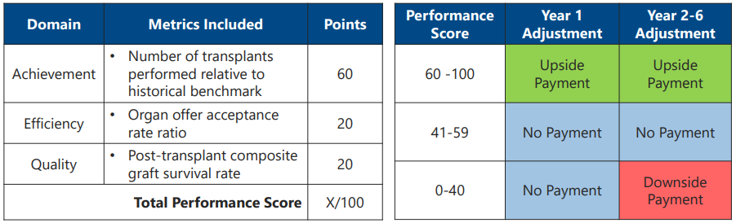
Increasing Organ Transplant Access (IOTA) Participation
Include if applicable to your program
Our center has been selected to participate in the mandatory IOTA model
Financial Incentive or Penalty will be largely determined by volume of transplants
Notes:
Source: https://www.cms.gov/priorities/innovation/files/iota-model-welcome-webinar-slides.pdf
IOTA is “designed to incentivize transplant hospitals to increase the number of kidney transplants performed, aiming to improve access to kidney transplants for patients with End-Stage Renal Disease (ESRD) while maintaining quality of care by providing performance-based incentives and penalties based on their transplant volume compared to a baseline, essentially rewarding hospitals for performing more kidney transplants while also focusing on quality metrics and addressing social determinants of health that may hinder access to transplants.”

Slide 19
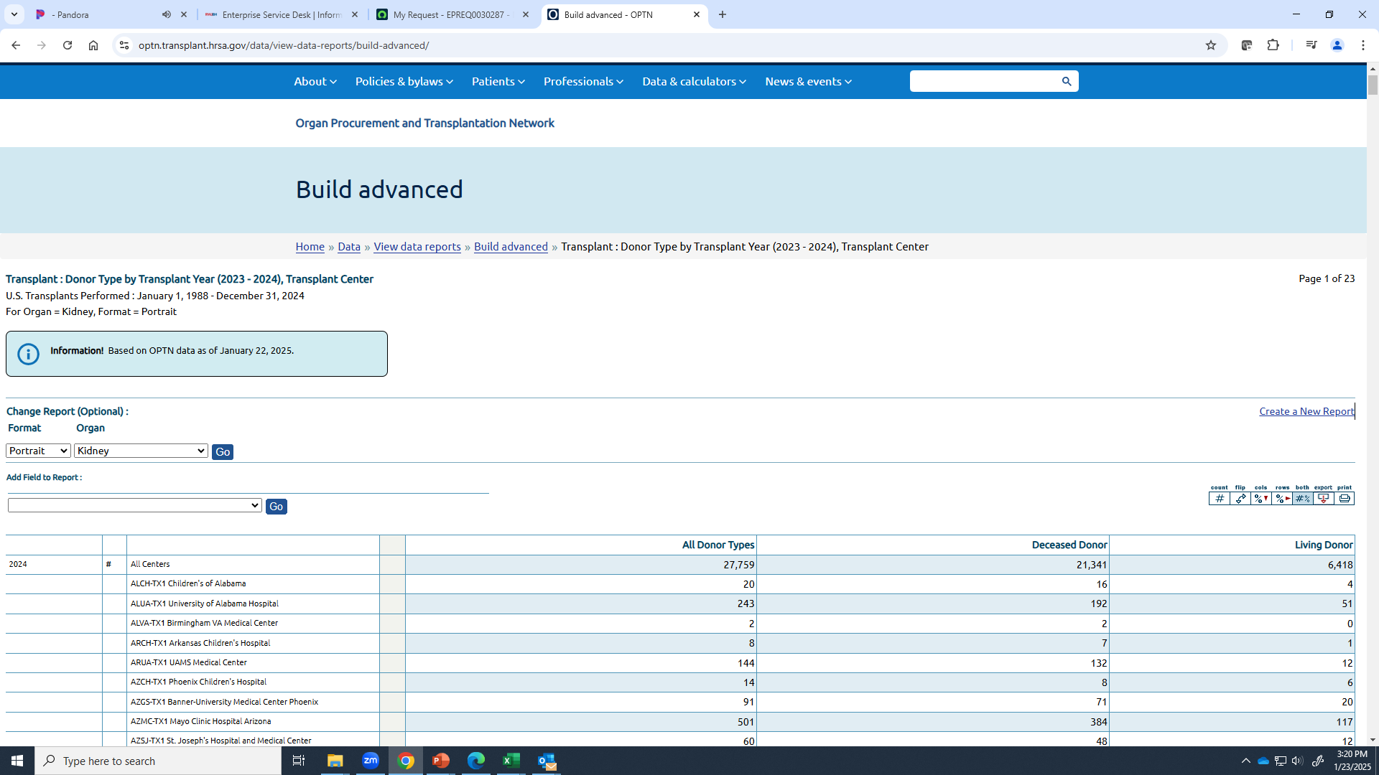
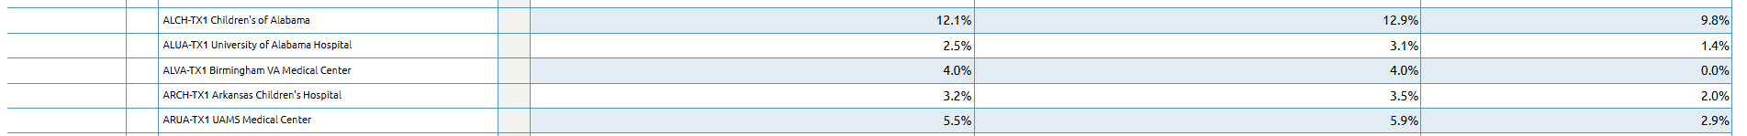
Our Living Donation Program
Instructions: To illustrate your program’s current state relative to past performance and/or local, regional, or national benchmarks
Insert OPTN Data – your program donation and living donation compared to other programs
https://optn.transplant.hrsa.gov/data/view-data-reports/build-advanced/
Select organ, transplant type, add center and years
Select % to show % of LD of total volume
Example: Compare your living donor volume and rate to regional peers
Notes:
We recommend you work with your quality team and medical/surgical directors to identify which data could be best used as a comparison. Choose data points that illustrate where your own program has an opportunity to grow or is being outperformed in total # of living donors, % of live donor cases, or perhaps showing the paired donation/.anonymous donors at your center versus other (available in OPTN ‘Center data’).
Above is an example.
What helps demonstrate evidence that we could grow or do better? Most compelling data you can find tied to the strategies/objectives you want to implement.

Slide 20
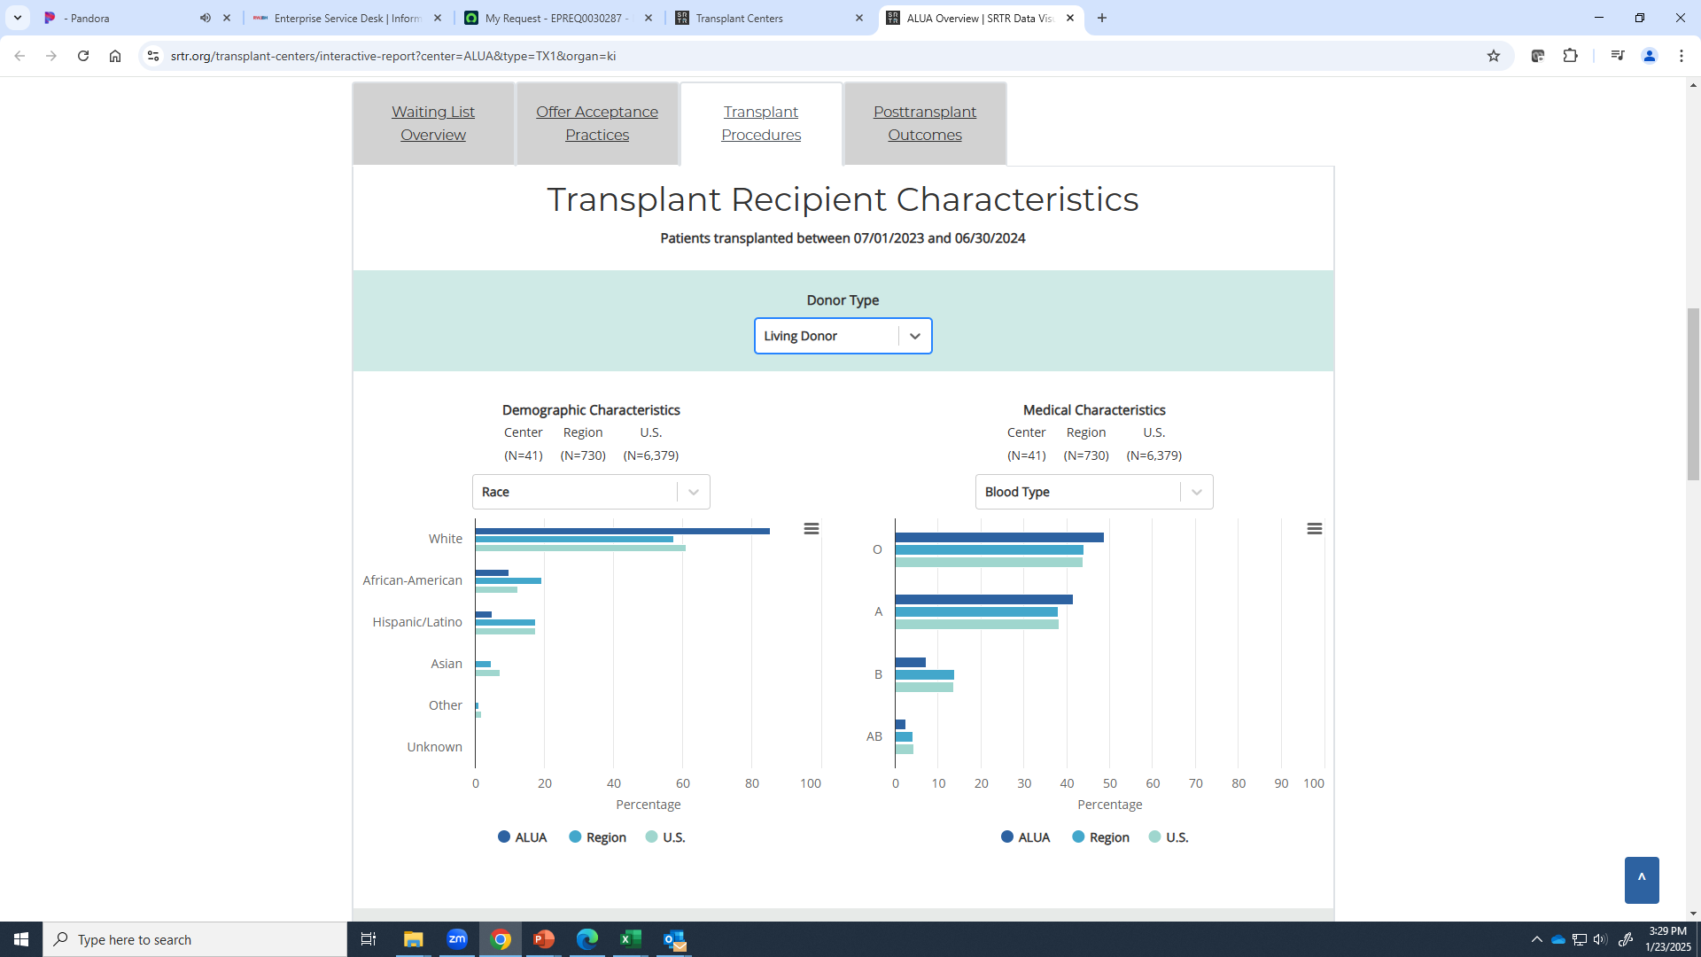
Our Living Donation Program
Insert SRTR Program Specific Reports (volumes, outcomes by donor type, etc.
  Center
  Region
  National
  https://www.srtr.org/reports/program-specific-reports/
Insert SRTR Program Specific Reports (volumes, outcomes by donor type, etc.
  Center
  Region
  National
  https://www.srtr.org/reports/program-specific-reports/
Instructions: Add additional points to illustrate the landscape of your program and its performance – e.g. over time, compared to your region and/or the nation. Look at living donor transplants and/or donor-specific details (e.g. demographics, rule-out reasons, etc.)
Example

Slide 21
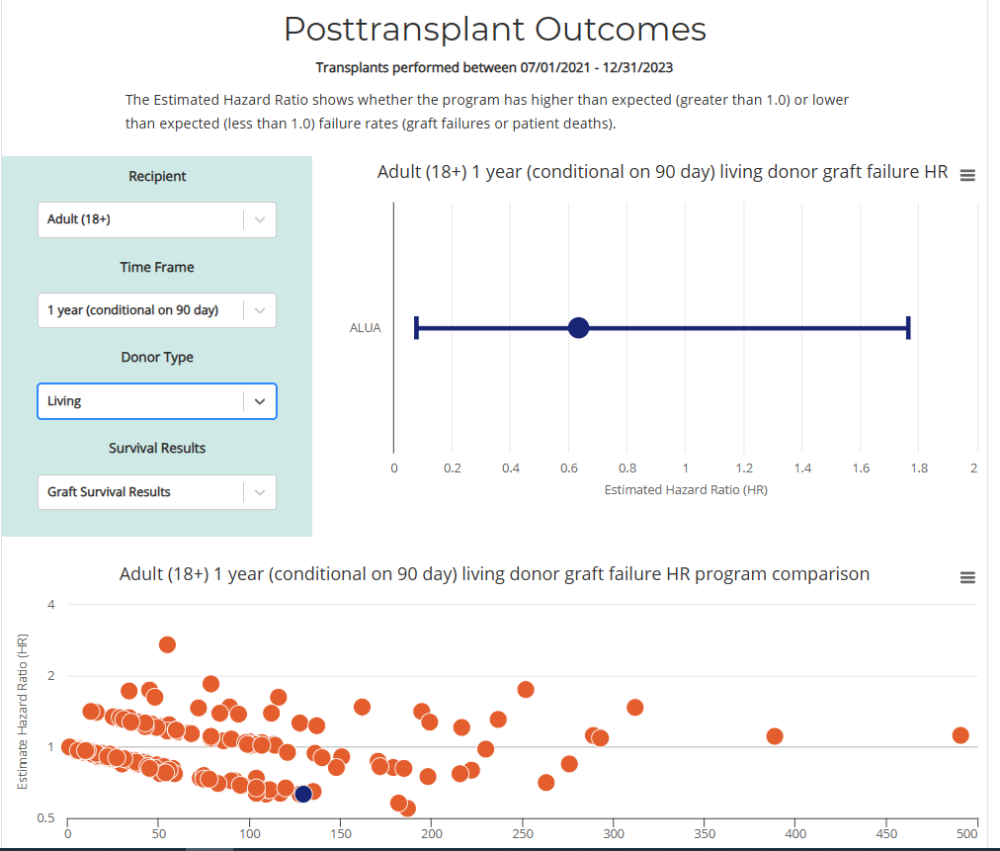
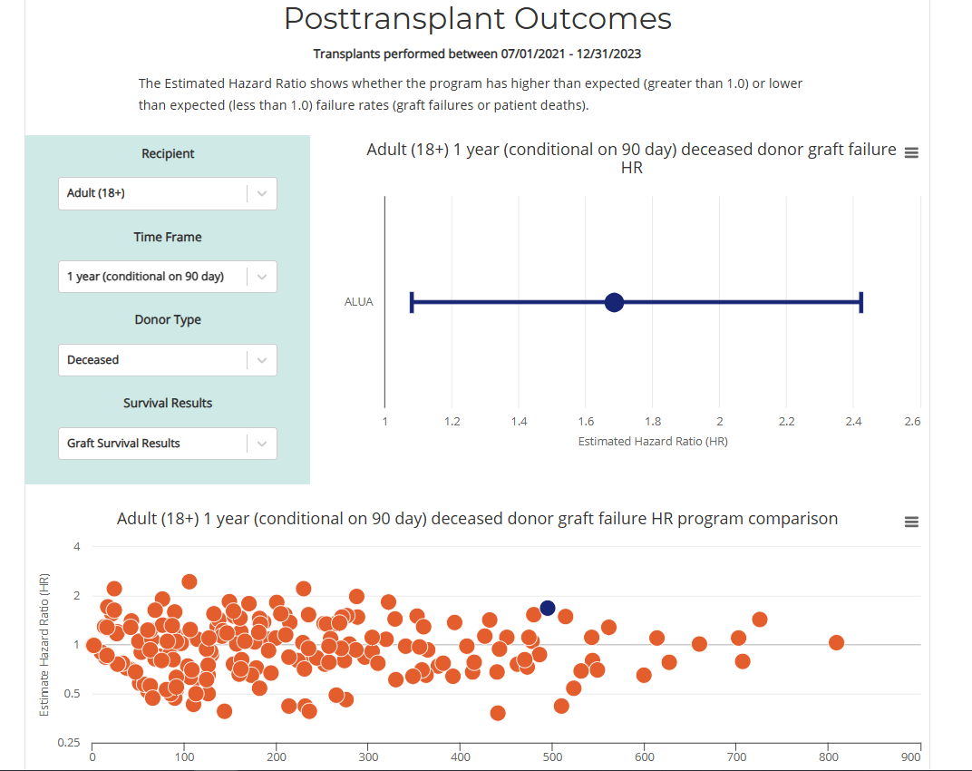
Our Living Donation Program
Examples
Add additional points to illustrate the landscape of your program and its performance
Insert SRTR Interactive Reports by Donor Type: https://www.srtr.org/reports/program-specific-reports/

Slide 22
How We Will Grow
Example Sub-title:
In order to be competitive with other programs in the region, we will…
Strategy | Investment Needed | Result
<Strategy 1> | $, time, FTE, etc. | Intended outcome/impact
<Strategy 2> |  | Intended outcome/impact
<Strategy 3> |  | Intended outcome/impact
Fill in with a summary of your strategies for growth, expected investment, and the impact or volume increase you are expecting

Slide 23
Strategy X: Expand Donor Referrals
Example slide – illustrates Expand Donor Referrals strategy.
Edit to fit your needs.
Deploy a Donor Champion Program
  Candidate identifies “Champion” for training in spreading awareness, telling story
  Champions educated by <Marketing/Social Media> expert
    Regular Virtual Champion Connections (keep engaged, creative & cross pollinating)
  LearningCenter.kidney.org for Finding a Living Donor self-paced education
  Refer to NKF Peers for 1:1 support with steps to finding a living donor
Implement Automated Donor Screening & Educational Services
  Establish contract with external vendor
  Time Study shows RN time savings of _____ (refocus on expedited clinical care)
We recommend an RN time study to quantify the impact of adding an automated screening and education service.
Growing Living Donation
Notes:
Many Donor Champion programs exist around the country.

Slide 24
Strategy X : Expand Donor Referrals
Example slide – illustrates Expand Donor Referrals strategy.
Edit to fit your needs.
Enhance Donor Educational Materials & Support
  High Quality Videos to educate champions, candidates, potential donors
  https://www.kidney.org/kidney-topics/becoming-living-donor
  LearningCenter.kidney.org for Becoming a Living Donor self-paced education
  Implement end-to-end peers support programs for pre- and post-donation, such as referring to NKF Peers
Launch “Weight Loss” program for candidates for donation
  ____% declined for BMIs close to, but out of cut-off range
  Hire dietitian (dedicated or partial FTE)
  Access resources for patients internally to your hospital or externally – i.e. Project Donor, Health to Hope, etc.
<Other Strategy>
Consider adding educational resources, such as NKF’s Becoming a Living Donor or Finding a Living Donor online programs or other online education.
Add your center’s % of referred patients declined for BMI
Add other Expand Donor Referrals-related strategies with data points
Growing Living Donation

Slide 25
Strategy X: Improve Efficiencies
& Quality of Care
Example slide – illustrates strategies to Improve Efficiencies & Quality of Care. Edit to fit your needs.
Improve Evaluation Process
Transition to evaluating 2 donors at a time
Transition to evaluate potential donors immediately (not after approval at selection of candidate or listing)
Increase donor evaluation efficiency
  Bottleneck 1
  Bottleneck 2
Implement Strategic Multidisciplinary Team Education
  Ensure each multidisciplinary touchpoint/visit includes targeted education on living donation that collectively improves each candidate’s understanding of the need, benefit and attainability of having a living donor
Improve Living Donor Access & Experience
Provide lodging for Living Donors for Evaluation & Better Access for Same-Day Admission
Implement end-to-end peers support programs for pre- and post-donation, such as referring to NKF Peers
Transition to Robotic Nephrectomy
<Other Strategy>
Identify key bottlenecks in your program’s process and insert them with mitigation plan here
Add other Efficiencies & Quality of Care-related strategies with data points

Slide 26
Strategy X: Increase Recipient Pool
Example slide – illustrates strategies to Increase Recipient Pool. Edit to fit your needs.
Live Donor Case growth is directly tied to recent referrals of new transplant candidates.
Deploy a Navigator
  Routinely visits dialysis units
    Educates candidates on list (including living donor)
    Increases touchpoints with dialysis staff & providers
Increase Outreach/Marketing Staff
Deploy a Waitlist Manager
  Reduce status 7
  Stay focused on living donation
  Refer patients for peer support, such as NKF Peers
<Other Strategy>
Add other Increase Recipient Pool-related strategies with data points

Slide 27
Strategy 4: External Paired Living Donation
Example slide – illustrates strategies related to paired living donation. Edit to fit your needs.
Adopt a “Compatible Paired Exchange Program”
Improve Education about Paired Exchange
Ensure every live donor is educated on the option to enter paired exchange and any benefits specific to your program
Ensure every recipient understands their donor does not need to be a match for them
Outsource to expand living donor pool with [partner name]
Build MOU with hospital network and/or regional kidney programs
Remedy Bottlenecks
  HLA lab assessment
  Add donor coordinators or other staff
<Other Strategy>
For example:
National Kidney Registry
Alliance for Paired Kidney Donation
Add other External Paired Living Donation-related strategies with data points

Slide 28
Return on Investment

Slide 29
Instructions for
“Return on Investment” Section
Include screenshots or key data points from the outputs of your calculator that relate to the strategies you’ve identified

Slide 30
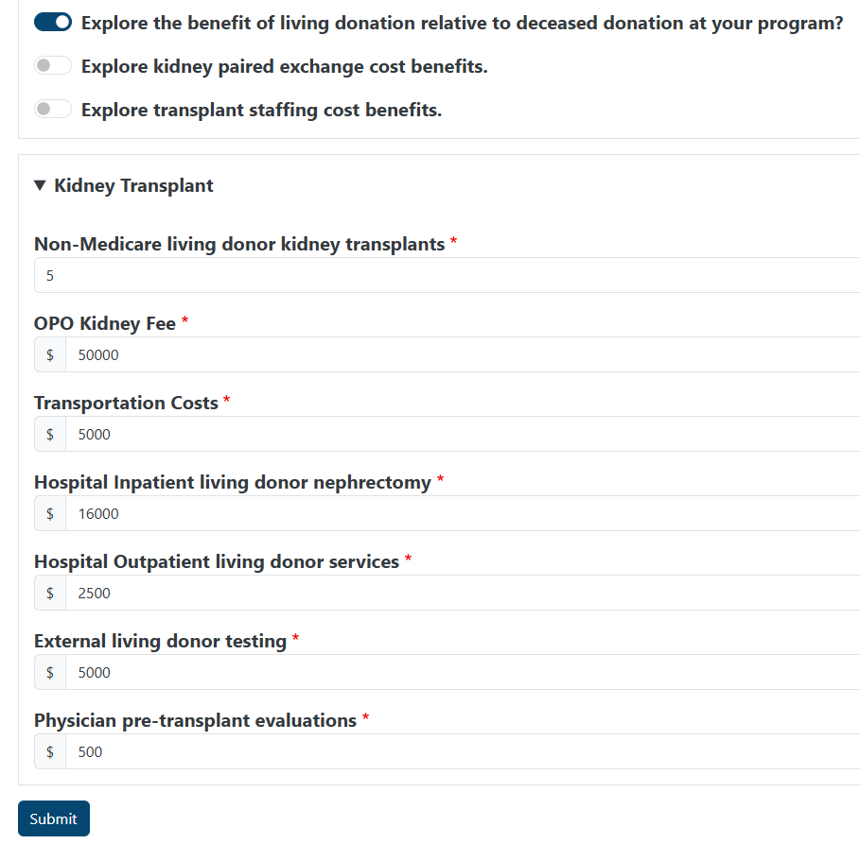
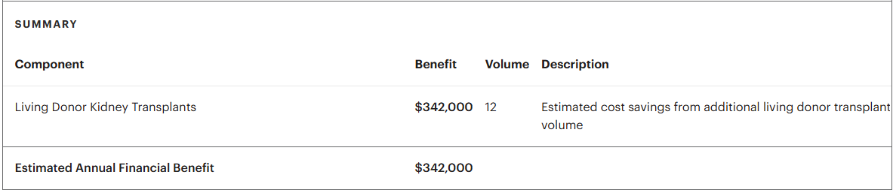
Direct Financial Benefit of LDKT
In addition to the improvements in length and quality of life, our living donor cases have a higher contribution margin per case than deceased donor cases, with shorter “accounts receivable”.
Living Donor Kidney Transplant Recipients typically have shorter LOS, less readmissions during global periods, less DGF and less resource-intensive post-transplant care, leading to cost savings.
Our Estimated Benefit from Expected Living Donor Kidney Transplants:
Add screenshot or details from the “Estimated Reimbursement Benefit for Performing Living Donor Kidney Transplants” detail tab
Notes:
In addition, LDKT drive ancillary and downstream revenue from providers, lab, radiology, etc., leading to additional revenue – though these benefits are not captured in the calculator and are harder to directly quantify.

Slide 31
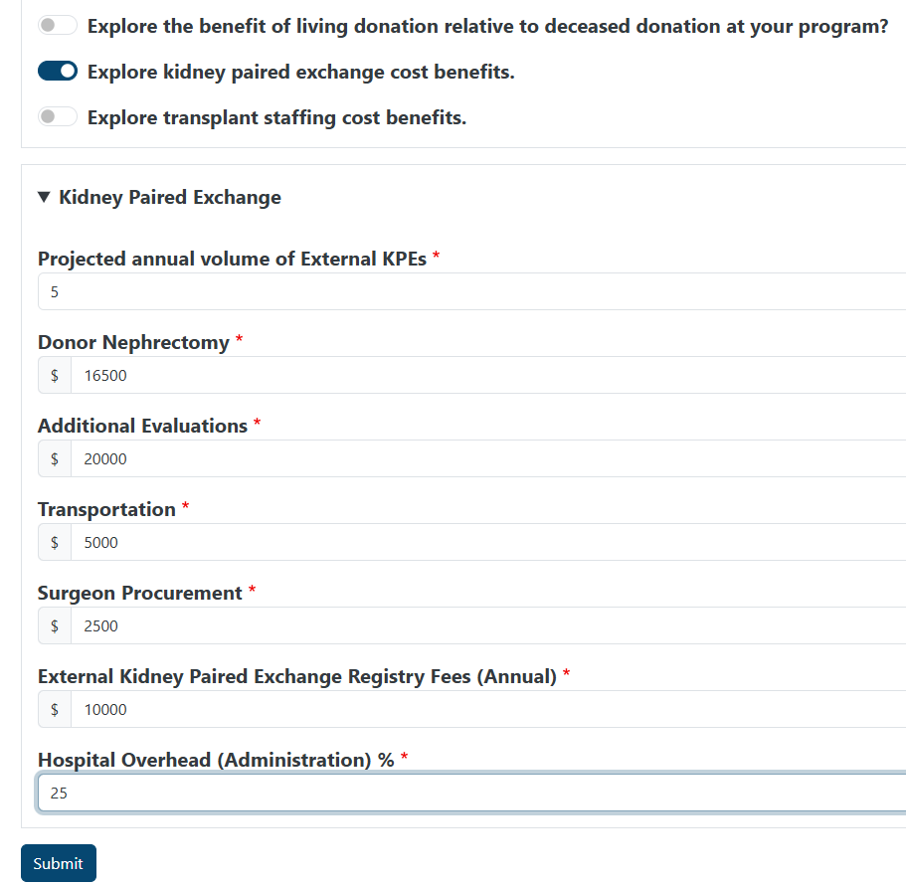
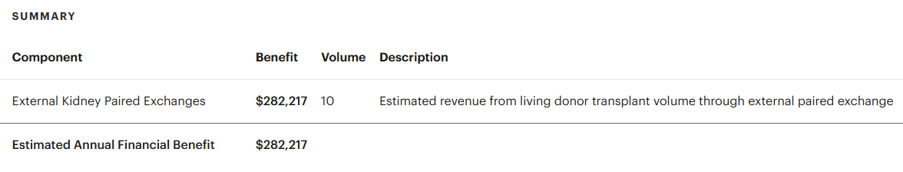
Financial Opportunity of Kidney Paired Exchange
Example Sub-title:
Joining/Increasing our participation with [registry] can increase our living donor volume and create financial benefit while benefiting our patients.
Our Estimated Benefit from Expected Living Donor Kidney Transplants
Add screenshot or details from the “Kidney Paired Exchange” tab

Slide 32
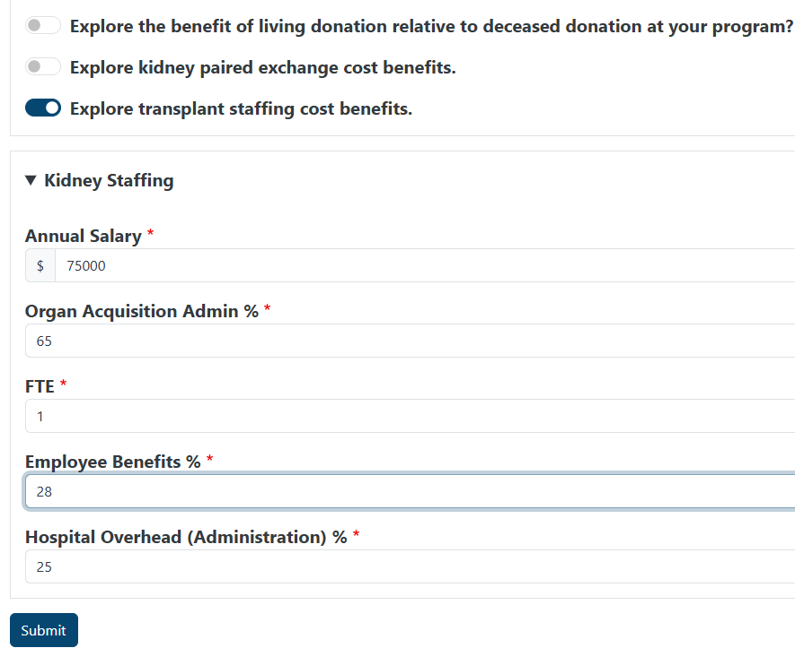
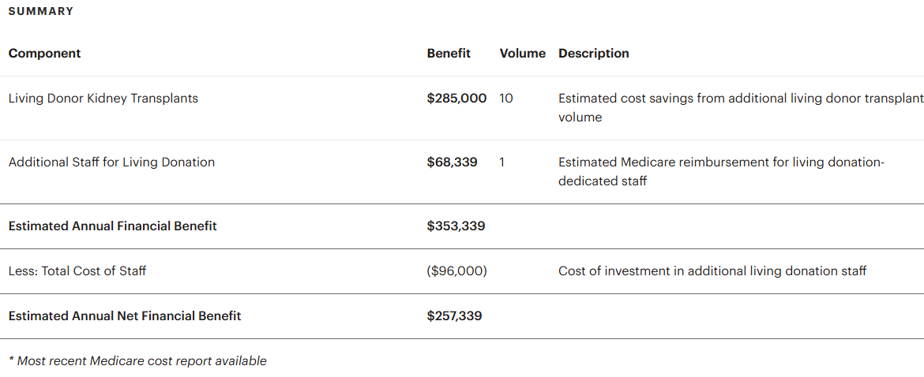
Recovering FTE Costs from Medicare
Example Sub-title:
Medicare cost report structures provide direct cost offsets for additional staff dedicated to living donation.
Our Estimated Financial Benefit:
Add screenshot or details from the “Additional Staff for Living Donation” tab

Slide 33
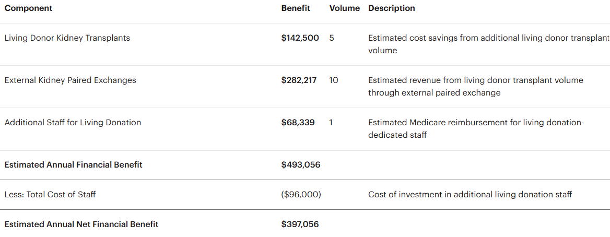
Conclusion
Example sub-title
To achieve our goal of X, an investment of Y will help us achieve a total financial benefit of Z.
Strategy | Investment Needed | Result
<Strategy 1> | $, time, FTE, etc. | Intended outcome/impact
<Strategy 2> |  | Intended outcome/impact
<Strategy 3> |  | Intended outcome/impact
Our Estimated Financial Benefit:
Restate your summary of strategies for growth, expected investment, and the impact or volume increase you are expecting

Slide 34

Thank you
Your logo here
This presentation was created with support from the National Kidney Foundation’s Living Donation Business Case Toolkit, available at www.kidney.org/ldtoolkit.

