Slide 1
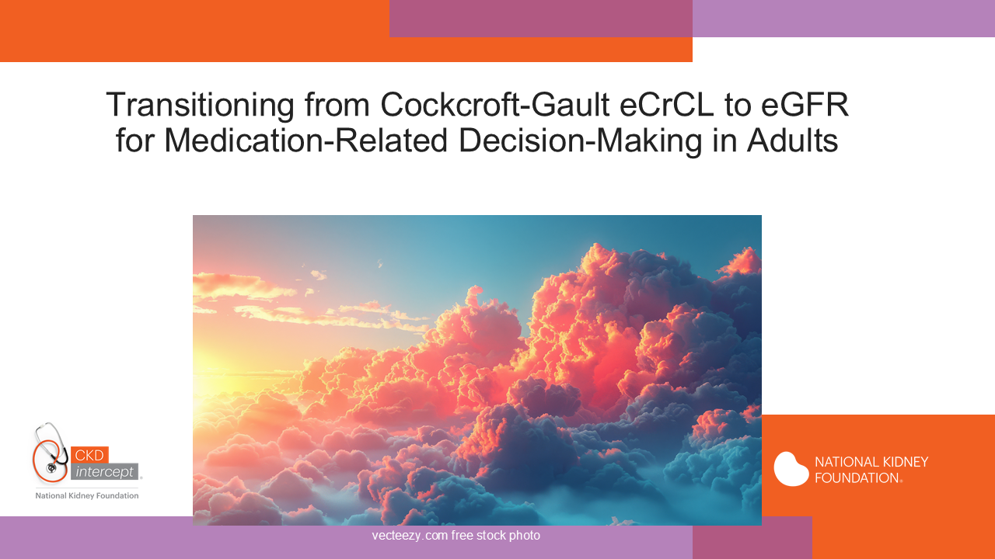
Notes:
Pharmacists and other health care practitioners have used the Cockcroft-Gault creatinine clearance equation results for over 40 years to estimate glomerular filtration rate for determining medication dosage adjustments. It’s time to change! Estimated glomerular filtration rate (eGFR) is used by physicians and other practitioners for medical decisions and it’s been demonstrated to be more accurate to predict drug clearance for several medications. This presentation is designed to answer the most common questions that practitioners have about transitioning to eGFR for medication decisions related to decreased . It’s a new day in kidney-related medication management!

Slide 2
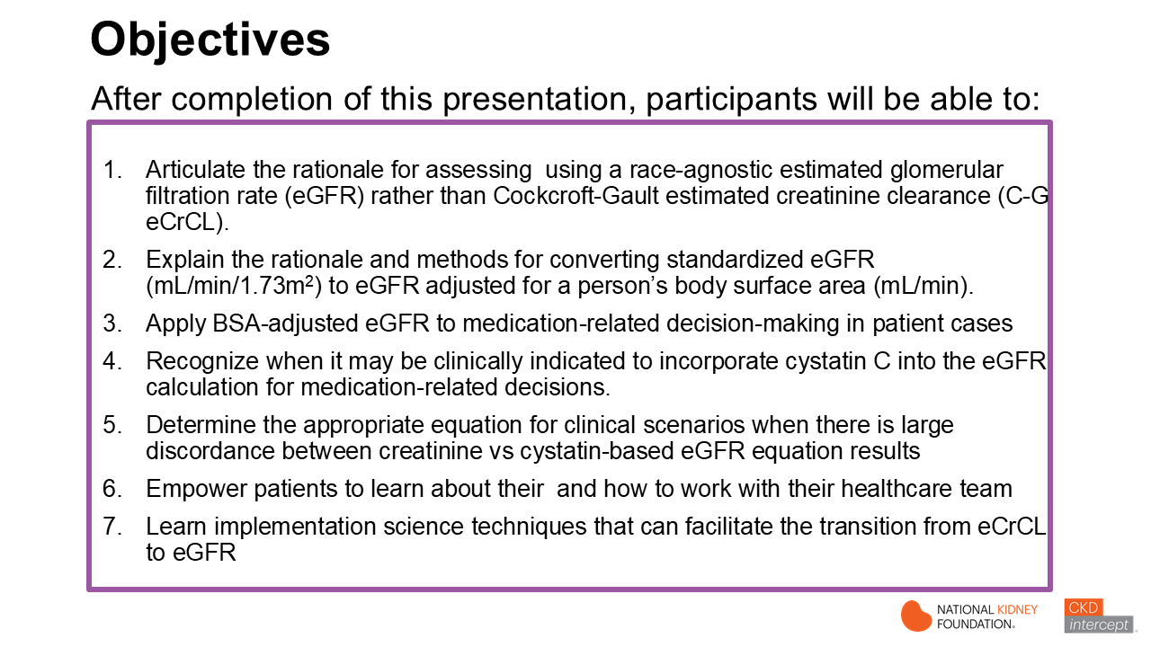

Slide 3
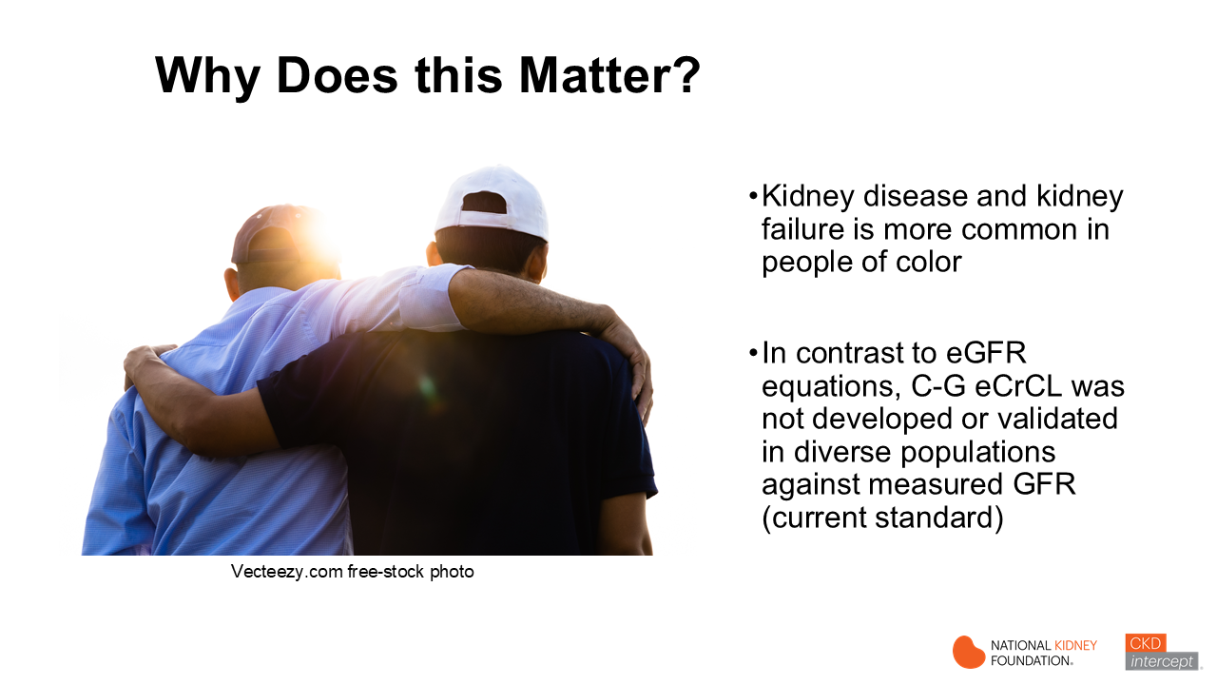
Notes:
Kidney disease is more common in people of color, including African Americans/Blacks, American Indians and those with Hispanic ethnicity
Unlike eGFR equations, C-G eCrCL was not developed or validated in diverse populations against measured glomerular filtration rate (mGFR), which is considered the current standard for measuring kidney filtration function.
Older eGFR equations that included race (MDRD and 2009 CKD-EPI eGFRcr) overestimated eGFR in Blacks as compared to other race/ethnicity groups likely leading to less CKD diagnosis and lower prescribing rates of newer medications that have been shown to reduce new CKD cases, progression of CKD and lower risk of cardiovascular complications
Using NKF-ASN recommended eGFR equations that have been reformulated without race (race-agnostic) and adjusting results for an individual’s body surface area (BSA) can help improve pharmacoequity in persons that are at higher risk for kidney disease and progression.

Slide 4
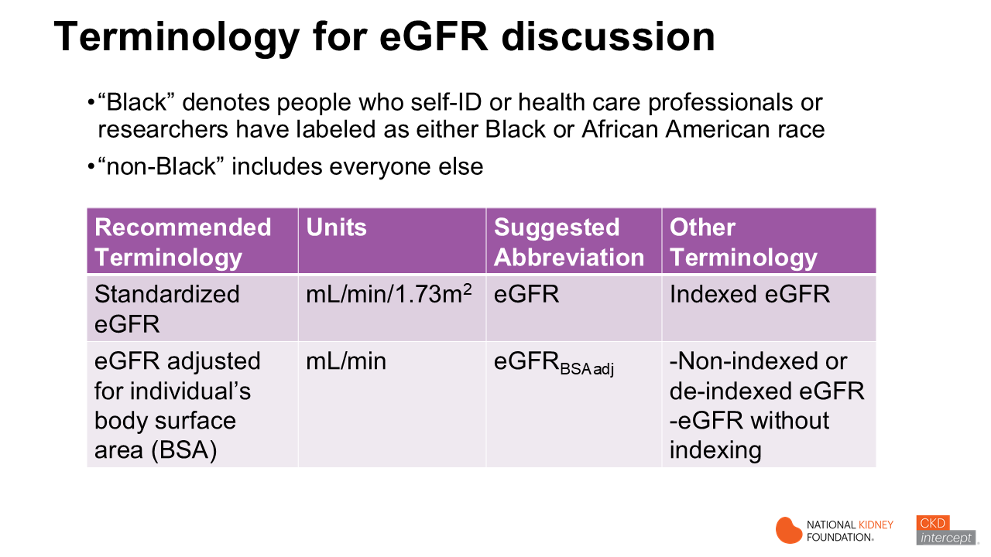
Notes:
Before we begin, I’m going to discuss terminology that will be used throughout this presentation. “Black” denotes people who self-identified, or health care professionals or researchers have labeled them as either Black or African American race in data that were used to develop and validate eGFR equations. “Non-Black” encompasses everyone else. The National Kidney Foundation Workgroup for Implementation of Race-Free eGFR-Based Medication-Related Decisions recommended that health care professionals, researchers, clinical laboratories and electronic health records (EHR) use standardized terminology for eGFR. Clinical laboratories and EHRs have reported eGFR in units of mL/min/1.73m2 for over 20 years. The NKF Workgroup suggests using the term ‘standardized’ eGFR for eGFR that is calculated relative to a single body surface area of 1.73m2. This should be reported in lab results and EHR as ‘eGFR’. And the Workgroup recommends using the abbreviation ‘eGFRBSAadj’ for eGFR that is adjusted to an individual’s body surface area and in reported in mL/min. In the right column, you can see other terms that are used. Unfortunately, many practitioners get confused with ‘indexed’ terminology and even researchers have used the terms inappropriately. The consistent use of these recommendations will result in consistent reporting in clinical settings and research papers, leading to lower medication dosing mistakes in patients with kidney disease.

Slide 5
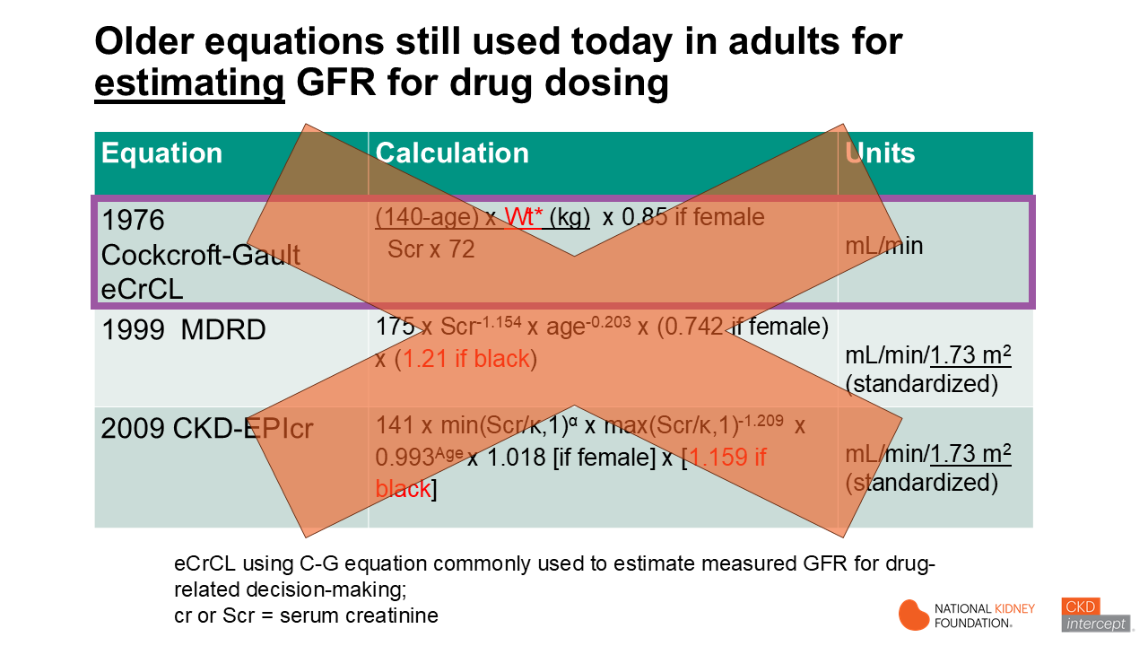
Notes:
Today, over 67% of clinical laboratories are using race-agn CKD-EPI eGFR equations. We’ll talk about those in a moment.
However, many other institutions and practices continue to use the 1999 MDRD equation or the 2009 CKD-EPIcr eGFR equations. And the majority of pharmacists and some other health care practitioners are using the C-G eCrCL equation, even though these equations are no longer recommended by guidelines or the National Kidney Foundation-American Society of Nephrology taskforce. Please note that C-G eCrCL results are in mL/min and age and sex are used as factors in the equation. In contrast the older (as well as newer) eGFR are typically reported in standardized units (mL/min/1.73m2). The older eGFR equations, like C-G eCrCL included age and sex, but also included a ‘Black’ race factor to improve equation performance. However, race is a social construct and not a biologic factor. In fact, the older eGFR equations underestimated measured GFR in Black compared to non-Black persons. This was concerning in that Black persons have been shown to have suffered from health and medication-related disparities from this bias. (e.g. less likely to be diagnosed with CKD, prescribed effective therapies shown to reduce CKD progression and more likely to get medication doses that were too low). Bottom-line, none of the equations on this slide should be used.

Slide 6
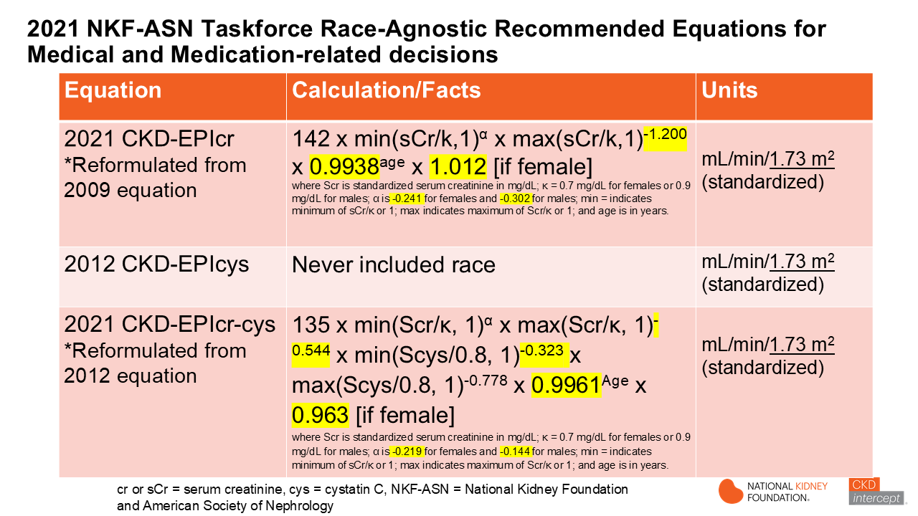
Notes:
The 2021 NKF-ASN Taskforce recommended the 3 equations on this slide for both medical and medication-related decision-making. The 2012 CKD-EPIcys equation never included race, so there was no need to reformulate this equation. The 2021 CKD-EPIcr (top) and 2021 CKD-EPIcr-cys eGFR (bottom) equations were reformulated from earlier CKD-EPI equations that included a Black/African-American race factor. What this means is that the race factor was removed and the regression equation was reformulated. The yellow highlighted numbers in the CKD-EPIcr equation showed which coefficients changed. The same was true of the reformulated CKD-EPIcr-cys combination equation. The main point is that the race factor wasn’t simply taken out. Some health systems did simply take the factor out without reformulating the equation which caused larger biased results in Black persons. Like all prior CKD-EPI eGFR equations, the lab results are reported in mL/min/1.73m2, which means results are standardized to a BSA of 1.73m2, which is problematic for medication dosing decisions, since patients come in many shapes and sizes, and few have a BSA of exactly 1.73m2 !

Slide 7
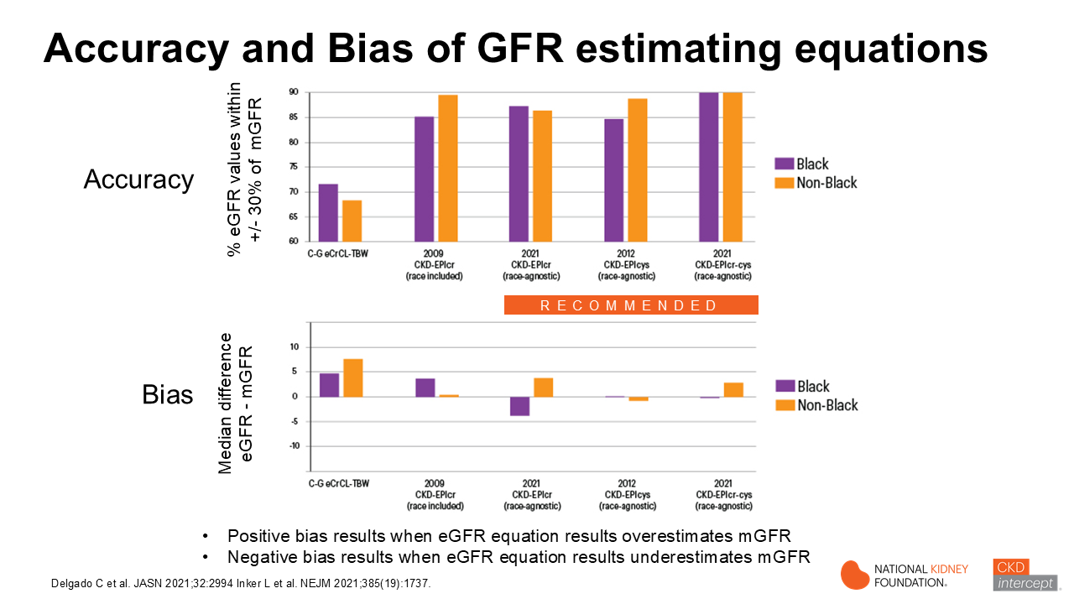
Notes:
The current measures for comparing eGFR equations are bias and accuracy. Bias is the average difference in a large group (or population) of people between the group’s average estimated GFR and the average measured GFR. The blue and orange bars in the bottom graph represent bias in Black and non-Black persons, respectively. The smallest bars indicate less bias. If the bars fall below the 0 line, it means that the equation underestimates a group’s eGFR. For example, the 2009 CKD-Epi eGFRcr equation shows a bias of -7.1? mL/min/1.73m2 which indicates that Black persons, on average, will show a lower eGFR than their average mGFR. You can see that the 2012 CKD-EPIcys eGFR equation shows the least bias in both Black and non-Black persons. In contrast, the C-G eCrCL (using total body weight) and 2009 CKD-EPIcr eGFR equations (with race removed, but equation not reformulated) have the most bias.
eGFR equation accuracy is measured using p30 value. P30 is defined as the percentage of eGFRs values in a group that lie within ±30% of the measured GFR (represented as mGFR in figure). The comparison in accuracy across eGFR equations is shown on the top graph. The bars closest to 100% are the most accurate. By this measure, the 2021 CKD-EPIcr-cys combination eGFR equation is the most accurate in Blacks (purple) and non-Blacks (orange), with C-G eCrCL (TBW) showing the least accuracy.
Overall, the 2021 CKD-EPIcr-cys equations shows the best blend of accuracy and least bias, although CKD-EPIcr eGFR results may be good enough for many medical and medication-related decisions.

Slide 8
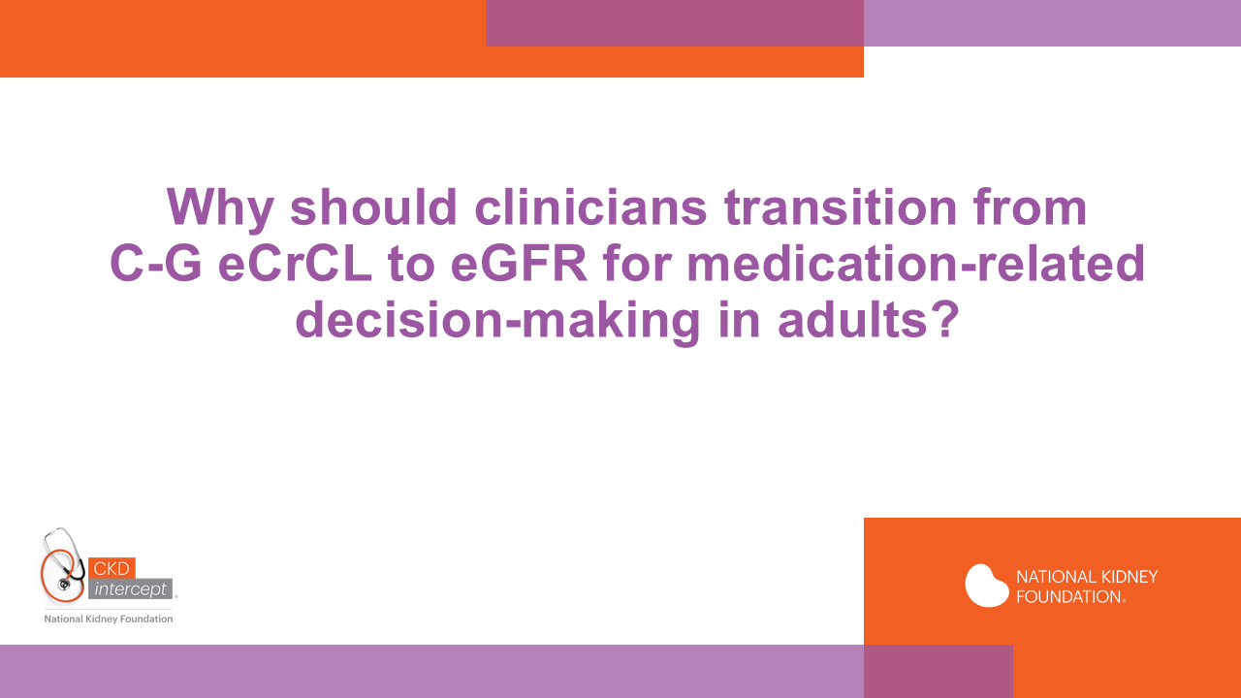

Slide 9
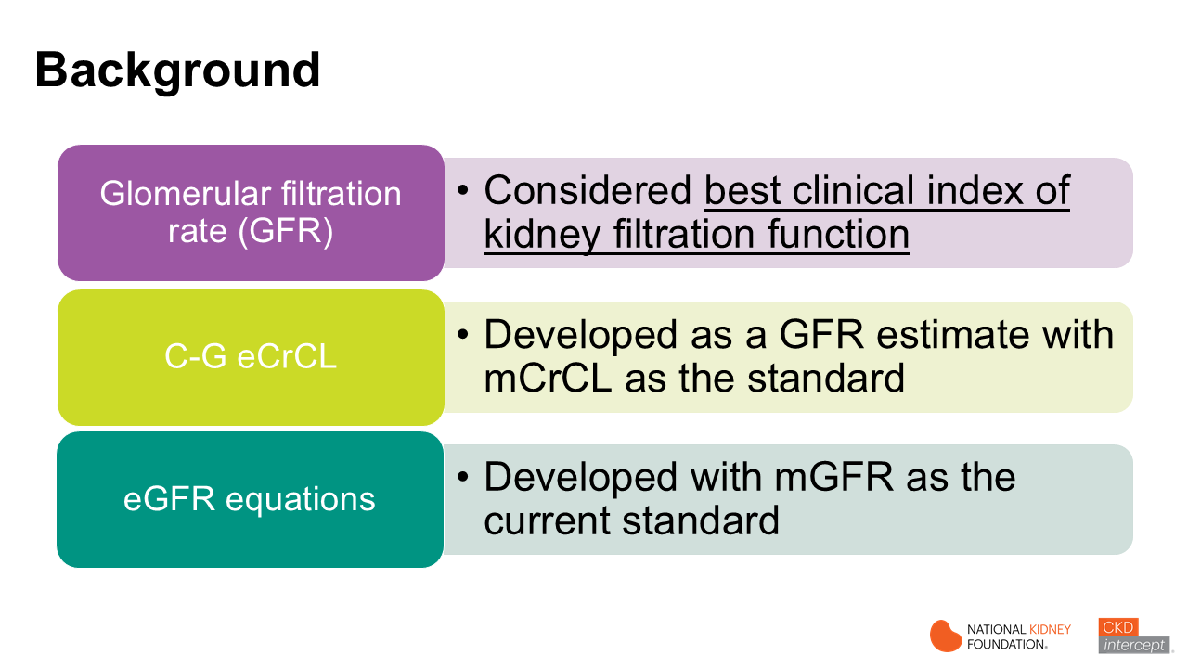
Notes:
It’s important to understand that glomerular filtration rate (GFR) not creatinine clearance is currently considered the best clinical index of kidney filtration function. Cockcroft-Gault estimated creatinine clearance equation (C-G eCrCL) was developed as an GFR estimate using measured CrCL as the standard. The CKD-EPI eGFR equations in use since 2000 were developed with measured GFR, which is the current standard.

Slide 10
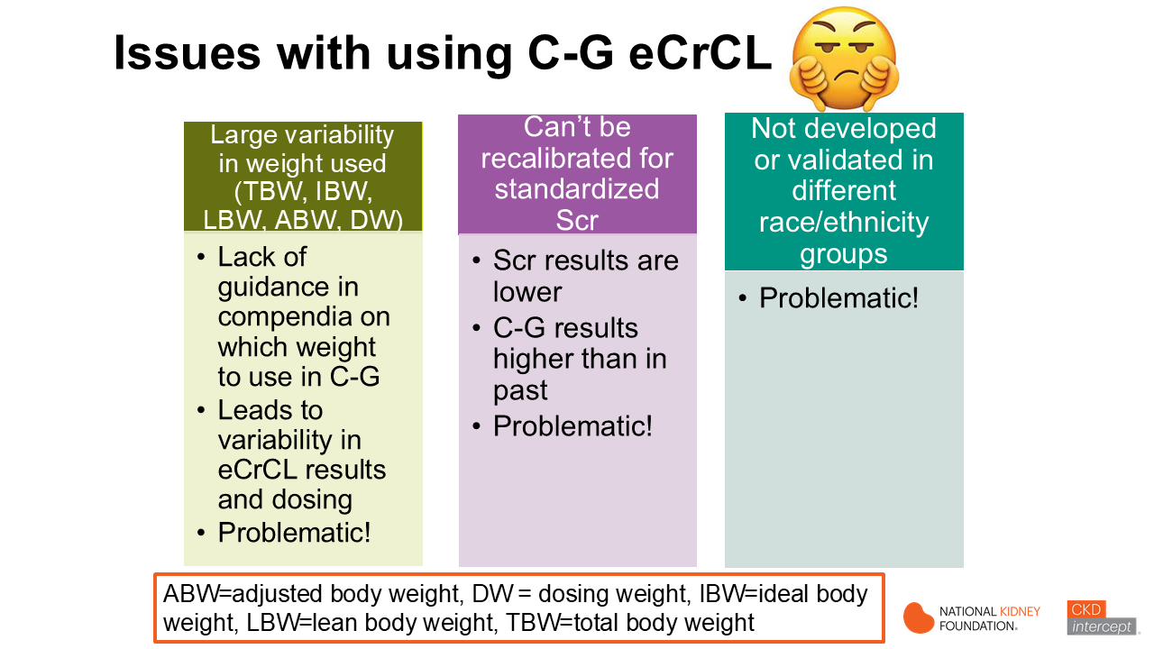
Notes:
There are multiple problems with continuing to use C-G eCrCL to estimate patient’s kidney filtration function. There is a large variability across the US in which weight pharmacists choose to use in the C-G eCrCL equation. Consequently, this results in variability in medication dosing from one pharmacist or health care system to the next. In addition, compendia dosing guidelines for dosage adjustment for old medications oftentimes recommend calculating C-G eCrCL, but do not recommend which weight to use.
Also problematic is that the C-G eCrCL equation can’t be recalibrated for standardized sCr that over 95% of US labs are using today. Standardization of creatinine assays resulted in an average lowering sCr values by 12%. Since sCr is in the denominator of the C-G equation, that means that C-G eCrCL results are higher today and patient’s results appear better than in the past.
In addition, the C-G equation was developed in white men. There was NO diversity. And the C-G equation has not been validated for use in other race or ethnicity groups.
Bottom line—it’s hard to justify use of this equation in current times. However, pharmacists are comfortable using it and ingrained practices are hard to change.

Slide 11
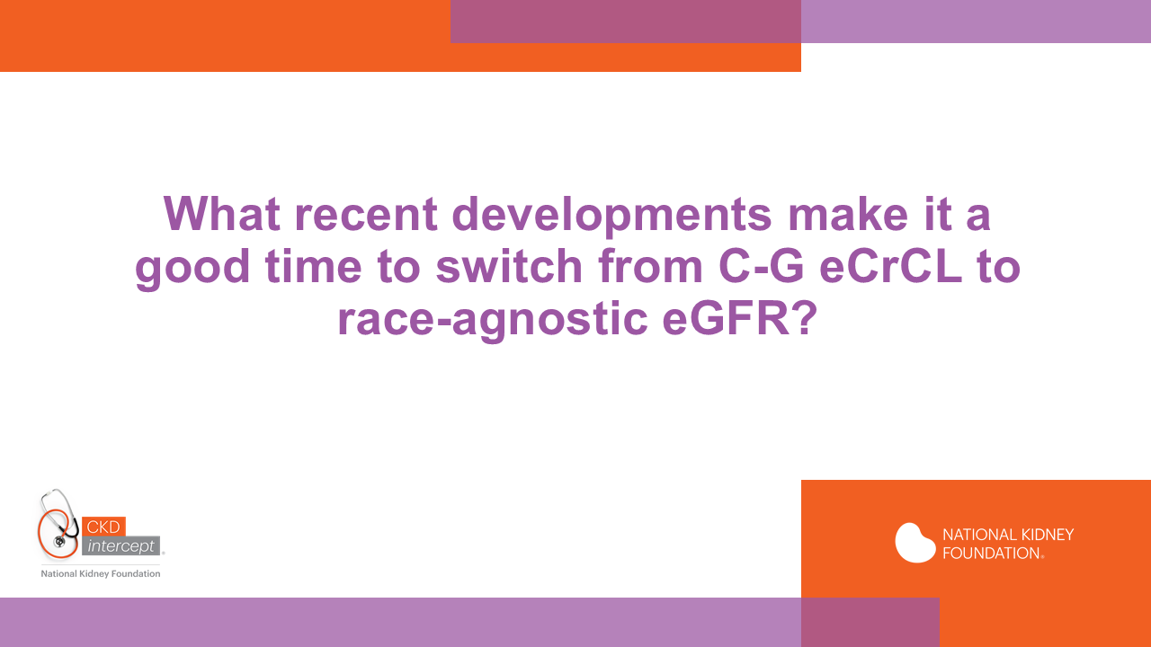

Slide 12
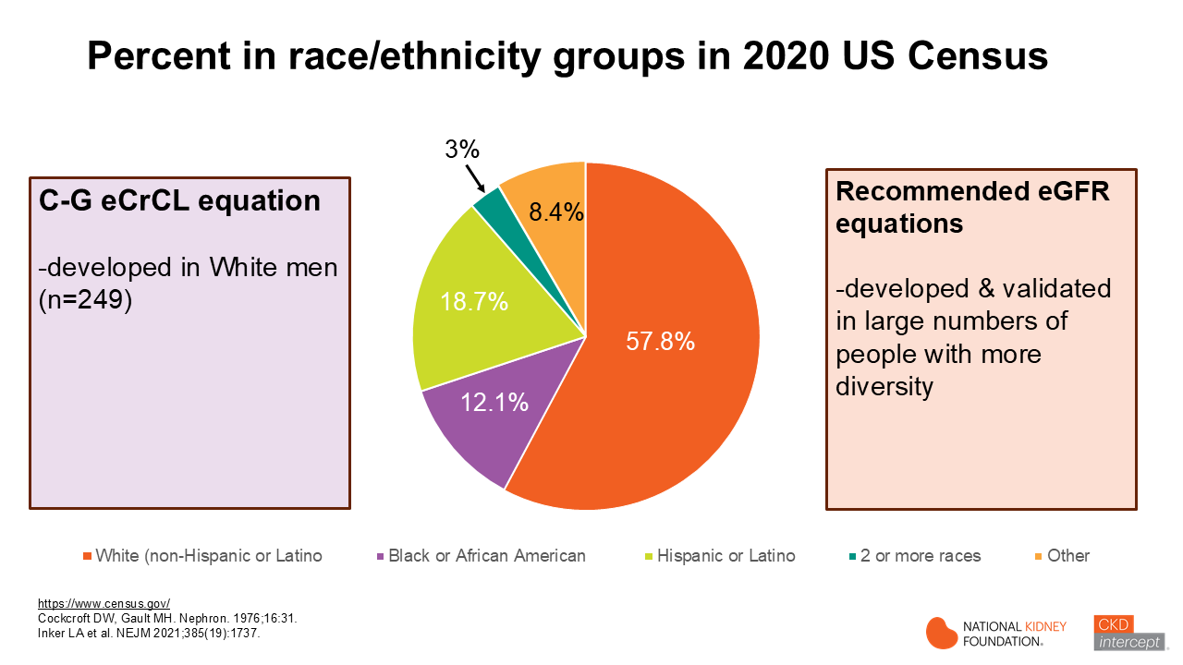
Notes:
This pie chart in the middle represents percent of race/ethnicity groups in the 2020 U.S. Census. There was almost 58% White race, 12% Black race and about 19% Hispanic or Latino ethnicity. The lime slice shows that 3% or 10 million people were multiracial. Based on increasing numbers of multiracial people from 2010 to 2020 census, it is estimated that by 2030, there will be 10% multiracial people in the US (approximately 33 million). In the left light purple box, you can see that C-G eCrCL equation was developed in only 249 White men and the equation has not been validated for use in Black persons or other race/ethnicity groups. And C-G eCrCL results are not able to be recalibrated with the standardized sCr concentrations that are used in over 95% of US clinical laboratories today.

Slide 13
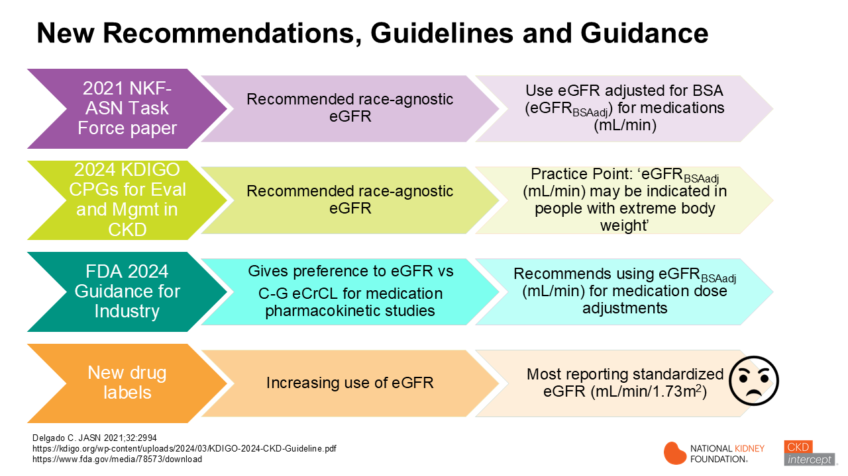
Notes:
New recommendations have been released over the past few years that make it a great time to transition from C-G eCrCL to eGFR for assessment of for medication-related decisions.
In 2021, the National Kidney Foundation-American Society of Nephrology Task Force unanimously recommended that clinicians and researchers move to use non-race-based eGFR equations. And they noted that the eGFR results should be adjusted for each individual’s body surface area (BSA) when being used for drug-related dosing decisions. These recommendations were reinforced in the 2024 KDIGO (Kidney Disease Improving Global Outcomes) Clinical Practice Guideline for Evaluation and Management in CKD Work Group. A new FDA Guidance for Industry document was also released in 2024 which gave preference to eGFR versus C-G-eCrCL for medication pharmacokinetic studies that are used for determining FDA label drug dosage alterations in kidney dysfunction. They also recommended that pharmaceutical companies use eGFR adjusted for BSA for medication dose adjustments. In the past few years, there has been increasing use of eGFR in new drug labels (AKA package inserts), but unfortunately, most labels are reporting standardized eGFR (mL/min/1.73m2), which is problematic, since most drug trials do not enroll patients that represent the full weight or size spectrum that we have in the US today.
___________________________________________________________________________________
Specific language in 2024 FDA Guidance “Pharmacokinetics in Patients with Impaired Renal Function” reads ‘use of eGFR to determine renal function in PK studies is recommended over eCLcr”

Slide 14
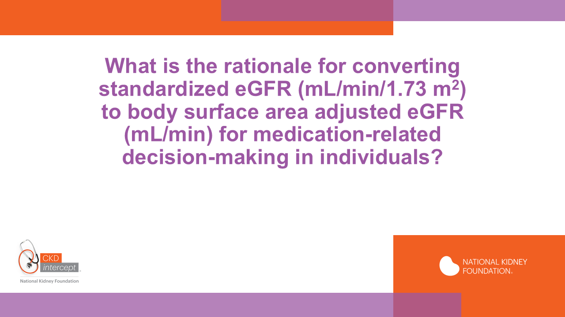
Notes:
So what is the rationale for converting standardized eGFR (mL/min/1.73 m²) to body surface area adjusted eGFR (mL/min) for medication-related decision-making in individuals? We will review some of the differences in the application of each in the next couple of slides.

Slide 15
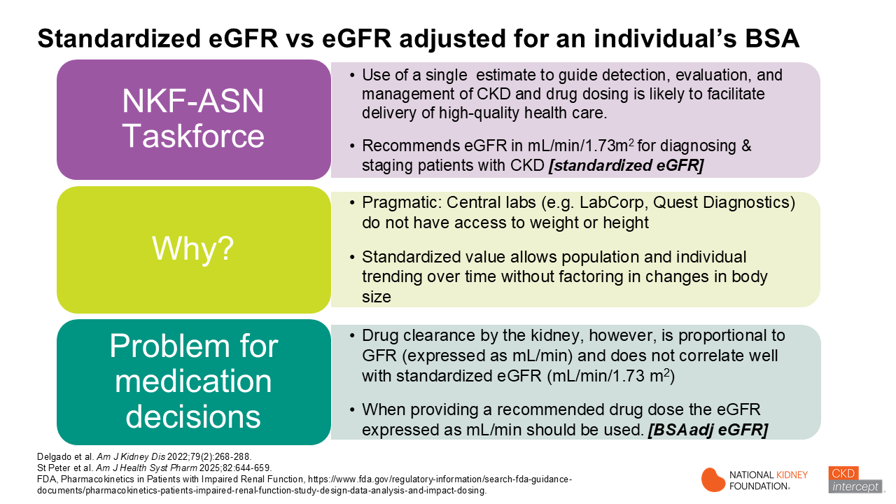
Notes:
Let’s talk about the standardized eGFR versus the eGFR adjusted for body surface area or BSA. The NKF-ASN task force on reassessing inclusion of race in diagnosing kidney diseases and other nephrology entities have acknowledged that use of a single estimate to guide detection, evaluation, and management of CKD and drug dosing is likely to facilitate delivery of high-quality health care. The eGFR in mL/min/1.73 m2 should be used for diagnosing and staging CKD. This is referred to as the standardized eGFR (note: sometimes this is referred to as the indexed eGFR). Why is this recommended? Often for pragmatic reasons in that most central labs do not have access to weight and/or height. The standardized value allows population and individual trending over time without factoring in changes in body size. The CKD-EPI equations were developed using measured iothalamate clearance as the gold standard.. Those values were indexed to BSA by multiplying by 1.73 divided by the BSA which is the reason the units are in mL/min/1.73 m2. This is a problem, however, for drug dosing. Drug clearance by the kidney is proportional to GFR (expressed as mL/min) and does not correlate well with standardized eGFR (mL/min/1.73 m²). Therefore, when providing a recommended drug dose the eGFR expressed as mL/min should be used. This is referred to as the BSA adjusted eGFR (sometimes noted in the literature as the non-indexed eGFR).

Slide 16
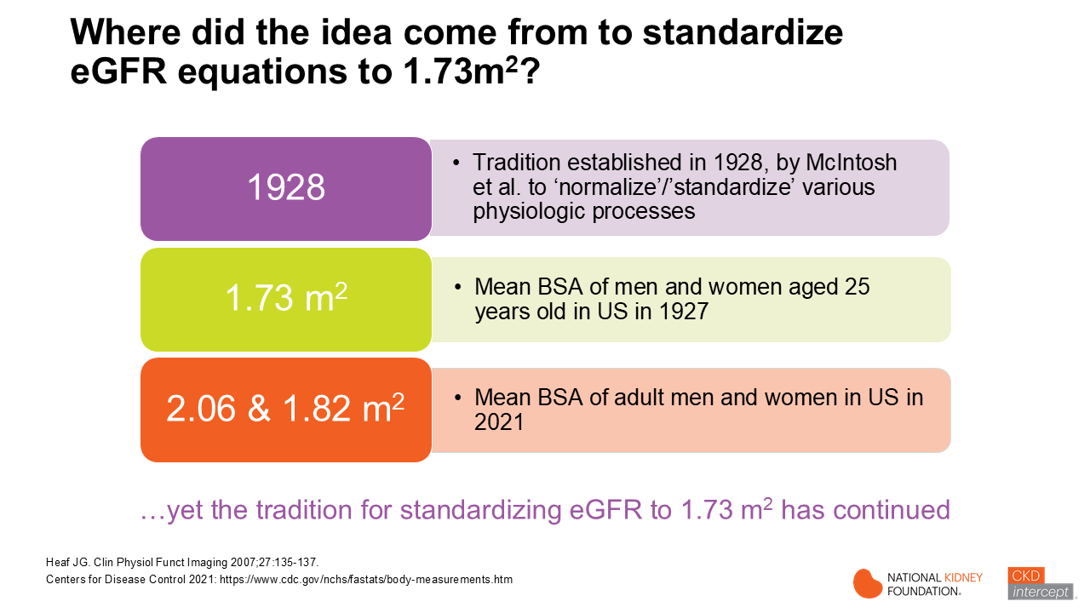
Notes:
The NKF-ASN Taskforce recommended use of standardized eGFR (eGFR) in mL/min/1.73m² for diagnosing and staging patients with kidney disease, and for following individual and population trends over time. Currently, estimated GFR standardizes results to a body surface area (BSA) of 1.73m², a tradition established in 1928 when a researcher (McIntosh) used 1.73m² as the mean BSA area for men and women aged 25 years old to normalize various physiologic processes, including eGFR. This tradition has continued through the development and validation of the currently recommended race-agnostic CKD-EPI equations. This choice made sense from a pragmatic perspective. Large US-wide commercial laboratories do not have access to current patient weights or heights, thus it is unrealistic for them to adjust eGFR results for an individual’s body surface area (BSA). However, given the obesity epidemic in the US, the average BSA in the US continues to rise and is now estimated to average 2.06m² and 1.82m² for adult men and women respectively. Yet, the for standardizing eGFR to 1.73 m² has continued.
_______________________________________________________________________________________________________________________
Ref: Centers for Disease Control and Prevention. Body measurements. Published online September 10, 2021. Accessed May 9, 2024. https://www.cdc.gov/nchs/fastats/body-measurements.htm

Slide 17
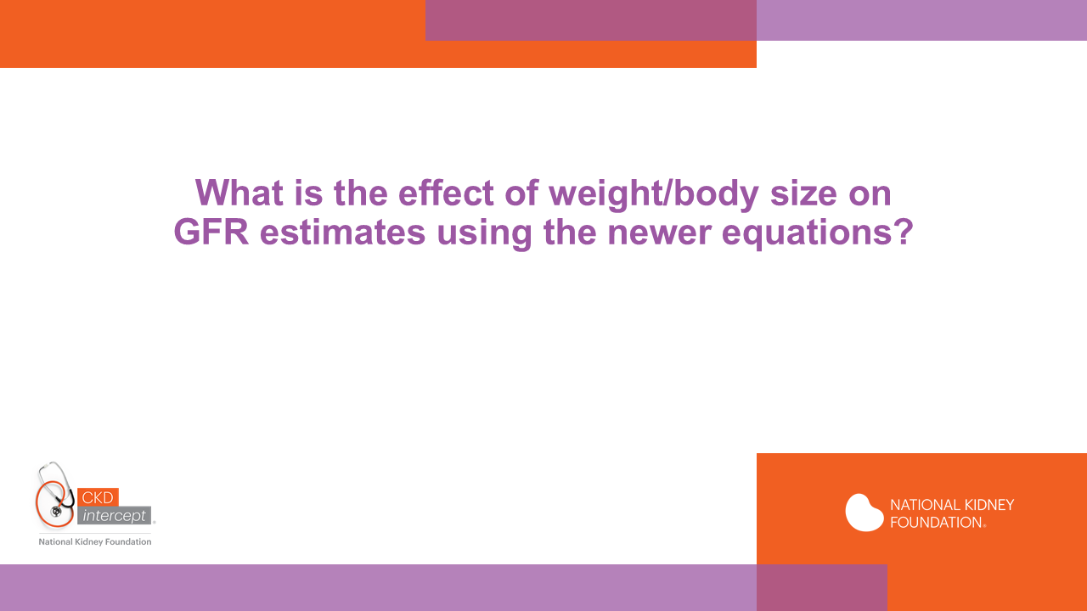
Notes:
So what do we know about the performance of available eGFR equations in individuals of varying body size?

Slide 18
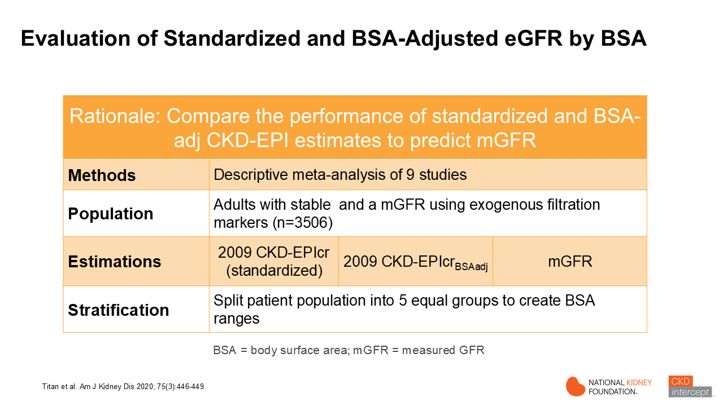
Notes:
This study (done before the 2021 eGFR equation was adopted) looked at the performance of standardized and body surface area-adjusted eGFR in individuals with low to high body surface areas. This was a meta-analysis of 9 studies performed in adults from US, China, and Europe with stable and who had a measured GFR. Estimated eGFR using standardized and BSA-adjusted values were compared to measured GFR. The population was stratified into 5 equal groups (quintiles) based on ranges of body surface area. The total population was just over 3500 patients.

Slide 19
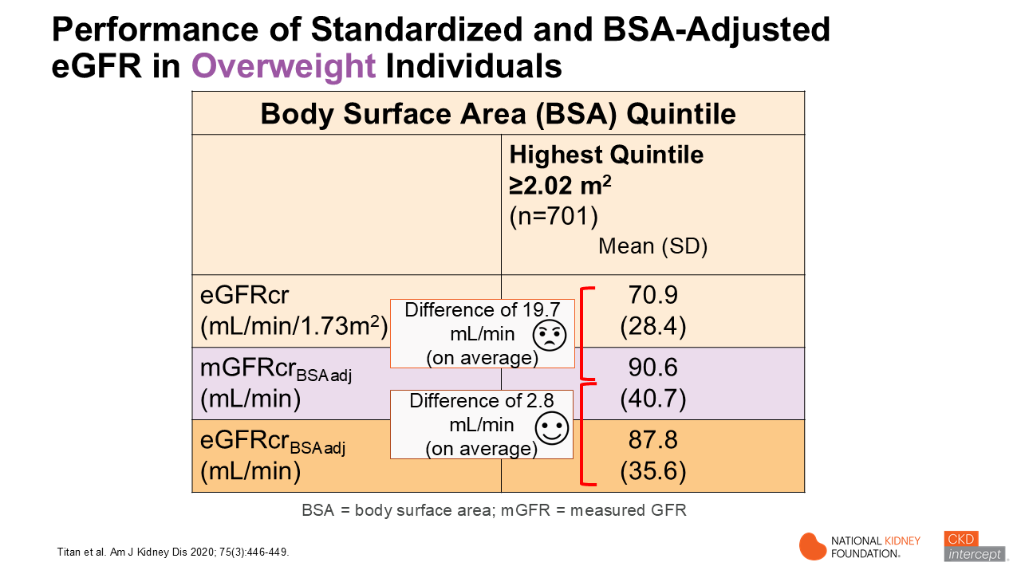
Notes:
Dr. Titan and colleagues combined 9 datasets from US, China and Europe that included mGFR results, serum creatinine and cystatin C levels for 3,506 people from diverse backgrounds. They divided participants into 5 groups based on their BSA quintile and analyzed the data using 3 CKD-EPI equations. If we look at the highest quintile (or overweight individuals) we see the magnitude of differences. Note big differences between mean mGFR adjusted for BSA and standardized eGFR (the standardized eGFR is almost 20 mL/min lower on average). The difference between the measured GFR in mL/min and the eGFRcr BSA-adjusted value is much less (difference of approximately 3 mL/min on average). The main limitation is that the individual studies did not contain a large number of participants with extreme values of BSA, and use of several mGFR methods across different studies.
_______________________________________
Values are mean (standard deviation)
Note big SD (variability)

Slide 20
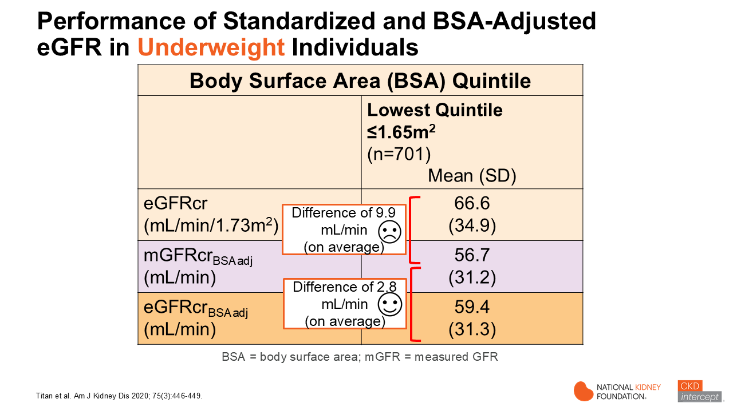
Notes:
In this slide we see data for the lowest quintile (BSA < or = 1.65 m2) or underweight individuals. The magnitude of the difference is much greater between measured eGFR in mL/min and the standardized eGFR (in mL/min/1.73 m2) compared to difference in the BSA-adjusted eGFR and measured GFR (in mL/min). The standardized eGFR yields a higher value than the mGFR and eGFR BSA adjusted. The clinical implications for drug dosing are important to consider for both populations (both over and under weight).
Of note, the variability around the mean values listed was large, which means that eGFR_{BSAadj} in individuals may still be much different than their mGFR, particularly in persons with higher mGFR. However, this publication as well as others provides support for the general use of eGFR_{BSAadj} (mL/min) values for medication-related decision-making in obese or underweight persons.
_______________________________________
Values are mean (standard deviation)
Note big SD (variability)

Slide 21
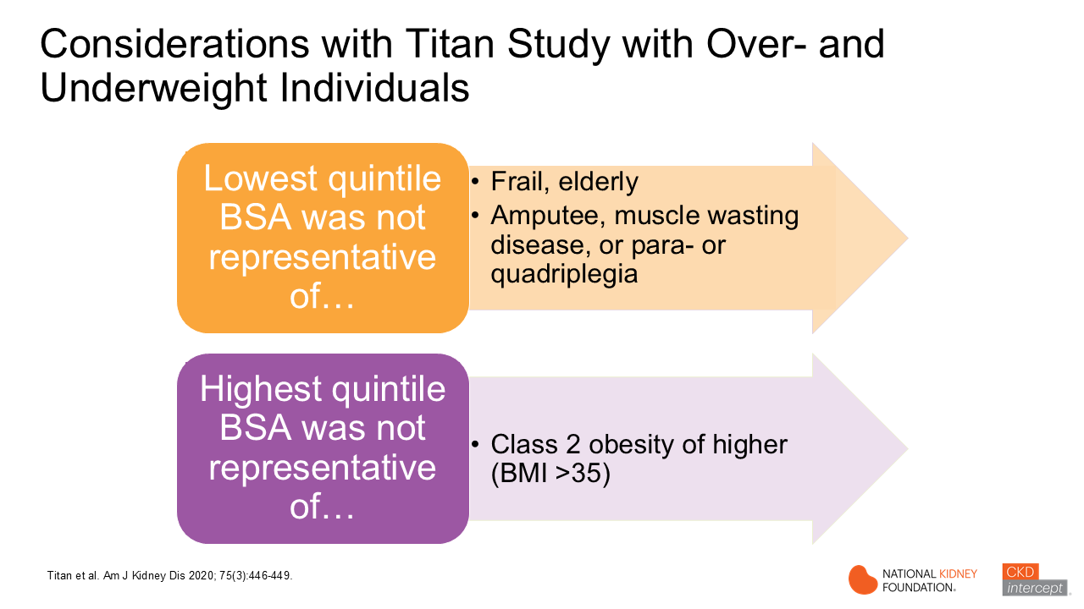
Notes:
So what are some of the limitations of the Titan study. [Read the information on the slide]

Slide 22
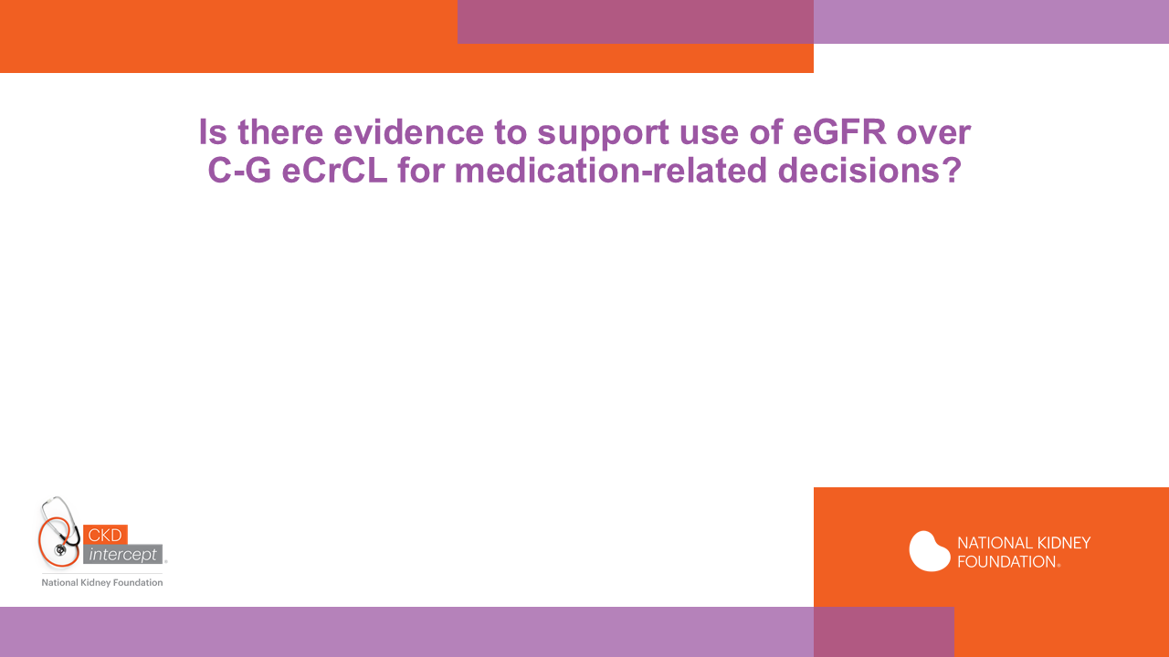
Notes:
Is there evidence to support use of eGFR over CG eCrCl for medication related decisions? Yes, evidence that is presented on the next few slides suggests that eGFR_{BSAadj} is better than C-G eCrCL. Let’s look at some of this evidence…

Slide 23
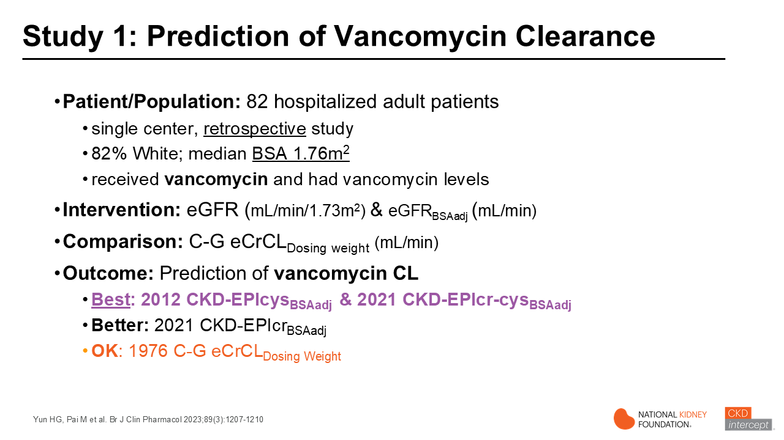
Notes:
This study was a retrospective single center study including patients who received vancomycin during admission. The estimated was determined using the 2012 CKD-EPIcys, the 2021 CKD-EPIcr-cys and C-G eCrCL equations using dosing weight. All eGFR estimates were adjusted for body surface area to give units of mL/min. The application of these equations to estimate vancomycin clearance was evaluated. The best model to predict vancomycin clearance incorporated the 2012 CKD-EPIcys BSAadj followed by the 2021 CKD-EPIcr-cys BSAadj. The next best model was developed using the 2021 CKD-EPIcr BSAadj. All were better than C-G eCrCL (dosing weight)
This study highlights that the 2021 CKD-EPIcr-cys eGFR-BSAadj is more accurate than C-G eCrCL using dosing weight for prediction of vancomycin clearance.
_____________________________________________________________________________________________________________________________________________________________
Abstract: The goal of this study was to use a model clearance-dependent drug (vancomycin) to understand the gain or loss of precision in dosing with use of serum creatinine (S_{cr} ), serum cystatin C (S_{cys} ) and race and nonrace-based equations of the estimated glomerular filtration rate (eGFR). In this study of hospitalized patients, we compared S_{cr} , S_{cys} and their combination to estimate and vancomycin clearance. The nonrace-based S_{cys} eGFR model outperformed other clearance models and improved the probability of target attainment by 15%. When S_{cys} is not available, we show that the new 2021 CKD-EPI eGFR_{cr} equation (no race factor) performs as well as the current conventional approach. This improvement in model performance does not negate the need for individualized dosing but exemplifies the need to remove race as a factor of kidney-function dose adjustment.

Slide 24
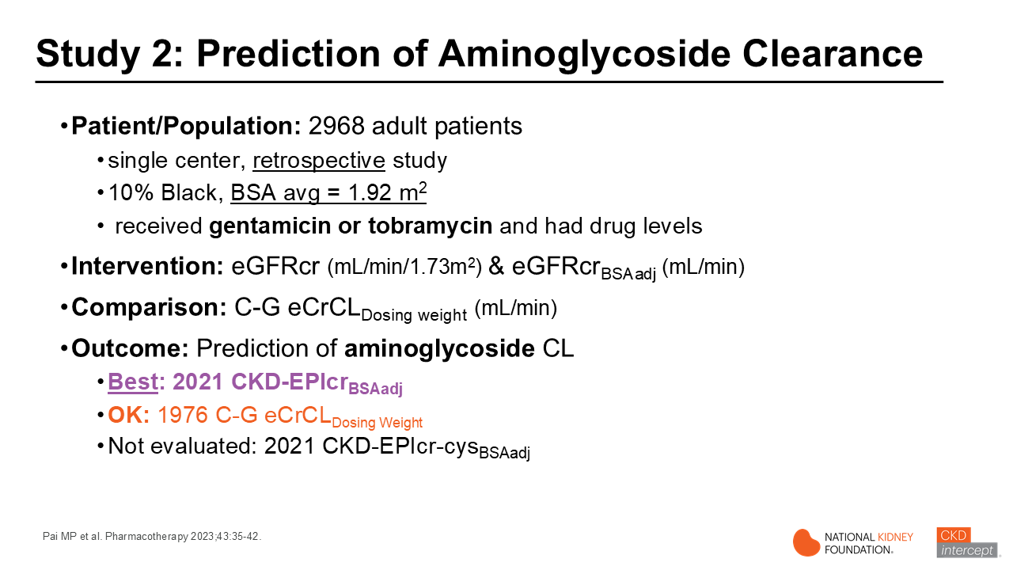
Notes:
Another study of just under 3000 patients evaluated application of the equations to predict aminoglycosides clearance (gentamicin 20%, and tobramycin 80% of patients). In this study the average BSA of the population was 1.92 m2. Both the standardized 2021 CKD-EPIcr eGFRcr (mL/min/1.73m²) and 2021 CKD-EPI eGFRcr_{BSAadj} (mL/min) were compared to the C-G eCrCL (dosing weight). The 2021 CKD-EPIcr eGFR BSAadj performed best in predicting aminoglycoside clearance (20% gentamicin, 80% tobramycin).
_______________________________________________________________________________________________________________
Abstract:
Study objective: The use of race in medicine can contribute to health inequity. Updated equations for estimated glomerular filtration rate (eGFR) without race have been published. Likewise, de-indexation of eGFR to body surface area (BSA) has been recommended by regulatory guidance for drug dosing in renal impairment. Clinical data justifying these recommendations for drug dosing are sparse. We examined the gain or loss of precision in drug dosing with estimated creatinine clearance (eCLcr) and eGFR using serum creatinine (eGFRcr) with and without race and BSA indexation by evaluating the population pharmacokinetics of the aminoglycosides as a classic drug class to probe .
Design: Medical records from adult patients treated with gentamicin or tobramycin over a 13-year period were queried. Population pharmacokinetic analyses were performed using a 1-compartment base structural model. Models compared body size descriptors as covariates of the volume of distribution (V). Estimated creatinine clearance and eGFRcr using multiple contemporary equations with and without BSA indexation were tested as covariates of clearance (CL).
Main results: The final data set included 2968 patients treated with either gentamicin (20.2%) or tobramycin (79.8%). Patients self-identified as Caucasian (82%), African-American (10%), or other. The median [5th, 95th percentile] weight and BSA were 80.5 [49.4, 136] kg and 1.94 [1.48, 2.56] m² , respectively. Models of eCLcr and eGFRcr without indexation to BSA had a better model fit than eGFRcr indexed to BSA for aminoglycoside CL. The 2021 Chronic Kidney Disease Epidemiology collaboration (CKD-EPI) eGFRcr equation (no race, no BSA indexation) provided a comparable model fit to the 2009 CKD-EPI eGFRcr equation (with race, no BSA indexation) for aminoglycoside CL.
Conclusions: Race is not a relevant covariate of aminoglycoside CL. The 2021 CKD-EPI eGFR equation without race and BSA indexation is a better method for gentamicin and tobramycin CL estimation. Confirmation of these results for other drugs can support the harmonization of dosing by .

Slide 25
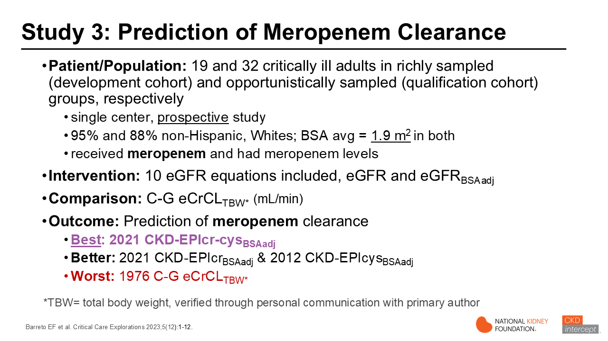
Notes:
In another study a number of eGFR equations were evaluated with regard to the ability to predict meropenem PK. This was a prospective pharmacokinetic study conducted in critically ill adult patients using a development cohort and a qualification cohort to evaluate performance of the equations. The average BSA was 1.9 m2. The eGFR equations were compared to the C-G eCrCL (TBW). The 2021 CKD-EPIcr-cys BSAadj performed best to predict meropenem PK in this study. C-G eCrCL (TBW) was the worst in term of predicting meropenem clearance.
____________________________________________________________________________________________________________________________ __
Abstract:
IMPORTANCE: Meropenem dosing is typically guided by creatinine-based estimated glomerular filtration rate (eGFR), but creatinine is a suboptimal GFR marker in the critically ill. OBJECTIVES: This study aimed to develop and qualify a population pharmacokinetic model for meropenem in critically ill adults and to determine which eGFR equation based on creatinine, cystatin C, or both biomarkers best improves model performance. DESIGN, SETTING, AND PARTICIPANTS: This single-center study evaluated adults hospitalized in an ICU who received IV meropenem from 2018 to 2022. Patients were excluded if they had acute kidney injury, were on kidney replacement therapy, or were treated with extracorporeal membrane oxygenation. Two cohorts were used for population pharmacokinetic modeling: a richly sampled development cohort (n = 19) and an opportunistically sampled qualification cohort (n = 32). MAIN OUTCOMES AND MEASURES: A nonlinear mixed-effects model was developed using parametric methods to estimate meropenem serum concentrations. RESULTS: The best-fit structural model in the richly sampled development cohort was a two-compartment model with first-order elimination. The final model included time-dependent weight normalized to a 70-kg adult as a covariate for volume of distribution (Vd) and time-dependent eGFR for clearance. Among the eGFR equations evaluated, eGFR based on creatinine and cystatin C expressed in mL/min best-predicted meropenem clearance. The mean (se) Vd in the final model was 18.2 (3.5) liters and clearance was 11.5 (1.3) L/hr. Using the development cohort as the Bayesian prior, the opportunistically sampled cohort demonstrated good accuracy and low bias. CONCLUSIONS AND RELEVANCE: Contemporary eGFR equations that use both creatinine and cystatin C improved meropenem population pharmacokinetic model performance compared with creatinine-only or cystatin C-only eGFR equations in adult critically ill patients.

Slide 26
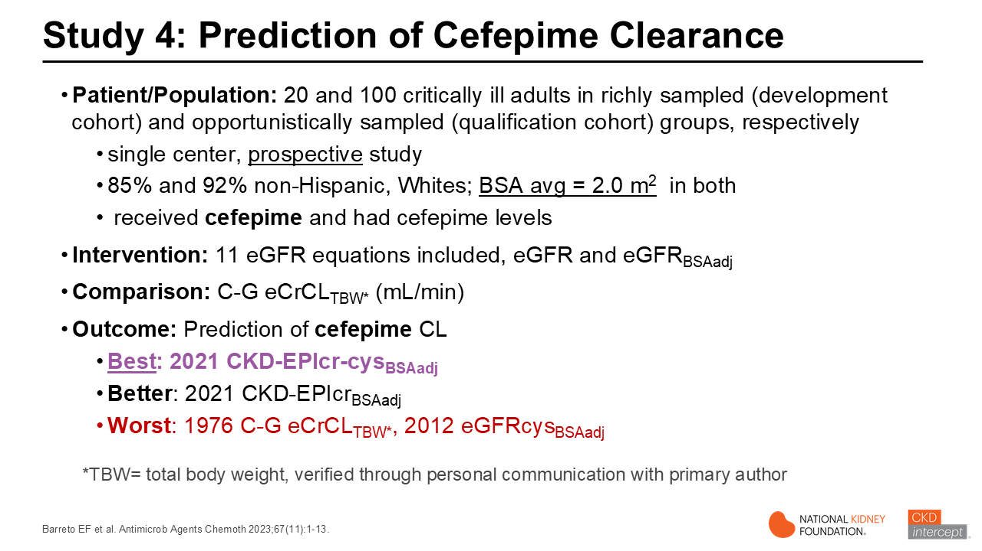
Notes:
Similar to the previous study evaluating meropenem PK, this study was performed in critically ill patients to evaluate the performance of various eGFR equations using creatinine, cystatin C or both to predict cefepime clearance. The average BSA was 2.0 m2. Among the eGFR equations analyzed, 2021 CKD-EPI eGFRcr-cys BSAadj equation expressed in mL/min reduced model variability to the greatest extent and was the best equation. Again C-G eCrCL (TBW) performed the worst along with 2012 CKD-EPIcys eGFR-BSAadj (mL/min).
__________________________________________________________________________________________________________________ _
Abstract; Cefepime exhibits highly variable pharmacokinetics in critically ill patients. The purpose of this study was to develop and qualify a population pharmacokinetic model for use in the critically ill and investigate the impact of various estimated glomerular filtration rate (eGFR) equations using creatinine, cystatin C, or both on model parameters. This was a prospective study of critically ill adults hospitalized at an academic medical center treated with intravenous cefepime. Individuals with acute kidney injury or on kidney replacement therapy or extracorporeal membrane oxygenation were excluded. A nonlinear mixed-effects population pharmacokinetic model was developed using data collected from 2018 to 2022. The 120 included individuals contributed 379 serum samples for analysis. A two-compartment pharmacokinetic model with first-order elimination best described the data. The population mean parameters (standard error) in the final model were 7.84 (0.24) L/h for CL1 and 15.6 (1.45) L for V1. Q was fixed at 7.09 L/h and V2 was fixed at 10.6 L, due to low observed interindividual variation in these parameters. The final model included weight as a covariate for volume of distribution and the eGFRcr-cysC (mL/min) as a predictor of drug clearance. In summary, a population pharmacokinetic model for cefepime was created for critically ill adults. The study demonstrated the importance of cystatin C to prediction of cefepime clearance. Cefepime dosing models which use an eGFR equation inclusive of cystatin C are likely to exhibit improved accuracy and precision compared to dosing models which incorporate an eGFR equation with only creatinine.

Slide 27
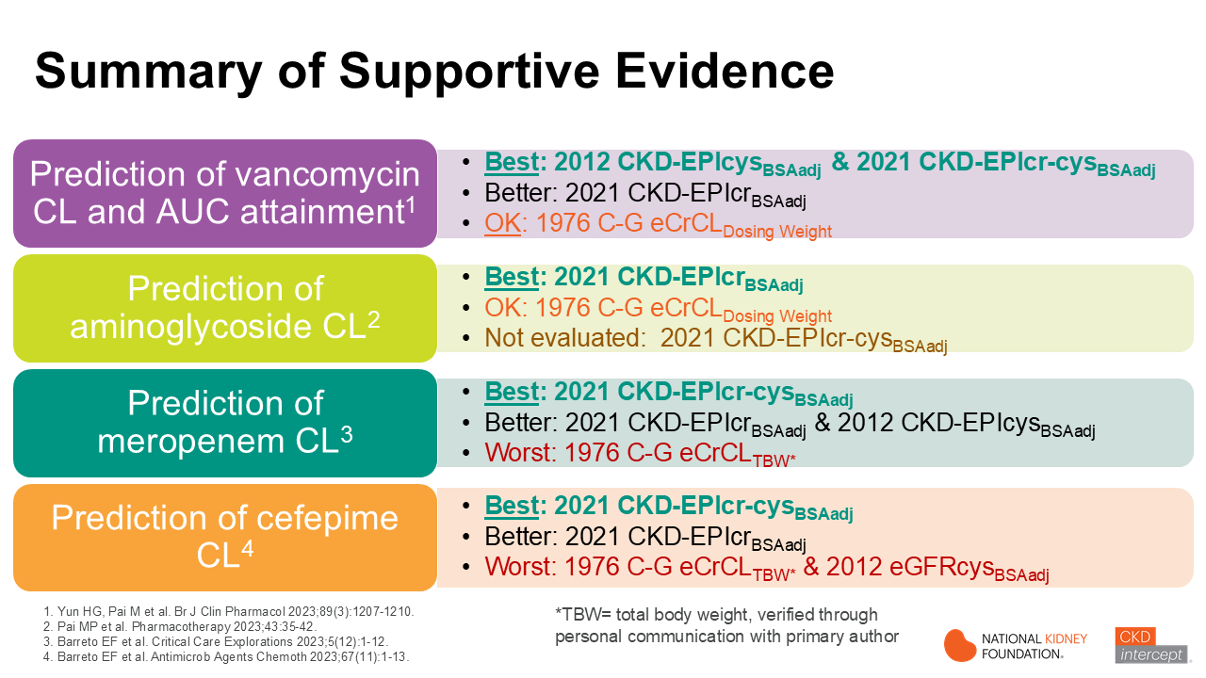
Notes:
This slide provides a summary of the data from studies comparing the ability of NKF-ASN Taskforce recommended eGFR equations compared to C-G eCrCL in predicting drug clearance of 4 antibiotics. Read through the slide information.

Slide 28
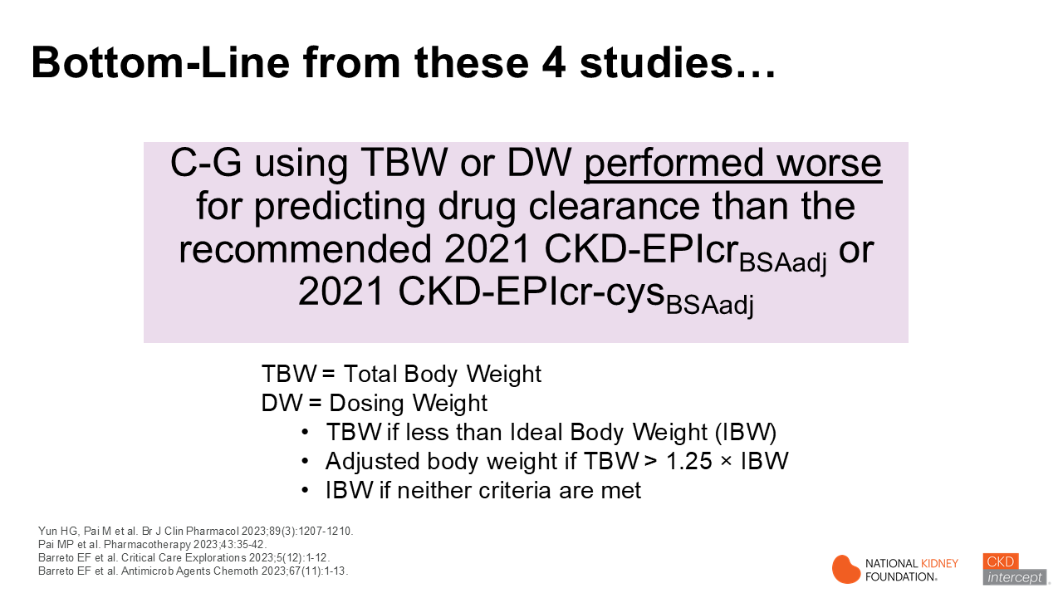
Notes:
Read statement in the purple box.
Some pharmacists have been concerned that all these studies have evaluated antibiotics and not other drug categories (e.g. anticoagulants/antithrombotics, chemotherapies) and the results of these studies may not apply. But, the fact that these were antibiotics is not relevant, as pharmacokinetic principles do not change based on drug class. This also does not discount the point that for narrow therapeutic index drugs, therapeutic drug monitoring, Bayesian estimation, or measured . may still be needed.

Slide 29
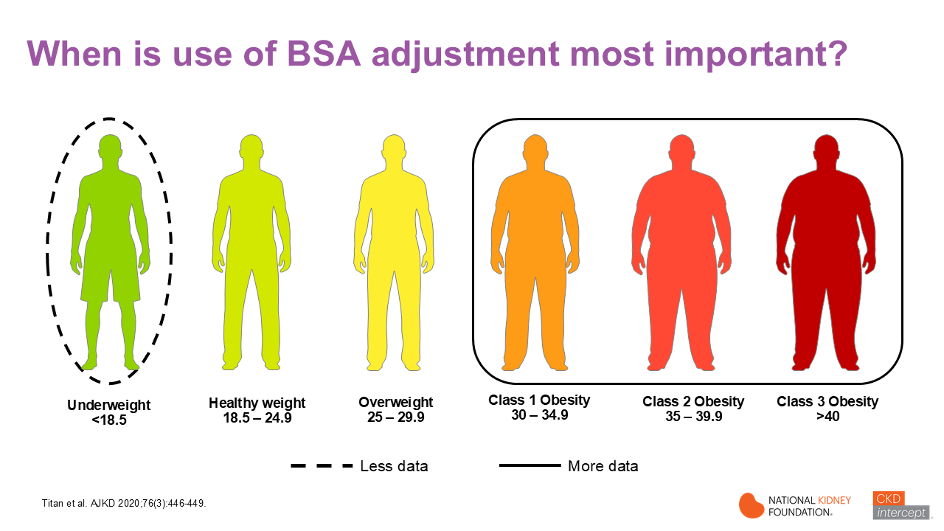
Notes:
When is use of body-surface area (BSA) adjusted eGFR most important? It is at extremes of weight where we are most concerned with using standardized eGFR (mL/min/1.73m2) for medication-related decisions. Let’s look at this in a little more detail. Evidence from several studies support adjusting eGFR for an individual’s BSA in persons that are obese. A limited amount of data suggest that it is not necessary to adjust for BSA in persons that are overweight, but not obese. Patients that are underweight represent ‘a mixed group’ of individuals. Some may be slightly underweight but have normal or high muscle mass (e.g. athletes). This group also includes older persons that may have lower muscle and higher fat mass and others may have sarcopenia (progressive, age-related loss of skeletal muscle mas, strength and function). It’s not surprising that the research isn’t clear when studies simply look at a group of persons with low BMI or BSA. But the study by Titan and colleagues provides some of the best evidence to date showing that in persons with lower BSA (< or = 1.65 m2), CKD-EPIcr eGFR-BSAadj (mL/min) results were much closer to mGFR results, on average, than the standardized eGFR result (mL/min/1.73m2).
________________________________________________________________________________________
See slides 20-22 for information on Titan study

Slide 30
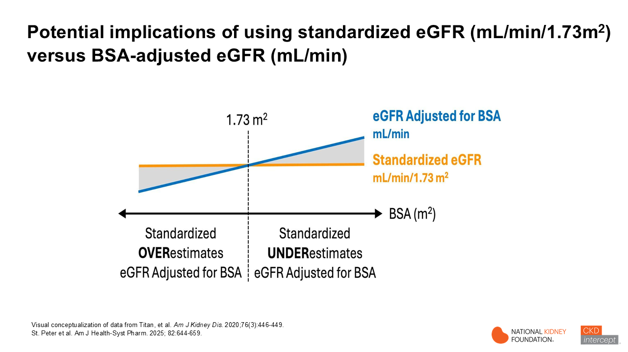
Notes:
If we look at this visual conceptualization of data from the Titan study we see that at lower body surface areas (BSA) or in underweight individuals) the standardized eGFR (in mL/min/1.73 m2) overestimates eGFR adjusted for BSA and the opposite is true at higher BSA values where the standardized values underestimate eGFR adjusted for BSA. The clinical implications are that if one uses standardized eGFR (mL/min/1.73m2) for the purpose of medication decision making, the dosage of a given medication may be overestimated in underweight individuals, while in obese patients medication dosage may be underestimated. There are also important considerations for when to start or stop a medication based on GFR cutoffs (for example metformin or SGLT-2i). This is an important issue that emphasizes the need to convert to eGFR-BSA adjusted values for medication-related decisions in persons with reduced .
______________________________________________________________________________________
See slides 20-22 for information on Titan study

Slide 31
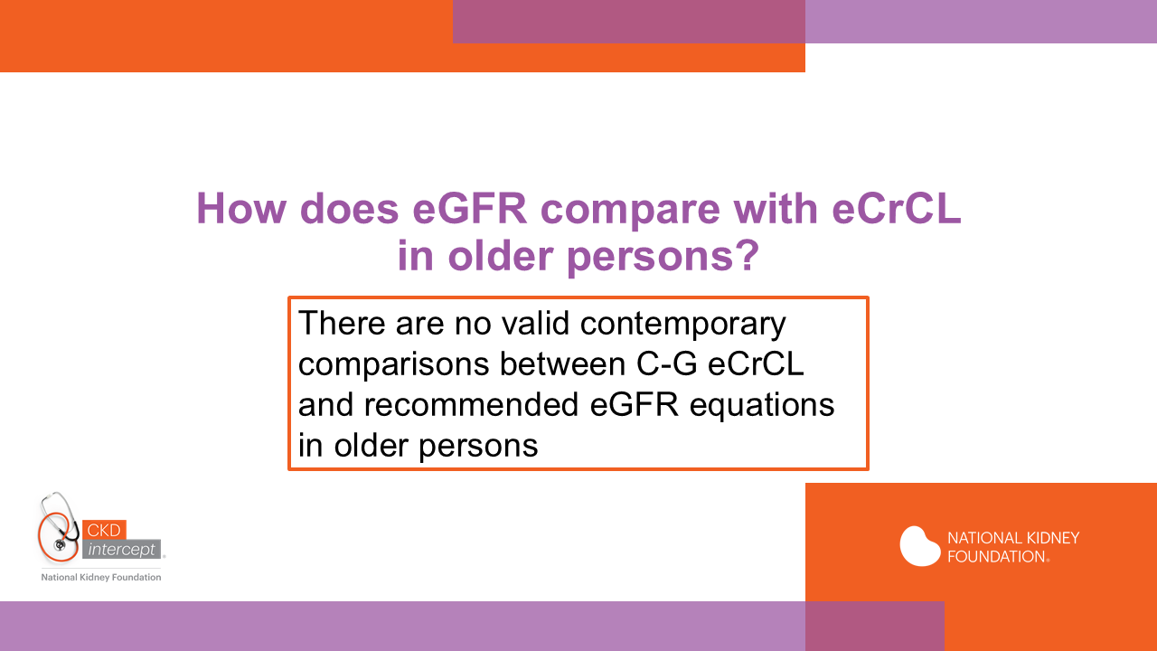
Notes:
We have talked about the implications of body size on GFR estimates for the purpose of drug dosing but what about age? How does eGFR compare with estimated CrCL in older persons? Unfortunately, there are no valid contemporary comparisons between C-G eCrCL and the three recommended eGFR equations in older persons.

Slide 32


Slide 33
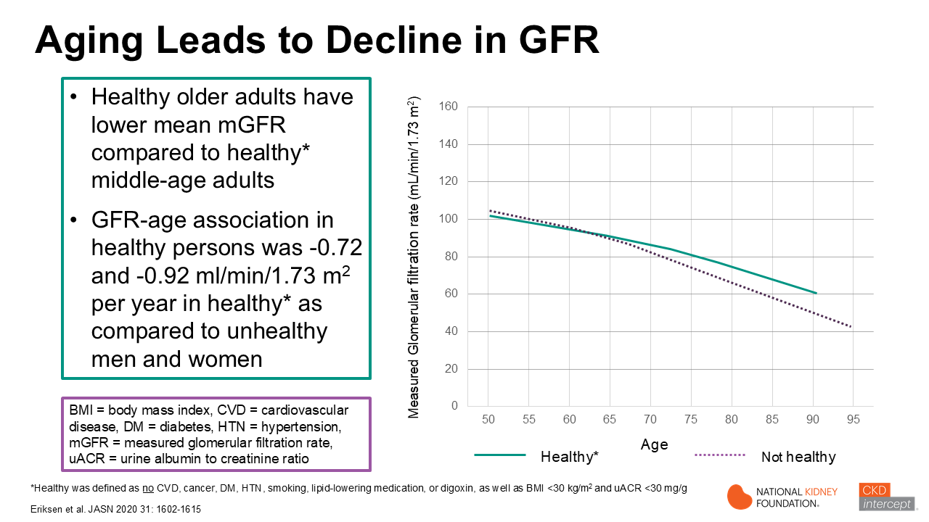
Notes:
An important concept in older persons is that aging leads to decline in eGFR even in persons without kidney disease. The information presented in this slide represents only one of several studies that have shown similar results. The figure on the right shows the average decline in measured GFR in healthy people in Europe (green solid line) compared to people with diabetes or hypertension or cardiovascular disease (purple dotted line). Focus on the green line: you can see that healthy older adults have a lower mean measured GFR compared to healthy middle-aged adults. Now compare the slope of both lines. Notice that unhealthy people have faster decline in kidney filtration function than do healthy adults of the same age. The difference is about 0.2 mL/min/1.73m2 per year.
________________________________________________________________________________________________________________________________________________________________________________________________________________________________________________________________________________________________________________________________________________
ABSTRACT Background Population mean GFR is lower in older age, but it is unknown whether healthy aging is associated with preserved rather than lower GFR in some individuals. Methods We investigated the cross-sectional association between measured GFR, age, and health in persons aged 50–97 years in the general population through a meta-analysis of iohexol clearance measurements in three large European population-based cohorts. We defined a healthy person as having no major chronic disease or risk factors for CKD and all others as unhealthy. We used a generalized additive model to study GFR distribution by age according to health status. Results There were 935 (22%) GFR measurements in persons who were healthy and 3274 (78%) in persons who were unhealthy. The mean GFR was lower in older age by 20.72 ml/min per 1.73 m2 per year (95% confidence interval [95% CI], 20.96 to 20.48) for men who were healthy versus 21.03 ml/min per 1.73 m2 per year (95% CI, 21.25 to 20.80) for men who were unhealthy, and by 20.92 ml/min per 1.73 m2 per year (95% CI, 21.14 to 20.70) for women who were healthy versus 21.22 ml/min per 1.73 m2 per year (95% CI, 21.43 to 21.02) for women who were unhealthy. For healthy and unhealthy people of both sexes, both the 97.5th and 2.5th GFR percentiles exhibited a negative linear association with age. Conclusions Healthy aging is associated with a higher mean GFR compared with unhealthy aging. However, both the mean and 97.5 percentiles of the GFR distribution are lower in older persons who are healthy than in middle-aged persons who are healthy. This suggests that healthy aging is not associated with preserved GFR in old age. JASN 31: 1602–1615, 2020. doi: https://doi.org/10.1681/ASN.2020020151
Unadjusted GFR according to cohort and health status. Body surface area–indexed GFR measured as plasma iohexol clearance and plotted against age in the RENIS, BIS, and AGES-Kidney cohorts (n54209). The marker colors indicate cohort membership. Filled circles indicate measurements in persons who were healthy and crosses in persons who were unhealthy. Measurements for both the baseline (RENIS-T6) and the follow-up examinations (RENIS-FU) of the same persons in the RENIS cohort are shown. The red and green curves represent unadjusted locally estimated scatterplot smoothing fits to measurements in people who were unhealthy and healthy, respectively.

Slide 34
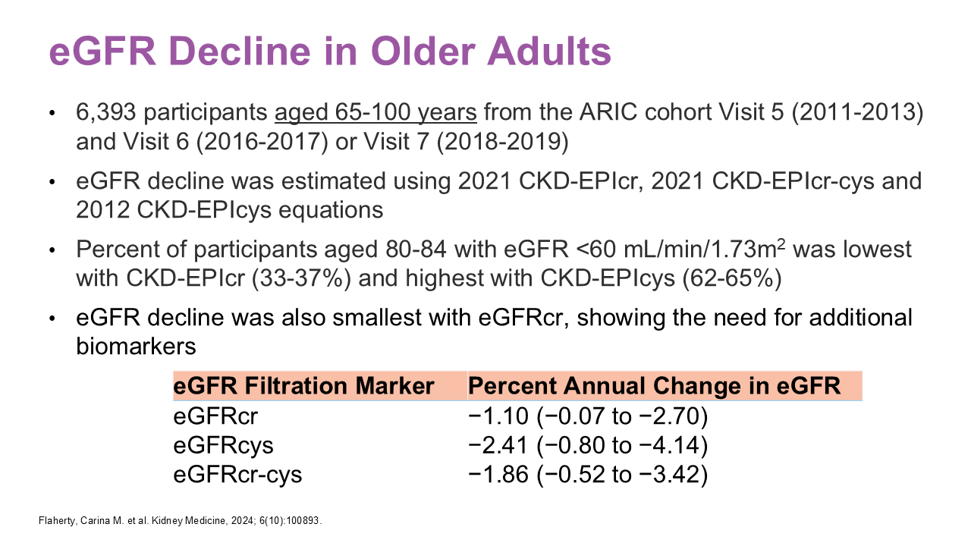
Notes:
Creatinine is by-product of muscle metabolism. Serum creatinine (sCr) concentration in an individual is a balance between creatinine production (from muscle metabolism) and ingestion of cooked proteins and elimination by the kidneys through glomerular filtration and tubular secretion. Older persons typically have lower muscle mass, produce less creatinine and consequently have lower sCr levels. Unfortunately, sCr is not a great biomarker for assessment in older adults. Alternatively, cystatin C is produced by all nucleated cells in the body and are not affected as much as sCr by reduced or changing muscle mass.
This study evaluated over 6000 participants aged 65-100 in the Atherosclerosis Risk in Communities (ARIC) study to look at GFR estimation using 3 biomarkers including sCr and cystatin C. They calculated percent of persons that had eGFR <60 mL/min/1.73m2 in the age range and eGFR decline with the NKF-ASN recommended 2021 CKD-EPIcr, 2021 CKD-EPIcr-cys and 2012 CKD-EPI equations.
The percent of participants aged 80-84 with eGFR <60 mL/min/1.73m2 was lowest with 2021 CKD-EPIcr eGFR, highest with 2012 CKD-EPIcys eGFR and combined equation results were in middle. The differences between creatinine-based and cystatin C-based eGFR were much smaller in persons aged 65-69.
In addition, creatine-based eGFR showed the smallest annual percent change in eGFR, which is not surprising. Both these measures suggested that loss in muscle mass typically seen in older persons masks true and decline.
This highlights the need for additional biomarkers than creatinine, such as cystatin C, in older adults.

Slide 35
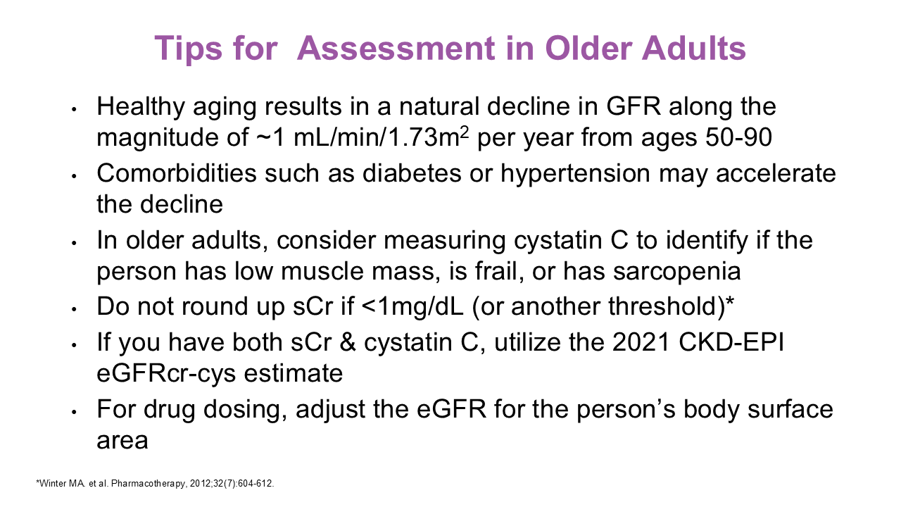
Notes:
Healthy aging results in GFR decline of approximately 1 mL/min/1.73m² annually
Comorbidities like diabetes and hypertension often accelerate this decline
In older adults, consider measuring cystatin C (cysC) alongside creatinine to better assess
Never round low sCr values in older adults - use actual values for more accurate estimation
When both sCr and cysC are available, use the combined 2021 CKD EPI eGFRcr-cys equation
For drug dosing, adjust eGFR for the patient's actual body surface area (eGFR-BSAadj)
These practices optimize assessment and medication management in older adults
Remember that accurate estimation directly impacts patient care and outcomes

Slide 36
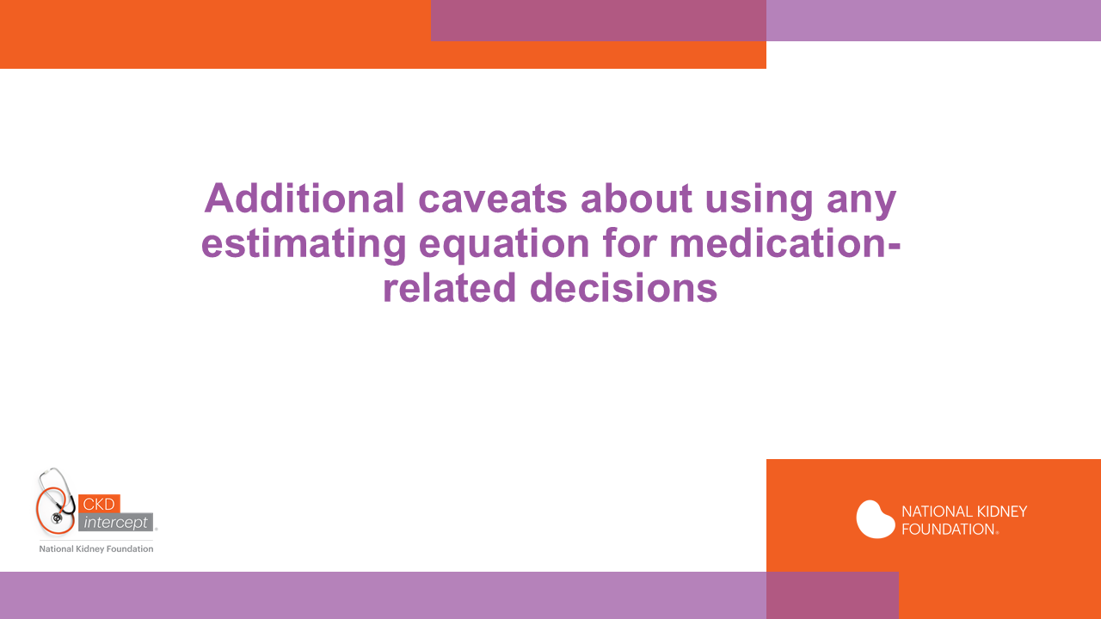

Slide 37
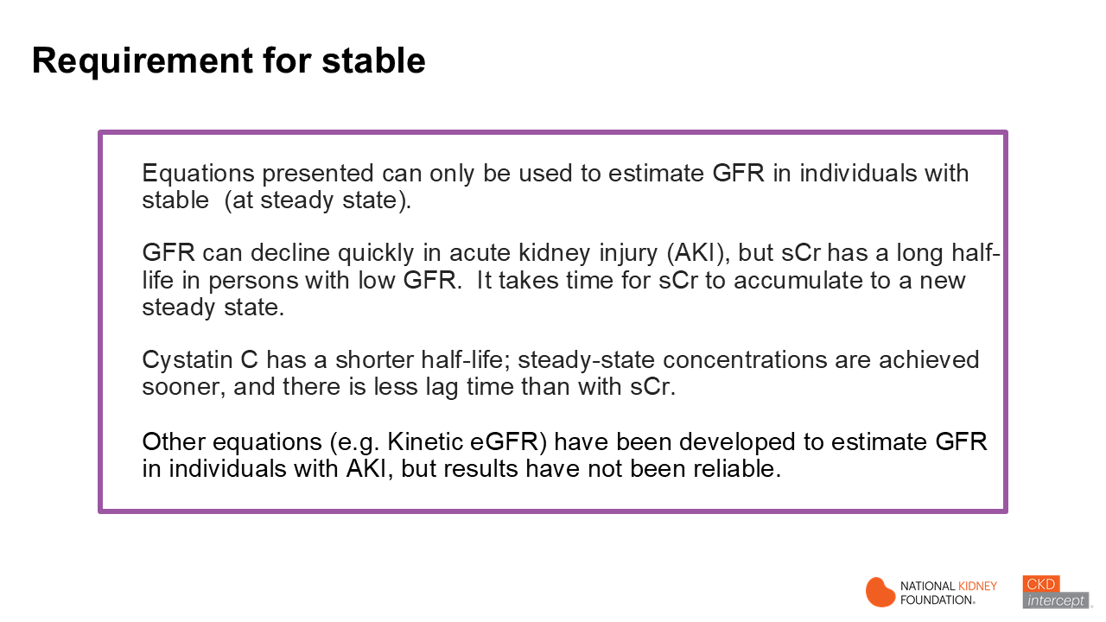
Notes:
It is important to note that the equations referenced in this presentation (CKD-EPI eGFR and eCrCL) are only for estimating GFR in individuals with stable . This is because early in the course of acute kidney injury, the GFR can decline rapidly, but sCr has a longer half-life in persons with low GFR, so it takes time for sCr to reach a new steady-state level. Cystatin C has a shorter half-life, so steady-state concentrations are achieved sooner, with less lag time than with serum creatinine. Even so, cystatin C-based equations were validated only in persons with stable . Of note, equations such as the Jelliffe equation and Kinetic eGFR have been developed to estimate in individuals with unstable (e.g., acute kidney injury), but neither has been shown to reliably estimate in AKI. The next slide illustrates the changes in GFR and serum creatinine as rapidly declines.

Slide 38
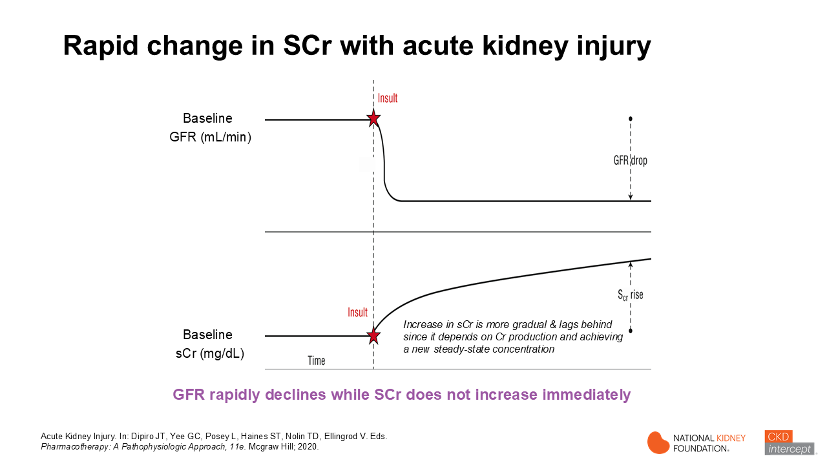
Notes:
Shown here is a representation of what happens to sCr following a sudden drop in GFR as would occur in an individual with acute kidney injury. Although the decline in GFR is more abrupt, the rise in serum creatinine is more gradual and lags behind the decline in GFR. Serum creatinine increases because its elimination rate has declined relative to its production rate, and it continues to rise until it reaches a new steady state, where the production rate equals the elimination rate. Early in the course of acute kidney injury, the GFR is markedly reduced, but there has not yet been time for serum creatinine to accumulate and, therefore, for the filtration marker to reflect the severity of kidney disease. If one were to use sCr to estimate GFR before the new plateau or steady state is reached, the estimated GFR would be higher than the individual's true GFR. Similarly, if an individual recovers after acute kidney injury, the drop in sCr will lag, and one may underestimate if sCr is used to estimate GFR. The key point here is that the CKD-EPI eGFR equations can only be used in steady-state conditions. They are not reliable in individuals with acute kidney injury.

Slide 39
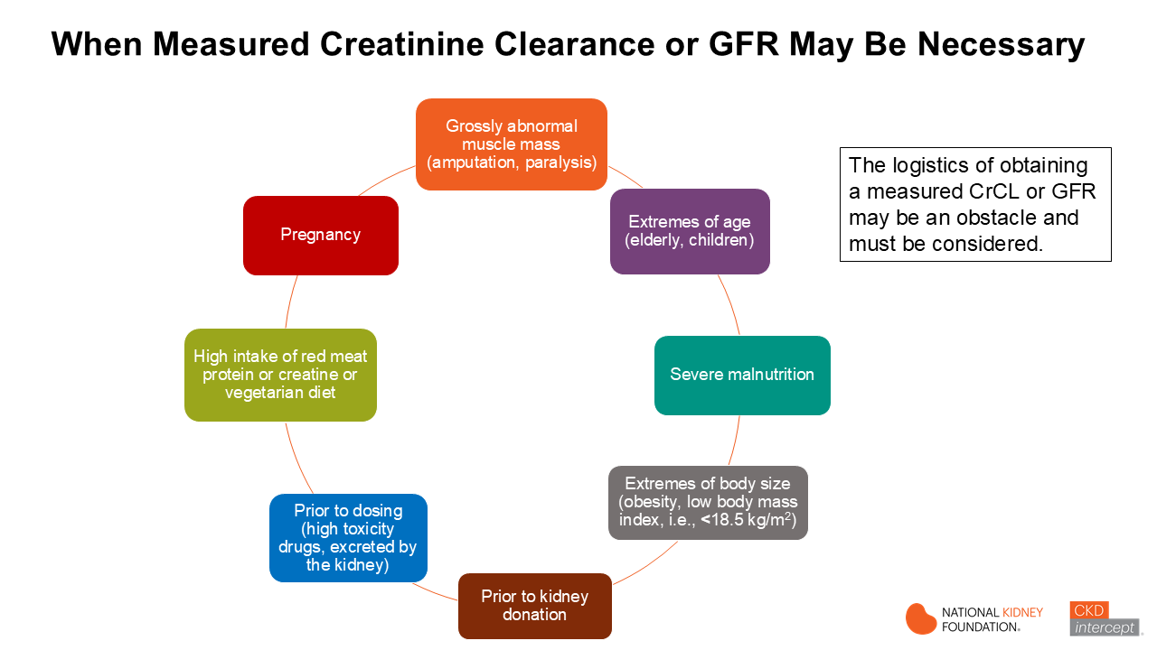
Notes:
This slide shows some conditions when consideration of measuring creatinine clearance or GFR are shown here (go through the list). The logistics, however, of performing these measurements may be an obstacle and must be considered.

Slide 40
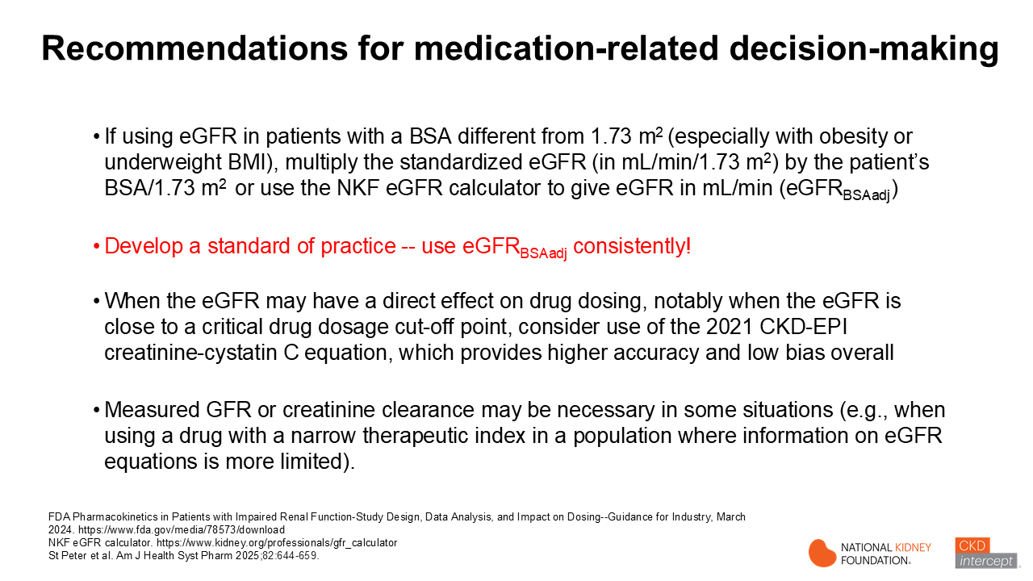
Notes:
With the background information and supporting information related to drug PK prediction using eGFR, what are the recommendations for medication-related decision making?
If using eGFR in obese or underweight patients with a BSA different than 1.73 m², multiply the standardized eGFR (in mL/min/1.73 m²) by BSA/1.73 m² to give eGFR in mL/min – referred to as the body surface area adjusted or BSAadj eGFR
It should be emphasized that use of eGFR-BSAadj should be the standard of practice and used consistently. It is also important to remember that any equation is an ESTIMATE based on population parameters and that clinical judgement needs to applied.
When the eGFR may have a direct effect on drug dosing, notably when the eGFR is close to a critical drug dosage cut off point, consider use of 2021 CKD-EPI creatinine-cystatin C equation, which provides higher accuracy and low bias, overall. At this time cystatin C is not as widely available as it should be, so the ability to use cystatin-C based equations in a timely manner is site specific.
There may also be times when a measured GFR or creatinine clearance is warranted (for example if using a drug with a narrow therapeutic index such as some chemotherapy agents), although the ability to perform these measurements are logistically challenging in many cases. Again, clinical judgement should prevail in these situations.

Slide 41
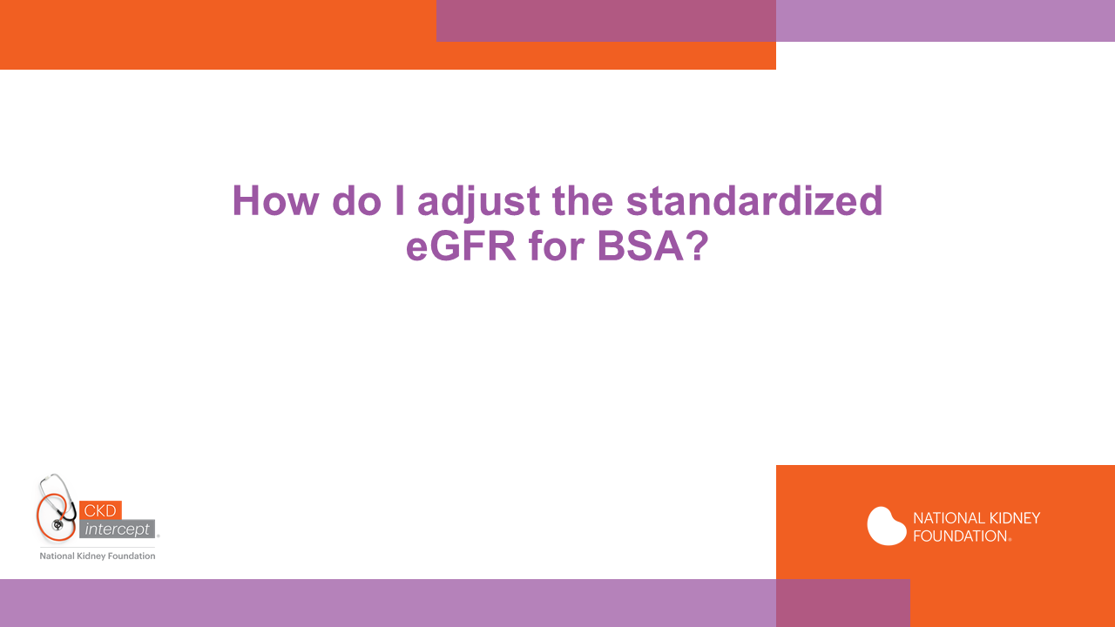
Notes:
How is the adjustment for BSA done in clinical practice to make it an easier process?

Slide 42
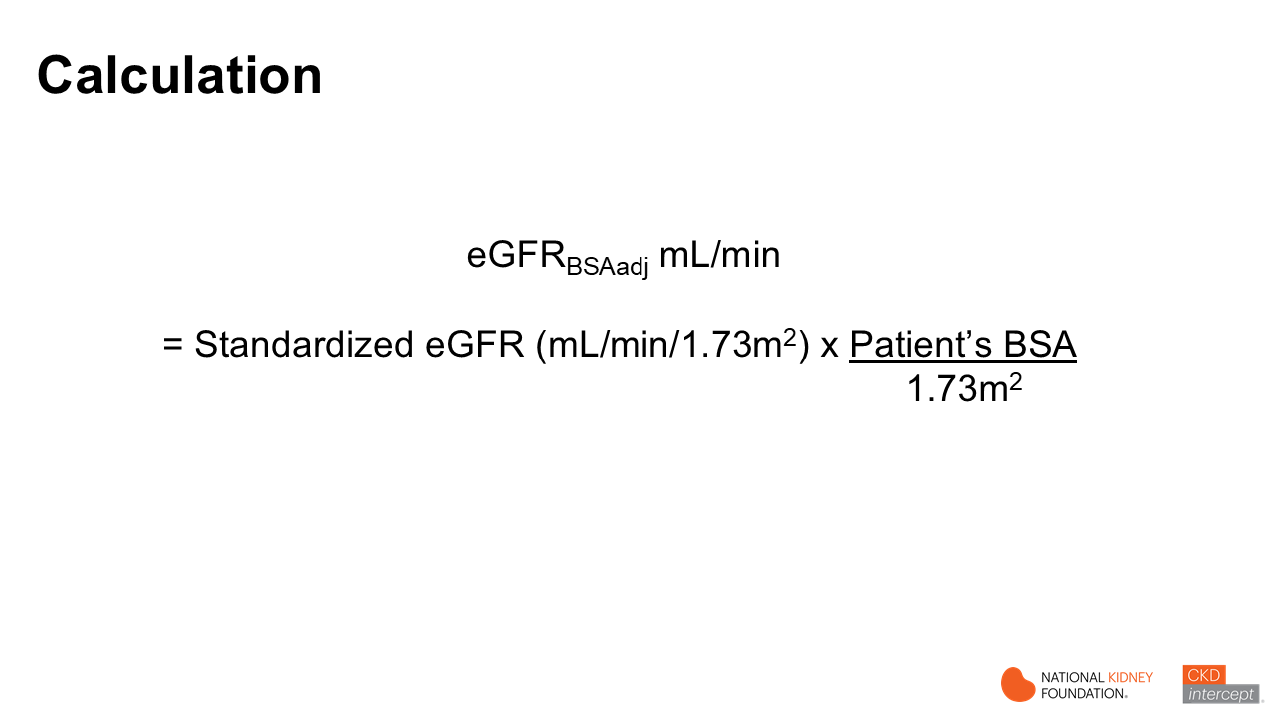
Notes:
The adjustment is made by multiplying the standardized eGFR in mL/min/1.73 m2 by the patients BSA divided by 1.73

Slide 43
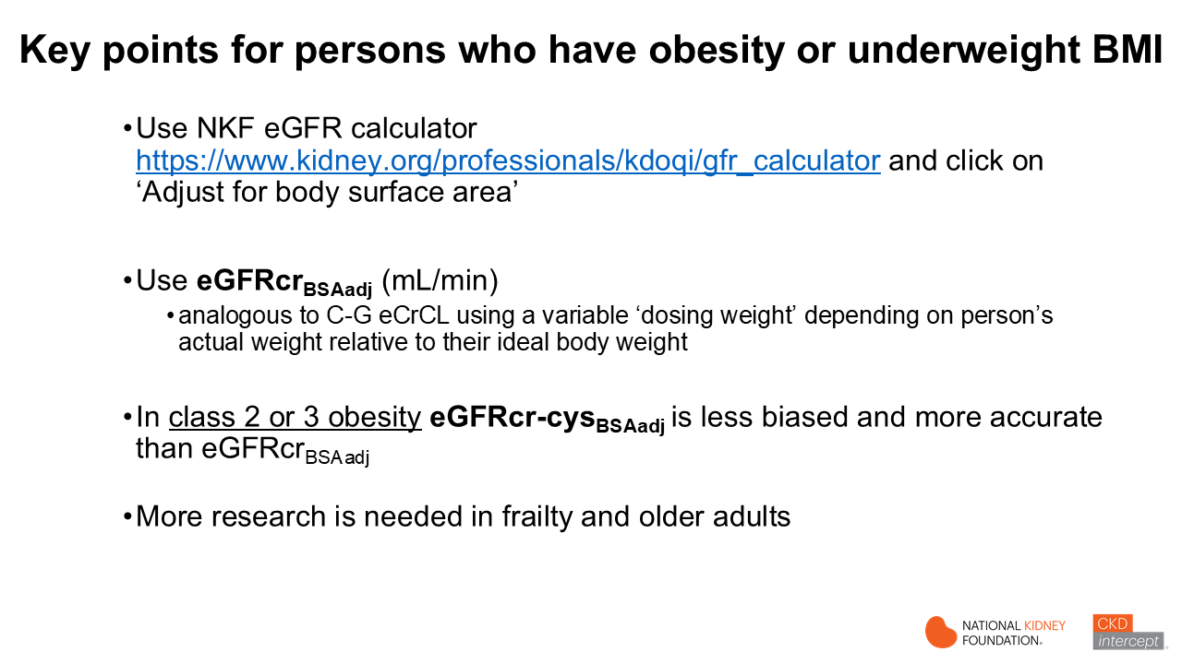
Notes:
BSA adjustment should be a practice standard for drug-related decision-making
Use NKF eGFR calculators https://www.kidney.org/professionals/kdoqi/gfr_calculator and in general, click on ‘Adjust for body surface area’
In general, use eGFRcr_{BSAadj} (mL/min)
In overweight or obesity eGFRcr-cys_{BSAadj} is less biased and more accurate than eGFRcr_{BSAAdj.} Why? Use of eGFR (mL/min/1.73m²) might result in overdose (in underweight) and underdose (in overweight)
In severe obesity (BMI >40), use eGFRcr-cys (2021) w/o BSA adjustment or C-G ABW_{0.4} eCrCL (or mGFR or mCrCL)
More research is needed in frail and elderly persons

Slide 44
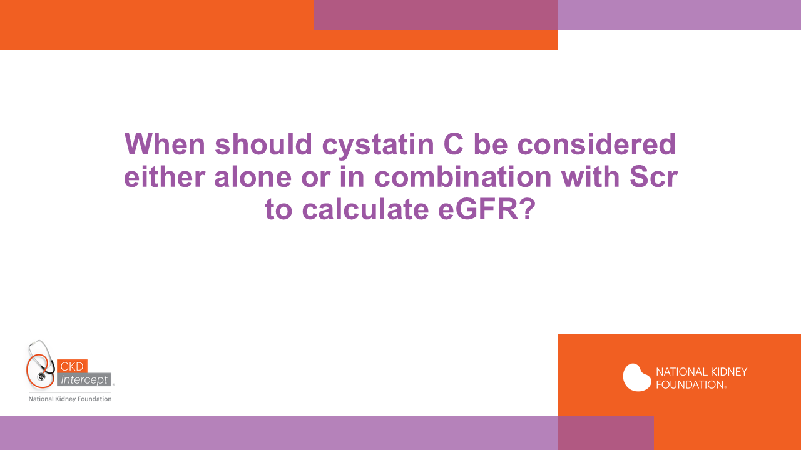

Slide 45
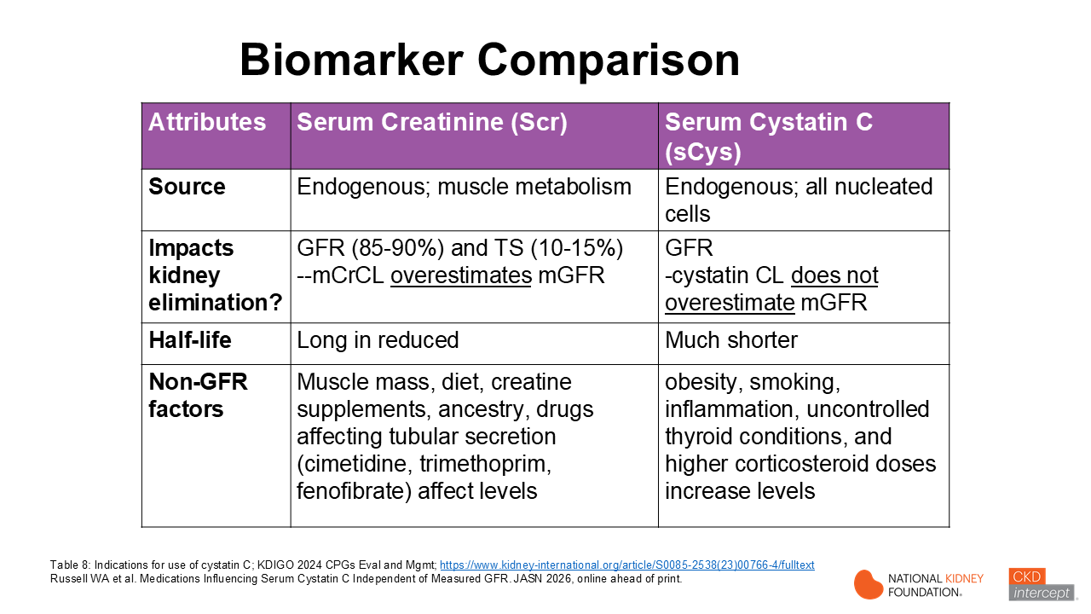
Notes:
Let’s do a quick comparison of the 2 biomarkers that are used in CKD-EPI eGFR equations, for better understanding of the limitations of use of these biomarkers for assessment.
-sCr is an endogenous product of muscle metabolism so production of creatinine is increased in patients with increased muscle mass and is decreased patients with amputations, muscle-wasting diseases or frailty, and it’s half-life increases as decreases.
-cystatin C is also an endogenous biomarker produced mainly by nucleated cells which has a much shorter half-life than sCr as decreases, which means that cystatin C serum concentration lags less does serum creatinine when is changing and since it isn’t secreted into the kidney tubules like sCr, it doesn’t overestimate mGFR. But it has other non-GFR factors, like obesity, smoking and uncontrolled hypothyroidism that increase its serum concentration.
This is the reason why use of both markers in combination in the 2021 CKD-EPIcr-cys eGFR equation produce more accurate, less biased results across the large diverse groups of patients that have been used to develop and validate eGFR equations. Non-GFR factors balance out across a population of patients when both biomarkers are used. However, considering patient health behaviors including dietary patterns, medication use as well as body habitus, clinical condition of the individual patient, use of one biomarker or the other may produce more accurate and less biased results in an individual patient. We recommend that you use table 8 in the 2024 KDIGO Clinical Practice Guideline for CKM management to determine which equation may be the most accurate in individual patients.

Slide 46
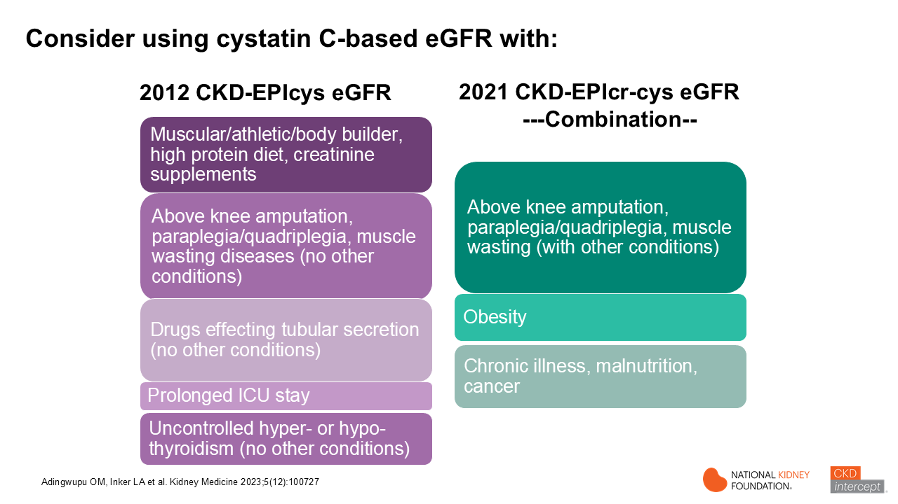
Notes:
Here is a helpful table that will help you determine whether use of a cystatin-based eGFR equation might be a good choice for estimating eGFR with various patient conditions or clinical situations.
As you can see on the right-hand side, obesity is a common condition where the evidence shows that using the 2021 CKD-EPIcr-cys combination equation along with BSA adjustment is a good choice when used for medication-related decisions
_______________________________________________________________________________________________________________________________________________________________________________________________________________________________________________________________________
Adingwupu, Barbosa, Palevsky, Inker L et al. Evaluation of Cystatin C as a marker for GFR Estimation in Clinical Populations: A Systematic Literature Review.
Plain-Language Summary
, specifically glomerular filtration rate (GFR), estimated using creatinine (eGFRcr) is often inaccurate in people with acute and chronic illness. The accuracy of estimates using cystatin C alone (eGFRcys) or together with creatinine (eGFRcr-cys) is not well studied in these populations. We conducted a systematic review to address the knowledge gap. Of the 179 papers reviewed, we identified 26 studies in clinical populations with cancer (n=5); HIV (n=5); cirrhosis (n=3); liver transplant (n=3); heart failure (n=2); neuromuscular disease (n=1); critical illness (n=5); and obesity (n=2). In general, eGFRcr-cys improved the GFR estimation in HIV, cancer, and obesity, providing indications for cystatin C measurement. Performance was poor in many studies, suggesting the need for more frequent measured GFR.

Slide 47
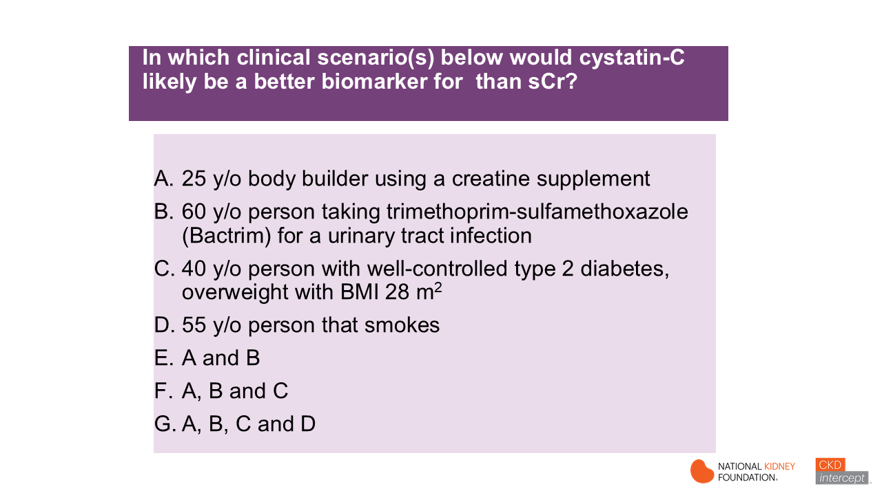

Slide 48
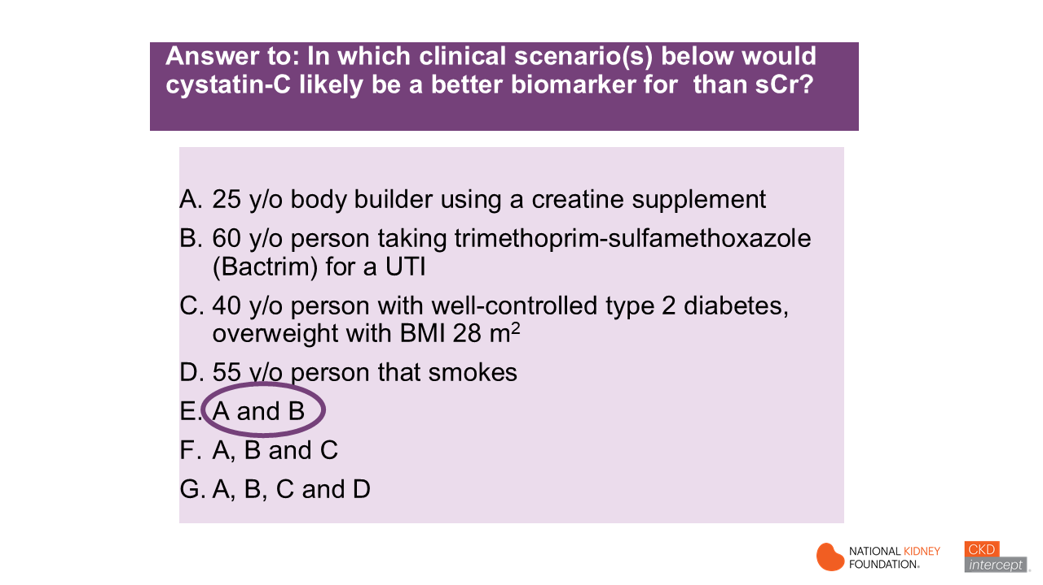
Notes:
Ans. E
A. and B. are true; a person that has increased muscle mass and/or is utilizing creatine supplements will generate more sCr, and the increased sCr is not a result of worsening
C. and D. are false; C. is false because the person does not have Class 2 or 3 obesity but is simply overweight. Overweight and diabetes are not non-GFR factors., D. is false, Smoking is a potential non-GFR factors that have been shown to increase cystatin C concentrations. In this case, serum creatinine may be the better biomarker to use.

Slide 49
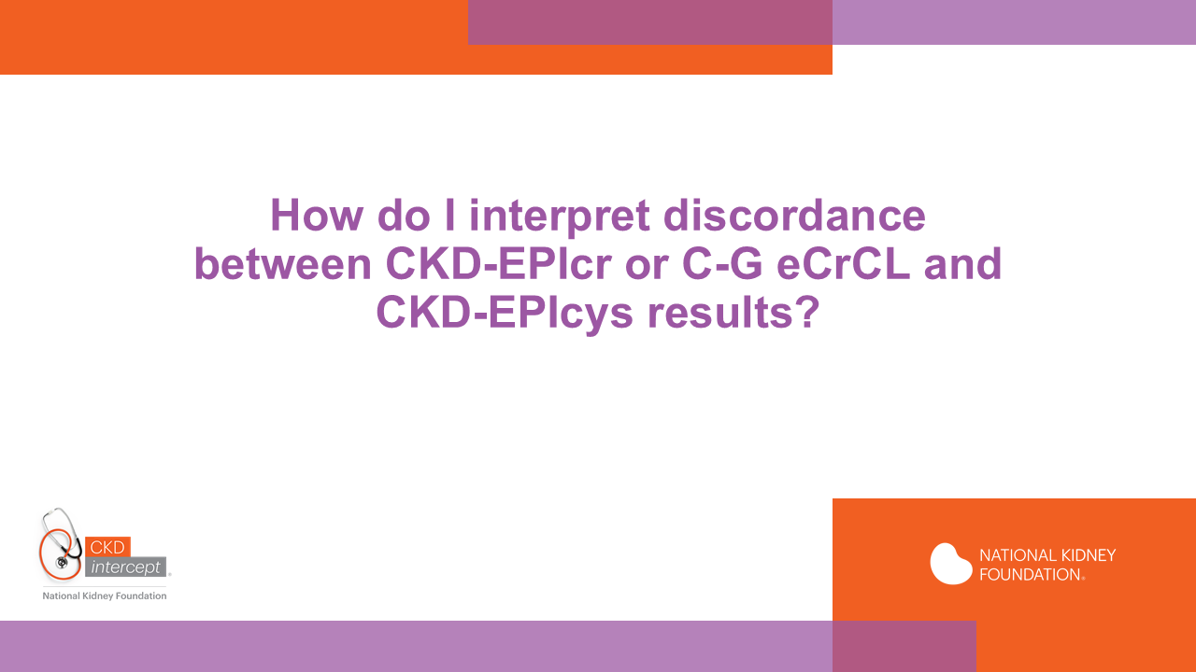

Slide 50
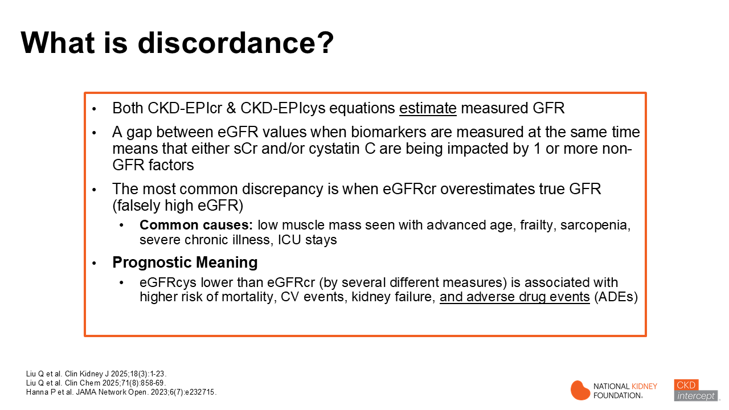
Notes:
The CKD-EPIcr and CKD-EPIcys equations both provide estimates measured GFR. A gap between eGFR calculated values, when sCr and cystatin C are measured at the same time means that either sCr and/or cystatin C are being impacted by 1 or more non-GFR factors.
The most common discrepancy is when eGFRcr overestimates true GFR (falsely high eGFR). There are several non-GFR factors that can impact sCr levels, but the most common reason is low muscle mass. Low muscle mass is seen in persons with advanced age, frailty, sarcopenia, severe chronic illness, long stays in the ICU, malnutrition, amputation and muscle-wasting diseases
Prognostic Meaning
eGFRcys lower than eGFRcr, by several different measures is associated with higher risk of mortality, CV events, kidney failure and adverse drug events (ADEs). While the accuracy of either estimating equation could only be known if both were compared to true GFR, identifying discordance can be useful for health risk stratification and prediction of adverse health outcomes including adverse drug events.

Slide 51
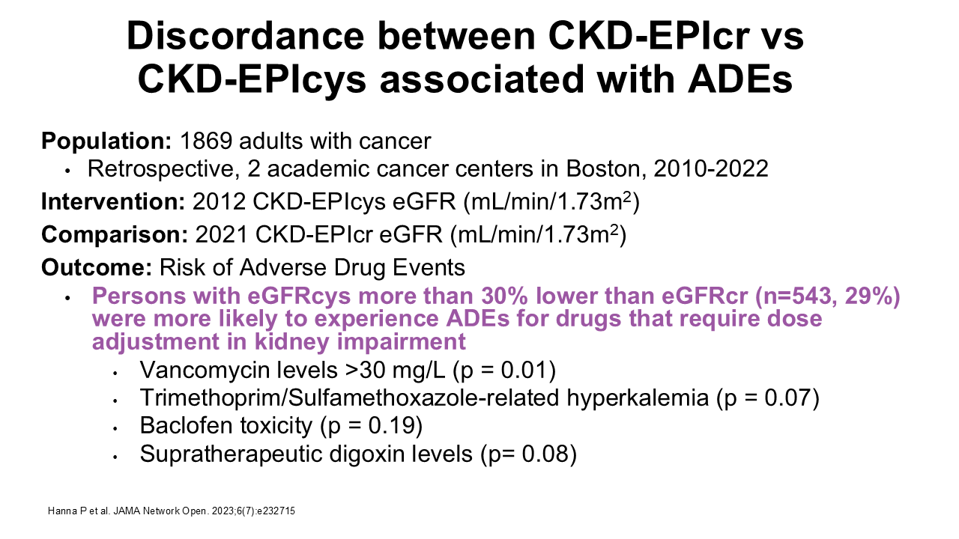
Notes:
As we’ve discussed, sCr is not an ideal biomarker to assess kidney filtration function. There are many non-GFR factors such as decreased muscle mass, that affect serum levels. A study in 2 cancer centers associated with the Massachusetts General Brigham Health System retrospectively evaluated persons with cancer. Knowing that people with cancer and related therapies may not eat well, and oftentimes lose weight, muscle mass, and may be frail. Researchers wanted to determine if CKD-EPIcr and CKD-EPIcys discordance (defined as eGFRcys results more than 30% lower than eGFRcys results (note: sCr and cys levels were drawn on the same day) was associated with more adverse drug events) ADEs. They showed that discordance was associated with vancomycin levels greater than 30 mg/L, trimethoprim-sulfamethoxazole related hyperkalemia, baclofen toxicity and supratherapeutic digoxin levels. The results for vancomycin were significant, even after adjustment for a number of other factors. It important to also note that cystatin C may also be inaccurate in persons with cancers with high cell turnover and large tumor burdens. This study suggests that cystatin C has value as marker for assessment of and for prediction for ADEs in persons with cancer, and that in cases of eGFR discordance, cystatin C alone or together with serum creatinine in eGFR equations may result in better estimates of and improved medication safety.
_____________________________________________________________________________________________________________________________________
Abstract
IMPORTANCE Serum creatinine–based estimated glomerular filtration rate (eGFRcr) may
overestimate the glomerular filtration rate (GFR) in patients with cancer. Cystatin C–based eGFR (eGFRcys) is an alternative marker of GFR.
OBJECTIVE To determine whether the therapeutic drug levels and adverse events (AEs) associated with renally cleared medicationswere higher in patients with cancer whose eGFRcyswas more than 30% lower than their eGFRcr.
DESIGN, SETTING, AND PARTICIPANTS This cohort study analyzed adult patients with cancer at 2 major academic cancer centers in Boston, Massachusetts. These patients had their creatinine and cystatin C measured on the same day between May 2010 and January 2022. The date of the first simultaneous eGFRcr and eGFRcys measurement was considered to be the baseline date.
EXPOSURE The primary exposure was eGFR discordance, defined as an eGFRcys that was more than 30% lower than the eGFRcr.
MAIN OUTCOMES AND MEASURES The primary outcome was risk of the following medication related AEs within 90 days of the baseline date: (1) supratherapeutic vancomycin trough level greater than 30 μg/mL, (2) trimethoprim-sulfamethoxazole–related hyperkalemia (>5.5 mEq/L), (3) baclofen toxic effect, and (4) supratherapeutic digoxin level (>2.0 ng/mL). For the secondary outcome, a multivariable Cox proportional hazards regression model was used to compare 30-day survival of those with vs without eGFR discordance.
RESULTS A total of 1869 adult patients with cancer (mean [SD] age, 66 [14] years; 948 males [51%]) had simultaneous eGFRcys and eGFRcr measurement. There were 543 patients (29%) with an eGFRcys that was more than 30% lower than their eGFRcr. Patients with an eGFRcys that was more than 30% lower than their eGFRcr were more likely to experience medication-related AEs compared with patients with concordant eGFRs (defined as eGFRcys within 30% of eGFRcr), including vancomycin levels greater than 30 μg/mL (43 of 179 [24%] vs 7 of 77 [9%]; P = .01), trimethoprim/sulfamethoxazole–related hyperkalemia (29 of 129 [22%] vs 11 of 92 [12%]; P = .07), baclofen toxic effects (5 of 19 [26%] vs 0 of 11; P = .19), and supratherapeutic digoxin levels (7 of 24 [29%] vs 0 of 10; P = .08). The adjusted odds ratio for vancomycin levels more than 30 μg/mL was 2.59 (95%CI, 1.08-7.03; P = .04). Patients with an eGFRcys more than 30% lower than their eGFRcr had an increased 30-day mortality (adjusted hazard ratio, 1.98; 95%CI, 1.26-3.11; P = .003).

Slide 52

Notes:
This retrospective study was conducted in 205 hospitalized patients in Mayo Clinic facilities that received bivalirudin and had both sCr and cystatin C levels drawn within 24 hours of bivalirudin administration, mainly in patients receiving ECMO. During the study timeframe, bivalirudin dosing protocols with clinical decision support embedded within the electronic health record. Clinicians were typically guided to select the initial bivalirudin dose based on C-G eCrCL (total body weight, TBW). Researchers calculated bivalirudin doses with C-G eCrCL (TBW) and also with 2021 CKD-EPIcys eGFR adjusted for each patient’s body surface area (BSA). They evaluated a subset of patients (n =59) that had received an initial dose based on C-G eCrCL protocol. They showed that 68% of these patients had discordance, which was defined as C-G eCrCL >15 mL/min higher than CKD-EPIcys eGFR-BSAadj. Discordance was associated with a lower % of aPTT in goal range (55% vs 63%) after first dose. The authors concluded that since the 2021 CKD-EPIcys eGFR-BSAadj results would lead to lower doses (on average) than C-G eCrCL (TBW), the 2021 CKD-EPIcys eGFR-BSAadj may be the better equation to use in patients that have discordance. Key limitations of this study was a small sample size and clinical safety or effectiveness outcomes were not assessed.

Slide 53

Notes:
This study evaluated the potential for carboplatin overdosing if 2021 CKD-EPIcr eGFR was used in the Calvert formula to determine carboplatin dose compared with 2012 CKD-EPIcys or 2021 CKD-EPIcr-cys eGFR adjusted for body surface area in cancer patients enrolled in the Stockholm CREAtinine Measurements (SCREAM) Project. Measured GFR using iohexol was the standard against which 2009 CKD-EPIcr, 2012 CKD-EPIcys & 2012 CKD-EPIcr-cys eGFR-BSAadj were compared. Researchers evaluated 2 main outcomes: eGFR accuracy and carboplatin dosing accuracy. eGFR accuracy was defined at the percent of patients with eGFR values within 30% (P30) and 15% (P15) of mGFR. P30 accuracy was 92% with 2012 CKD-EPI cr-cys equation, vs 81-82% with the 2 other equations, P15 accuracy (more stringent definition) was 66% with 2021 CKD-EPI, and 49-53% with the other 2 equations. Bias and precision were also evaluated, and bias was the lowest and precision was the highest using CKD-EPIcr-cys eGFR. Dose accuracy was determined by the carboplatin dose calculated using the Calvert formula aiming for an area under the curve (AUC) of 5 mg/mL/min. CKD-EPIcr-cys was less likely to recommend an “overdose” than CKD-EPIcr or to recommend an “underdose” than CKD-EPIcys. This study had some limitations including using older ‘race-based’ versions of the CKD-EPI equations, which are commonly used in Europe. The data from this study came from Stockholm, and participants were predominantly White Europeans which explains why the older equations were used. None-the-less, these data are consistent with other studies conducted in patients with cancer that show the combined CKD-EPI eGFRcr-cys equation results provide the most accurate estimates of mGFR in persons with cancer, which is not surprising given that sCr is primarily impacted by muscle mass, and these patients (especially those in advanced cancer) oftentimes have cachexia. Cystatin C may be increased with smoking, chronic inflammation and use of corticosteroids—also seen in persons with cancer. Thus, in persons with non-eGFR factors that impact both biomarkers, the combination CKD-EPIcr-cys is likely to be more accurate.
_________________________________________________________________________________________________________________________________________________________
Abstract
BACKGROUND: Glomerular filtration rate (GFR) estimation is a key issue in determining cancer treatment eligibility and dosing of treatments with narrow therapeutic index. Yet, little is known about the accuracy of GFR estimation among people with cancer in routine care.
METHODS: In a cross-sectional study including 1611 adults with cancer referred for 1837 determinations of measured GFR (mGFR), we assessed the accuracy of estimated GFR based on creatinine (eGFRcr), cystatin C (eGFRcys) and their combination (eGFRcr-cys). Accuracy was reported as percentage of patients with estimated values within 30% of mGFR; bias and precision as the median and interquartile range of eGFR-mGFR, respectively. Dosing accuracy was assessed by calculating expected dose of carboplatin for area under the curve of 5 mg/mL/min using the Calvert formula.
RESULTS: Median age was 68 (IQI 61 to 74) years, 38.5% were female with mean mGFR 75 (SD 30) mL/min; 17% had metastatic disease. Accuracy, bias and precision were best for eGFRcr-cys. Using eGFRcr would recommend an “overdose” of carboplatin in 10–20% of participants: this was 3–4 times less common using eGFRcr-cys.
CONCLUSION: eGFRcr-cys equations provide the most accurate estimates of mGFR in patients with cancer, with potential to improve dosing accuracy substantially compared to eGFRcr. British Journal of Cancer (2025) 133:1652–1659; https://doi.org/10.1038/s41416-025-03190-3

Slide 54


Slide 55

Notes:
Patients need to understand what the eGFR result means and how to answer patients questions. Some key questions are bulleted on this slide. We need to explain that the patient has a role in keeping track of their eGFR and how the pharmacist uses that number to determine if a medication will be safe for them and whether their doses need to be decreased compared to someone with normal .
Let's break it down in simpler terms:
Why it matters: When doctors measure how well your kidneys are working, they use a number called eGFR. This number helps them understand if your kidneys are filtering your blood properly.
Standard vs. Adjusted eGFR:
Standard eGFR: This is a general number that assumes everyone has the same body size. It's like saying "one size fits all," but we know people come in different shapes and sizes.
Adjusted eGFR: This number takes into account your actual body size. Think of it as tailoring the measurement to fit you personally.
Why It Matters:
Personalized Care: When pharmacists or doctors adjust the eGFR to your specific body size, they get a clearer picture of your . This helps them make better decisions for your treatment.
Accurate Medication Dosing: Some medications are processed through the kidneys. If doctors know exactly how well your kidneys are working, pharmacists can give you the right dose to make sure the medication is effective and safe.
So, adjusting eGFR to your body size means your doctors and pharmacist can make a medication plan for you that works and is as safe as possible.

Slide 56

Notes:
Read statement on this slide and add:
Understanding the core elements of medication management is crucial for patients for several reasons:
Empowerment: Knowledge about their medications and how to manage them empowers patients to take an active role in their own healthcare. This can lead to better adherence to treatment plans and improved health outcomes.
Safety: By understanding the importance of medication reconciliation and monitoring, patients can help prevent medication errors, such as taking the wrong dose or experiencing harmful drug interactions.
Communication: Being informed allows patients to have more meaningful conversations with their healthcare providers. They can ask better questions, express concerns, and provide valuable information about their medication experiences.
Personalized Care: Patients who understand medication management can better appreciate the importance of personalized care. They will understand why certain medications or dosages are chosen for them based on their unique health needs and circumstances.
Adherence: Patients are more likely to take their medications as prescribed if they understand the reasons behind the regimen and the potential consequences of non-adherence.
Prevention of Adverse Effects: Awareness of medication safety and monitoring helps patients recognize early signs of adverse drug reactions and seek timely medical advice, thereby preventing serious complications

Slide 57

Notes:
A multidisciplinary healthcare team typically includes professionals from various fields working together to provide comprehensive care for patients. Here are some common roles and their responsibility:
Primary Care Professionals: Manages and coordinates overall patient care and include physicians and advanced practice providers
Specialists (e.g., Nephrologist, Cardiologist, Endocrinologist): Provides expertise in kidney disease, heart disease, diabetes and other health areas
Pharmacist: Educates patients about their medications, develops a medication plan and helps them manage their medications along with their healthcare team
Dietitian: Provides nutritional guidance and support.
Social Worker: Offers emotional support and resources for patients and families
Care Coordinator: Helps your health care team and you stay on the same page
There are other health care team members that may be a part of your team like mental health care professionals, transplant surgeon and nephrologist….but, regardless, you are the most important member of the team!

Slide 58

Notes:
When talking to patients about multidisciplinary care, pharmacists can emphasize the following points to highlight holistic care, coordinated care, and improved outcomes:
Holistic Care: "Our healthcare team works together to look at your whole health, not just one part. This means we consider your physical, mental, and emotional well-being to provide comprehensive care.“
Coordinated Care: "All the specialists, primary care professionals, pharmacists, nurses involved in your care communicate and collaborate to ensure that everyone is on the same page. This coordination helps us avoid any gaps or overlaps in your treatment, ensuring that you receive the best possible care."
Improved Outcomes: "By working together as a team, we can catch potential issues early, adjust treatments as needed, and make sure you're on the right path. This approach leads to better health outcomes and a smoother healthcare experience for you."
Pharmacists play a key role in this team, ensuring that medications are used safely and effectively while providing support and education to patients. By emphasizing these points, pharmacists can help patients understand the benefits of multidisciplinary care and how it contributes to their overall well-being.

Slide 59

Notes:
The patient's role in a healthcare team is vital and multifaceted. Here are some key aspects of their role:
Be an Active Player: Dive right in and get involved in your care. Don't be shy to ask questions, voice concerns, and give accurate info to your healthcare team.
Stick to the Plan: Follow your treatment plan like a champ. Take your medications as prescribed and don't skip appointments.
Speak Up: Keep the lines of communication open with your doctors. Be honest and clear about what you need and how you're feeling.
Health Literacy - Know Your Stuff: Learn about your health conditions, treatments, and meds. The more you know, the better decisions you can make.
Manage Your Life: Stay on top of your lifestyle choices—eat right, exercise, manage stress, and keep an eye on your symptoms.
Stand Up for Yourself: Don't be afraid to advocate for what you need. If something doesn't feel right, speak up, and don't hesitate to seek second opinions.
By playing an active role in your healthcare, you're setting yourself up for better outcomes and building a solid partnership with your healthcare team.

Slide 60

Notes:
Pharmacists play a vital role in the healthcare team, and it's important for patients to understand how pharmacists contribute to their overall care
Medication Expert: "As a pharmacist, I am here to make sure that your medications are safe, effective, and right for your specific health needs. I review your prescriptions and work with your doctors to avoid any potential drug interactions or side effects."
Personalized Support: "I provide personalized advice and support to help you understand your medications, how to take them correctly, and what to expect in terms of benefits and side effects. I'm here to answer any questions you have and to help you manage your medications effectively."
Preventative Care: "In addition to managing your medications, I also play a role in preventative care. This includes administering vaccinations, conducting health screenings, and offering lifestyle advice to help you maintain your health and prevent illness."
Coordination and Communication: "I work closely with the rest of your healthcare team to ensure that everyone is on the same page regarding your medication plan. This coordination helps provide seamless care and ensures that all aspects of your health are addressed."
Advocate for Your Health: "I advocate for you by making sure you receive the best possible care and by keeping your health and safety as my top priority. If there are any concerns or adjustments needed in your treatment plan, I communicate with your doctors to make sure your needs are met."

Slide 61


Slide 62

Notes:
Hopefully this presentation has made it clear that current kidney dosing practices should utilize race-free, BSA-adjusted eGFR equations over Cockcroft-Gault creatinine clearance. Evidence is mounting to tell us that this is the most accurate method, and accuracy matters here because drug dosing directly relates to efficacy and safety, which impacts patient outcomes. It’s time to be an advocate for change!
Pharmacists are the medication experts in healthcare and hold the responsibility of ensuring safe and effective dosing of medication. Therefore, it makes sense to have a uniform message coming from a pharmacy department (and the profession). A starting point could be gauging the temperature of the water at your institution. Meaning, get a sense of how many pharmacists know about this data and what is their current use of it in practice or their willingness to adopt it in practice. Try an informal survey at a department meeting or start even smaller, within your clinical specialty, then move outward. Once you understand the knowledge and opinions of your peers, work to get everyone on the same page. To do this, you must make it easy for those who need to change to do so. If you know how pharmacists are currently using kidney estimating equations you can brainstorm how they can move to the current recommendations in a way that has minimal impact on their routine practice and time. It’s also important that pharmacists understand the benefit in their daily practice. Creating inservice presentations, continuing education, and other learning opportunities to summarize the data and show that a newer practice is needed for optimal patient care are some suggestions. Understanding that healthcare is also a business, showing leadership that this change can save money and/or resources will get more buy in.
Working closely with your health system’s information technology department is a critical next step. Working to get cystatin C measured in house will allow for timely assessment. Work to consolidate EHR-reported estimates to race-free, standardized eGFR and additional BSA-adjusted eGFR for drug dosing. This simplifies the process for those needing to use these equations for health and medication decisions.
Sending the same message from the entire pharmacy department will have more weight than competing views. Get nephrologists involved to advocate for this change. With this unified voice, move on to spread the message among other healthcare professions. Include those that prescribe/order medications as well as those that administer medications. Similar strategies can be used to deliver education, framing it from the perspective of the intended audience and in a way that is easy to implement immediately. Recruit champions from the other healthcare fields to expand the unified voice. Above all, the goal should be that patients get the same highest standard of care no matter where they receive it.

Slide 63

Notes:
Deciding to make the change can be exciting, but implementing change can seem daunting. One example of implementation of science to practice is clinical guidelines. There are several attributes of clinical guidelines that lead to better compliance and could be applicable to this current topic. The quality of evidence matters, which we’ve already discussed and know to be true for kidney drug dosing. There’s enough data to show that this will be a positive improvement of current diagnosis and drug dosing methods, and more supporting data will follow. A central tenet of implementation science is that strategies will be most successful when they already align with a healthcare systems’ existing culture, infrastructure, and practices. This requires knowledge of these areas, or recruiting people into your ‘change group’ who have that knowledge. It’s also vital that the proposed changes are as easy as possible, in all ways. Tailoring assessments down to race free CKD-EPI eGFR equations is a start. For now, BSA adjustment is an added step that may be able to be incorporated into EHR’s to remove the need for any calculation for users. And if we standardize drug dosing to BSA-adjusted values for all that can lessen complexity.

Slide 64

Notes:
Understandably, changing this practice will likely not be easy as it requires collaboration among disciplines and changes in routine daily practice. Change also happens faster if the reason for the change is shared widely. For example, healthcare institutions’ adoption of a race-agnostic GFR equation was fairly quick because many healthcare providers agreed that bias in equations that incorporated race was wrong. Not all healthcare professionals might agree that the Cockcroft-Gault equation is outdated or can lead to patient harm if use continues. They need the updated information to understand why change is important.
Obstacles to change can come at various stages in the healthcare system, from the patient, to the individual professional, to the team, and on up to the whole institution and beyond. Anticipating these obstacles beforehand or realizing them in real time is key. Having a broad team of people from various healthcare backgrounds and institution roles allows for a collective skill set to overcome barriers. Key team members can include pharmacy leaders, IT personnel, lab director, and health system leaders
As this is a change that affects all types of healthcare providers and patients, leaders need to be designated. Pharmacy should lead the charge, but this type of change is a collaborative effort. There should be an organizational scaffolding for these people to know what their specific role is, who they work with and report to, and what they are tasked with. It is likely that this change will not result in new hires and therefore people will be asked to add this on top of their existing job responsibilities, likely without added compensation. Think of ways to provide incentives to leaders (eg. Job promotion or other recognition, research and practice opportunities, etc).
Data shows that a strategy employing computerized decision support can be effective for implementing change in drug dosing (Grol 2003). It’s important to understand the capabilities of the institution’s lab and EHR. All labs can report a GFR when a BMP is ordered (assuming basic patient demographic information is available) and could be able to adopt the recommended race-free equations. Some labs automatically calculate CLcr too, but even so, combining the same equation for assessment into kidney drug dosing would be easier for the user. It could be trickier to incorporate BSA-adjusted GFR into lab reporting given that height and weight are not collected or updated in every situation. In the inpatient setting, consider including information about weight and height in the nursing or provider intake/admission form that is already in routine use. This could be similar for the outpatient setting.
For now, lab capabilities for measuring cystatin C are low, but as they increase, should be used to provide alternatives to sCr-only equations. The first step though, should be focusing on the lab (and EHR) to report one race-free eGFR result that can be used for disease and drug decisions. Removing or minimizing the need for someone to make any calculations themselves would simplify the task. Incorporation of a BSA-adjusted equation is the next step.
Once the kidney drug dosing tool is given, the user still has to understand how to incorporate it into known cutoffs for specific drug dosing recommendations. Education must be constant to first provide adequate education to everyone expected to be affected by the change. People should know how to apply this new knowledge and be confident in their ability to do so (or know where to go when they need help)
Pharmacists and other healthcare professionals should already be accessing accurate resources for kidney impairment drug dosing recommendations, such as package inserts or reputable drug information software (eg. Lexi-Comp). Educational strategies could work to effect change in how pharmacists use the equation provided to them for dosing decisions.

Slide 65

Notes:
Walk through bullet points on this slide
While this change needs to go immediately into practice, it’s also important to start with those that are in training and learning to become health providers that will use this information, so that re-education and change aren’t necessary in the future. Currently, the pharmacy licensing exams still require knowledge of C-G eCLcr and other non-race-free eGFR equations. Pharmacy faculty and other academic allies should use the same strategies just described but within a school of pharmacy and accreditation and licensing bodies. Awareness campaigns must go beyond a health system and into groups that influence professions nationwide.

Slide 66


Slide 67

  https://academic.oup.com/ajhp/article/82/12/644/7903007
Notes:
The AJHP article on this slide is the consensus paper that was written by the National Kidney Foundation Workgroup for Implementation of Race-free eGFR-Based Medication-Related Decisions. This workgroup was comprised of a multiprofessional group of individuals across the U.S. (academic, inpatient, ambulatory-care pharmacists; nephrologists, primary care practitioners, laboratory scientist and a FDA representative. This publication will answer many of the questions that you may have after listening to this presentation.

Slide 68

Evaluation of -Part 1
  Use of “Race-Less” eGFR https://kidneymedicationmanagement.nexusipe.org/module/evaluation-kidney-function-part-1-use-race-less-egfr
Evaluation of -Part 2
  Application of eGFR Assessment Equation https://kidneymedicationmanagement.nexusipe.org/module/evaluation-kidney-function-part-2-application-egfr-assessment-equations
Notes:
For those that want more detailed information about use of race-free eGFR equations and their application, 2 free continuing education modules are available through the Advancing Kidney Health through Optimal Medication Management (AKHOMM) initiative. The website address and links to these modules are listed.

Slide 69


Slide 70

Notes:
This patient is a 57 year-old male with CKD that self-identifies as African American. His weight is 250 lbs, height 5’11” and body mass index is 34.9. His SCr is 2.74 mg/dL and cystatin C is 2.55 mg/L.
Read the questions.

Slide 71

Notes:
This slide shows what you will see when you go to the NKF eGFR calculator website. You input values for SCr and cystatin C (if available) and patient’s age and gender. Although you should check to see if your clinical laboratory is using a standardized creatinine assay, >93% of US labs are. If you are making a medication-related decision, you should adjust the eGFR value for the person’s body surface area. So, checking ‘Yes’ will reveal height and weight fields, and after these are filled in, the eGFRBSAadj value will be calculated.

Slide 72


Slide 73

Notes:
Go over the answers on this slide. Make the point that 15, 30, 45 and 60 are common cutpoints that PhRMA uses to for drug-dose changes. In this example, if patient was on a medication that required a dosage adjustment when eGFR <30, you would get a different dosage recommendation depending on whether you used the standardized value (mL/min/1.73m2) or the individual’s BSA adjusted value (mL/min).

Slide 74

Notes:
This question regarding CKD staging is intended to be the first in a series of questions where patient characteristics change thereafter and the audience is asked to think about how those changed factors affect the estimating equations. While the subsequent CKD staging questions can be used as needed, this first question should always be included.
Note that these questions relate to equations for CKD staging and not drug dosing.

Slide 75

Notes:
The correct answers are B. C and D. When staging CKD, only standardized eGFR equations are recommended for use by KDIGO guidelines (A is incorrect). The 2024 KDIGO CKD guidelines state that initial eGFR testing for CKD staging can be eGFRcr, eGFRcys or eGFRcr-cys. eGFRcr for the initial test is usually eGFRcr, as this biomarker is available in all clinical laboratories and it is an inexpensive test. However changes in creatinine generation due to non-GFR determinants such as changes in muscle mass or reduced creatinine secretion due to the use of specific medications would be indicators that a cystatin-based equation should be considered. Of the three standardized eGFR equations presented in the case, the 2021 CKD-EPI eGFRcr-cys has been shown to be the most accurate in a large population of persons in the U.S. (ref: Inker NEJM 2021). It may also be the most accurate in this person. But this person does not appear to have any non-GFR determinants that would increase or decrease either Scr or cystatin C, so any of the equations could be used. And the fact that all of the eGFR values are very close also supports that non-eGFR factors are likely not present in this person. If non-GFR determinants are not present, then the 2021 CKD-EPIcr would be the most cost-effective choice. While not presented in this question, know that the eGFR adjusted for BSA is not appropriate for CKD staging.

Slide 76

Notes:
Let’s take the same patient and adjust some of their medical history, which is highlighted in red. Given the new information, how would you answer the same question?

Slide 77

Notes:
The correct answer is B. What’s new in this case is that now the patient has a history of tobacco use and their cystatin C is higher than their Scr. Recall that smoking is a non-GFR determinant of serum cystatin C and can lead to decreased accuracy of eGFR equations that include cystatin C (C and D are incorrect). In the case above, there are no significant non-GFR determinants of Scr that would decrease the accuracy of the creatinine-based equation (B is correct). Only standardized eGFR equations should be used to stage CKD based on the KDIGO guidelines (A is incorrect).

Slide 78

Notes:
Let’s take the original patient and adjust some of their medical history, which is highlighted in red. Given the new information, how would you answer the same question?

Slide 79

Notes:
best answer is C. C-G should not be used to classify CKD stage. KDIGO guidelines specify using valid standardized eGFR equation (mL/min/1.73m2) or measured GFR (mL/min/1.73m2) to determine CKD stage. (A. is incorrect) What’s new in this case is that now the patient has a history of active cancer and they are underweight. Underweight status may be due cancer-associated weight loss including loss of muscle mass and/or frailty which we know is a non-GFR determinate of Scr, (B. is incorrect). Cystatin C is produced by all nucleated cells in the body, and a high tumor mass or high cell turnover may lead to increased production and release of cystatin C into the circulation, which is a non-eGFR factor; corticosteroid treatment may also increase cystatin C levels. (D. is incorrect). In cases like this when both biomarker levels may be impacted by non-GFR factors, the 2021 CKD-EPI eGFRcr-cys equation has been shown to be the most appropriate.

Slide 80

Notes:
Let’s take the original patient and adjust some of their medical history, which is highlighted in red. Given the new information, how would you answer the same question?

Slide 81

Notes:
The correct answer is C. Only standardized eGFR equations should be used to stage CKD based on the KDIGO guidelines (A is incorrect). What’s new in this case is that now the patient has class 3 obesity. Recall that obesity is a non-GFR determinant of Scr and serum cystatin C and can lead to decreased accuracy of eGFR equations that have a single biomarker (B and D are incorrect). Given the impact on both biomarkers, 2021 CKD-EPI eGFRcr-cys is likely the most appropriate. (C is correct)

Slide 82

Notes:
Let’s take the original patient and adjust some of their medical history, which is highlighted in red. Given the new information, how would you answer the same question?

Slide 83

Notes:
The correct answer is D. Only standardized eGFR equations should be used to stage CKD based on the KDIGO guidelines (A is incorrect). What’s new in this case is that now the patient has spinal cord injury with paraplegia. Recall that this is a non-GFR determinant of Scr because paraplegia leads to a loss of muscle mass in the lower half of the body and can lead to decreased accuracy of eGFR equations that include sCr (B and C are incorrect). In the absence of other comorbid conditions, 2012 CKD-EPIcys has been demonstrated to be the most appropriate (D is correct).

Slide 84

Notes:
This question relates to choosing an equation for drug dosing based on a patient’s .

Slide 85

Notes:
The correct answer is C. For assessing and making decisions about drug dosing, validated eGFR equations are recommended. The 2024 KDIGO CKD guidelines say that 1) validated eGFR equations using Scr are appropriate for drug dosing 2) use of equations that combine both Scr and cystatin C may be indicated when eGFRcr estimates may be unreliable and 3) eGFR adjusted for BSA may be indicated in people with extremes of body weight. We know from the 2021 NKF-ASN Task Force that non-race based eGFR equations should be used for CKD diagnosis, staging, and drug dosing (A is incorrect). The NKF workgroup recommends BSA adjusted eGFR for dosing considerations in kidney impairment for all patients (B is incorrect, C is correct). For this patient, there are no apparent non-GFR factors present that would less to severe inaccuracy in the serum creatinine-based equations, therefore cystatin C is not needed to improve accuracy (D is incorrect). Notice, that there is not much difference between any of the estimates. It makes sense because the patient is not obese or underweight. But, BSA adjustment should become a standard of practice and integrated into electronic health records dashboards for all clinicians that make medication decisions in persons with decreased kidney filtration function.

Slide 86

Notes:
This question builds from the previous question to determine a recommended dose based on the appropriate kidney dosing equation.

Slide 87

Notes:
The correct answer is B. From question 1 we know that eGFR adjusted for a patient’s BSA is the most appropriate value to use for drug dosing in kidney impairment. This value should be used regardless of which kidney equation is listed in the drug compendium for dose adjustments in kidney impairment. The package insert says that for eGFR equal to 25 and less than 60 mL/min/1.73m² the recommended initial dose is 10mg daily (B is correct, A and C are incorrect). The blood potassium level is within normal limits and appropriate for initiating finerenone. If we incorrectly used the standardized eGFR value of 24 then it would be below the eGFR cutoff to initiate finerenone. However, we know that BSA adjusted values should be used always, even when the drug reference gives kidney impairment dosing cutoffs in standardized units (ie. mL/min/1.73m²). Therefore the standardized eGFR should not be used (D is incorrect). As another point, if we use the C-G eCrCL then we would get the same initial starting dose as we would using the most appropriate eGFR equation that is adjusted for BSA. This is not uncommon in clinical practice, that several equations give the same recommended drug dose because they all fall within the same cutoff for kidney impairment. While we may think that it’s OK to use either, there could be times when using the wrong equation would lead to a different dose. In order to eliminate that chance and provide safe, effective, and standardized care, it’s best to routinely use the eGFR adjusted for BSA.

Slide 88

Notes:
In this question, given dose adjustment recommendations in kidney impairment, we are looking to 1) determine the best equation to use and 2) use the equation to recommend a dose of medication

Slide 89

Notes:
For answer 1: Even though we are already given two equations, neither are the equation recommended for use in drug-related decisions making in kidney impairment, which is BSA adjusted eGFR. Therefore we have to calculate the patient’s eGFR adjusted for BSA. This can be done manually after using any reputable BSA calculator using the Du Bois and Du Bois formula. Or by using the NKF GFR calculator and entering the patient’s height and weight. Point out that if you use standardized eGFR then you risk giving too low of a dose. Notice, that C-G eCrCL results also suggest no dose adjustment. It is not uncommon in clinical practice that several equations give the same recommended drug dose because they all fall within the same cutoff for kidney impairment. While we may think that it’s OK to use either, there could be times when using the wrong equation would lead to a different dose. In order to eliminate that chance and provide safe, effective, and standardized care, it’s best to routinely use the eGFR adjusted for BSA.
For answer 2: Even though the drug compendium lists dosing cutoffs in CLcr mL/min/1.73m2, we should be directly substituting the eGFR-BSA-adjusted equation for all cutoffs. Therefore a value of 30 would indicate no dose adjustment is needed for this indication of acyclovir.

Slide 90

Notes:
In this question, given dose adjustment recommendations in kidney impairment, we are looking to 1) determine the best equation to use and 2) use the equation to recommend a dose of medication

Slide 91

Notes:
For answer 1:
Even though we are already given two equations, neither are the equation recommended for use in drug-related decisions making in kidney impairment, which is BSA adjusted eGFR. Therefore we have to calculate the patient’s eGFR adjusted for BSA. This can be done manually after using any reputable BSA calculator using the Du Bois and Du Bois formula. Or by using the NKF GFR calculator (www.kidney.org/professionals/gfr_calculator) and entering the patient’s height and weight. Point out that if you use standardized eGFR or C-G eCrCL using IBW, you risk giving too low of a dose in this person that has class 1 obesity. Using the BSA adjusted value will give the most accurate dosing recommendation.
For answer 2:
Even though the drug compendium lists dosing cutoffs in CLcr mL/min, we should be directly substituting the eGFR-BSA adjusted equation for all cutoffs. Therefore a value of 30 would indicate dose adjustment is needed for this indication of IV penicillin. The recommendations are to give 50-75% of the dose every 4 hours. Given severity of clinical situation, it would be reasonable to be more aggressive and give 3 million units every 4 hours. But, Scr should be monitored daily and patient should be evaluated for hyperkalemia and neurotoxicity.

Slide 92


Slide 93

Notes:
The correct answer is C. Even though we are already given four equations, none are recommended for use in medication-related decisions making in kidney impairment, which is BSA adjusted eGFR. The eGFR equation that we use and adjust for body surface area should be the equation expected to be most accurate in the individual patient. In this case, the patient has significant non-GFR determinants of Scr being their quadriplegia and vegetarian diet, which will decrease the Scr due to low muscle mass and no meat diet which results in low creatinine production, making the eGFRcr equation inaccurate. Given this, it is recommended to use a cystatin C-based equation. Additionally, we need to calculate the patient’s BSA-adjusted eGFR. When you do this using the 2012 CKD-EPI eGFRcys equation you get a value of 13 mL/min. Using this value, the patient falls below the threshold for dose adjustment and should be given 1 gram loading dose to rapidly increase ertapenem levels and then 500 mg IV once daily.

Slide 94


Slide 95

Notes:
The correct answer is A. Even though we are already given four equations, none are the equation recommended for use in drug-related decisions making in kidney impairment, which is BSA adjusted eGFR. The eGFR that use and than adjust for BSA depends on which is most accurate in the individual patient. In this case, the patient has significant non-GFR determinants of Scr being their weight lifting practice, which could increase the Scr not from kidney filtration, and make the eGFRcr inaccurate. Given this extreme of muscle mass, it is recommended to use a cystatin C-based equation. Additionally, we need to calculate the patient’s BSA-adjusted eGFR. When you do this using the 2012 CKD-EPIcys eGFR equation you get a value of 51 mL/min. Using this value, the patient falls above the threshold for dose adjustment and should therefore be on the usual dosing for the indication.
If we would have used the standardized eGFRcr or eGFRcr-cys equations, we would have inappropriately recommended a lower dose for the patient and risk not effectively treating their infection. If we would have used the standardized eGFRcys or C-G eCrCL we would have come to the same dosing recommendation but that may not be true for every situation. Therefore it’s recommended to always convert any given equation to BSA adjusted. In addition, given severity of infection and lupus nephritis, serum cystatin should be monitored daily to assess kidney filtration function (in case it falls below 50 mL/min) and patient should be observed for signs of neurotoxicity given the aggressive meropenem dose.

Slide 96


Slide 97

Notes:
To answer this question, we have to think about what are non-GFR determinants that would make Scr only-based equations less accurate. Those include class 3 obesity (B is correct), and extremes in muscle mass (E is correct). Race/ethnicity is not a factor needed to assess kidney filtration function (A is incorrect); although significant albuminuria (which can be a marker of systemic inflammation) does correlate with non-GFR determinants for cystatin C, the association is higher at higher UACR levels so A1 (UACR < 30 mg/g) should not affect sCr or cystatin C levels and albuminuria is not needed for determining eGFR (D is incorrect). Heart failure is a chronic illness with presumed impact on non-GFR determinants of both Scr and cystatin C. With limited data, 2012 eGFRcys appears to be less biased in this population. Therefore, we should get a cystatin C in order to use the 2021 CKD-EPIcr-cys equation and/or the 2012 CKD-EPI eGFRcys equation (C is correct).

Slide 98

Notes:
With support from the National Kidney Foundation, we are committed to disseminate information and guidance on why practitioners and health systems should transition from using C-G eCrCL to eGFR-BSAadj for medication decisions that are related to . We are disseminating information through publications, presentations to multiple audiences including pharmacists, physicians, advanced practice providers, nurses, laboratory scientists and personnel. The NKF-eGFR-CKD-Intercept Toolkit includes FAQs, EHR best practices, patient case vignettes and slides to help others implement eGFR for medication-related decisions. (https://www.kidney.org/professionals/ckdintercept/race-agnostic-egfr-medication-related-decisions-adults)
We convened major pharmacy associations and related organizations (AACP, ACCP, APhA, ASHP, HOPA) which have endorsed transition from C-G eCrCL to CKD-EPI eGFR equations to improve medication-related decision-making on adults across healthcare settings. This will improve consistency in kidney filtration function estimation, which will improve consistency in medication-related decisions across the U.S.
The next steps include a focus on medical and pharmacy board certification reviews (e.g. PSAP), and exams (e.g NAPLEX, relevant BPS Specialty Certification Examinations)

Slide 99

Notes:
Read

Slide 100

Notes:
C-G eCrCL is ‘Old School’. Use new race-agnostic eGFR equations for consistency across medical and medication-related decisions. The evidence for this transition is rapidly building!
eGFR adjusted for BSA should be used for medication-related decisions.
Cystatin C needs to be used more widely; cystatin C should be ordered in addition to sCr in clinical scenarios where non-eGFR factors are present that can increase or decrease sCr levels.
The best equation overall is 2021 CKD-EPIcr-cys. This equation shows the best accuracy and low bias across large diverse population data that has been used in development and validation of eGFR equations.
-Pros:
-Best balance -between accuracy and bias
-Using both markers in eGFR eqns reduces errors due to variation in non-GFR determinants of each.
-Con: Most labs don’t have cystatin C, $$$
Next Steps….Advocate that electronic health records: 1) include all 3 recommended eGFR equations (sCr and cys), 2) have the ability to calculate BSA (height and weight input fields) and use it to adjust the eGFR for an individual’s BSA, 3) are transparently including units on every eGFR results so clinicians are clear whether the result is a standardized eGFR (mL/min/1.73m² or the eGFR adjusted for BSA (mL/min).

Slide 101

Open Access Link
Link
Link

Slide 102


