Slide 1



Nephrology Consult,
Co-Management and Referral
11:00 to 11:45 am, Saturday, 26 April 2014
Joseph A. Vassalotti, MD, FASN, FNKF
Chief Medical Officer
Associate Clinical Professor of Medicine
e
Notes:
Title page to the treatise on urine analysis in the late medieval book, HORTUS SANITATIS (Origin of Health). The book describes herbal remedies and cites the works of Galen, Albertus Magnus and Dioscorides. 1491 woodcut.
William Osler: A Life in Medicine
By Michael Bliss Professor of History University of Toronto
Osler insisted that the examination was not complete without at least a glance of the blood and urine under the microscope, but he also emphasized the importance of the clinical context.
“What I wish to emphasize is the importance of basing the judgment less on the urine than on the general condition of the patient.”

Slide 2

Nephrology Consult,
Co-Management and Referral
Best Practice Models and Clinical Practice Guidelines
- CKD detection vs. nephrology referral distinction
- Majority of patients remain in primary care
- Indications for nephrology referral
- Early vs. late nephrology referral impact
- Co-management considerations
Question & Answer
11:00 to 11:45 am, Saturday, 26 April 2014
Joseph A. Vassalotti, MD, FASN, FNKF
Chief Medical Officer
Associate Clinical Professor of Medicine

Slide 3
Disclosures
Baxter Healthcare, Inc. – (Speaker – Independent Content)
Janssen Pharmaceuticals, Inc. – SGLT-2 inhibitor (Consultant)
11:00 to 11:45 am, Saturday, 26 April 2014
Joseph A. Vassalotti, MD
Chief Medical Officer
Associate Clinical Professor of Medicine
Notes:
New information on albuminuria and GFR and their association(s) with mortality and other outcomes has become available since the 2002 KDOQI CKD classification.
There has also been increasing recognition of limitations of the CKD definition and classification, leading to a heated debate (mostly within nephrology subspecialty journals) which:
Reflects changing knowledge and practice within the discipline;
Provides opportunities for improvement.

Slide 4
Objectives
Understand the distinction between making a diagnosis of CKD and needing to refer the patient for nephrology services.
Apply the CKD indications for nephrology referral to the context of your practice setting.
Apply a Patient Safety approach to CKD in your practice.
Consider enhancements to care coordination and integration with nephrology in your practice, which may include formal or informal service or collaborative care agreements, clinical decision support, and the curbside consult.

Slide 5
Old Classification of CKD as Defined by
Kidney Disease Outcomes Quality Initiative (KDOQI)
Modified and Endorsed by KDIGO
Stage | Description | Classification by Severity | Classification by Treatment
1 | Kidney damage with normal or increased GFR | GFR ≥ 90
2 | Kidney damage with mild decrease in GFR | GFR of 60-89 | T if kidney transplant
3 | Moderate decrease in GFR | GFR of 30-59 | recipient
4 | Severe decrease in GFR | GFR of 15-29 | D if dialysis
5 | Kidney failure | GFR < 15 | D if dialysis
Note: GFR is given in mL/min/1.73 m²
National Kidney Foundation. KDOQI Clinical Practice Guidelines for Chronic Kidney Disease:
Evaluation, Classification, and Stratification. Am J Kidney Dis 2002;39(suppl 1):S1-S266

Slide 6
New Classification
Clinical Diagnosis Or Cause | GFR Categories (ml/min/1.73m²) | Albuminuria Categories (ACR, mg/g)
Diabetes | ≥90 | <30
Hypertension | 60-89
Glomerular Disease | 45-59 | 30-299
Transplant | 30-44
Unknown | 15-29 | ≥300
etc | <15
Notes:
6

Slide 7
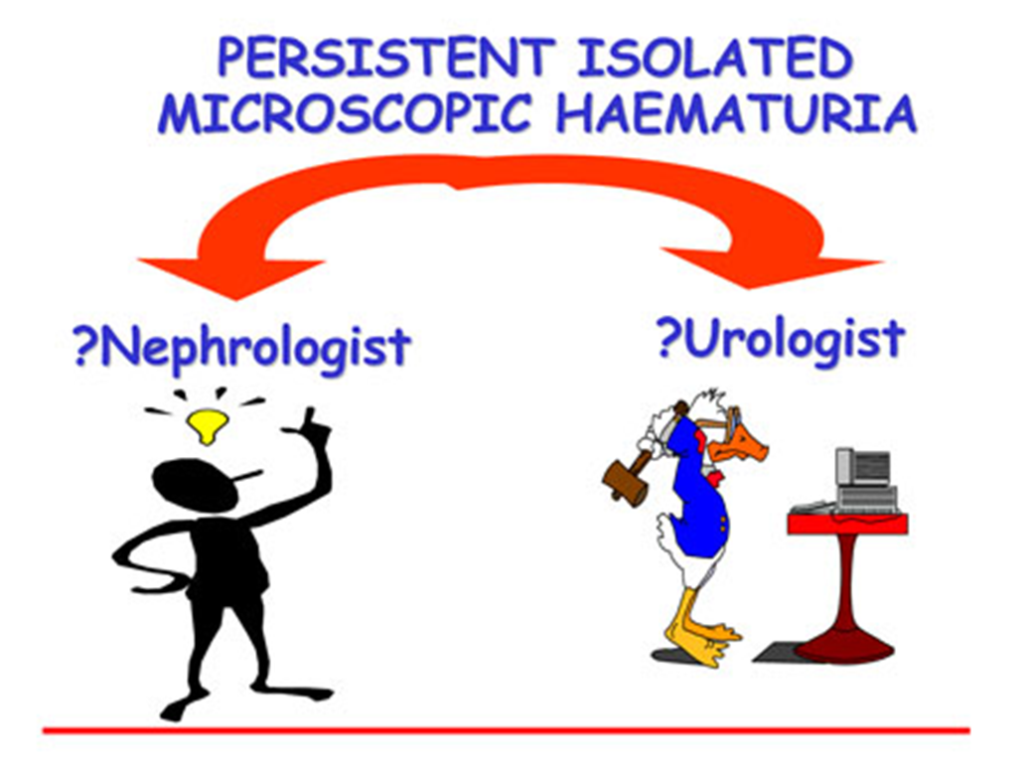
Indications for Nephrology Referral
http://www.ndt-educational.org/fogazzislidepart2.asp

Slide 8
All of the following adult patients should be referred for nephrology consultation, EXCEPT?
A. Initial visit: eGFR 26 & 3 months later: eGFR 28 (mL/min/1.73m2)
B. Initial visit: eGFR 55, & 3 months later: eGFR 43 confirmed with repeat eGFR 45 (mL/min/1.73m2)
C. Initial visit: ACR 450 & 3 months later: ACR 355 (mg/g) on both dates the eGFR > 60 mL/min/1.73m2
D. Initial visit: eGFR > 60 & 3 months later: eGFR > 60 (mL/min/1.73m2) with personal history of Autosomal Dominant Polycystic Kidney Disease.
E. Initial visit: eGFR 42 & 3 months later: eGFR 44 (mL/min/1.73m2) on both dates the ACR < 30 mg/g.
Notes:
The correct answer is E. This patient has CKD G3bA1 with no indication for nephrology referral. Answer B is incorrect as the eGFR trend reflects rapid progression of CKD, which is defined as a sustained decline of more than 5 ml/min/1.73 m² per year. Answer A and C are incorrect with low eGFR (G4) and severe albuminuria (A3) as indications for nephrology referral, respectively. Answer D is incorrect as a hereditary cause of CKD.

Slide 9
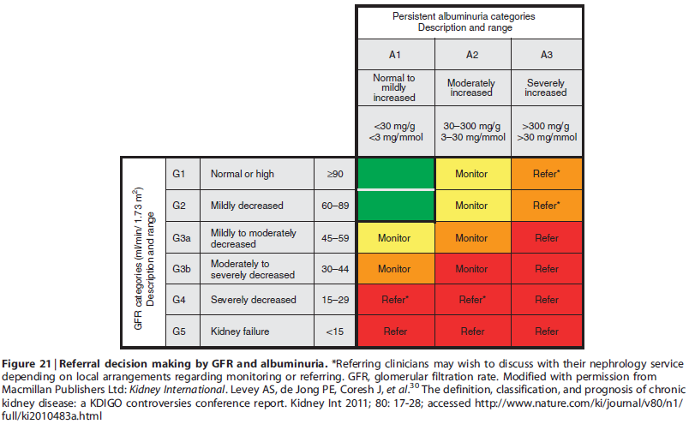
Referral to Nephrology by CKD Stage

Slide 10
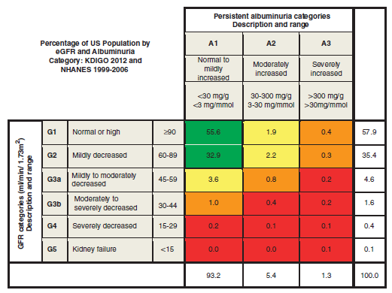
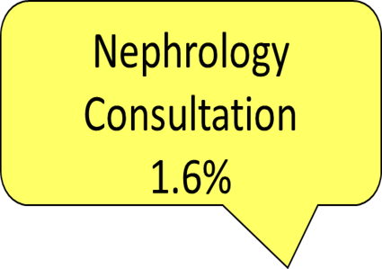


Percent of U.S. Population
by CKD Screening Result
Kidney Disease: Improving Global Outcomes (KDIGO) CKD Work Group. KDIGO 2012 Clinical Practice Guideline for the Evaluation and Management of Chronic Kidney Disease.
Kidney inter., Suppl. 2013; 3: 1-150.

Slide 11
Indications for referral to specialist kidney care services for people with CKD
Acute kidney injury or abrupt sustained fall in GFR
GFR <30 ml/min/1.73 m2 (GFR categories G4-G5)
Persistent albuminuria (ACR > 300 mg/g)*
Progression of CKD**
Urinary red cell casts, RBC more than 20 per HPF sustained and not readily explained
CKD and hypertension refractory to treatment with 4 or more antihypertensive agents
Persistent abnormalities of serum potassium
Recurrent or extensive nephrolithiasis
Hereditary kidney disease
*Significant albuminuria is defined as ACR ≥300 mg/g (≥30 mg/mmol) or AER ≥300 mg/24 hours, approximately
equivalent to PCR ≥500 mg/g (≥50 mg/mmol) or PER ≥500 mg/24 hours
**Progression of CKD is defined as one or more of the following: 1) A decline in GFR category accompanied by a 25%
or greater drop in eGFR from baseline; and/or 2) rapid progression of CKD defined as a sustained decline in eGFR of more
than 5ml/min/1.73m²/year. KDOQI US Commentary on the 2012 KDIGO Evaluation and Management of CKD.

Slide 12
Late nephrology referral before the onset
of chronic kidney failure remains common.
U.S. data from 2011 reveal 42.1% of
new dialysis starts had no prior
nephrology care.*
*USRDS 2013 Annual Data Report: Table 1.f (Volume 2)
Page 430 Analytical Methods
www.usrds.org
Notes:
12
Forty-two percent of patients starting ESRD therapy in 2011 had not seen a nephrologist prior to initiation. Of these patients, 51 percent initiated with a catheter and only 10.5 percent with a mature fistula; 32 and 37 percent, respectively, had either a maturing fistula or maturing graft. Patients with more than one year of pre-ESRD nephrologist care, in contrast, were far more likely to initiate with a mature fistula, at 50.2 percent. • Table 1.f; see page 430 for analytical methods. Incident ESRD patients, 2011; eGFR calculated using the CKD-EPI equation.

Slide 13
A 42-year-old African American man with diabetic nephropathy and hypertension has a stable eGFR of 25 mL/min/1.73m2. Observational Studies of Early as compared to Late Nephrology Referral have demonstrated which of the following?
A. Reduced 1-year Mortality
B. Increase in Mean Hospital Days
C. No change in serum albumin at the initiation of dialysis or kidney transplantation
D. Decrease in hematocrit at the initiation of dialysis or kidney transplantation
E. Delayed referral for kidney transplantation
Notes:
Answer: A
There are no randomized trials of early versus late nephrology referral in the literature. Interpretation of the approximately 50 published observational studies that assessed the timing of nephrology services and outcomes is complicated by heterogeneity in study design and variable definitions of early referral. The minimum of 3 months is probably less than the absolute amount of time required for assessment, education and preparation for RRT. A meta-analysis of 22 observational studies from 10 different countries found one year mortality was significantly reduced, 13 versus 29%, making answer A correct. This meta-analysis also showed early referral was associated with significantly fewer mean hospital days, higher serum albumin at initiation of RRT and higher hematocrit at RRT initiation. Thus, answers B, C, and D are incorrect, respectively. Greater choice of treatment options, including home hemodialysis, peritoneal dialysis and pre-emptive kidney transplantation, are associated with early initiation of nephrology services, making answer E incorrect.

Slide 14
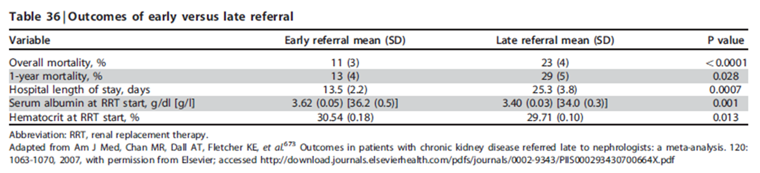
Observational Studies of
Early vs. Late
Nephrology Consultation

Slide 15
A 42-year-old African American man with diabetic nephropathy and hypertension has a stable eGFR of 25 mL/min/1.73m2. A patient safety approach that considers the level of kidney function includes all of the following, EXCEPT?
A. Avoidance of nonsteroidal anti-inflammatory drugs for analgesia
B. Discontinuation of metformin
C. Intravenous isotonic sodium chloride to reduce the risk of AKI following iodinated contrast media exposure for acute coronary syndrome.
D. Avoidance of aspirin 81 mg daily for cardiovascular prophylaxis
E. Avoidance of sodium phosphate bowel preparations for routine colonoscopy surveillance.
Notes:
The correct answer is D. Routine daily aspirin prophylaxis for CVD is not contraindicated in CKD. Nonsteroidal anti-inflammatory drugs (ibuprofen, naproxen) use should generally be avoided since they are a cause of AKI in CKD, especially when combined with diuretics or ACEI and ARB therapy (Answer A). The risk of lactic acidosis in CKD patients treated with Metformin poses a contraindication to its use when the eGFR is less than 30 ml/min/1.73m² (Answer B). For patients with eGFR between 30 to 60 ml/min/1.73m² this biguanine should be used with caution. Intravenous isotonic sodium chloride (or sodium bicarbonate) administration is an evidenced-based prophylactic measure for a patient with CKD who requires iodinated contrast administration for cardiac catheterization. (Answer C). Other considerations to reduce the risk of contrast-induced AKI include avoidance of high osmolar agents, use of the lowest possible contrast dose, and withdrawal of diuretics before and after the procedure. Sodium phosphate oral bowel preparations should be avoided, since these are associated with acute phosphate nephropathy in CKD and in diabetic patients with normal kidney function treated with ACEIs and ARBs (Answer E).

Slide 16
Prevention of Contrast-induced AKI (CI-AKI)
1. Assess Risk
Assess the risk for CI-AKI and, in particular, screen for pre-existing impairment of kidney function in all patients who are considered for a procedure that requires intravascular (i.v. or i.a.) administration of iodinated contrast medium. (Not Graded)
2. Consider alternative imaging methods
Consider alternative imaging methods in patients at increased risk for CI-AKI. (Not Graded)
3. Volume Expansion
We recommend i.v. volume expansion with either isotonic sodium chloride or sodium bicarbonate solutions, rather than no i.v. volume expansion, in patients at increased risk for CI-AKI. (Evidence Level 1A)
Kidney Disease: Improving Global Outcomes Acute Kidney Injury Work Group
KDIGO Clinical Practice Guideline for Acute Kidney Injury
Kidney Inter, Suppl. 2012; 2; 1-138

Slide 17
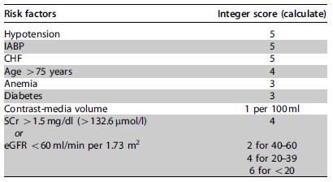
CI-AKI risk-scoring model for percutaneous coronary intervention
Note: Low risk: cumulative score o5; high risk: cumulative score 416. CHF, congestive heart failure; eGFR, estimated glomerular filtration rate; IABP, intraaortic balloon pump; SCr, serum creatinine. Reprinted from Mehran R, Aymong ED, Nikolsky E et al. A simple risk score for prediction of contrast-induced nephropathy after percutaneous coronary intervention: development and initial validation. J Am Coll Cardiol 2004; 44: 1393–1399 et al.,418 copyright 2004, with permission from American College of Cardiology Foundation; accessed http://content.onlinejacc.org/
cgi/content/full/44/7/1393

Slide 18
CKD Patient Safety Issues
Medication errors
  Toxicity (nephrologic or other)
  Improper dosing
  Inadequate monitoring
Electrolytes
  Hyperkalemia
  Hypoglycemia
  Hypermagnesemia
  Hyperphosphatemia
Miscellaneous
  Multidrug-resistant infections
  Vessel preservation/dialysis access
Diagnostic tests
  Iodinated contrast media: AKI
  Gadolinium-based contrast: NSF
  Sodium Phosphate bowel preparations: AKI, CKD
CVD
  Missed diagnosis
  Improper management
Fluid management
  Hypotension
  AKI
  CHF exacerbation
AKI = acute kidney injury; CHF = congestive heart failure; NSF = nephrogenic systemic fibrosis.
Fink JC, Brown J, Hsu, VD, et al. CKD as an underrecognized threat to patient safety. Am J Kidney Dis 2009;53:681-668.
Notes:
Sequalea of the disease that are improperly managed to consequences of misguided therapeutic interventuions
Fink
18

Slide 19
Who Should be Involved in the
Patient Safety Approach to CKD?
Kidney
damage and normal or ↑ GFR
Kidney
damage and
mild ↓
GFR
Moderate
↓ GFR
Severe
↓ GFR
Kidney
failure
Stage 1 Stage 2 Stage 3 Stage 4 Stage 5
GFR 90 60 30 15
Primary Care Practitioner
Nephrologist
Consult?
Patient safety
The Patient (always)
and other subspecialists (as needed)

Slide 20
Impact of primary care CKD detection with a patient safety approach
Patient Safety
Following
CKD detection
Am J Kidney Dis 2009,53:681-668
Notes:
Sequalea of the disease that are inproperly managed to consequences of misguided therapeutic interventuions
Jeff Fink
20

Slide 21
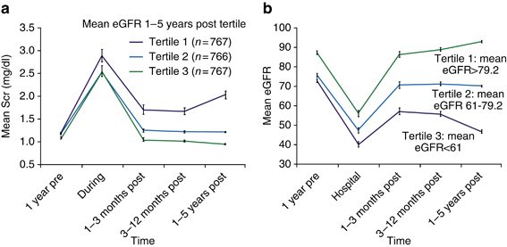
AKI and CKD Integration:
Severity of AKI and CKD
Effect of severity of acute kidney injury (AKI) on outcomes. AKI patients who survived for 1 year. (a) Mean eGFR over time (tertiles). (b) AKI patients who survived for 1 year. Mean serum creatinine (Scr) over time (tertiles). Tertiles were defined based on Scr at 1–5 years post admission. Error bars show the 95% confidence interval at each time point.
Chawla, LS; Kimmel, PL Acute kidney injury and chronic kidney disease: an integrated clinical syndrome
Kidney Int., 2012 vol. 82(5) pp. 516-24
Notes:
These new Guidelines:
Defined CKD and established a CKD classification based on severity as indicated by glomerular filtration rate (GFR)
Described issues related to measurement of kidney function that had previously not been identified by the clinical community
Staging of CKD provided a common language for kidney disease that would :
Facilitate new research;
Provide clinicians with a stage-specific clinical action plan;
Provide a framework for developing a public health approach toward resolution.
Publication of the guidelines revolutionized the concept of CKD and made early diagnosis and treatment more likely.

Slide 22
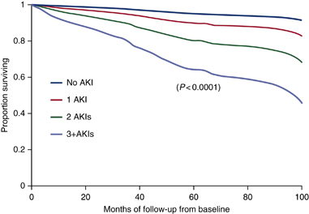
AKI and CKD Integration:
Frequency of AKI and CKD
Effect of acute kidney injury (AKI) frequency on outcomes. Survival to stage 4 chronic kidney disease (CKD) in no AKI vs. multiple AKI episode groups.
Chawla, LS; Kimmel, PL Acute kidney injury and chronic kidney disease: an integrated clinical syndrome
Kidney Int., 2012 vol. 82(5) pp. 516-24
Notes:
These new Guidelines:
Defined CKD and established a CKD classification based on severity as indicated by glomerular filtration rate (GFR)
Described issues related to measurement of kidney function that had previously not been identified by the clinical community
Staging of CKD provided a common language for kidney disease that would :
Facilitate new research;
Provide clinicians with a stage-specific clinical action plan;
Provide a framework for developing a public health approach toward resolution.
Publication of the guidelines revolutionized the concept of CKD and made early diagnosis and treatment more likely.

Slide 23
AKI and Nephrology Consultation
AKI Survivors Following Discharge within 30 days
  11.9% Nephrology follow up
  29.5% Cardiology follow up
  74.5% Primary care visit
AKI Requiring Dialysis Survivors Following Discharge
  33% Nephrology visit within 30 days
  48.6% Nephrology visit within 1 year
Acute Myocardial Infarction Survivors After Discharge
  - 76% Cardiology Consultation within 30 days
Chawla, LS; Kimmel, PL Acute kidney injury and chronic kidney disease: an integrated clinical syndrome
Kidney Int., 2012 ; 82(5) :516-24
Notes:
We recommend that hospital survivors of AKI who experience severe AKI (AKIN stage III) be followed up by a nephrologist
after discharge. Currently, this does not occur. At 30 days after discharge from the hospital with an episode of AKI, 74.5% of
patients were seen by a primary physician compared with 11.9% and 29.5%, respectively, who were seen by a nephrologist
or a cardiologist.82 Surprisingly, only about one-third of AKI patients requiring dialysis (AKIN stage III) are seen by a
nephrologist within 30 days of discharge. This increases to 48.6% within 1 year of discharge, which is likely a result of a
rising serum creatinine.82 Overall, a very small fraction of AKI patients are currently followed up by nephrologists after
hospital discharge.82 To put this into context, an assessment of the nephrology follow-up of AKI survivors as compared with
the cardiology follow-up of myocardial infarction survivors reveals a stark difference (11.9% vs. 76%, respectively).31,82 At
the very least, we should continue to see our patients. Monitoring patients for blood pressure control, the use of
drugs that interfere with the renin–angiotensin system, and avoidance of nephrotoxins may prove critical as public health
measures, which may oppose current secular trends.

Slide 24
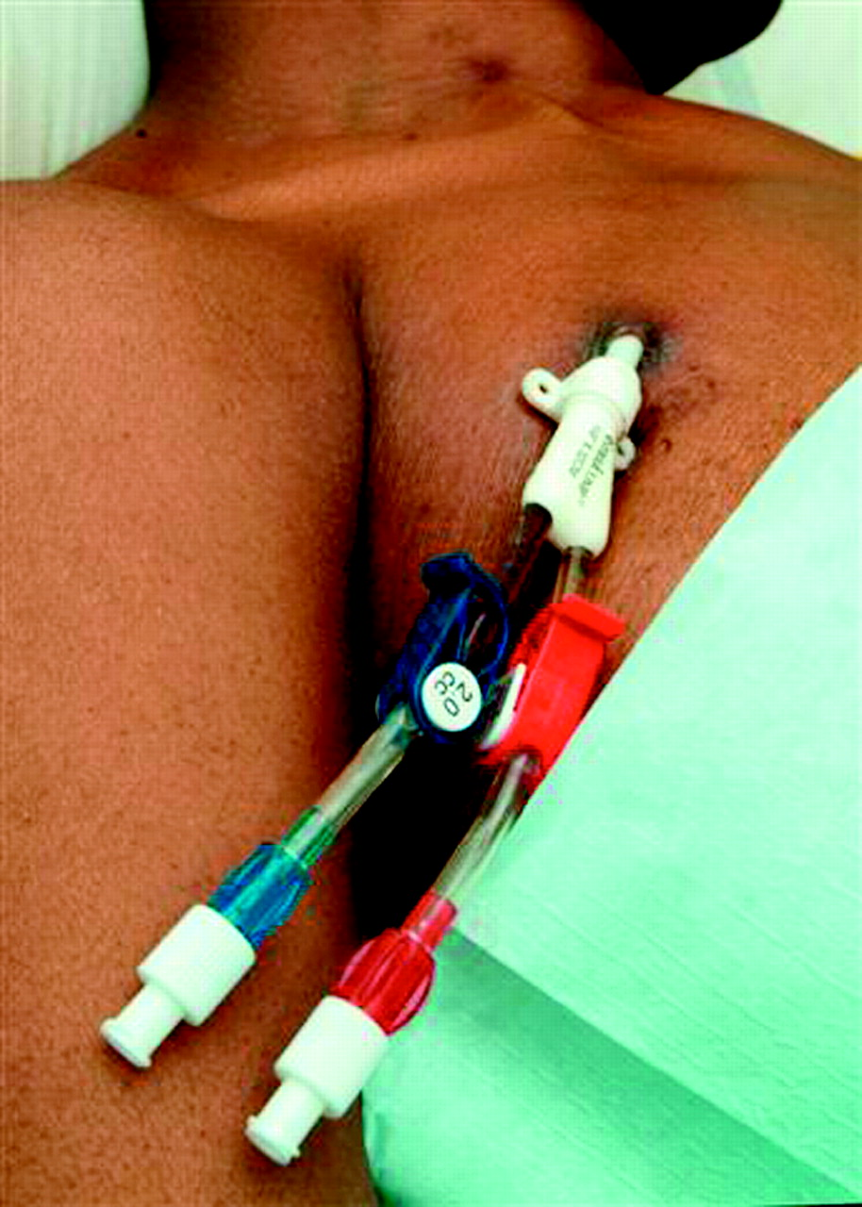
Know the Enemy
Catheter treated patients
  Higher mortality
  Increased bacteremia rates
  Increased hospitalization rates
  Increased costs
  (Even after adjustment)
CKD Vessel Preservation
  Avoid PICC lines in CKD G3b+
  Know the access plan
  Selected venipuncture
Rule of thumb eGFR 30-20-10*
  Nephrology Consultation
  Referral to vascular surgeon
  Initiation of dialysis
* HakimRL,Himmelfarb J:Hemodialysis access failure:
a call to action-revisited. Kidney Int 76:1040–1048, 2009
BMJ 332:1435, 2006

Slide 25
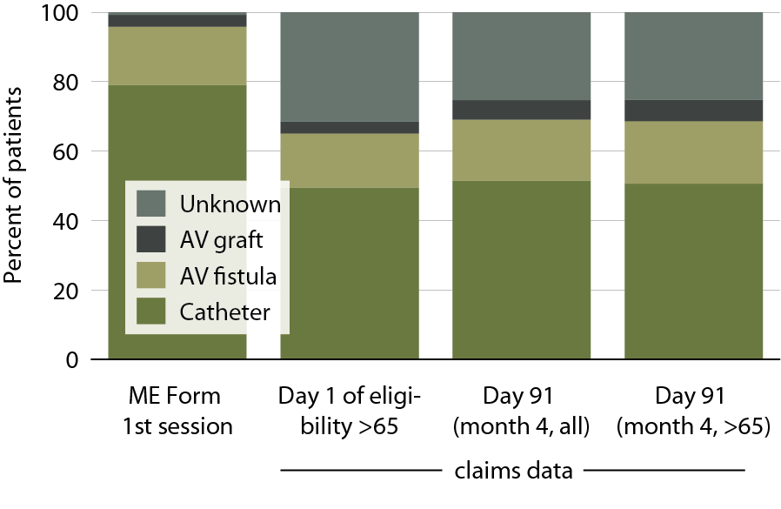
Access use at first outpatient hemodialysis, 2011
Figure 1.21 (Volume 2)
78% of hemodialysis patients
start with a dialysis catheter!
Incident ESRD patients, 2011. United States Renal Data System Annual Data Report, 2013 www.usrds.org

Slide 26
Collaborative Care Agreements
Soft Contract between primary care and nephrologist
Defines responsibilities of primary care (examples follow)
  Provide pertinent clinical information to inform the consultation prior to the scheduled visit.
  Initiate a phone call if the condition is emergent
  Provide timely referrals with adequate number of visits to treat the condition.
Defines responsibilities of nephrologist (examples follow)
  Timely communication of consultation (7 days routine & 48 hours emergent) – fax if no electronic information sharing
  No consultation to other specialist initiated without primary care input
*Detailed Collaborative Care Agreements for Primary and Specialty Care are available upon request.

Slide 27
Indications for referral to specialist kidney care services for people with CKD
Acute kidney injury or abrupt sustained fall in GFR
GFR <30 ml/min/1.73 m2 (GFR categories G4-G5)
Persistent albuminuria (ACR > 300 mg/g)*
Progression of CKD**
Urinary red cell casts, RBC more than 20 per HPF sustained and not readily explained
CKD and hypertension refractory to treatment with 4 or more antihypertensive agents
Persistent abnormalities of serum potassium
Recurrent or extensive nephrolithiasis
Hereditary kidney disease
*Significant albuminuria is defined as ACR ≥300 mg/g (≥30 mg/mmol) or AER ≥300 mg/24 hours, approximately
equivalent to PCR ≥500 mg/g (≥50 mg/mmol) or PER ≥500 mg/24 hours
**Progression of CKD is defined as one or more of the following: 1) A decline in GFR category accompanied by a 25%
or greater drop in eGFR from baseline; and/or 2) rapid progression of CKD defined as a sustained decline in eGFR of more
than 5ml/min/1.73m²/year. KDOQI US Commentary on the 2012 KDIGO Evaluation and Management of CKD.

Slide 28
Co-management may be useful in areas of uncertainty with advanced age and CKD.
Is your patient a dialysis candidate?

Slide 29
A 75-year old wheel-chair bound woman with left hemiparesis after CVA has co-morbidities of advanced dementia, hypertension, and type-2 diabetes. Over the
last year the eGFR is approximately 25 ml/min/1.73m²
Her daughter asks you about nephrology consultation
and the need for dialysis in the future.
A. Age
B. Dementia
C. Co-morbidities other than dementia
D. Frailty
E. All of the above
Notes:
Answer D: all of the above. See subsequent slides. Co-management may be helpful in areas of uncertainty.

Slide 30
Mean Life Expectancy by Quartile After
the Initiation of Dialysis by Age and Phenotype
Phenotype | 60-69 | 70-74 | 75-79 | 80-84 | 85-89 | 90+
25th Percentile Frail | 0.9 | 0.7 | 0.5 | 0.4 | 0.3 | 0.2
50th Percentile Vulnerable | 2.5 | 2.1 | 1.7 | 1.3 | 0.9 | 0.6
75th Percentile Healthy | 4.6 | 4.3 | 3.7 | 3.0 | 2.3 | 1.7
The cardiovascular Health Study developed a frailty clinical tool, in the 65-years and older study population, defined as at least 3 of 5 components:
1) unintentional weight loss, 2) exhaustion, 3) low physical activity, 4) slow gait, and 5) weakness.
Bottom Line – Functional Age rather than Age alone
Tamura MK, Tan J, O’Hare AM. Optimizing renal replacemnt therapy in older adults: A framework for making individualized decisions. Kidney Int 2012; 82:261-269.
Notes:
The frailty phenotype measure by Fried et al. (17) is a useful screening and research tool for physical frailty, but it does not incorporate other contributors to frailty, such as cognitive decline or comorbidities (26), which can drive the Cycle of Frailty. For any particular age group, dialysis patients can be divided into quartiles with differences in life expectancy (33) (Table 1). Parallel healthy (75th to 100th percentile), vulnerable (25th to 75th percentile), and frail (0 to 25th percentile) renal phenotypes have been described (Table 2) to improve decision-making and supportive/palliative renal management (28,34). The frail renal phenotype (Table 3) is a useful global construct that combines geriatric susceptibility factors (dementia, inability to ambulate, positive physical frailty testing, hypoalbuminemia, and significant symptom burden), survival data, and comorbidity information (2,34–38). Identifying this phenotype provides useful information relevant to the shared decision-making ESRD treatment discussion. Can this phenotype be considered an EOL diagnosis? Qualitatively, it can. Although the quantitative prognosis may be uncertain, it is important to implement an advance care plan (ACP) (34).
Frailty is a risk factor for disability and comorbidity but may exist independently of both (17). A useful conceptual model is the Cycle of Frailty (24) (Figure 1) that is activated through trigger points of entry by intervening health events and continues to recycle after the event has terminated. At 6 months after an episode of septicemia or long bone fracture, dialysis patients have adjusted relative risks of death of 7.1 and 3.2, respectively, compared with a reference nonevent (no septicemia or long bone fracture) dialysis population (25). As the number of acute health events increases, the frailty cycle will accelerate to its end points of dependence, disability, and death.
The Cardiovascular Health Study, a longitudinal observational study in a geriatric outpatient ≥65-years-old patients community, operationalized a frailty clinical tool or frailty phenotype comprising five components: unintentional weight loss, exhaustion, low physical activity, slow gait, and weakness; a positive test requires the presence of at least three of five components, and one to two of five components signifies a prefrail state (17). The frailty phenotype had an overall prevalence of 6.9% (16.3% in those patients 80–84 years old and 25.7% in those patients 85–89 years old), with a 4-year incidence of 7.2%. It was an independent predictor (HRs estimated over 3 years in parentheses; all significance levels at P<0.05) for incident falls (1.29), worsening mobility (1.50), Activities of Daily Living (ADL) disability (1.98), hospitalization (1.29), and death (2.24). Of those patients who tested positive for frailty, 27% had neither ADL disability nor comorbidity (two or more comorbidities). Additionally, those patients who were prefrail at baseline (46.6%) had an adjusted odds ratio of 2.63 of becoming frail in the next 3–4 years compared with those patients who had no frailty components (17). It must be emphasized that the operational definition of frailty varies widely according to the conceptual framework, and no gold standard exists (14,26).

Slide 31
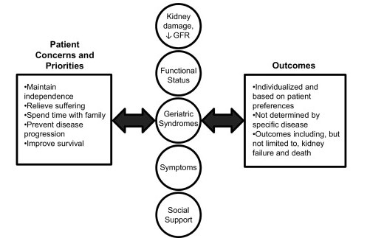
Individualized Patient-centered Approach for Older Adults with CKD
Bowling CB, O’Hare AM. Managing older adults with CKD: individualized versus disease-based approach.
Am J Kidney Dis. 2012;59(2):293-302.
Notes:
The last decade has seen the evolution and ongoing refinement of a disease-oriented approach to chronic kidney disease (CKD). Disease-oriented models of care assume a direct causal association between observed signs and symptoms and underlying disease pathophysiologic processes. Treatment plans target underlying disease mechanisms with the goal of improving disease-related outcomes. Because average glomerular filtrate rates tend to decrease with age, CKD becomes increasingly prevalent with advancing age and those who meet criteria for CKD are disproportionately elderly. However, several features of geriatric populations may limit the utility of disease-oriented models of care. In older adults, complex comorbid conditions and geriatric syndromes are common; signs and symptoms often do not reflect a single underlying pathophysiologic process; there can be substantial heterogeneity in life expectancy, functional status, and health priorities; and information about the safety and efficacy of recommended interventions often is lacking. For all these reasons, geriatricians have tended to favor an individualized patient-centered model of care over more traditional disease-based approaches. An individualized approach prioritizes patient preferences and embraces the notion that observed signs and symptoms often do not reflect a single unifying disease process and instead reflect the complex interplay between many different factors. This approach emphasizes modifiable outcomes that matter to the patient. Prognostic information related to these and other outcomes generally is used to shape rather than dictate treatment decisions. We argue that an individualized patient-centered approach to care may have more to offer than a traditional disease-based approach to CKD in many older adults.

Slide 32
Additional Reading?
To learn more about the entire guideline statements:
  Kidney Disease Improving Global Outcomes (KDIGO) CKD Work Group. KDIGO 2012 Clinical Practice Guideline for the Evaluation and Management of Chronic Kidney Disease. Kidney inter., Suppl. 2013; 3: 1-150.
  http://www.ajkd.org/article/S0272-6386(14)00491-0/fulltext
  KDOQI U.S. Commentary on the 2012 KDIGO Clinical Practice Guideline for the Evaluation and Management of CKD. Am J Kidney Dis 2014 (epub 18 March 2014)

Slide 33

Notes:
6/23/14
33

Slide 34
Questions?

Slide 35


