Slide 1

Evaluation and Management of Hyperkalemia
This presentation was funded by and created in collaboration with Relypsa
Notes:
Thank you for your interest in this educational activity, entitled “Evaluation and Management of Hyperkalemia.” This activity describes the pathophysiology of hyperkalemia and addresses appropriate clinical evaluation and management. This educational resource includes PowerPoint slides and speaker notes. This presentation was funded by and created in collaboration with Relypsa.

Slide 2
Agenda
Pathogenesis of Hyperkalemia
Evaluation of Hyperkalemia
Hyperkalemia Management
Notes:
The agenda topics for this program includes the pathogenesis, evaluation, and management of hyperkalemia.

Slide 3
Learning Objectives
Describe the pathophysiology of hyperkalemia
Understand hyperkalemia-associated risk factors, including kidney disease
Discuss evaluation and methods of testing for hyperkalemia
Discuss treatment strategies in kidney disease patients with hyperkalemia
Notes:
The learning objectives for this activity include:
*Describe the pathophysiology of hyperkalemia
*Understand hyperkalemia-associated risk factors, including kidney disease
*Discuss evaluation and methods of testing for hyperkalemia
*Discuss treatment strategies in kidney disease patients with hyperkalemia

Slide 4
Pathogenesis of Hyperkalemia
Notes:
The next section of this program will address the pathogenesis of hyperkalemia.

Slide 5
Hyperkalemia
A potentially serious medical condition in which elevated serum potassium levels can increase the risk of severe cardiac electrophysiology abnormalities (e.g., cardiac arrhythmias) and sudden death
Notes:
Potassium is an essential dietary mineral that is required for the maintenance of cell membrane potential, ion and solute transport, and the regulation of cell volume.
Hyperkalemia is a serious medical condition in which elevated potassium levels can lead to severe cardiac electrophysiology alterations, such as cardiac arrhythmias, and sudden death. Hyperkalemia is encountered more frequently in current medical practices because common chronic diseases, such as diabetes and chronic kidney disease, are associated with disturbance of potassium homeostasis.

Slide 6
Hyperkalemia
Can result from one or a combination of these factors:
  Abnormal net release of potassium from cells
  Impaired distribution between intracellular and extracellular spaces
  Impairment of potassium excretory process
  Increased potassium load
Dunn J, et al. Am J Manag Care. 2015;21:s307-s315.
Allon M. NKF Primer on Kidney Diseases. 2014.
Notes:
Hyperkalemia can be caused by an abnormal net release of potassium from cells, often due to trauma, metabolic acidosis, hemolytic states, or other cell degradations. Hyperkalemia may also result from impaired distribution between the intracellular and extracellular spaces, as well as increased potassium intake, reduced renal excretion, or a combination of several of these factors.
1. Dunn J, Benton W, Orozco-Torrentera E, Adamson R. The burden of hyperkalemia in patients with cardiovascular and renal disease. Am J Manag Care. 2015;21(15 Suppl):s307-s315.
2. Allon M. Disorders of Potassium Metabolism. In: Gilbert S, Weiner D, Gipson D, Perazella M, Tonelli M., eds. National Kidney Foundation. Primer on kidney diseases. 6th ed. Philadelphia, PA: Saunders Elsevier; 2014.

Slide 7
Causes of Hyperkalemia
Pseudohyperkalemia
  Hemolysis
  Thrombocytosis
  Severe Leukocytosis
  Fist clenching (venipuncture)
Abnormal Potassium Distribution
  Insulin Deficiency
  Beta-blockers
  Metabolic or respiratory acidosis
  Familial hyperkalemic periodic paralysis
Abnormal Potassium Release from Cells
  Rhabdomylosis
  Tumor Lysis syndrome
Decreased Renal Excretion
  Acute or Chronic kidney disease
  Diseases that impact kidney function (e.g., lupus)
  Aldosterone deficiency
  Adrenal insufficiency
  Heart failure
  Drugs that inhibit potassium excretion
Modified from Allon M. NKF Primer on Kidney Diseases. 2014.
Notes:
This slide provides a list of specific possible causes of hyperkalemia, including comorbid conditions and medications. Patients with hyperkalemia can have multiple contributory factors. It is important to understand the multiple causes of hyperkalemia in order to address the disorder.
Pseudohyperkalemia is a fractious elevation of serum potassium due to in vitro release of potassium from blood cells.
1. Allon M. Disorders of Potassium Metabolism. In: Gilbert S, Weiner D, Gipson D, Perazella M, Tonelli M., eds. National Kidney Foundation. Primer on kidney diseases. 6th ed. Philadelphia, PA: Saunders Elsevier; 2014.

Slide 8
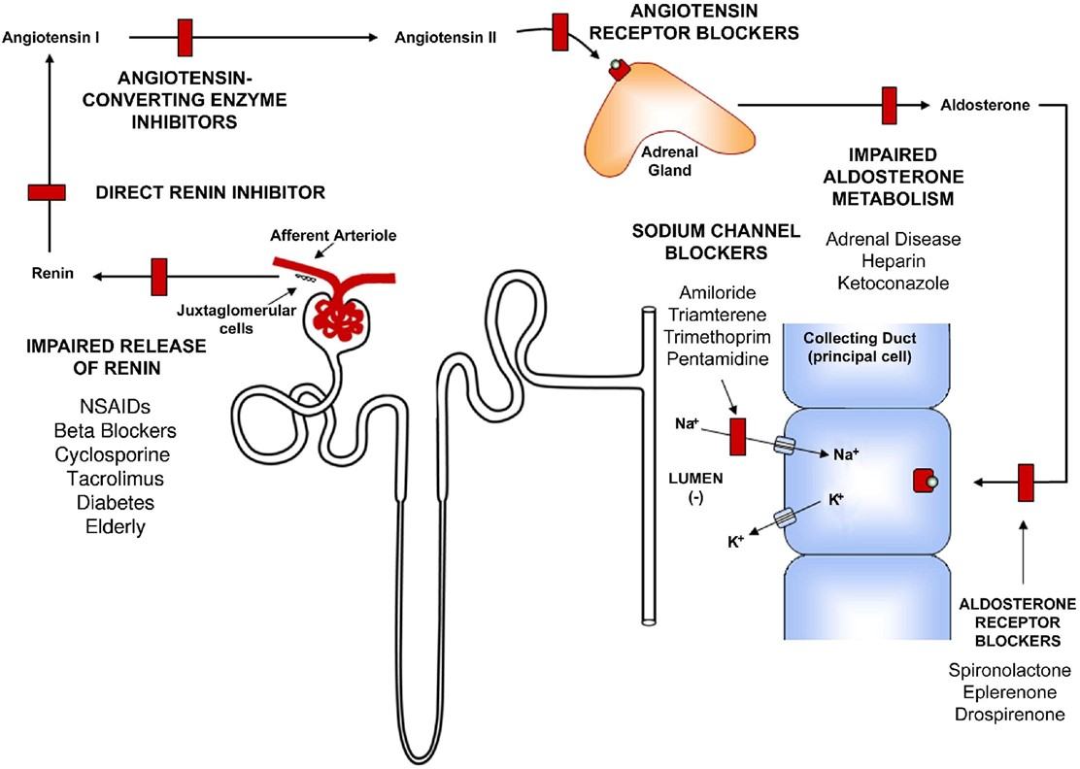
Pathogenesis of Hyperkalemia: RAAS and Potassium Excretion
RAAS, renin-angiotensin-aldosterone system
Palmer B. Am J Kidney Dis. 2010;56:387-393.
Notes:
The kidneys play a major role in maintaining potassium homeostasis by matching potassium intake with potassium excretion. Potassium is freely filtered by the glomerulus and 90-95% is reabsorbed in the proximal tubule and loop of Henle. Urinary excretion of potassium begins in the distal convoluted tubule and is further regulated by the distal nephron and collecting duct. Therefore, loss of nephron function due to kidney disease results in renal retention of potassium. The main regulators of this process are aldosterone and serum potassium level.
This slide outlines pathogenesis of hyperkalemia, as it relates to the renin-angiotensin-aldosterone system (RAAS) and potassium excretion. Aldosterone binds to a cytosolic receptor in the principal cell and stimulates sodium (Na) reabsorption across the luminal membrane through a well-defined sodium channel. As sodium is reabsorbed, the electronegativity of the lumen increases, thereby providing a more favorable driving force for potassium secretion through an apically located potassium channel. The permeability of the anion that accompanies sodium also influences potassium secretion, with less permeable anions having a greater stimulatory effect on potassium secretion. Disease states or drugs that interfere at any point along this system can impair renal potassium secretion and increase the risk of hyperkalemia. In many patients, this risk is magnified because of disturbances at multiple sites along this system.
1. Palmer B. A physiologic-based approach to the evaluation of a patient with hyperkalemia. Am J Kidney Dis. 2010;56:387-393.

Slide 9
Drugs Known to Induce Hyperkalemia
Method of Induction | Examples
Drug-inducing transmembrane potassium movement | Non-selective beta blockers Digoxin intoxication Intravenous cationic amino acids Mannitol Suxamethonium
Drugs that affect aldosterone secretion | ACE inhibitors ARBs Direct renin inhibitors NSAIDs and COX-2 inhibitors Calcineurin inhibitors
Drugs that cause tubular resistance to the action of aldosterone | Aldosterone antagonists Potassium-sparing diuretics Trimethoprim, pentamidine
Potassium-containing agents | Salt substitutes and alternatives Penicillin G, stored blood products
Ben Salem C, et al. Drug Saf. 2014;37:677-692.
Notes:
Dietary factors (high-potassium foods, additives, and/or salt substitutes) and comorbid conditions (e.g., CKD, heart failure, Addison's disease) can contribute to hyperkalemia. However, drug-induced hyperkalemia is considered the most important cause of high potassium in everyday clinical practice. A wide range of drugs can induce hyperkalemia by a variety of mechanisms. Many of these medications can inhibit potassium removal and secretion, while others contain potassium thus increasing serum levels of potassium.1
1. Ben Salem C, Badreddine A, Fathallah N, et al. Drug-induced hyperkalemia. Drug Saf. 2014;37:677-692.

Slide 10
Hyperkalemia and CKD
Patients with CKD are at higher risk for hyperkalemia, due to their decreased ability to excrete potassium, and the presence of other comorbid/predisposing conditions (e.g., diabetes, CVD)
Hyperkalemia has been reported as high as 40-50%, in CKD patients (compared to 2-3% in the general population)
Kovesdy C. Nat Rev Nephrol. 2014;10:653-662.
Notes:
Patients with reduced kidney function due to advanced CKD are at chronic risk for hyperkalemia, and as kidney disease progresses and renal function declines, the ability to achieve potassium homeostasis is significantly impaired. Hyperkalemia has been reported as high as 40-50%, in CKD patients (compared to 2-3% in the general population). CKD patients with the highest risk include those with diabetes, cardiovascular disease, advanced CKD, transplant recipients, and patients taking renin-angiotensin aldosterone system (RAAS) inhibitors.
1. Kovesdy CP. Management of hyperkalaemia in chronic kidney disease. Nat Rev Nephrol. 2014;10:653-662.

Slide 11
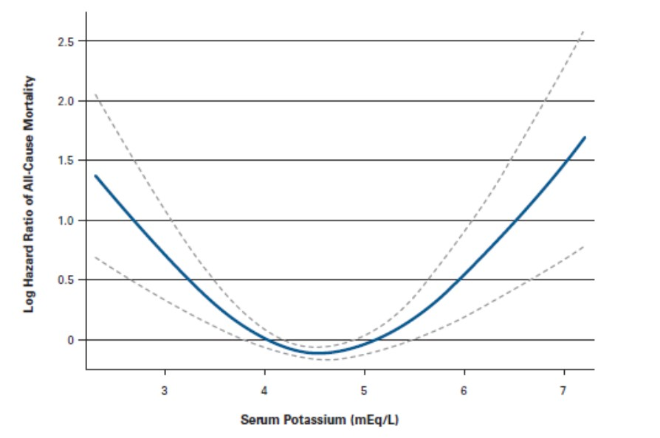
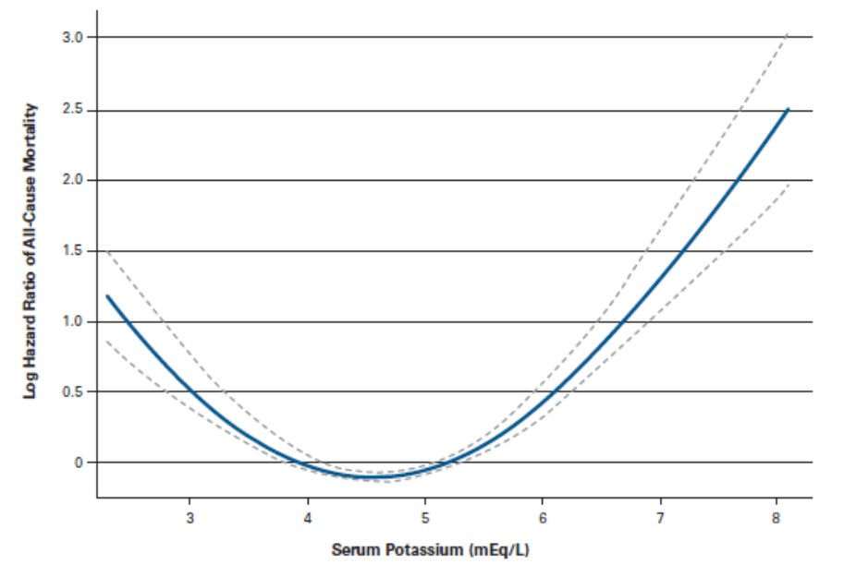
All-Cause Mortality Associated With Serum Potassium Levels in Patients with CKD
Non-Dialysis CKD¹
Dialysis²
Multivariable adjusted log hazards (solid line) and 95% confidence intervals (dashed lines) of all-cause predialysis mortality associated with serum potassium levels in the entire study population (n=1,227).
Association of serum potassium, used as a time-varying covariate, with mortality in patients undergoing peritoneal dialysis (n=10,454). Dashed lines represent 95% confidence intervals.
1) Hayes J, et al. Nephron Clin Pract. 2012;120:c8-c16.
2) Torlén K, et al. Clin J Am Soc Nephrol. 2012;7:1272-1284.
Notes:
Hyperkalemia has been associated with increased risk for mortality in both dialysis and non-dialysis CKD populations.1,2
Left Figure: Multivariable adjusted log hazards (solid line) and 95% confidence intervals (dashed lines) of all-cause predialysis mortality associated with serum potassium levels in the entire study population (n=1,227). The association of serum potassium with all-cause mortality in the overall patient population was significant and non-linear (p < 0.001 for the quadratic term), with regression splines showing an increase in mortality in association with both high and low serum potassium levels.1
Right Figure: Association of serum potassium, used as a time-varying covariate, with mortality in patients undergoing peritoneal dialysis (n=10,454). Dashed lines represent 95% confidence intervals. The trend, with increased death risk with both low and high levels, was observed in models that used serum potassium as time-varying.2
Hayes J, Kalantar-Zadeh K, Lu JL, Turban S, Anderson JE, Kovesdy CP. Association of Hypo- and Hyperkalemia with Disease Progression and Mortality in Males with Chronic Kidney Disease: The Role of Race. Nephron Clin Pract. 2012;120:c8-c16.
Torlén K, Kalantar-Zadeh K, Molnar MZ, Vashistha T, Mehrotra R. Serum Potassium and Cause-Specific Mortality in a Large Peritoneal Dialysis Cohort. Clin J Am Soc Nephrol. 2012;7:1272-1284.

Slide 12
Risk Factors for Hyperkalemia in CKD
Potassium intake
Metabolic acidosis
RAAS inhibition
Diabetes
Heart failure
Coronary artery and peripheral vascular disease
RAASi, renin-angiotensin-aldosterone system inhibitors.
Kovesdy C. Nat Rev Nephrol. 2014;10:653-662.
Notes:
In many cases, CKD, CVD, and diabetes do not occur in isolation. When multiple conditions are present, the nature of these disease, along with lifestyle choices and treatments, can increase the risk of hyperkalemia. In addition to a decrease in kidney function and disturbances in renal handling of potassium, CKD patients often have other factors and comorbidities that worsen hyperkalemia. This slide lists some of the main chronic risk factors for hyperkalemia in CKD.
1. Kovesdy CP. Management of hyperkalaemia in chronic kidney disease. Nat Rev Nephrol. 2014;10:653-662.

Slide 13
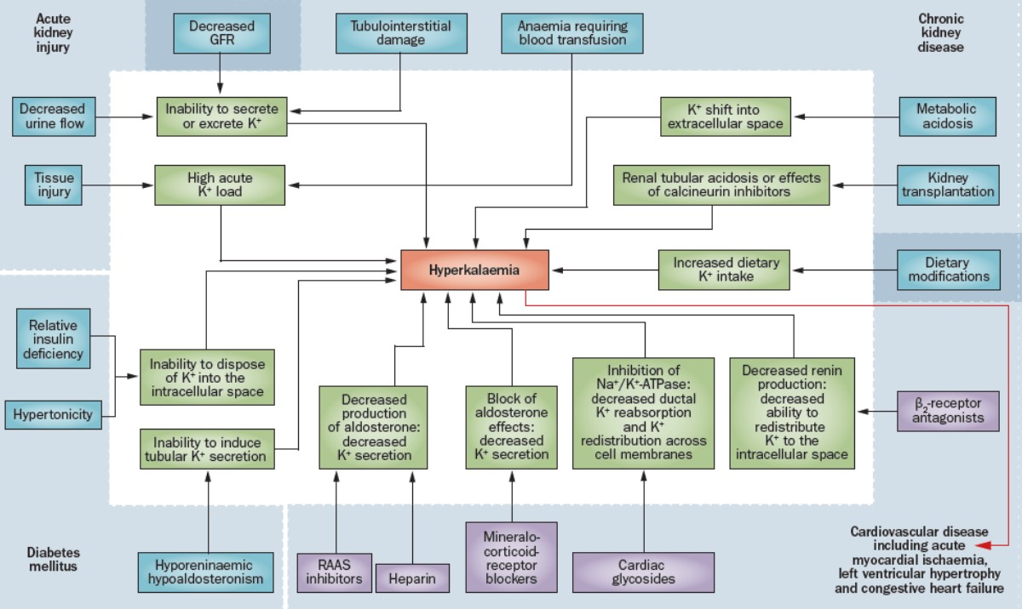
Mechanisms of Hyperkalemia in CKD
Kovesdy CP. Nat Rev Nephrol. 2014;10:653-662.
Notes:
Slide Figure: Mechanisms contributing to the development of hyperkalemia in patients with chronic kidney disease and associated comorbidities.1
This slide illustrates the comprehensive and complex nature of hyperkalemia in CKD.
Cardiovascular disease and other associated conditions, such as acute myocardial ischaemia, left ventricular hypertrophy and CHF, require various medical treatments that have been linked to hyperkalemia. Patients with CKD often have other conditions that exacerbate hyperkalemia, in addition to the decreased GFR and tubulointerstitial damage that prevent the kidneys from upregulating potassium excretion.1
1. Kovesdy CP. Management of hyperkalaemia in chronic kidney disease. Nat Rev Nephrol. 2014;10:653-662.

Slide 14
Evaluation of Hyperkalemia
Notes:
The next section will address the evaluation of hyperkalemia.

Slide 15
Hyperkalemia: Symptoms
Often asymptomatic, but patients may report non-specific symptoms, including palpitations, nausea, muscle pain, weakness, dyspnea, or paresthesia
Hyperkalemia can lead to disturbances of cardiac rhythm, which can be fatal
Viera A, Wouk N. Am Fam Physician. 2015;92:487-495.
Epstein M, et al. Am J Manag Care. 2015;21(11 Suppl):S212-S220.
Notes:
Hyperkalemia is rarely associated with symptoms. However, patients can report non-specific symptoms, including palpitations, nausea, muscle pain, or paresthesia (burning or prickling sensation). Hyperkalemia can lead to cardiotoxicity and death.
Viera A, Wouk N. Potassium Disorders: Hypokalemia and Hyperkalemia. Am Fam Physician. 2015;92:487-495.
Epstein M, Reaven N, Funk S, McGaughey K, Oestreicher N, Knispel J. Evaluation of the treatment gap between clinical guidelines and the utilization of renin-angiotensin-aldosterone system inhibitors. Am J Manag Care. 2015;21(11 Suppl):S212-S220.

Slide 16
Hyperkalemia: Serum Potassium Levels
Hyperkalemia is defined as a serum potassium level above the normal/reference range (3.0 - 5.0 mEq/L*)
Various cutoffs, such as >5.0, >5.5, or >6.0 mEq/L have been used to indicate different levels of severity
Severe hyperkalemia is most often defined as serum levels >6 mEq/L
*Reference range may vary by lab.
1) Kovesdy C. Nat Rev Nephrol. 2014;10:653-662.
Notes:
Hyperkalemia is defined as a serum potassium level above the normal range, and various cutoffs, such as >5.0, >5.5 or >6.0 mEq/L, have been used to indicate different levels of severity. The normal/reference range is 3.0 - 5.0 mEq/L, but reference ranges may vary slightly by lab. Severe hyperkalemia is most often defined as serum levels >6 mEq/L, and typically represents a clinical urgency or emergency, which may warrant immediate attention in the form of cardiac monitoring and acute medical interventions.
1. Kovesdy C. Management of hyperkalaemia in chronic kidney disease. Nat Rev Nephrol. 2014;10:653-662.

Slide 17
Acute Versus Chronic Hyperkalemia
Acute Hyperkalemia | Chronic Hyperkalemia
Requires immediate attention (e.g., cardiac monitoring, acute medical interventions, possibly dialysis) | Requires ongoing management to correct underlying disturbances in potassium balance (i.e., nonpharmacological and pharmacological interventions)
Kovesdy C. Nat Rev Nephrol. 2014;10:653-662.
Viera A, Wouk N. Am Fam Physician. 2015;92:487-495.
Notes:
This slide shows the different approaches to acute versus chronic hyperkalemia. Acute or severe hyperkalemia usually requires immediate attention such as cardiac monitoring, acute medical interventions, and possibly emergency dialysis. Chronic hyperkalemia develops over the course of weeks or months, may be persistent or develop periodically, and requires ongoing outpatient management to correct underlying disturbances in potassium balance (i.e., nonpharmacological and pharmacological interventions).
1. Viera A, Wouk N. Potassium Disorders: Hypokalemia and Hyperkalemia. Am Fam Physician. 2015;92:487-495.
2. Kovesdy C. Management of hyperkalaemia in chronic kidney disease. Nat Rev Nephrol. 2014;10:653-662.

Slide 18
Hyperkalemia Diagnosis
Clinical history
Physical examination
Review of medications
Assessment of cardiac function, kidneys, and urinary tract
Assessment of hydration status
Electrocardiogram
Comprehensive laboratory workup
Viera A, Wouk N. Am Fam Physician. 2015;92:487-495.
Notes:
The presence and severity of hyperkalemia has to be confirmed. The cause of hyperkalemia needs to be determined to prevent future episodes. Examination and investigations should include assessment of cardiac function, kidneys, and urinary tract as well as hydration status and neurological evaluation. Laboratory workup should be comprehensive, especially if the underlying cause is unknown.1
1. Viera A, Wouk N. Potassium Disorders: Hypokalemia and Hyperkalemia. Am Fam Physician. 2015;92:487-495.

Slide 19
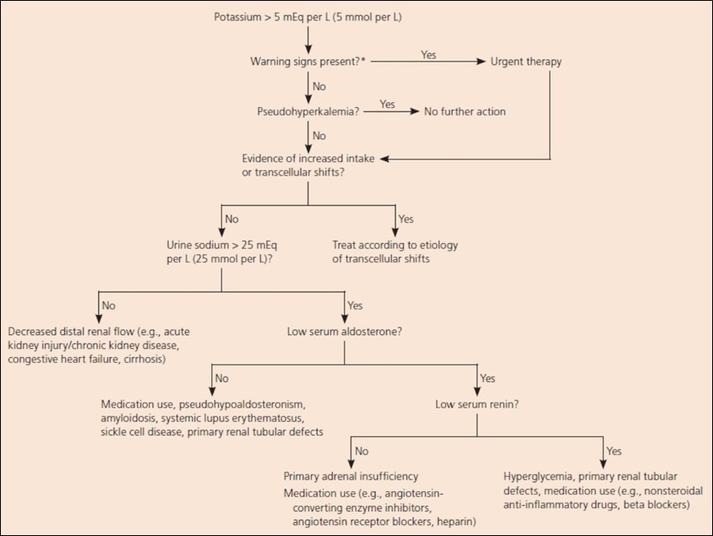
Diagnostic Algorithm of Hyperkalemia
*-Symptoms of hyperkalemia, changes on electrocardiography, rapid-onset hyperkalemia, or underlying heart disease, cirrhosis, or kidney disease.
Viera A, Wouk N. Am Fam Physician. 2015;92:487-495.
Notes:
This slide shows a diagnostic algorithm of hyperkalemia. Initial efforts should focus on determining the need for urgent intervention. The absence of symptoms does not exclude severe hyperkalemia, because hyperkalemia is often asymptomatic. Because of their increased risk of developing hyperkalemia, patients with underlying kidney disease merit special attention.1
1. Viera A, Wouk N. Potassium Disorders: Hypokalemia and Hyperkalemia. Am Fam Physician. 2015;92:487-495.

Slide 20
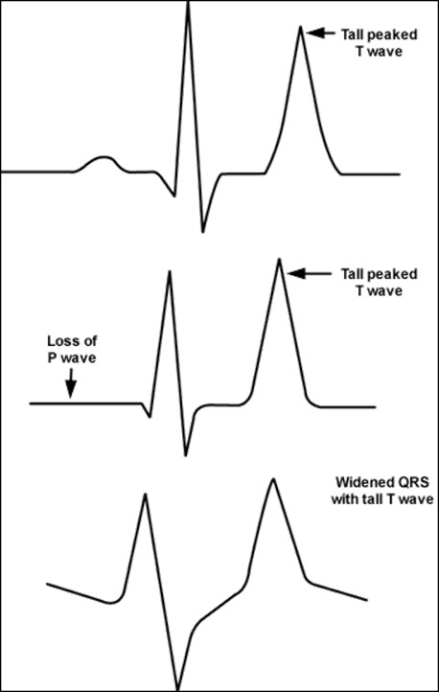
Electrocardiograph Changes Seen in Patients With Hyperkalemia*
EKG features of hyperkalemia:¹
5.5-6.5 mEq/L: Tall peaked T waves
6.5-7.5 mEq/L: Loss of P waves
7.0-8.0 mEq/L: Widening of QRS complexes
8.0-10.0 mEq/L: Sine wave, ventricular arrhythmias, asystole
*EKG changes not always present
1. Slovis C, Jenkins R. BMJ. 2002;324:1320.
Notes:
Hyperkalemia decreases the transmembrane potassium gradient leading to increased potassium conductance, and this shortens the duration of the action potential.1
Increases in total body potassium may have dramatic effects on the electrocardiogram. The most common changes associated with hyperkalemia are tall, peaked T waves, reduced amplitude and eventually loss of the P wave, and marked widening of the QRS complex. The earliest changes associated with hyperkalemia are tall T waves.1
EKG features of hyperkalemia:¹
Tall peaked T waves: 5.5-6.5 mEq/L
Loss of P waves: 6.5-7.5
Widening of QRS complexes: 7.0-8.0
Sine wave, ventricular arrhythmias, asystole: 8.0-10
It should be noted that EKG changes are not always present.
1. Slovis C, Jenkins R. ABC of clinical electrocardiography: conditions not primarily affecting the heart. BMJ 2002;324:1320.

Slide 21
Management of Hyperkalemia
Notes:
The next section will address the management of hyperkalemia.

Slide 22
Management Goals: Acute Versus Chronic Hyperkalemia
Acute Hyperkalemia | Chronic Hyperkalemia
Prevent potentially life-threatening cardiac conduction and neuromuscular disturbances Shift potassium into cells Eliminate excess potassium Resolve underlying disturbance | Prevent the development or recurrence of hyperkalemia Correct underlying defects in potassium homeostasis Increase potassium excretion (e.g., diuretics, potassium binders)
Dunn J, et al. Am J Manag Care. 2015;21:s307-s315.
Viera A, Wouk N. Am Fam Physician. 2015;92:487-495.
Kovesdy C. Nat Rev Nephrol. 2014;10:653-662.
Notes:
This slide outlines the management goals, as it relates to acute and chronic hyperkalemia. The goals of acute management are to induce potassium transport into the intracellular space and remove potassium from the body, in order to quickly restore the normal electrophysiology of the cell membrane and prevent cardiac arrhythmia. The goal of chronic management of hyperkalemia is to prevent the development or recurrence of hyperkalemia by correcting the underlying disturbances in potassium balance.
Dunn J, Benton W, Orozco-Torrentera E, Adamson R. The burden of hyperkalemia in patients with cardiovascular and renal disease. Am J Manag Care. 2015;21(15 Suppl):s307-s315.
Viera A, Wouk N. Potassium Disorders: Hypokalemia and Hyperkalemia. Am Fam Physician. 2015;92:487-495.
Kovesdy CP. Management of hyperkalaemia in chronic kidney disease. Nat Rev Nephrol. 2014;10:653-662.

Slide 23
Management Approaches to Hyperkalemia
Acute Management
Chronic Management
Stabilize: Evaluate patient for life-threatening toxicities
  Initiate EKG monitoring
  Ca-Gluconate
Shift: Augment the shift of potassium from extra- to intracellular space
  Dextrose and/or insulin infusion
  Beta-adrenergic agonists
  Sodium bicarbonate
Remove: Renal replacement therapy
  Hemodialysis
  CRRT
  Potassium binders
Remove or manage any ongoing contributors to hyperkalemia
  Diet
  Medications
  Co-morbid conditions
Increase excretion of potassium
  Loop diuretics (furosemide)
  Mineralocorticoid accentuation
  Potassium binders
Kovesdy C. Nat Rev Nephrol. 2014;10:653-662.
Viera A, Wouk N. Am Fam Physician. 2015;92:487-495.
Dunn J, et al. Am J Manag Care. 2015;21:s307-s315.
CRRT, Continuous Renal Replacement Therapy
Notes:
This slide outlines the approaches between acute and chronic hyperkalemia. Acute hyperkalemia can be life-threatening and require immediate attention, such as cardiac monitoring, acute medical interventions, and possibly emergency dialysis. In chronic hyperkalemia, modifiable causes (e.g., high potassium intake, hyperkalemia-inducing medications, metabolic acidosis) should be identified, managed, and eliminated when possible. Medications to increase potassium excretion are also administered. Use of potassium binders are another cornerstone of treatment for hyperkalemia.1,2
Kovesdy CP. Management of hyperkalaemia in chronic kidney disease. Nat Rev Nephrol. 2014;10:653-662.
Viera A, Wouk N. Potassium Disorders: Hypokalemia and Hyperkalemia. Am Fam Physician. 2015;92:487-495.
Dunn J, Benton W, Orozco-Torrentera E, Adamson R. The burden of hyperkalemia in patients with cardiovascular and renal disease. Am J Manag Care. 2015;21(15 Suppl):s307-s315.

Slide 24
Dietary Modifications in CKD that can Potentially Worsen Hyperkalemia
Increased dietary potassium intake from salt substitute (potassium chloride)
Herbal supplements (noni, alfalfa, dandelion, etc.)
Potassium-rich heart-healthy diets
Allon M. NKF Primer on Kidney Diseases. 2014.
Kovesdy C. Nat Rev Nephrol. 2014;10:653-662.
Notes:
Dietary modifications in patients with CKD often involve an emphasis on sodium restriction, and as a result some patients switch to salt substitutes not realizing these products can contain potassium salts. Furthermore, ‘heart-healthy’ diets are inherently rich in potassium—which is beneficial in most people (by virtue of improved blood pressure control and other mechanisms), but can also contribute to an increased risk of hyperkalemia in at-risk patients. Patients at risk for hyperkalemia should be counseled on dietary potassium restriction, including potassium-rich diets, salt substitutes, and herbal supplements that can increase potassium intake.
Allon M. Disorders of Potassium Metabolism. In: Gilbert S, Weiner D, Gipson D, Perazella M, Tonelli M., eds. National Kidney Foundation. Primer on kidney diseases. 6th ed. Philadelphia, PA: Saunders Elsevier; 2014.
Kovesdy C. Management of hyperkalaemia in chronic kidney disease. Nat Rev Nephrol. 2014;10:653-662.

Slide 25
Potassium Content of Select Foods Considered High in Potassium
Food | Potassium (mg) | Potassium (mEq)
Pinto beans (1 cup) | 1370 | 35
Raisins (1 cup) | 1106 | 28
Honeydew (1/2 melon) | 939 | 24
Nuts (1 cup) | 688 | 18
Black-eyed peas (1 cup) | 625 | 16
Collard greens (1 cup) | 498 | 13
Banana (1 medium) | 440 | 11
Tomato (1 medium) | 366 | 9
Orange (1 large) | 333 | 9
Milk (1 cup) | 351 | 9
Allon M. NKF Primer on Kidney Diseases. 2014.
Notes:
Patients at risk for hyperkalemia should be counseled on foods high in potassium. This slide shows the potassium content of selected foods, many of which could be recommended for a ‘heart-healthy’ diet (e.g., fruits, vegetables, beans), but can also have high levels of potassium. Clinicians should base the dietary potassium prescription on the serum potassium level. A balanced and practical approach to dietary potassium restriction includes choosing the sources of potassium which provide the most benefit.
1. Allon M. Disorders of Potassium Metabolism. In: Gilbert S, Weiner D, Gipson D, Perazella M, Tonelli M., eds. National Kidney Foundation. Primer on kidney diseases. 6th ed. Philadelphia, PA: Saunders Elsevier; 2014.

Slide 26
Restriction of Dietary Potassium
Potassium in DASH diet: Approximately 4.5 g/d
  DASH Diet should not be routinely recommended to patients with GFR <60 mL/min
Guidelines recommend potassium intake of 2-4 g/d for patients with CKD stages 3-4 (GFR 15-59 mL/min)
Hyperkalemia risk is especially high in patients with GFR <30 mL/min receiving ACEi or ARB therapy, or other conditions that raise serum potassium
  More stringent potassium intake may be required
  “Low potassium diet" target intake: ≤2-3 g/d
Kidney Disease Outcomes Quality Initiative (KDOQI). Am J Kidney Dis. 2004;43(5 Suppl 1):S1-S290.
Dash, Dietary Approaches to Stop Hypertension
Notes:
The DASH diet contains approximately 4.5 g/d of potassium, and therefore, should not be routinely recommended to patients with GFR <60 mL/min. Guidelines recommend 2-4 g/d of potassium for patients with CKD stages 3-4 (GFR 15-59 mL/min). The risk of hyperkalemia is especially high in patients with GFR <30 mL/min receiving ACEi or ARB therapy, or other conditions that raise serum potassium, therefore, requiring more stringent potassium intake. Target potassium intake of a "low potassium diet" is ≤2-3 g/d.
Kidney Disease Outcomes Quality Initiative (KDOQI). KDOQI clinical practice guidelines on hypertension and antihypertensive agents in chronic kidney disease. Am J Kidney Dis. 2004;43(5 Suppl 1):S1-S290.

Slide 27
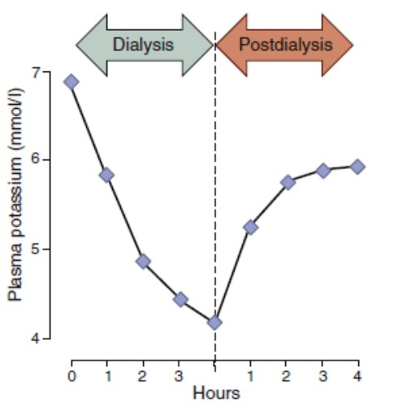
Dialysis and Hyperkalemia
Plasma Potassium Concentration During and After Dialysis³
Hemodialysis: Acute/Chronic
Peritoneal dialysis: Chronic
Effects of dialysis on serum sodium, bicarbonate, calcium and/or magnesium levels can affect results¹
For chronic hemodialysis, missed treatments and 2-day interdialytic interval may have a negative impact on outcomes (i.e., mortality, hospital admission for CV events) ²
Kovesdy C. Nat Rev Nephrol. 2014;10:653-662.
Foley R, et al. N Engl J Med. 2011;365:1099-1107.
Sterns R, et al. Kidney Int. 2016;89,546-554.
Notes:
This slide provides an overview of the use of dialysis in hyperkalemia.
The figure in this slide shows the plasma potassium concentration in patients with kidney failure during and after hemodialysis, and the relationship with dialytic potassium removal and total body potassium. Because replenishment from cellular stores continue when potassium removal stops, there is a substantial post-dialysis rebound of plasma potassium.1
The effects of dialysis on serum sodium, bicarbonate, calcium and/or magnesium levels can affect results.1
For chronic hemodialysis, missed treatments and 2-day interdialytic interval may have a negative impact on outcomes including mortality and hospital admission for cardiovascular events.2
Kovesdy CP. Management of hyperkalaemia in chronic kidney disease. Nat Rev Nephrol. 2014;10:653-662.
Foley R, Gilbertson D, Murray T, Collins A. Long interdialytic interval and mortality among patients receiving hemodialysis. N Engl J Med. 2011;365:1099-1107.
Sterns R, Grieff M, Bernstein P. Treatment of hyperkalemia: something old, something new. Kidney Int. 2016;89:546-554.

Slide 28
Dialysate Potassium and Clinical Outcomes: DOPPS
Associations Between Dialysate Potassium and Clinical Outcomes by Predialysis Serum Potassium Concentration
 |  | Predialysis Serum Potassium
 | All Patients | <4.0 mEq/L | 4.0-5.0 mEq/L | 5.1-6.0 mEq/L | >6.0 mEq/L
All-cause mortality: Dialysate potassium 3.0 vs 2.0 mEq/L (reference) | 0.96 (0.91-1.01) | 1.03 (0.91-1.17) | 0.96 (0.90-1.03) | 0.94 (0.85-1.03) | 0.97 (0.78-1.20)
Arrhythmia composite: Dialysate potassium 3.0 vs 2.0 mEq/L (reference) | 0.98 (0.88-1.08) | 1.13 (0.86-1.47) | 0.91 (0.80-1.04) | 1.06 (0.89-1.27) | 1.15 (0.81-1.62)
DOPPS, Dialysis Outcomes and Practice Patterns Study
Karaboyas A, et al. Am J Kidney Dis. 2017;69:266-277.
Notes:
Slide Table: Associations Between Dialysate Potassium and Clinical Outcomes by Predialysis Serum Potassium Concentration.
In this table, the associations with clinical outcomes of dialysate potassium concentration of 3.0 versus 2.0 mEq/L at various predialysis serum potassium levels is shown. The estimated differences in mortality risk were minimal, with hazard ratios (HRs) ranging from 0.94 to 1.03 across the 4 serum potassium subgroups, with no discernible pattern. Similarly, the study found no associations between dialysate potassium concentration and the arrhythmia composite outcome in any of the serum potassium strata. Furthermore, there was no evidence for effect modification of dialysate potassium concentration by serum potassium level for all-cause mortality (P for interaction = 0.7) or the arrhythmia composite outcome (P for interaction = 0.7).
Note: Values are given as hazard ratio (95% confidence interval). Cox models stratified by Dialysis Outcomes and Practice Patterns Study phase, country, US large dialysis organization (all-cause mortality only), and accounted for facility clustering. Arrhythmia composite includes sudden death or arrhythmia-related hospitalizations. Number of patients (events) in all-cause mortality analyses: 6,300 (1,642) for serum potassium level, 4.0, 27,525 (6,473) for serum potassium level of 4.0 to 5.0, 16,959 (3,985) for serum
potassium level of 5.0 to 6.0, 4,399 (1,014) for serum potassium level 6.0 mEq/L. Number of patients (events) in arrhythmia composite analyses: 5,105 (350) for serum potassium level <4.0, 21,997 (1,607) for serum potassium level of 4.0 to 5.0, 14,428 (1,039) for serum potassium level of 5.0 to 6.0, 3,981 (304) for serum potassium level >6.0 mEq/L. Adjustments: age, sex, dialysis vintage, 13 comorbid conditions, vascular access, body mass index, albumin level, normalized protein catabolic rate, serum calcium level, serum phosphorus level, serum phosphorus squared, serum bicarbonate level, dialysate bicarbonate concentration, hemoglobin level, session duration, and Kt/V.
Study Background
Sudden death is a leading cause of death in patients on maintenance hemodialysis therapy. During hemodialysis sessions, the gradient between serum and dialysate levels results in rapid electrolyte shifts, which may contribute to arrhythmias and sudden death. Controversies exist about the optimal electrolyte concentration in the dialysate; specifically, it is unclear whether patient outcomes differ among those treated with a dialysate potassium concentration of 3 mEq/L compared to 2 mEq/L.
Study Design
Prospective cohort study.
Setting & Participants
55,183 patients from 20 countries in the Dialysis Outcomes and Practice Patterns Study (DOPPS) phases 1 to 5 (1996-2015).
Predictor: Dialysate potassium concentration at study entry.
Results
During a median follow-up of 16.5 months, 24% of patients died and 7% had an arrhythmia composite outcome. No meaningful difference in clinical outcomes was observed for patients treated with a dialysate potassium concentration of 3 versus 2 mEq/L (adjusted HRs were 0.96 [95% CI, 0.91-1.01] for mortality and 0.98 [95% CI, 0.88-1.08] for arrhythmia composite). Results were similar across predialysis serum potassium levels. As in prior studies, higher serum potassium level was associated with adverse outcomes. However, dialysate potassium concentration had only minimal impact on serum potassium level measured predialysis (10.09 [95% CI, 0.05-0.14] mEq/L serum potassium per 1 mEq/L greater dialysate potassium concentration).
Conclusions
In combination, these results suggest that approaches other than altering dialysate potassium concentration (e.g., education on dietary potassium sources and prescription of potassium-binding medications) may merit further attention to reduce risks associated with high serum potassium levels.
1. Karaboyas A, Zee J, Brunelli S, et al. Dialysate Potassium, Serum Potassium, Mortality, and Arrhythmia Events in Hemodialysis: Results From the Dialysis Outcomes and Practice Patterns Study (DOPPS). Am J Kidney Dis. 2017;69:266-277.

Slide 29
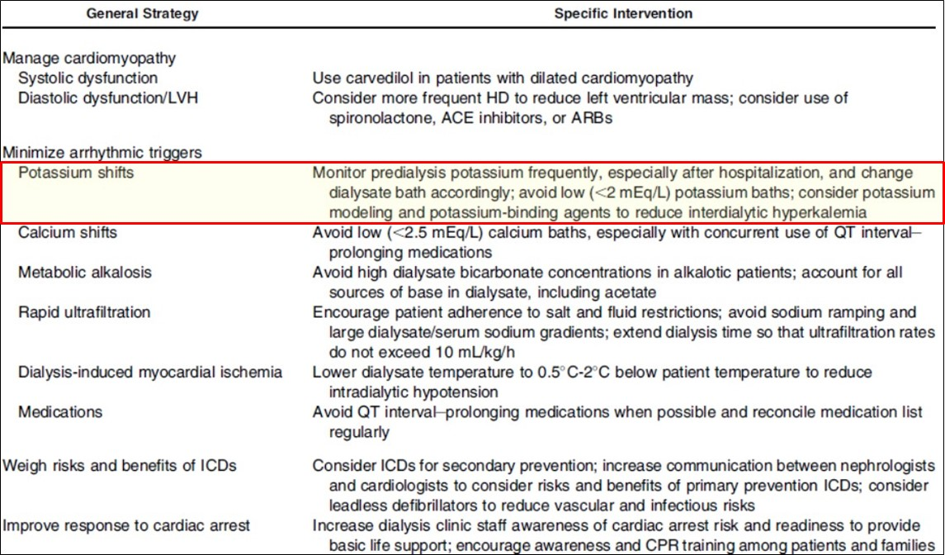
Possible Strategies for SCD Prevention in HD
SCD, Sudden cardiac death; HD, Hemodialysis
Makar M, Pun P. Am J Kidney Dis. 2017 Feb 17. [Epub ahead of print]
Notes:
This slides provides an overview of possible strategies for prevention of sudden cardiac death in patients receiving hemodialysis, as outlined in a paper by Makar and Pun.1 General strategies include managing cardiomyopathy, weighing risks and benefits of implantable cardioverter defibrillators (ICDs), and improving response to cardiac arrest. Minimizing of arrhythmic triggers include managing potassium shifts, calcium shifts, metabolic acidosis, and medications. Interventions to manage potassium shifts that can be considered include:1
Monitoring predialysis potassium frequently especially after hospitalization, and changing the dialysate bath accordingly
Avoiding low (<2 mEq/L) potassium baths
Considering potassium modeling and potassium-binding agents to reduce interdialytic hyperkalemia.1
Makar M, Pun P. Sudden Cardiac Death Among Hemodialysis Patients. Am J Kidney Dis. 2017 Feb 17. pii: S0272-6386(17)30025-2 [Epub ahead of print]
Abbreviations: ACE, angiotensin-converting enzyme; ARBs, angiotensin receptor blockers; CPR, cardiopulmonary resuscitation; HD, hemodialysis; ICDs, implantable cardioverter defibrillators; LVH, left ventricular hypertrophy; SCD, sudden cardiac death.

Slide 30
Potassium Binders
^{Treatment} | ^{Route of Administration} | ^{Onset/ Duration} | ^{Mechanism} | ^{Comments}
^{Cation exchange resin} Sodium polystyrene sulfonate 25-50 g | Oral or rectal (either acute or chronic), with or without sorbitol | ^{1-2 h} ^{≥4-6 h} | ^{Excretion} | Cannot be used in medical emergencies Cases of intestinal necrosis, which may be fatal, and other serious GI adverse events have been reported Caution in patients with heart failure due to sodium load May cause hypokalemia and electrolyte disturbances
^{Cation exchange polymer} ^{Patiromer 8.4, 16.8, or 25.2 g} | ^{Oral (either acute or chronic)} | ^{7 h} ^{~48 h} | ^{Excretion} | Should not be used as an emergency treatment for life-threatening hyperkalemia because of its delayed onset of action Contraindicated in patients with a history of a hypersensitivity reaction to VELTASSA or any of its components Risks include Worsening of Gastrointestinal Motility and Hypomagnesemia The most common Adverse Reactions in clinical trials were constipation, hypomagnesemia, diarrhea, nausea, abdominal discomfort and flatulence
1. SPS Package Insert
2. Patiromer Package Insert
Notes:
In many cases, failure to manage hyperkalemia through diet, adjustments in medications, and other interventions, may necessitate the need for potassium binders. Generally, potassium binders aim to increase fecal potassium excretion, thus promoting a reduction of serum potassium levels. SPS is a non-absorbed, organic resin, approved in 1958. Patiromer is a non-absorbed, cation-exchange polymer and was approved in 2015.
1. SPS Package Insert, http://www.accessdata.fda.gov/drugsatfda_docs/label/2009/011287s022lbl.pdf
2. U.S. Food and Drug Administration (FDA). Kayexalate. http://www.accessdata.fda.gov/drugsatfda_docs/label/2011/011287s023lbl.pdf.
3. Patiromer Package Insert, https://www.veltassa.com/pi.pdf
4. U.S. Food and Drug Administration (FDA). FDA approves new drug to treat hyperkalemia. http://www.fda.gov/NewsEvents/Newsroom/PressAnnouncements/ucm468546.htm.

Slide 31
Considerations for RAAS Inhibition
Notes:
We will now provide a brief overview of considerations for the use of RAAS inhibition therapy in patients at-risk for hyperkalemia.

Slide 32
RAAS Inhibition and CKD
ACEis and ARBs are primarily used for hypertension, and are well-established treatments for many chronic diseases, including CKD, heart failure, and diabetic nephropathy
However RAAS inhibition can impair renal potassium secretion, thus increasing the risk of hyperkalemia
This can raise a dilemma in treating patients with CKD or other conditions
Kovesdy C. Nat Rev Nephrol. 2014;10:653-662.
Notes:
Angiotensin converting enzyme inhibitors (ACEis) and angiotensin receptor blockers (ARBs) are well-established treatments for many chronic kidney diseases, where they can help delay CKD progression and manage proteinuria in glomerular diseases. They are primarily used for hypertension and other chronic conditions, including heart failure and diabetic nephropathy. However, as previously mentioned, these medications interfere with the Renin-Angiotensin-Aldosterone System (RAAS), and can impair renal potassium secretion, thus increasing the risk of hyperkalemia. This can raise a dilemma in patients with CKD, because they can be at high risk for hyperkalemia, but can also benefit from RAAS inhibition through ACEIs or ARBs.
1. Kovesdy C. Management of hyperkalaemia in chronic kidney disease. Nat Rev Nephrol. 2014;10:653-662.

Slide 33
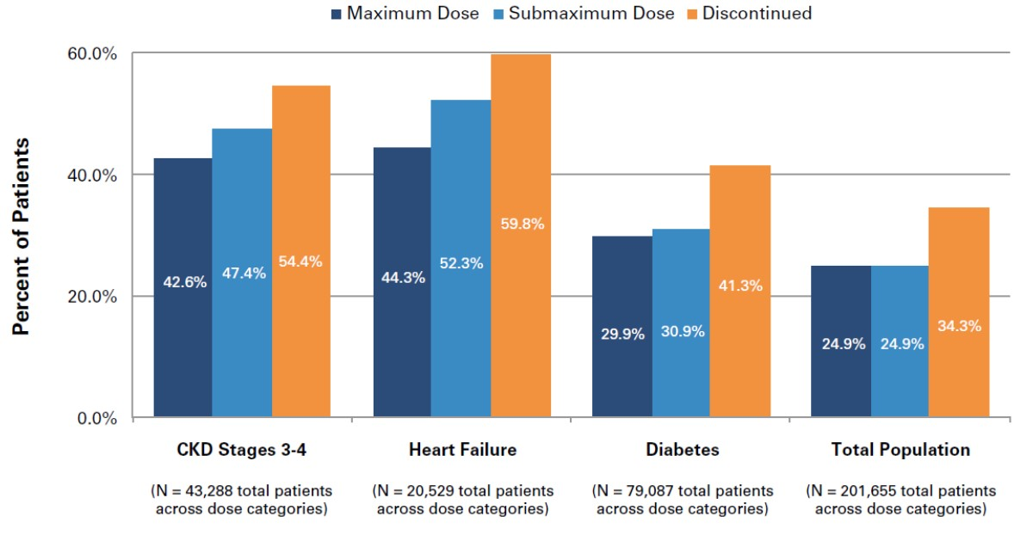
Adverse Outcomes or Mortality by Prior RAAS Inhibitor Dose
Epstein M, et al. Am J Manag Care. 2015;21(11 Suppl):S212-S220.
Notes:
Despite the presence of serious comorbidities, relatively few patients are prescribed the maximum recommended doses of RAAS inhibitors, and hyperkalemia associated with RAAS inhibitor therapy was frequently followed by reduction in dosage or discontinuation of therapy. These dose reductions have been associated with worse outcomes.1
Slide Figure: Percent of Patients Who Experienced Adverse Outcomes or Mortality by Prior RAAS Inhibitor Dose.
Over 50% of patients with CKD stages 3 to 4 who discontinued RAAS inhibitors experienced an adverse outcome or died compared with 47.4% of patients on submaximum doses and 42.6% of patients on maximum doses (all comparisons P <.05). Nearly 60% of patients with HF who discontinued RAAS inhibitors experienced an adverse outcome or mortality compared with 52.3% of patients on submaximum doses and 44.3% of patients on maximum doses (all comparisons P <.05). Patients with DM had better outcomes than patients in the HF or CKD stage 3 to 4 comorbidity groups. A total of 41.3% of DM patients who discontinued RAAS inhibitors experienced an adverse outcome or mortality compared with 30.9% of patients on submaximum doses and 29.9% of patients on maximum doses (all comparisons P <.05).
1. Epstein M, Reaven N, Funk S, McGaughey K, Oestreicher N, Knispel J. Evaluation of the treatment gap between clinical guidelines and the utilization of renin-angiotensin-aldosterone system inhibitors. Am J Manag Care. 2015;21(11 Suppl):S212-S220.
Abstract
Objectives: This study examined renin-angiotensin-aldosterone system (RAAS) inhibitor dose levels in a US patient population and investigated the impact of hyperkalemia on RAAS inhibitor dose and the association between dose levels and clinical outcomes.
Study Design: De-identified medical records from a large database of electronic health records (Humedica) for patients 5 years of age or older with at least 2 serum potassium readings were analyzed (N = 205,108 patients; 1.7 million records).
Methods: Inclusion criteria required 1 RAAS inhibitor prescription and 12 months’ data prior to July 1, 2009 (index date). Patients were classified by comorbidities (chronic kidney disease, heart failure, or diabetes) and RAAS inhibitor dose level at index date, as determined by prescription information. Additional analyses examined RAAS inhibitor dose changes following hyperkalemia and the frequency of cardiorenal adverse outcome/mortality or mortality alone by post index dose level.
Results: Dose level was similarly distributed irrespective of patient comorbidity status, with RAAS inhibitors prescribed at maximum dose in 19% to 26% of patients and submaximum dose in 58% to 65% of patients; RAAS inhibitors were discontinued in 14% to 16% of patients. RAAS inhibitor dose was down-titrated after 16% to 21% of hyperkalemia events and discontinued after 22% to 27% of hyperkalemia events. Cardiorenal adverse event/mortality and mortality occurred in 34.3% and 11.0% of patients who discontinued RAAS inhibitors, 24.9% and 8.2% of patients on submaximum doses, and 24.9% and 4.1% of patients on maximum doses, respectively.
Conclusions: Relatively few patients were prescribed maximum doses of RAAS inhibitors, and dose and usage declined following hyperkalemia. Patients on submaximum doses or who discontinued RAAS inhibitors had worse outcomes than patients on maximum doses.
1. Epstein M, Reaven N, Funk S, McGaughey K, Oestreicher N, Knispel J. Evaluation of the treatment gap between clinical guidelines and the utilization of renin-angiotensin-aldosterone system inhibitors. Am J Manag Care. 2015;21(11 Suppl):S212-S220.

Slide 34
Considerations for Managing Patients at Risk for Hyperkalemia Caused by RAAS Inhibition
Monitor kidney function (eGFR, ACR)
Monitor serum potassium levels
Discontinue drugs that increase hyperkalemia risk, if possible
Prescribe low-potassium diet
Prescribe diuretics (loop diuretics when eGFR <30 mL/min)
Correct metabolic acidosis in patients with CKD
If required, initiate therapy with low-dose ACEi or ARB and monitor
Newer potassium binders may offer a potential option to continue RAAS inhibition in patients who need these therapies
Modified form Palmer B. N Engl J Med. 2004;351:585-592.
Makar M, Pun P. Am J Kidney Dis. 2017. [Epub ahead of print]
Sterns R, et al. Kidney Int. 2016;89:546-554.
Dunn J, et al. Am J Manag Care. 2015;21(15 Suppl):s307-s315.
GFR, glomerular filtration rate; ACR, albumin-to-creatinine ratio; RAAS, Renin-Angiotensin-Aldosterone System
Notes:
This slide outlines considerations for the administration of RAAS inhibitors in patients at high risk for hyperkalemia. Kidney function and potassium levels should be monitored. Dietary potassium should be restricted and monitored. Diuretics should be considered and metabolic acidosis (when present) should be corrected. Initial low-dose ACEi or ARB therapy should be considered. Newer therapeutic options may potentially allow for RAAS inhibition to continue in patients who need these therapies.
Palmer B. Managing hyperkalemia caused by inhibitors of the renin-angiotensin-aldosterone system. N Engl J Med. 2004;351:585-592.
Makar M, Pun P. Sudden Cardiac Death Among Hemodialysis Patients. Am J Kidney Dis. 2017 Feb 17. pii: S0272-6386(17)30025-2 [Epub ahead of print]
Sterns R, Grieff M, Bernstein P. Treatment of hyperkalemia: something old, something new. Kidney Int. 2016;89:546-554.
Dunn J, Benton W, Orozco-Torrentera E, Adamson R. The burden of hyperkalemia in patients with cardiovascular and renal disease. Am J Manag Care. 2015;21(15 Suppl):s307-s315.

Slide 35
Summary
Hyperkalemia can lead to adverse cardiac outcomes and mortality
Medications and co-morbid conditions (e.g., CKD) can contribute to high serum potassium
Approaches include low potassium diet and avoidance/dose-adjustments of certain medications
Other measures include bicarbonate, diuretics, potassium binders
Notes:
In conclusion, hyperkalemia occurs commonly in the medical management of diabetic, kidney and cardiovascular diseases. The effects of hyperkalemia can be severe and life threatening. The process of preventing and managing hyperkalemia requires a multi-faceted approach that entails reducing high-potassium foods, adjusting medications that cause hyperkalemia, and adding medications that reduce it when possible.
Once again, thank you for your interest in this activity.

