Slide 1
Managing CKD Complications
Mineral and bone disorder, electrolytes, and acidosis
MICHELLE M. ESTRELLA, Md, mhs
April 26, 2014
mestrel1@jhmi.edu

Slide 2
Learning Objectives
To recognize and initiate work-up of CKD-related complications
To implement interventions which address these complications
To understand how these interventions may slow progression of CKD and lower risk of cardiovascular disease events

Slide 3
Case 1
A 53 year old gentleman who you diagnosed with stage 3b CKD presents to you clinic for follow-up. He has long-standing poorly controlled type 2 diabetes and hypertension. He is single and takes most of his meals at fast-food restaurants.
On exam, his blood pressure is 140/80 with a heart rate of 78 beats per min. His BMI is 32 kg/ m2. He has 1+ pitting edema along his lower extremities, but the remainder of his exam was otherwise unremarkable.

Slide 4
Case 1 continued
The patient’s labs from week prior to his visit reveal the following:
Which of the following is most correct?
  A) The patient’s intact PTH is likely within normal limits.
  B) His serum phosphate is optimal for a patient with stage 3b CKD.
  C) His risk of a cardiovascular death exceeds his risk of progressing to end-stage kidney disease.
  D) The patient’s blood pressure is at goal for stage 3b CKD.
142
112
64
Serum calcium 8.4 mg/dL
Serum phosphate 5.2 mg/dL
Urine protein-to-creatinine ratio 1.2 g/g
234
4.8
16
1.8
eGFR ~40 ml/min/1.73 m²
Notes:
C

Slide 5
CKD is prevalent
Stage 3 (30-59)
N=15,500,000
Stage 2 (60-89)
N=6,500,000
Stage 1 (>90)
N=3,600,000
Stage 4
(15-29)
N=700,000
Stage 5 (<15) N=372,000
CV death

Slide 6
Case 1 continued
The patient’s labs from week prior to his visit reveal the following:
Which of the following is most correct?
  A) The patient’s intact PTH is likely within normal limits.
  B) His serum phosphate is optimal for a patient with stage 3b CKD.
  C) His risk of a cardiovascular death exceeds his risk of progressing to end-stage kidney disease.
  D) The patient’s blood pressure is at goal for stage 3b CKD.
142
112
64
Serum calcium 8.4 mg/dL
Serum phosphate 5.2 mg/dL
Urine protein-to-creatinine ratio 1.2 g/g
234
4.8
16
1.8
eGFR ~40 ml/min/1.73 m²
Notes:
C

Slide 7
Prevalence of CKD-related Complications
Moranne O. et al. J Am Soc Nephrol 20:164-171, 2009.

Slide 8
Bone and Mineral Disorder

Slide 9
Case 2
45 yo woman with long-standing type 2 DM, HTN, and dyslipidemia
ACEI with good BP control; urine P/C = 0.4 g/g Cr
LABS | 3 yrs ago | 2 yrs ago | 1 yr ago | Now
Serum creatinine | 1.35 | 1.53 | 1.75 | 2.06
eGFR (mL/min/1.73m²) | 46 | 40 | 34 | 28
Calcium (mg/dL) | 9.8 | 9.6 | 8.8 | 8.2
Phosphorus (mg/dL) | 3.5 | 3.9 | 4.8 | 5.2

Slide 10
Case 2 continued.
Her intact PTH is 220 pg/ml, and her 25-OH vitamin D is 30 pg/mL
Which of the following is most correct?
  A) She likely has primary hyperparathyroidism.
  B) She likely has secondary hyperparathyroidism.
  C) She has phosphate retention due to low levels of the phosphaturic hormone, fibroblast growth factor (FGF)-23.
  D) She likely has tertiary hyperparathyroidism.

Slide 11
Differential Diagnosis for Elevated iPTH
Calcium | Phos | iPTH | Suggested Diagnosis
Normal or ↓ | Normal or ↑ | ↑ | Secondary hyperparathyroidism due to CKD
↓ | ↓ | ↑ | Secondary hyperparathyroidism due to vitamin D deficiency
↑ | ↑ | ↑↑↑ | Tertiary hyperparathyroidism in advanced CKD
High-normal or ↑ | Low-normal or ↓ | High-normal or ↑ | Primary hyperparathyroidism or familial hypocalciuric hypercalcemia
↑ | Variable | ↓ | Non-iPTH related process (e.g. vitamin D toxicity, PTH-rp)
Adapted from Estrella M, Sisson S. CKD Module. Internet Learning Center, 2014.

Slide 12
Mineral and Bone Disorder
A systemic disorder of mineral and bone metabolism due to CKD manifested by either one or a combination of the following:
  Abnormalities of calcium, phosphorus, PTH, or vitamin D metabolism
  Abnormalities in bone turnover, mineralization, volume, linear growth, or strength
  Vascular or other soft tissue calcification
Moe S, et al. Kidney Int 69: 1945, 2006

Slide 13
Honkanen E, et al. Nephrol Dial Transplant 23:4009-15, 2008.
Nickolas TL, et al. J Am Soc Nephrol 21:1371-80, 2010.

Slide 14
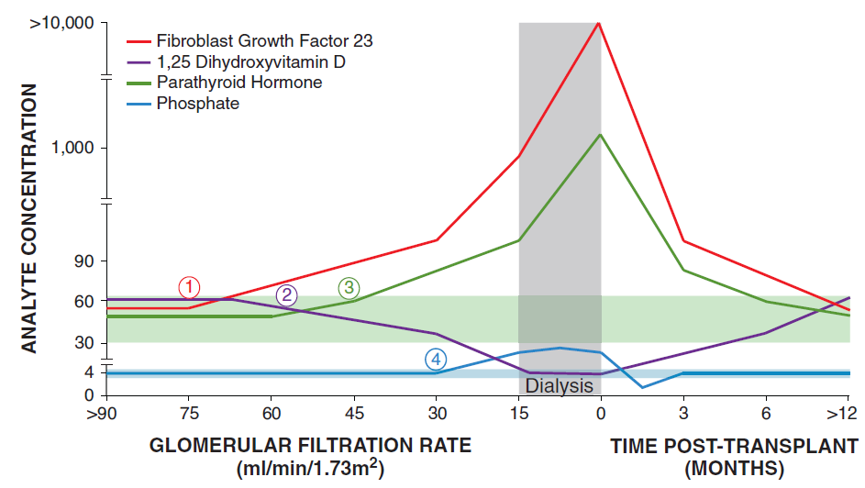
Disordered Phosphorus Metabolism in CKD
Wolf M. J Am Soc Nephrol. 21: 1427-35, 2010.

Slide 15
Case 2 continued
You are preparing to place your orders into the computer. Which of the following is most correct?
  A) A DEXA scan would help predict her fracture risk.
  B) Treatment should be adjusted to maintain a serum calcium-phophorus product below 55 mg²/dL².
  C) Her 1,25 diOH vitamin D level should be checked at least once.
  D) A bone biopsy is not indicated at this time.

Slide 16
Mineral Bone Disease Testing Schedule
CKD Stage | Calcium, Phosphorus | iPTH | 25(OH)D
Stage 3b | Every 6-12 months | Once then based on CKD progression | Once, then based on level and treatments
Stage 4 | Every 3-6 months | Every 6-12 months
Stage 5 | Every 1-3 months | Every 3-6 months
KDIGO Guideline. Kidney Int. 2009;76 (113):S1-S130.

Slide 17
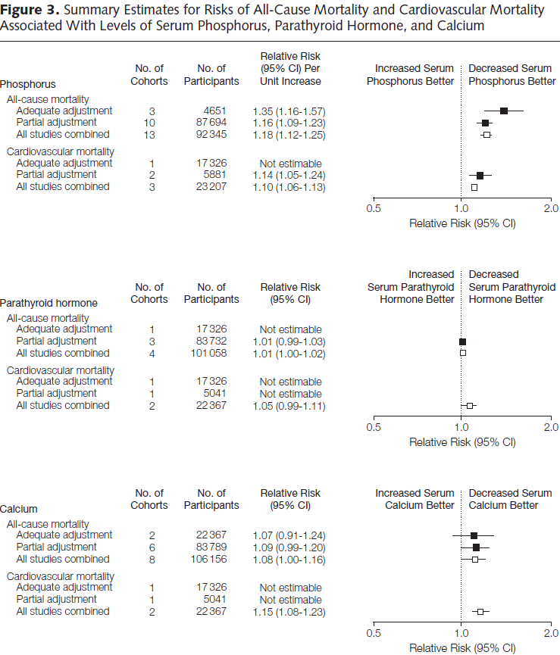
Palmer SC, et al. JAMA 305:1119-1127, 2011.

Slide 18
Shortcomings of these measurements
Adynamic
Low turnover
Mixed
High turnover
iPTH <100 pg/ml
BS-Alk phos ≤7 ng/mL
Ca⁺² normal to high
iPTH >800 pg/ml
Ca⁺² normal
KDIGO Guideline. Kidney Int. 2009;76 (113):S1-S130.

Slide 19
Mineral Bone Disease KDIGO Treatment Goals
Bone density testing (DEXA) does not predict fracture risk in stage 3-5D CKD.
Goals
  Maintain calcium and phosphorus levels in normal reference ranges
  Maintain iPTH
    High-normal (~55 pg/mL) for Stage 3 & 4 (eGFRs 15-59 mL/min)
    2-9x normal for Stage 5 (eGFRs <15 mL/min)
KDIGO Guideline. Kidney Int. 2009;76 (113):S1-S130.

Slide 20
Case 2 Continued
You had recommended that she restrict her dietary phosphorus intake. She presents for follow-up 6 months later with the following labs:
LABS | 6 mos ago | Now
eGFR (mL/min/1.73m²) | 28 | 28
Calcium (mg/dL) | 8.6 | 8.5
Phosphorus (mg/dL) | 5.2 | 5.4
Intact PTH (pg/mL) | 220 | 260
25-OH vitamin D (pg/mL) | 30 | 16

Slide 21
Case 2 Continued
In addition to dietary counseling, which of the following is the most appropriate next step?
  A) Start sevelamer carbonate with each meal for her hyperphosphatemia
  B) Initiate ergocalciferol at 50,000 IU weekly to replete her 25-OH vitamin D level
  C) Start aluminum hydroxide with each meal for her hyperphosphatemia
  D) Start calcium carbonate between meals for her hyperphosphatemia

Slide 22
Dietary Phosphate Restriction
K/DOQI guidelines: <1000 mg/d
KDIGO guidelines
  “Suggest limiting dietary phosphate intake”, but no cutoff provided
  Limit protein intake to 0.8 g/kg/day in patients with GFR<30 ml/min
  Avoid high protein intake (>1.3 g/kg/day) in patients at risk for CKD progression
Consultation of patients complicated by:
  Differences in dietary phosphate content
  Differences in phosphate bioavailability
  No clear listing of phosphate additives in food

Slide 23
Food for Thought . . .
Food | Serving | Phosphate content (mg) | Phos:Protein (mg/g) | Bio-availability
Ground beef | 3 oz | 165 | 7.5 | ++
Tofu | ½ C | 239 | 12 | +
Breakfast sandwich | 1 | 562 | 28.1 | ++++
Lower P absorption
Veg/nuts
Fruits
Higher P absorption
Processed foods
Dark sodas/ Punch
Meats
Kalantar-Zadeh K, et al. Clin J Am Soc Nephrol. 5: 519-30, 2010.

Slide 24
Phosphate Binders
Binder | Advantages | Disadvantages
Aluminum hydroxide | Very effective, inexpensive | Aluminum toxicity (adynamic bone disease & dementia)
Calcium carbonate | Effective, inexpensive, comes in liquid or chewable form | Calcium load GI side effects
Calcium acetate | As effective as CaCO₃ | Potentially less calcium load GI side effects Potential decrease tetracycline & fluoroquinolone levels
Sevelamer carbonate | Effective, no calcium load, potentially improves acid-base balance, comes in powder form | Most expensive GI side effects including bowel obstruction Potential ↓absorption of fat-soluble vitamins Potential decrease fluoroquinolone levels
Lanthanum carbonate | Effective, no calcium load, comes in chewable form | More expensive Potential for systemic accumulation GI side effects
KDIGO Guideline. Kidney Int. 2009;76 (113):S1-S130.

Slide 25
Calcium and 25-OH Vitamin D in Stage 3-4 CKD - Opinions
Keep corrected serum calcium within normal range preferably toward the lower end (8.4 to 9.5 mg/dL)
Vitamin D2 if serum 25-OH vit D level <30 ng/mL
  Cholecalciferol 800 IU daily
Treat with active oral vitamin D if serum 25(OH) vitamin D >30 ng/mL and iPTH is above target range
  Calcitriol: 0.25 mcg 3x/wk-daily
  Doxercalciferol: 2 mcg 3x/wk-daily
  Paricalcitol: 2 mcg 3x/ wk-daily
Notes:
If a drastic change, consider repeating iPTH level.
If “truly” low,
Hold vitamin D supplements
Resume at a lower dose/ frequency when iPTH rises above goal again.

Slide 26
Bisphosphonates for osteoporosis
Safety and efficacy unclear in CKD
Treat as in the general population (w/ dose adjustment) if:
  Stages 1-2 CKD
  Stage 3 CKD w/ normal iPTH
Exclude other potential forms of bone disease in those w/ Stages 4-5.

Slide 27
Summary I
Pathophysiological changes occur early in CKD
Associated with increased fracture risk, vascular calcification and increased mortality
Phosphate thought to be primary culprit
Keep levels as close to normal as possible, though iPTH goal more liberal
Replete vitamin D only if suspect or confirm vitamin D deficiency

Slide 28
Metabolic Acidosis

Slide 29
Case 3
A 60 year old diabetic gentleman presents to clinic for a new patient visit with you. He has a history of hypertension. He complains of burning in his feet especially at night.
On exam, he has a blood pressure of 156/88, P 78. He is obese. You note decreased pinpoint sensation along the dorsum of his feet. The remainder of his exam was unremarkable.

Slide 30
Case 3 continued
139
112
54
Serum calcium 8.6 mg/dL
Serum phosphate 4.8 mg/dL
Urine protein-to-creatinine ratio 1.8 g/g
234
5.2
16
2.2
eGFR ~31 ml/min/1.73 m²
Which of the following is incorrect?
Dietary intake of meat products may exacerbate his acidosis.
Metabolic acidosis may contribute to muscle wasting.
Metabolic acidosis may contribute to CKD progression.
His metabolic acidosis puts him at risk for cardiovascular events.
Notes:
D

Slide 31
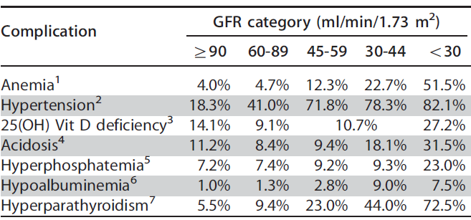
Prevalence of Acidosis in CKD
Notes:
kdigo

Slide 32
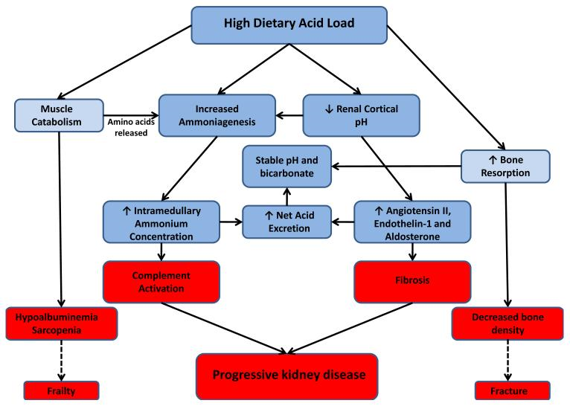
Association of Acidosis with Complications
Scialla JJ and Anderson CA. Adv Chron Kid Dis. 20:141-9, 2013.

Slide 33
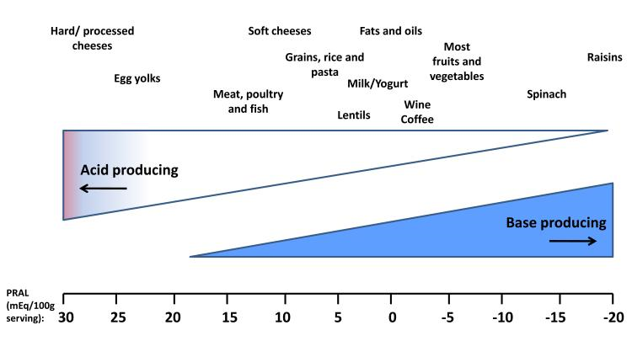
Dietary Acid Load
PRAL=Potential renal acid load
Scialla JJ and Anderson CA. Adv Chron Kid Dis. 20:141-9, 2013.
Notes:
Average American diet leads to an average dietary acid load of approximately 1 mEq/kg/day

Slide 34
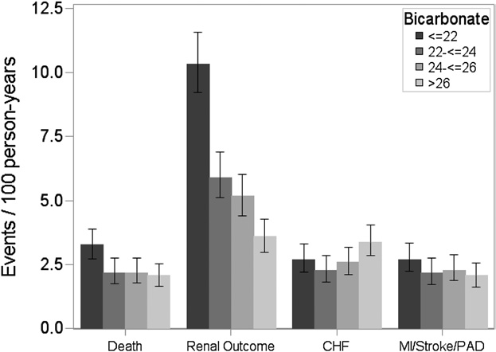
Association of Acidosis with Complications
Unadjusted Event Rates by Quartile of Serum Bicarbonate (mEq/L)
Dobre M, et al. AM J Kidney Dis.62:670-8, 2013.
Notes:
ESRD or 50% decline in eGFR; Adjusted HR=0.97 per 1mEq/L increase. Those w/ eGFR >45 had 9% lower risk in kidney disease progression and those with UPCR <0.2 g/g had 10% lower risk.

Slide 35
Case 3 Continued
You offer counseling to the patient to address his metabolic acidosis. Which of the following is incorrect?
A) Sodium bicarbonate repletion may slow his CKD progression.
B) Sodium bicarbonate repletion may improve muscle strength.
C) His goal serum bicabonate level is 20 mmol/L.
D) Fruits and vegetables are as effective as sodium bicarbonate in correcting the acidosis.
Notes:
C

Slide 36
Open Label RCT of Bicarb Repletion
184
Study Population:
Aged 18-75 yrs
CKD stage 4-5
HCO3 16-21 mmol/L
Exclusion Criteria:
Uncontrolled HTN, Fluid overload/ CHF
Refusal of consent = 20
Not eligible = 30
134
5 patients withdrew
67
62
No Bicarbonate Oral NaHCO3 1–3 g/d
de Brito-Ashurst et al. J Am Soc Nephrol 20:2075-84, 2009.
Notes:
Bicar 19.9 (control)vs. 19.8 rx

Slide 37
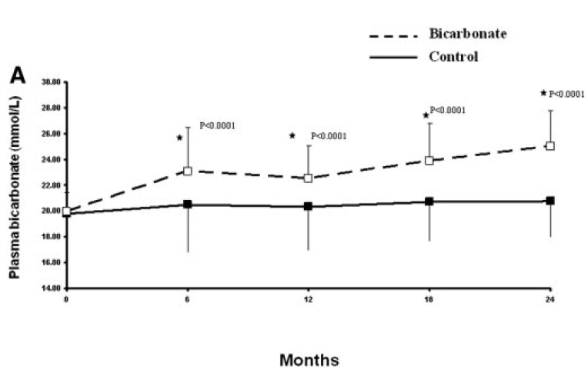
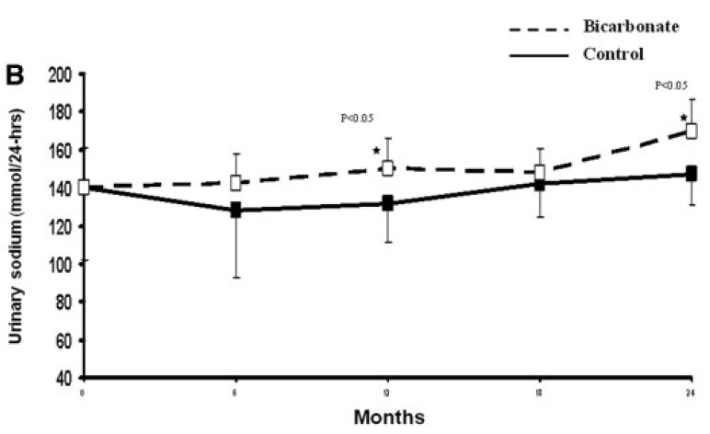
de Brito-Ashurst et al. J Am Soc Nephrol 20:2075-84, 2009.

Slide 38
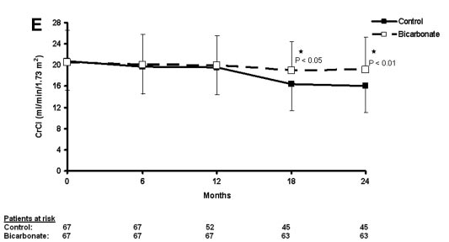
Sodium bicarb repletion and kidney function
de Brito-Ashurst et al. J Am Soc Nephrol 20:2075-84, 2009.

Slide 39
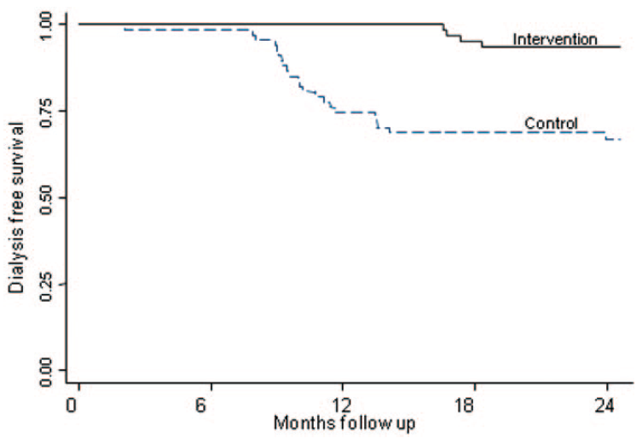
Sodium bicarb repletion and ESRD
de Brito-Ashurst et al. J Am Soc Nephrol 20:2075-84, 2009.

Slide 40
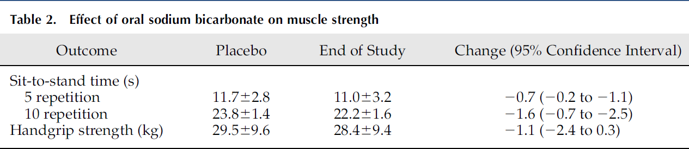
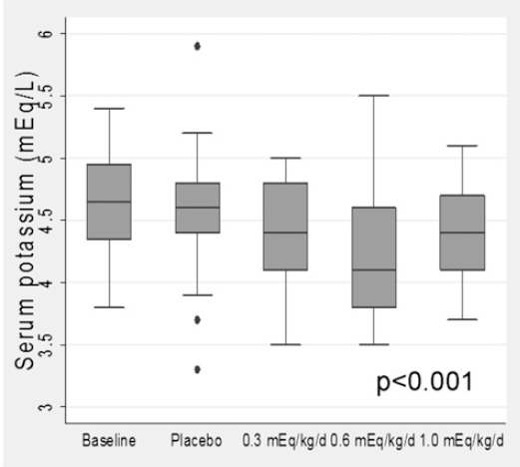
Other potential benefits of bicarb repletion
Abramowitz MK, et al. Clin J Am Soc Nephrol 8:714-20, 2013.
Notes:
In this single-blinded pilot study from March of 2009 to August of 2010, 20 adults with estimated GFR 15–45 ml/min per 1.73 m2 and serum bicarbonate 20–24 mEq/L were treated
during successive 2-week periodswith placebo followed by escalating oralNaHCO3 doses (0.3, 0.6, and 1.0mEq/kg
per day). At each visit, handgrip strength and time required to complete 5 and 10 repetitions of a sit-to-standtestwere
measured.

Slide 41
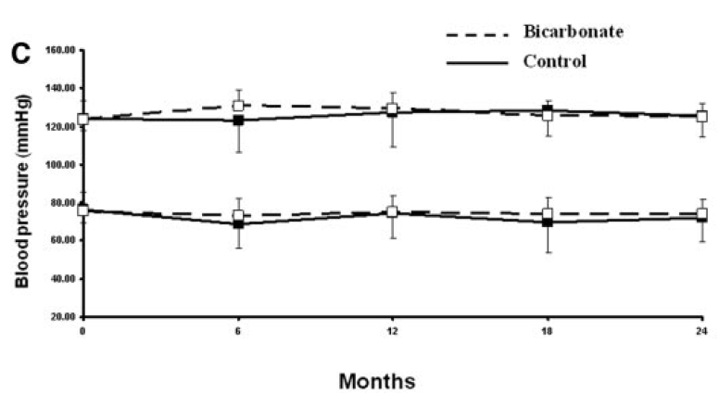
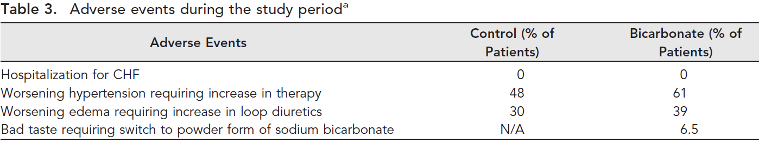
But . . . Sodium bicarb will cause edema and hypertension
de Brito-Ashurst et al. J Am Soc Nephrol 20:2075-84, 2009.

Slide 42
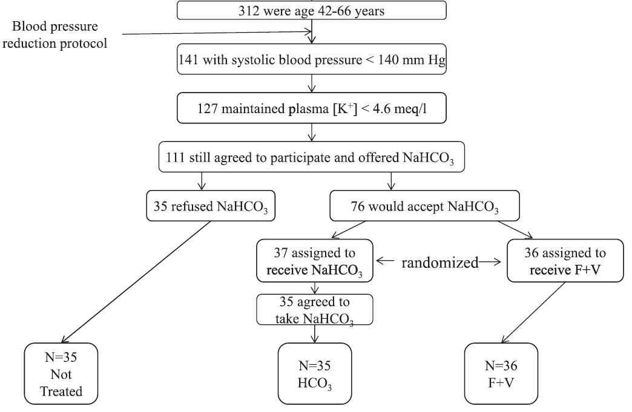
What about fruits and veggies?
e.g. apples, oranges, eggplant, spinach, cauliflower
1 mEq/kg/d
Goraya N, et al. Clin J Am Soc Nephrol 8:371-81, 2013.
Notes:
Inclusion criteria for all patients were as follows: (1) nonmalignant hypertension; (2) eGFR (by Modification of Diet in Renal Disease equation [10]) of 15–29 ml/min per 1.73 m2; (3) plasma TCO2 , 22 mM; (4) no diabetes or cardiovascular disease on problem lists; (5) two or more primary care physician visits in the preceding year; and (6) age $ 18 years and ability to give consent. Exclusion criteria for all patients were as follows: (1) primary kidney disease or findings consistent thereof, such as $3 red blood cells per high-powered field or urine cellular casts; (2) history of diabetes or fasting blood glucose level $ 110 mg/dl; (3) current pregnancy,
history of malignances, chronic infections, or clinical evidence of cardiovascular disease; (4) peripheral edema or diagnoses associated with edema, such as heart or liver failure or nephrotic syndrome; (5) plasma [K+] level . 4.6 mEq/L; and (6) taking or inability to stop taking drugs (other than angiotensin-converting enzyme [ACE] inhibitors) that limit K+ excretion

Slide 43
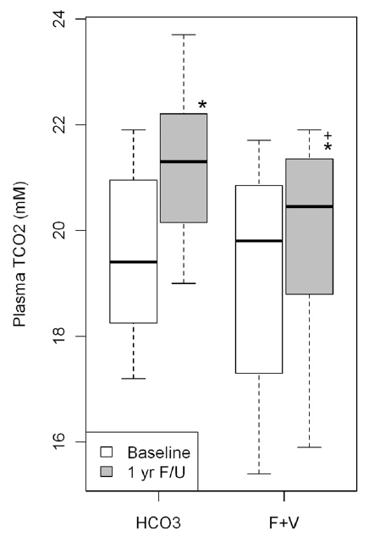
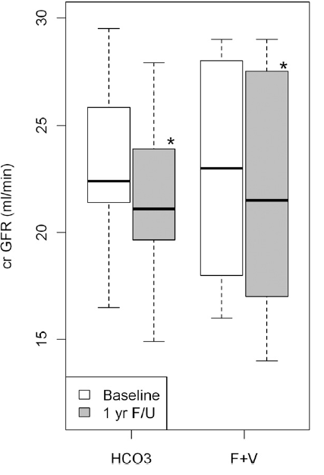
Goraya N, et al. Clin J Am Soc Nephrol 8:371-81, 2013.
Notes:
Results Plasma cystatinC–calculated eGFR did not differ at baseline and 1 year between groups. One-year PTCO2 was higher than baseline in the HCO3 group (21.261.3 versus 19.561.5 mM; P,0.01) and the fruits and vegetables group (19.961.7 versus 19.361.9 mM; P,0.01), consistent with improved metabolic acidosis, and was higher in the HCO3 than the fruits and vegetable group (P,0.001). One-year urine indices of kidney injury were
lower than baseline in both groups. Plasma [K+] did not increase in either group (but all were on loop diuretics; Blood pressure was slightly lower in the F+V group

Slide 44
How to correct CKD-related metabolic acidosis
Goal serum bicarbonate >22 mmol/L
Sodium-based alkali therapy
  Start 0.5-1 mEq/kg/d (e.g. 38-75 mEq/d for 75 kg patient)
  Sodium bicarbonate 325 tablet: 3.9 mEq
  Sodium citrate solution: 1 mEq/mL
  Baking soda: 54 mEq/level tsp

Slide 45
How to correct CKD-related metabolic acidosis
Fruits and Veggies: Must balance risk for hyperkalemia
High K+ | Low K+
Bananas | Apples
Potatoes | Watermelon
Almonds | Kale
Green beans | Cauliflower
Raisins | Corn Cereal
Apricots | Celery
Broccoli | Eggplant
Greens (except Kale) | Asparagus
Raisins, apricots | Brussel sprouts
Beets | Squash
http://www.heartspring.net/list_of_alkaline_foods.html
http://www.kidney.org

Slide 46
Summary II
Increased prevalence in stage 4-5 CKD
Due to decreased renal acid excretion
Major dietary acid source are meat-based proteins
Alkali repletion to goal serum bicarb ≥22 mEq/L may slow CKD progression
  But, potential risk for heart failure if exceed serum bicarb >24 mEq/L
Fruit & vegetables can replete bicarb level, but many present risk for hyperkalemia

Slide 47
Hyperkalemia

Slide 48
Case 4
A 46 year old morbidly obese African American gentleman with stage 3b CKD presents to clinic for follow-up. His CKD is thought to be secondary to diabetic nephropathy. He also has heart failure with stable 2 pillow orthopnea. His interim history is unremarkable, and he has been feeling well. As you had recommended, he has been eating a more well-balanced diet with fruits and vegetables.
He currently takes insulin glargine, lisinopril, metoprolol, spironolactone, aspirin, and atorvastatin.
BMI 32 kg/m²; BP=130/80; P=64. He has 1+ LE edema. The remainder of his exam is unremarkable.

Slide 49
Case 4 continued
140
112
46
Serum calcium 8.9 mg/dL
Serum phosphate 5.0 mg/dL
Urine protein-to-creatinine ratio 2.0 g/g
450
5.6
19
2.4
eGFR ~36 ml/min/1.73 m²
Which of the following factors is NOT contributing to his hyperkalemia?
A) Atorvastatin
B) Metoprolol
C) Spironolactone
D) Lisinopril
E) Hyperglycemia
F) Metabolic acidosis
Notes:
D

Slide 50
Risk Factors for Hyperkalemia
Characteristics | Odds Ratio | 95% CI
Female vs. male | 0.61 | 0.57, 0.66
Black vs. white | 1.29 | 1.25, 1.32
Either ACEi/ARB | 1.41 | 1.37, 1.44
Both ACEi/ ARB | 1.67 | 1.55, 1.80
Cancer | 1.16 | 1.13, 1.19
Diabetes | 1.51 | 1.47, 1.55
CVD | 1.14 | 1.12, 1.17
CKD Stage
3 | 2.24 | 2.17, 2.30
4 | 5.91 | 5.63, 6.20
5 | 11,00 | 10.34, 11.69
Einhorn LM, et al. Arch Intern Med 169:1156-62, 2009.
Notes:
ACEI/ ARBs raise serum potassium by 0.3-0.24 mmol/L in patients w/ CKD

Slide 51
Drug-Induced Hyperkalemia in CKD
Mechanisms | Drugs
Impaired RAS function | ACEi/ ARBs, β-blockers, heparin, NSAIDs, COX-2 inhibitors
Altered K+ distribution | Insulin antagonists, hypertonic solutions, digoxin, β-blockers
Increased K+ load | K+ supplements, herbal supplements, PRBC infusions
Reduced K+ excretion | K+ sparing diuretics, calcineurin inhibitors, TMP-SMX, pentamidine, lithium
K/DOQI Guidelines on Hypertension and Antihypertensive Agents in CKD

Slide 52
Case 4 continued
You referred the patient for nutritional consultation, initiated him on sodium citrate, and temporarily held his spironolactone and lisinopril. His potassium eventually improved, and you were able to resume his lisinopril.
On follow-up, however, you note that his serum potassium has increased again to 6.2 mEq/L, although his blood sugar is 200 mg/dL.
You refer him to the emergency department where he undergoes an EKG.

Slide 53
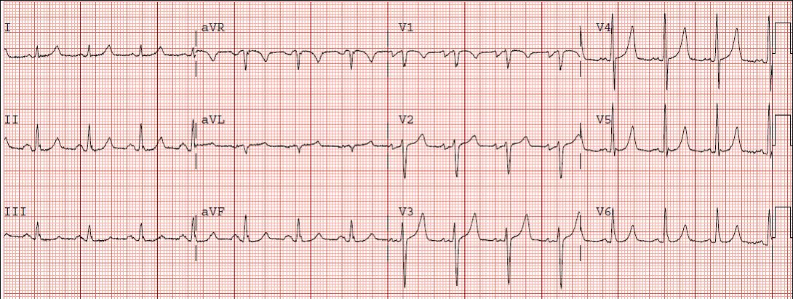
Which of the following is most correct?
IV calcium chloride will lower his serum K+.
He should be given Kayexalate® orally stat.
β₂-adrenergic agonists has a faster onset than treatment with regular insulin with glucose.
Sodium bicarbonate infusion is equally effective as insulin infusion.

Slide 54
Acute Management of Hyperkalemia
Treatment | Expected serum K+ ↓ | Peak effect | Duration | Mechanism
IV Calcium chloride | None | Instant | Transient | Stabilize myocardium
Insulin + dextrose | 0.5-1 mEq/L | 30-60 mins | 4-6 hrs | Cellular shift
B2-adrenergic agonists | 0.5-1 mEq/L | 30 mins | 2 hrs | Cellular shift
Sodium bicarbonate | Variable depending on acidosis | 4h |  | Cellular shift
Loop/ thiazide diuretics |  | Hours |  | ↑ renal K+ excretion
Kamel KS, Wei C. Nephrol Dial Transplant 18:2215-18, 2003.

Slide 55
Chronic Management of Hyperkalemia
Loop or thiazide diuretics
Laxatives
  As effective as cation exchange resins in sorbitol
  Those that induce secretory diarrhea may be more effective (e.g. bisacodyl)
  Diphenolic laxatives may stimulate colonic K+ secretion
Cation exchange resins
  Sodium polysterene sulfonate (SPS®, Kayexalate®)
  Mechanism
    Theoretical: Bound Na+ exchanged for K+ in colonic/ rectal lumen
    Likely: Accompanying sorbitol induces diarrhea
  Usually requires multiple doses
  Risk of bowel necrosis or perforation

Slide 56
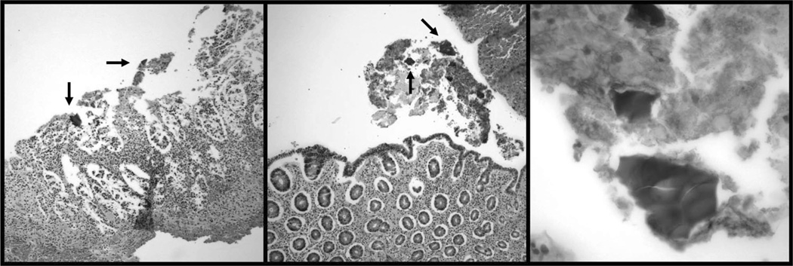
SPS-Associated Colonic Necrosis
Initial cases reported in post-op or critically ill patients who received enemas
More recent cases received oral form in non-post-op patients
Secondary to sorbitol or crystalization of resin within colonic mucosa
Avoid in post-op patients, those with ileus or bowel obstruction
Kamel KS, Schreiber M. Nephrol Dial Transplant 0:1-4, 2012.
McGowan CE, et al. South Med J. 102:493-7, 2009.
Notes:
eft: Ischemic and necrotic epithelium with SPS crystals (arrows) (H&E orig. mag. ×20); Center: Ischemic mucosa with epithelial attenuation, atrophy, and SPS crystals

Slide 57
Summary III
Risk factors for hyperkalemia include moderate-advanced CKD, black race and diabetes.
Common drug culprits: ACEi/ ARBs, beta-blockers and Bactrim
Acute treatment includes calcium chloride, insulin + dextrose, and possibly β2 agonists
Chronic treatment options include diuretics or laxatives
Unclear if SPS more effective than laxatives and carries the risk of bowel necrosis.

