Slide 1
A Primary Care Approach to CKD Management

Slide 2
Learning Objectives
Facilitate timely testing and intervention in patients at-risk for chronic kidney disease (CKD).
Apply appropriate clinical measures to manage risk and increase patient safety in CKD.
Co-manage and refer patients to nephrology specialists, when appropriate, in order to improve outcomes in CKD.

Slide 3
Case Question 1
A 50-year-old Hispanic female was diagnosed with type 2 diabetes at age 30. She has taken medications as prescribed since diagnosis. The fact that she has confirmed diabetes puts this patient at:
A. Higher risk for kidney failure and CVD
B. Higher risk for kidney failure only
C. Higher risk for CVD only
D. None of the above
Notes:
Answer A
Diabetes, an established CVD risk factor, is the leading cause of kidney failure

Slide 4
Case Question 2
A 42-year-old African American man with diabetic nephropathy and hypertension has a stable eGFR of 25 mL/min/1.73m². Observational Studies of Early as compared to Late Nephrology Referral have demonstrated which of the following?
A. Reduced 1-year Mortality
B. Increase in Mean Hospital Days
C. No change in serum albumin at the initiation of dialysis or kidney transplantation
D. Decrease in hematocrit at the initiation of dialysis or kidney transplantation
E. Delayed referral for kidney transplantation
Notes:
Answer: A
There are no randomized trials of early versus late nephrology referral in the literature. Interpretation of the approximately 50 published observational studies that assessed the timing of nephrology services and outcomes is complicated by heterogeneity in study design and variable definitions of early referral. The minimum of 3 months is probably less than the absolute amount of time required for assessment, education and preparation for RRT. A meta-analysis of 22 observational studies from 10 different countries found one year mortality was significantly reduced, 13 versus 29%, making answer A correct. This meta-analysis also showed early referral was associated with significantly fewer mean hospital days, higher serum albumin at initiation of RRT and higher hematocrit at RRT initiation. Thus, answers B, C, and D are incorrect, respectively. Greater choice of treatment options, including home hemodialysis, peritoneal dialysis and pre-emptive kidney transplantation, are associated with early initiation of nephrology services, making answer E incorrect.

Slide 5
Primary Care Providers –
First Line of Defense Against CKD
Primary care professionals can play a significant role in early diagnosis, treatment, and patient education
A greater emphasis on detecting CKD, and managing it prior to referral, can improve patient outcomes
CKD is Part of Primary Care

Slide 6
The Public Burden of CKD

Slide 7
CKD as a Public Health Issue
26 million American affected
Prevalence is 11-13% of adult population in the US
28% of Medicare budget in 2013, up from 6.9% in 1993
$42 billion in 2013
Increases risk for all-cause mortality, CV mortality, kidney failure (ESRD), and other adverse outcomes.
6 fold increase in mortality rate with DM + CKD
Disproportionately affects African Americans and Hispanics
ESRD, end stage renal disease

Slide 8
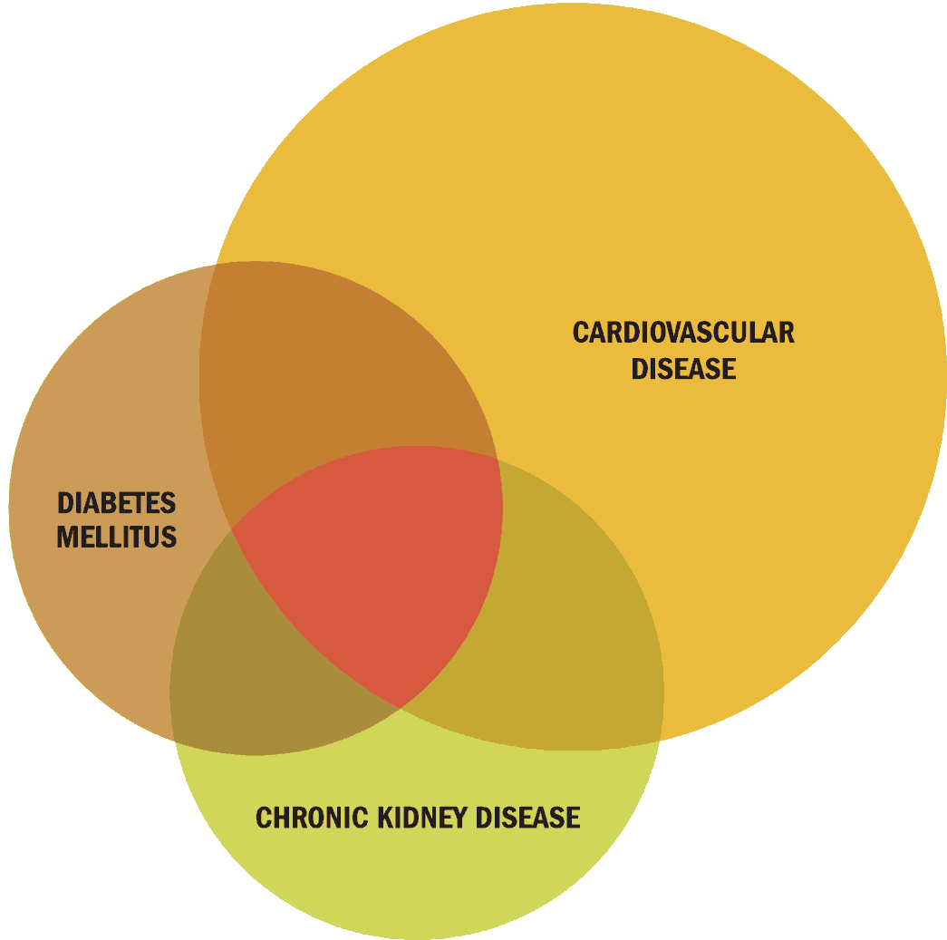
CKD-CVD-Diabetes Link: CKD is a Disease Multiplier

Slide 9
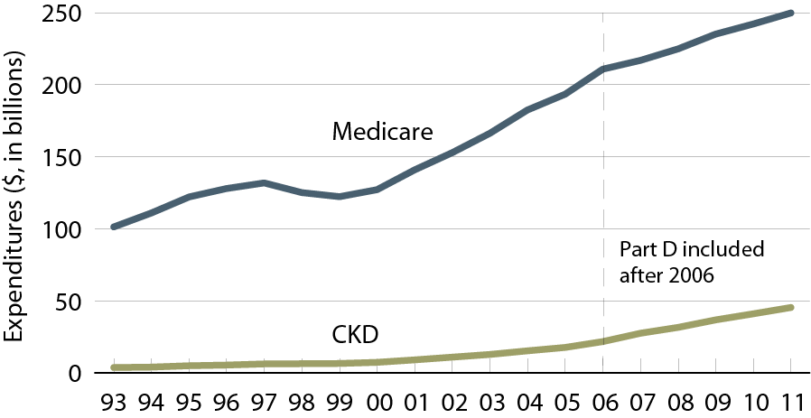
Overall expenditures for CKD in the
Medicare population age 65 & older
Point prevalent Medicare CKD patients age 65 & older; costs are total expenditures per calendar year.
USRDS ADR, 2013

Slide 10
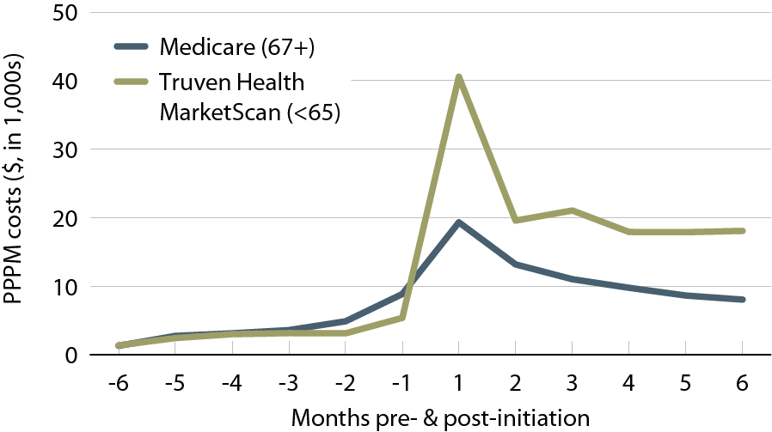
Per person per month (PPPM) expenditures during the transition to ESRD, by dataset, 2011
Preventing progression of CKD will help hold down costs as the treatment of kidney failure is expensive. ESRD requires some type of replacement therapy to maintain life.
Incident Medicare (age 67 & older) & Truven Health MarketScan (younger than 65) ESRD patients, initiating in 2008.
USRDS ADR, 2013

Slide 11
CKD Risk Factors*
Non-Modifiable
Family history of kidney disease, diabetes, or hypertension
Age 60 or older (GFR declines normally with age)
Race/U.S. ethnic minority status
Modifiable
Diabetes
Hypertension
History of AKI
Frequent NSAID use

Slide 12
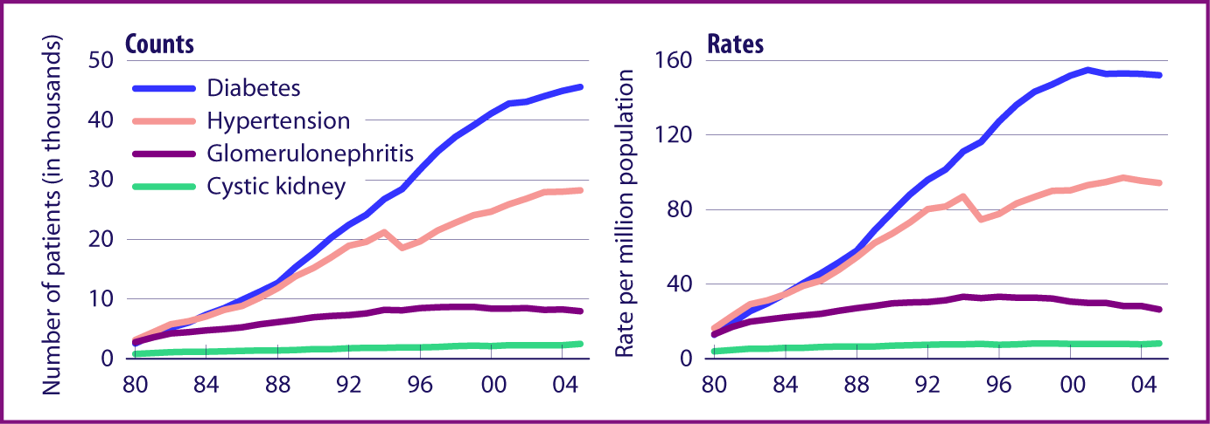
Diabetes and hypertension are
leading causes of kidney failure
Incident ESRD rates, by primary diagnosis, adjusted for age, gender, & race.
ESRD, end stage renal disease
USRDS ADR, 2007

Slide 13
CKD Screening and Evaluation

Slide 14
Gaps in CKD Diagnosis
Szczech, Lynda A, et al. "Primary Care Detection of Chronic Kidney Disease in Adults with Type-2 Diabetes: The ADD-CKD Study (Awareness, Detection and Drug Therapy in Type-2 Diabetes and Chronic Kidney Disease)." PLOS One - In press (2014).

Slide 15
Improved Diagnosis…
Studies demonstrate that clinician behavior changes when CKD diagnosis improves. Significant improvements realized in:¹⁻³
  Increased urinary albumin testing
  Increased appropriate use of ACEi or ARB
  Avoidance of NSAIDs prescribing among patients with low eGFR
  Appropriate nephrology consultation
Wei L, et al. Kidney Int. 2013;84:174-178.
Chan M, et al. Am J Med. 2007:120;1063-1070.
Fink J, et al. Am J Kidney Dis. 2009,53:681-668.
Notes:
Studies demonstrate that clinician behavior changes when CKD diagnosis improves (1-3).
Wei, L., MacDonald, T. M., Jennings, C., Sheng, X., Flynn, R. W., & Murphy, M. J. (2013). Estimated GFR reporting is associated with decreased nonsteroidal anti-inflammatory drug prescribing and increased renal function. Kidney In, 84(1), 174-8
Chan, M. R., Dall, A. T., Fletcher, K. E., Lu, N., & Trivedi, H. (2007). Outcomes in patients with chronic kidney disease referred late to nephrologists: a meta-analysis. Am J Med, 120(12), 1063-1070.
Fink, Jeffrey C. et al. “Chronic Kidney Disease as an Under-Recognized Threat to Patient Safety.” American journal of kidney diseases : the official journal of the National Kidney Foundation 53.4 (2009): 681–688. PMC. Web. 27 Jan. 2015.

Slide 16
Screening Tools: eGFR
Considered the best overall index of kidney function.
Normal GFR varies according to age, sex, and body size, and declines with age.
The NKF recommends using the CKD-EPI Creatinine Equation (2009) to estimate GFR. Other useful calculators related to kidney disease include MDRD and Cockroft Gault.
GFR calculators are available online at www.kidney.org/GFR.
Summary of the MDRD Study and CKD-EPI Estimating Equations:
https://www.kidney.org/sites/default/files/docs/mdrd-study-and-ckd-epi-gfr-estimating-equations-summary-ta.pdf
Notes:
Serum creatinine alone should not be used to estimate kidney function. A rise in blood creatinine levels is observed only after significant loss of functioning nephrons.
Estimates of GFR (eGFR) is considered a better way to measure kidney function. eGFR utilizes equations that use serum creatinine levels and some or all of the following variables: gender, age, weight, and race.
Glomerular filtration rate (GFR) is considered the best overall index of kidney function. Normal GFR varies according to age, sex, and body size, and declines with age. The National Kidney Foundation recommends using the CKD-EPI Creatinine Equation (2009) to estimate GFR.
No methods to estimate GFR unless patient is in steady state. All are of limited value for patients at extremes of age, over/underweight, amputees, non black/white racial groups.
MDRD
Cockroft Gault
CKD-EPI (Preferred)
The MDRD equation was the first and most widely used eGFRcr equation with a known calibration. Recommended by NKF KDOQI 2002.
The CKD-EPI (2009) equation improves on the MDRD Study equation, particularly in reducing bias at eGFR >60 allowing for reporting across the full range of eGFR. Recommended by KDIGO 2013
Adjust for body size for most accurate eGFR with MDRD and CKD-EPI Creatinine Clearance
GFR calculators are available online at www.kidney.org/GFR.
Summary of the MDRD Study and CKD-EPI Estimating Equations
https://www.kidney.org/sites/default/files/docs/mdrd-study-and-ckd-epi-gfr-estimating-equations-summary-ta.pdf
Calculators for Health Care Professionals
http://www.kidney.org/professionals/KDOQI/gfr_calculator

Slide 17
Screening Tools: ACR
Urinary albumin-to-creatinine ratio (ACR) is calculated by dividing albumin concentration in milligrams by creatinine concentration in grams.
Creatinine assists in adjusting albumin levels for varying urine concentrations, which allows for more accurate results versus albumin alone.
Spot urine albumin-to-creatinine ratio for quantification of proteinuria
  New guidelines classify albuminuria as mild, moderately or severely increased
First morning void preferable
24hr urine test rarely necessary

Slide 18
Criteria for CKD
Abnormalities of kidney structure or function, present for >3 months, with implications for health
Either of the following must be present for >3 months:
  ACR >30 mg/g
  Markers of kidney damage (one or more*)
  GFR <60 mL/min/1.73 m²
*Markers of kidney damage can include nephrotic syndrome, nephritic syndrome, tubular syndromes, urinary tract symptoms, asymptomatic urinalysis abnormalities, asymptomatic radiologic abnormalities, hypertension due to kidney disease.m²

Slide 19
Old Classification of CKD as Defined by Kidney Disease Outcomes Quality Initiative (KDOQI) Modified and Endorsed by KDIGO
Stage | Description | Classification by Severity | Classification by Treatment
1 | Kidney damage with normal or increased GFR | GFR ≥ 90
2 | Kidney damage with mild decrease in GFR | GFR of 60-89 | T if kidney transplant
3 | Moderate decrease in GFR | GFR of 30-59 | recipient
4 | Severe decrease in GFR | GFR of 15-29 | D if dialysis
5 | Kidney failure | GFR < 15 | D if dialysis
Note: GFR is given in mL/min/1.73² m²
National Kidney Foundation. KDOQI Clinical Practice Guidelines for Chronic Kidney Disease:
Evaluation, Classification, and Stratification. Am J Kidney Dis 2002;39(suppl 1):S1-S266
KDIGO, Kidney Disease: Increasing Global Outcomes

Slide 20
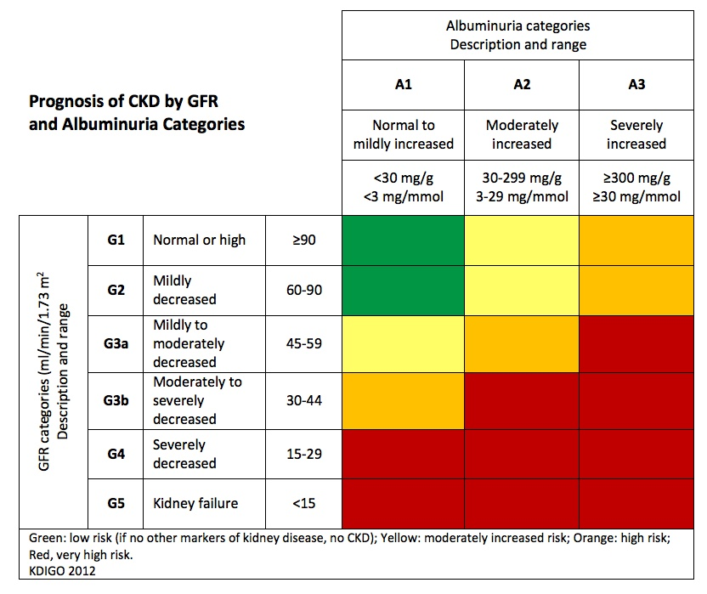
Classification of CKD Based on GFR and Albuminuria Categories: “Heat Map”
Kidney Disease: Improving Global Outcomes (KDIGO) CKD Work Group. Kidney Int Suppls. 2013;3:1-150.
Notes:
Colors: Represents the risk for progression, morbidity and mortality by color from best to worst. Green: low risk (if no other markers of kidney disease, no CKD); Yellow: moderately increased risk; Orange: high risk; Red, very high risk.

Slide 21
CKD Management and the PCP

Slide 22
Goals of Care in CKD
Slow decline in kidney function
Blood pressure control¹
  ACR <30 mg/g: ≤140/90 mm Hg
  ACR 30-300 mg/g: ≤130/80 mm Hg*
  ACR >300 mg/g: ≤130/80 mm Hg
  Individualize targets and agents according to age, coexistent CVD, and other comorbidities
  ACE or ARB
*Reasonable to select a goal of 140/90 mm Hg, especially for moderate albuminuria (ACR 30-300 mg/g.)²
Kidney Disease: Improving Global Outcomes (KDIGO) Blood Pressure Work Group. Kidney Int Suppl. (2012);2:341-342.
KDOQI Commentary on KDIGO Blood Pressure Guidelines. Am J Kidney Dis. 2013;62:201-213.

Slide 23
Slowing CKD Progression: ACEi or ARB
Risk/benefit should be carefully assessed in the elderly and medically fragile
Check labs after initiation
  If less than 25% SCr increase, continue and monitor
  If more than 25% SCr increase, stop ACEi and evaluate for RAS
Continue until contraindication arises, no absolute eGFR cutoff
Better proteinuria suppression with low Na diet and diuretics
Avoid volume depletion
Avoid ACEi and ARB in combination^{1,2}
  Risk of adverse events (impaired kidney function, hyperkalemia)
Kunz R, et al. Ann Intern Med. 2008;148:30-48.
Mann J, et al. ONTARGET study. Lancet. 2008;372:547-553.
Notes:
Avoid combination of ACEi and ARB. Data has shown an increase in adverse events, particularly impaired kidney function and hyperkalemia.1,2
1. Kunz R, Friedrich C,Wolbers M, Mann JF. Meta-analysis: effect of monotherapy and combination therapy with inhibitors of
the renin angiotensin system on proteinuria in renal disease. Ann Intern Med. Jan 1 2008;148(1):30-48.
2. Mann JF, Schmieder RE, McQueen M, et al. Renal outcomes with telmisartan, ramipril, or both, in people at high vascular risk (the ONTARGET study): a multicentre, randomised, doubleblind, controlled trial. Lancet. Aug 16 2008;372(9638):547-553

Slide 24
Goals of Care in CKD: Glucose Control
Target HbA1c ~7.0%
Can be extended above 7.0% with comorbidities or limited life expectancy, and risk of hypoglycemia
Risk of hypoglycemia increases as kidney function becomes impaired
Declining kidney function may necessitate changes to diabetes medications and renally-cleared drugs
NKF KDOQI. Diabetes and CKD: 2012 Update.
Am J Kidney Dis. 2012 60:850-856.

Slide 25
Modification of Other CVD Risk Factors in CKD
Smoking cessation
Exercise
Weight reduction to optimal targets
Lipid lowering therapy
  In adults >50 yrs, statin when eGFR ≥ 60 ml/min/1.73m²; statin or statin/ezetimibe combination when eGFR < 60 ml/min/1.73m²
  In adults < 50 yrs, statin if history of known CAD, MI, DM, stroke
Aspirin is indicated for secondary but not primary prevention
Kidney Disease: Improving Global Outcomes (KDIGO) CKD Work Group. Kidney Int Suppls. 2013;3:1-150.

Slide 26
Detect and Manage CKD Complications
Anemia
  Initiate iron therapy if TSAT ≤ 30% and ferritin ≤ 500 ng/mL (IV iron for dialysis, Oral for non-dialysis CKD)
  Individualize erythropoiesis stimulating agent (ESA) therapy: Start ESA if Hb <10 g/dl, and maintain Hb <11.5 g/dl. Ensure adequate Fe stores.
  Appropriate iron supplementation is needed for ESA to be effective
CKD-Mineral and Bone Disorder (CKD-MBD)
  Treat with D3 as indicated to achieve normal serum levels
  2000 IU po qd is cheaper and better absorbed than 50,000 IU monthly dose.
  Limit phosphorus in diet (CKD stage 4/5), with emphasis on decreasing packaged products - Refer to renal RD
  May need phosphate binders

Slide 27
Detect and Manage CKD Complications
Metabolic acidosis
  Usually occurs later in CKD
  Serum bicarb >22mEq/L
  Correction of metabolic acidosis may slow CKD progression and improve patients functional status^{1,2}
Hyperkalemia
  Reduce dietary potassium
  Stop NSAIDs, COX-2 inhibitors, potassium sparing diuretics (aldactone)
  Stop or reduce beta blockers, ACEi/ARBs
  Avoid salt substitutes that contain potassium
Mahajan, et al. Kidney Int. 2010;78:303-309.
de Brito-Ashurst I, et al. J Am Soc Nephrol. 2009;20:2075-2084.
Notes:
Correction of metabolic acidosis may slow CKD progression and improve patients functional status^{1,2}
1) Mahajan A, Simoni J, Sheather S, Broglio K, Rajab M, Wesson D. Daily oral sodium bicarbonate preserves glomerular filtration rate by slowing its decline in early hypertensive nephropathy. Kdney Int. 2010;78:303-309.
2) de Brito-Ashurst I, Varagunam M, Raftery M, Yaqoob M. Bicarbonate supplementation slows progression of CKD and improves nutritional status. J Am Soc Nephrol. 2009;20:2075-2084.
Hyperkalemia can usually be controlled with the measures above, but if not use Kayexelate, or other diarrhea inducing laxative (lactulose).

Slide 28
A Balanced Approach to Nutrition in CKD:
Macronutrient Composition and Mineral Content*
Adapted from DASH (dietary approaches to stop hypertension) diet.
*Adjust so total calories from protein, fat, and carbohydrate are 100%. Emphasize such whole-food sources as fresh vegetables, whole grains, nuts, legumes, low-fat or nonfat dairy products, canola oil, olive oil, cold-water fish, and poultry.
*(CKD Stages 1-4)
NKF KDOQI. Am J Kidney Dis. 2007;49(suppl 2):S1-S179.

Slide 29
What can primary care providers do?
Recognize and test at-risk patients
Educate patients about CKD and treatment
Manage blood pressure and diabetes
Address other CVD risk factors
Monitor eGFR and ACR (encourage labs to report these tests)

Slide 30
What can primary care providers do?
Evaluate and manage anemia, malnutrition, CKD-MBD, and other complications in at-risk patients
Refer to dietitian for nutritional guidance
Consider patient safety issues in CKD
Consult or team with a nephrologist (co-management)
Refer patient to nephrology when appropriate

Slide 31
Co-Management, Patient Safety, and Nephrology Specialist Referral

Slide 32
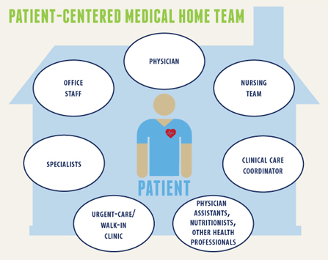
Co-Management Model
Collaborative care
  Formal arrangement
  Curbside consult
Care coordination
Clinical decision support
Population health
  Development of treatment protocols

Slide 33
Collaborative Care Agreements
Soft Contract between primary care and nephrologist
Defines responsibilities of primary care
  Provide pertinent clinical information to inform the consultation prior to the scheduled visit.
  Initiate a phone call if the condition is emergent
  Provide timely referrals with adequate number of visits to treat the condition.
Defines responsibilities of nephrologist
  Timely communication of consultation (7 days routine & 48 hours emergent) – fax if no electronic information sharing
  No consultation to other specialist initiated without primary care input

Slide 34
Who Should be Involved in the
Patient Safety Approach to CKD?
Kidney
damage and normal or ↑ GFR
Kidney
damage and
mild ↓
GFR
Moderate
↓ GFR
Severe
↓ GFR
Kidney
failure
Stage 1 Stage 2 Stage 3 Stage 4 Stage 5
GFR 90 60 30 15
Primary Care Practitioner
Nephrologist
Consult?
Patient safety
The Patient (always)
and other subspecialists (as needed)

Slide 35
Impact of primary care CKD detection with a patient safety approach
Patient Safety
Following
CKD detection
Improved diagnosis creates opportunity for strategic preservation of kidney function
Fink et al. Am J Kidney Dis. 2009,53:681-668
Notes:
Sequalea of the disease that are inproperly managed to consequences of misguided therapeutic interventuions
Jeff Fink
35

Slide 36
CKD Patient Safety Issues
Medication errors
  Toxicity (nephrologic or other)
  Improper dosing
  Inadequate monitoring
Electrolytes
  Hyperkalemia
  Hypoglycemia
  Hypermagnesemia
  Hyperphosphatemia
Miscellaneous
  Multidrug-resistant infections
  Vessel preservation/dialysis access
Fink JC, Brown J, Hsu, VD, et al. Am J Kidney Dis 2009;53:681-668.
Notes:
Sequalea of the disease that are improperly managed to consequences of misguided therapeutic interventions
Fink
36

Slide 37
CKD Patient Safety Issues
Diagnostic tests
  Iodinated contrast media: AKI
  Gadolinium-based contrast: NSF
  Sodium Phosphate bowel preparations: AKI, CKD
CVD
  Missed diagnosis
  Improper management
Fluid management
  Hypotension
  AKI
  CHF exacerbation
AKI = acute kidney injury; CHF = congestive heart failure; NSF = nephrogenic systemic fibrosis.
Fink JC, Brown J, Hsu, VD, et al. Am J Kidney Dis 2009;53:681-668..
Notes:
Sequalea of the disease that are improperly managed to consequences of misguided therapeutic interventuions
Fink
37

Slide 38
Common Medications Requiring Dose
Reduction in CKD
Renally cleared beta blockers
  Atenolol, bisoprolol, nadolol
Digoxin
Some Statins
  Lovastatin, pravastatin, simvastatin. Fluvastatin, rosuvastatin
Antimicrobials
  Antifungals, aminoglycosides, Bactrim, Macrobid
Enoxaparin
Methotrexate
Colchicine
Allopurinol
Gabapentin
  CKD 4- Max dose 300mg qd
  CKD 5- Max dose 300mg qod
Reglan
  Reduce 50% for eGFR< 40
  Can cause irreversible EPS with chronic use
Narcotics
  Methadone and fentanyl best for ESRD patients
    Lowest risk of toxic metabolites

Slide 39
Key Points on Medications in CKD
CKD patients at high risk for drug-related adverse events
Several classes of drugs renally eliminated
Consider kidney function and current eGFR (not just SCr) when prescribing meds
Minimize pill burden as much as possible
Remind CKD patients to avoid NSAIDs
No Dual RAAS blockade
Any med with >30% renal clearance probably needs dose adjustment for CKD
No bisphosphonates for eGFR <30
Avoid GAD for eGFR <30

Slide 40
Indications for Referral to Specialist Kidney Care Services for People with CKD
Acute kidney injury or abrupt sustained fall in GFR
GFR <30 ml/min/1.73m² (GFR categories G4-G5)
Persistent albuminuria (ACR > 300 mg/g)*
Atypical Progression of CKD**
Urinary red cell casts, RBC more than 20 per HPF sustained and not readily explained
Hypertension refractory to treatment with 4 or more antihypertensive agents
Persistent abnormalities of serum potassium
Recurrent or extensive nephrolithiasis
Hereditary kidney disease
*Significant albuminuria is defined as ACR ≥300 mg/g (≥30 mg/mmol) or AER ≥300 mg/24 hours, approximately
equivalent to PCR ≥500 mg/g (≥50 mg/mmol) or PER ≥500 mg/24 hours
**Progression of CKD is defined as one or more of the following: 1) A decline in GFR category accompanied by a 25%
or greater drop in eGFR from baseline; and/or 2) rapid progression of CKD defined as a sustained decline in eGFR of more than 5ml/min/1.73m²/year. KDOQI US Commentary on the 2012 KDIGO Evaluation and Management of CKD
Notes:
Late nephrology referral before the onset of chronic kidney failure remains common. U.S. data from 2011 reveal 42.1% of new dialysis starts had no prior nephrology care.*
*USRDS 2013 Annual Data Report
www.usrds.org

Slide 41
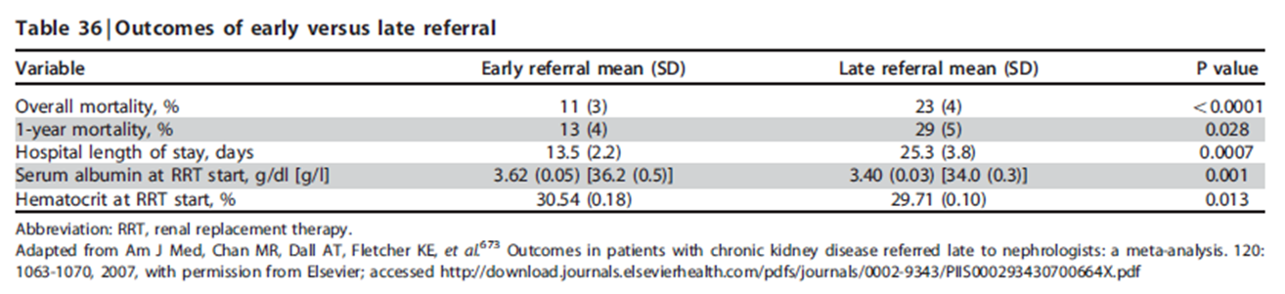
Observational Studies of Early vs. Late
Nephrology Consultation
Chan M, et al. Am J Med. 2007;120:1063-1070.
http://download.journals.elsevierhealth.com/pdfs/journals/0002-9343/PIIS000293430700664X.pdf
KDIGO CKD Work Group. Kidney Int Suppls. 2013;3:1-150.
Notes:
Overall there are more than 50 studies in the published literature and a meta-analysis of 22 of these studies from 10 different countries serves to underline some of the key messages (Table), giving an indication of the size of the differences in mortality and hospital length of stay and also highlighting the significantly lower serum albumin level in late referred patients.1,2
1. Kidney Disease: Improving Global Outcomes (KDIGO) CKD Work Group. Kidney Int Suppls. 2013;3:1-150.
2. Chan MR, Dall AT, Fletcher KE et al. Outcomes in patients with chronic kidney disease referred late to nephrologists: a meta-analysis. Am J Med. 2007; 120: 1063-1070.
http://download.journals.elsevierhealth.com/pdfs/journals/0002-9343/PIIS000293430700664X.pdf

Slide 42
Take Home Points
PCPs play an important role
Identify risk factors
Know patient’s GFR using appropriate screening tools
Help your patient adjust medication
Modify diet
Partner and refer to specialist

Slide 43
Additional Online Resources for CKD Learning
National Kidney Foundation: www.kidney.org
United States Renal Data Service: www.usrds.org
CDC’s CKD Surveillance Project: http://nccd.cdc.gov/ckd
National Kidney Disease Education Program (NKDEP): http://nkdep.nih.gov

