Slide 1
A PCP’s Guide to CKD Screening and Delaying Progression

Slide 2
Learning Objectives
Utilize appropriate screening tools, such as GFR and ACR, in order to diagnose and monitor CKD patients.
Classify CKD, based on GFR and albuminuria categories, in order to guide appropriate treatment.
Implement evidence-based management strategies to delay CKD progression in patients and improve outcomes.

Slide 3
Case Question 1
A 55 year-old Caucasian-American man, with a history of type 2 diabetes (15 years), hypertension (3 years) dyslipidemia (5 years) and cardiovascular disease (myocardial infarction 3 years ago). He was recently diagnosed with CKD. His most recent labs reveal an eGFR of 45 ml/min/1.73m² and an ACR of 38 mg/g. Which of the following should be avoided?
A. ACE and ARB in combination
B. Daily low-dose aspirin
C. NSAIDs
D. Statins
E. A and C
Notes:
The correct answer is E.
Routine daily aspirin prophylaxis for CVD is not contraindicated in CKD. Nonsteroidal anti-inflammatory drugs (ibuprofen, naproxen) use should generally be avoided. ACE and ARB in combination is not recommended.

Slide 4
Case Question 2
All of the following adult patients should be referred for nephrology consultation, EXCEPT?
A. Initial visit: eGFR 26 & 3 months later: eGFR 28 (mL/min/1.73m²)
B. Initial visit: eGFR 55, & 3 months later: eGFR 43 confirmed with repeat eGFR 45 (mL/min/1.73m²)
C. Initial visit: ACR 450 & 3 months later: ACR 355 (mg/g) on both dates the eGFR > 60 mL/min/1.73m²
D. Initial visit: eGFR > 60 & 3 months later: eGFR > 60 (mL/min/1.73m²) with personal history of Autosomal Dominant Polycystic Kidney Disease.
E. Initial visit: eGFR 42 & 3 months later: eGFR 44 (mL/min/1.73m²) on both dates the ACR < 30 mg/g.
Notes:
The correct answer is E. This patient has CKD G3bA1 with no indication for nephrology referral. Answer B is incorrect as the eGFR trend reflects rapid progression of CKD, which is defined as a sustained decline of more than 5 ml/min/1.73 m² per year. Answer A and C are incorrect with low eGFR (G4) and severe albuminuria (A3) as indications for nephrology referral, respectively. Answer D is incorrect as a hereditary cause of CKD.

Slide 5
Steps to CKD Patient Care
Does the patient have CKD?
Assess GFR, albuminuria
Determine etiology
Assess for evidence of progression
Assess for associated complications
Patient education
Assess life expectancy and patient wishes for dialysis/transplantation

Slide 6
Definition of Chronic Kidney Disease
CKD is defined as abnormalities of kidney structure or function, present for >3 months, with implications for health.
Kidney Disease: Improving Global Outcomes (KDIGO) CKD Work Group. Kidney Int Suppls. 2013;3:1-150.

Slide 7
Assign Albuminuria Category
Albuminuria Categories in CKD
Category | ACR (mg/g) | Terms
A1 | < 30 | Normal to mildly increased
A2 | 30-300 | Moderately increased*
A3 | > 300 | Severely increased**
*Relative to young adult level. ACR 30-300 mg/g for > 3 months indicates CKD. **Including nephrotic syndrome (albumin excretion ACR > 2220 mg/g).
Kidney Disease: Improving Global Outcomes (KDIGO) CKD Work Group. Kidney Int Suppls. 2013;3:1-150.

Slide 8
Assign GFR Category
GFR Categories in CKD
Category | GFR | Terms | Clinical Presentations
G1 | ≥ 90 | Normal or high | Markers of kidney damage (nephrotic syndrome, nephritic syndrome, tubular syndromes, urinary tract symptoms, asymptomatic urinalysis abnormalities, asymptomatic radiologic abnormalities, hypertension due to kidney disease)
G2 | 60-89 | Mildly decreased*
G3a | 45-59 | Mildly to moderately decreased | Mild to severe complications: Anemia Mineral and bone disorder Elevated parathyroid hormone Cardiovascular disease Hypertension Lipid abnormalities Low serum albumin
G3b | 30-44 | Moderately to severely decreased
G4 | 15-29 | Severely decreased
G5 | < 15 | Kidney failure | Includes all of the above Uremia
GFR = mL/min/1.73 m² *Relative to young adult level In the absence of evidence of kidney damage, neither GFR category G1 nor G2 fulfill the criteria for CKD. Refer to a nephrologist and prepare for kidney replacement therapy when GFR <30 mL/min/1.73m².
Kidney Disease: Improving Global Outcomes (KDIGO) CKD Work Group. Kidney Int Suppls. 2013;3:1-150.

Slide 9
Classification of CKD Based on GFR and Albuminuria Categories: “Heat Map”
Colors: Represents the risk for progression, morbidity and mortality by color from best to worst. Green: low risk (if no other markers of kidney disease, no CKD); Yellow: moderately increased risk; Orange: high risk;
Red, very high risk.
Numbers: Represent a recommendation for the number of times per year the patient should be monitored.
Refer: Indicates that nephrology referral and services are recommended.
*Referring clinicians may wish to discuss with their nephrology service depending on local arrangements regarding monitoring or referral.
Adapted from Kidney Disease: Improving Global Outcomes (KDIGO) CKD Work Group. Kidney Int Suppls. 2013;3:1-150.
Notes:
Earlier referral might also be acceptable, and should be a clinical judgment, based on age, etiology, and rate of decline of kidney function.
Key to Figure:
Colors: Represents the risk for progression, morbidity and mortality by color from best to worst.
Green: low risk (if no other markers of kidney disease, no CKD); Yellow: moderately increased risk; Orange: high risk;
Red, very high risk.
Numbers: Represent a recommendation for the number of times per year the patient should be monitored.
Refer: Indicates that nephrology referral and services are recommended.
*Referring clinicians may wish to discuss with their nephrology service depending on local arrangements regarding monitoring or referral.
Adapted with permission from KDIGO 2012

Slide 10
Screening Tools: eGFR
Considered the best overall index of kidney function.
Normal GFR varies according to age, sex, and body size, and declines with age.
The NKF recommends using the CKD-EPI Creatinine Equation (2009) to estimate GFR. Other useful calculators related to kidney disease include MDRD and Cockroft Gault.
GFR calculators are available online at www.kidney.org/GFR.
Summary of the MDRD Study and CKD-EPI Estimating Equations:
https://www.kidney.org/sites/default/files/docs/mdrd-study-and-ckd-epi-gfr-estimating-equations-summary-ta.pdf
Notes:
Serum creatinine alone should not be used to estimate kidney function. A rise in blood creatinine levels is observed only after significant loss of functioning nephrons.
Estimates of GFR (eGFR) is considered a better way to measure kidney function. eGFR utilizes equations that use serum creatinine levels and some or all of the following variables: gender, age, weight, and race.
Glomerular filtration rate (GFR) is considered the best overall index of kidney function. Normal GFR varies according to age, sex, and body size, and declines with age. The National Kidney Foundation recommends using the CKD-EPI Creatinine Equation (2009) to estimate GFR.
No methods to estimate GFR unless patient is in steady state. All are of limited value for patients at extremes of age, over/underweight, amputees, non black/white racial groups.
MDRD
Cockroft Gault
CKD-EPI (Preferred)
The MDRD equation was the first and most widely used eGFRcr equation with a known calibration. Recommended by NKF KDOQI 2002.
The CKD-EPI (2009) equation improves on the MDRD Study equation, particularly in reducing bias at eGFR >60 allowing for reporting across the full range of eGFR. Recommended by KDIGO 2013
Adjust for body size for most accurate eGFR with MDRD and CKD-EPI Creatinine Clearance
GFR calculators are available online at www.kidney.org/GFR.
Summary of the MDRD Study and CKD-EPI Estimating Equations
https://www.kidney.org/sites/default/files/docs/mdrd-study-and-ckd-epi-gfr-estimating-equations-summary-ta.pdf
Calculators for Health Care Professionals
http://www.kidney.org/professionals/KDOQI/gfr_calculator

Slide 11
eGFR, SCr Comparison
Age | Weight in lbs Height in Ft/in | Sex | Race | SCr mg/dl | eGFR ml/ min per CKD-EPI | eGFR Adj for BMI
25 | 285 6’ | M | AA | 1.6 | 68 | 97
49 | 180 5’4’’ | F | Hispanic | 1.6 | 38 | 41
67 | 155 5’8’’ | M | Asian | 1.6 | 44 | 46
92 | 98 5’1’’ | F | Caucasian | 1.6 | 28 | 22

Slide 12
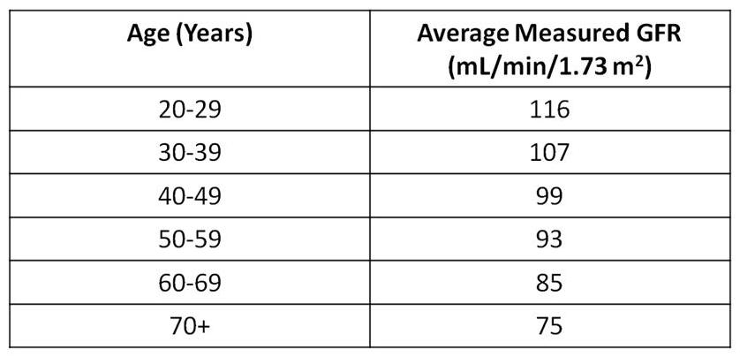
Average Measured GFR by Age in People Without CKD
Coresh J, et al. Am J Kidney Dis. 2003;41(1):1-12.
Notes:
This slide shows the average values of estimated GFR by decade in the general population.¹
GFR declines gradually with age, even in people without kidney disease. However, there appears to be substantial variation among individuals and the reasons for decline are not known. Although the age-related decline in GFR was formerly considered part of normal aging, decreased GFR in the elderly is an independent predictor of adverse outcomes, such as death and cardiovascular disease. In addition, decreased GFR in the elderly requires adjustment in drug dosages, as with other patients with CKD.
1. Coresh J, Astor BC, Greene T, Eknoyan G, Levey AS. Prevalence of chronic kidney disease and decreased kidney function in the adult U.S. population: Third National Health and Nutrition Examination Survey. Am J Kidney Dis. 2003;41(1):1-12.

Slide 13
Use These Equations Cautiously, if at all in ….
Patients who have/are:
  Poor nutrition/loss of muscle mass
  Amputation
  Chronic illness
  Not African American or Caucasian
  Changing serum creatinine
  Obese
  Very elderly, young

Slide 14
Clinical Evaluation of Patients with CKD
Blood pressure
HbA1c
Serum creatinine
  Use a GFR estimating equation or clearance measurement; don’t rely on serum creatinine concentration alone
  Be attentive to changes in creatinine over time--even in “normal” range
Urinalysis
  Urine sediment
  Spot urine for protein/creatinine or albumin/creatinine ratio
Albuminuria/Proteinuria
Electrolytes, blood glucose, CBC

Slide 15
Clinical Evaluation of Patients with CKD
Depending on stage: albumin, phosphate, calcium, iPTH
Renal imaging
Depending on age and H&P
  Light chain assay, serum or urine protein electrophoresis (SPEP, UPEP)
  HIV, HCV, HBV tests
  Complements, other serologies—limited role unless specific reason

Slide 16
Clinical Evaluation of Patients with CKD
Standard urine dipsticks detect total protein >30 mg/dL - not sensitive enough for “microalbuminuria” screening
Untimed, random “spot” urine for albumin/creatinine or protein/creatinine ratio (first morning void preferred)

Slide 17
Definitions: Albuminuria and Proteinuria
Normal Albuminuria
  Albumin:creatinine ratio < 30 mg/g creatinine
Moderately Increased Albuminuria
  Albumin:creatinine ratio 30-300 mg/g creatinine
  24-hour urine albumin 30-300 mg/d
Severely Increased Albuminuria
  Albumin:creatinine ratio > 300 mg albumin/g creatinine
  24-hour urine albumin > 300 mg/d
Proteinuria
  (+) urine dipstick at > 30 mg/dl
  > 200 mg protein/g creatinine
  24-hour urine protein > 300 mg/d

Slide 18
Slowing Progression of CKD

Slide 19
CKD- Progression of Kidney Failure
Variable depending on several factors including (1) type of disease and (2) how well it is treated
GFR
100
90
80
70
60
50
40
30
20
10
Slow decline
Stage 2
Rapid decline
Moderate decline
Stage 3
Stage 4
Stage 5 (Dialysis)
0 1 2 3 4 5 6 7
Years

Slide 20
Blood Pressure and CKD Progression
Control of BP more important than exactly which agents are used
  Avoidance of side-effects is important
With proteinuria: diuretic + ACEi or ARB
No proteinuria: no clear drug preference
  ACEi or ARB ok to use
Fujisaki K, et al. Impact of combined losartan/hydrochlorothiazide on proteinuria in patients with CKD and hypertension. Hypertens Res. 2014;37:993-998.
Notes:
Fujisaki K, Tsuruya K, Nakano T, Taniguchi M, Higashi H, Katafuchi R, Kanai H, Nakayama M, Hirakata H, Kitazono T. Impact of combined losartan/hydrochlorothiazide on proteinuria in patients with chronic kidney disease and hypertension. Hypertens Res. 2014;37(11):993-998.

Slide 21
Slowing CKD Progression: ACEi/ARB
Check labs after initiation
  If less than 25% SCr increase, continue and monitor
  If more than 25% SCr increase, stop ACEi and evaluate for RAS
Continue until contraindication arises, no absolute eGFR cutoff
Better proteinuria suppression with low Na diet and diuretics
Avoid volume depletion

Slide 22
Goals for Renoprotection
Target blood pressure in non-dialysis CKD:¹
  ACR <30 mg/g: ≤140/90 mm Hg
  ACR 30-300 mg/g: ≤130/80 mm Hg*
  ACR >300 mg/g: ≤130/80 mm Hg
  Individualize targets and agents according to age, coexistent CVD, and other comorbidities
Avoid ACEi and ARB in combination^{3,4}
  Risk of adverse events (impaired kidney function, hyperkalemia)
*Reasonable to select a goal of 140/90 mm Hg, especially for moderate albuminuria (ACR 30-300 mg/g.)²
Kidney Disease: Improving Global Outcomes (KDIGO) Blood Pressure Work Group. Kidney Int Suppl. (2012);2:341-342.
KDOQI Commentary on KDIGO Blood Pressure Guidelines. Am J Kidney Dis. 2013;62:201-213.
Kunz R, et al. Ann Intern Med. 2008;148:30-48.
Mann J, et al. ONTARGET study. Lancet. 2008;372:547-553.
Notes:
Avoid combination of ACEi and ARB. Data has shown an increase in adverse events, particularly impaired kidney function and hyperkalemia.1,2
1. Kunz R, Friedrich C,Wolbers M, Mann JF. Meta-analysis: effect of monotherapy and combination therapy with inhibitors of
the renin angiotensin system on proteinuria in renal disease. Ann Intern Med. Jan 1 2008;148(1):30-48.
2. Mann JF, Schmieder RE, McQueen M, et al. Renal outcomes with telmisartan, ramipril, or both, in people at high vascular risk (the ONTARGET study): a multicentre, randomised, doubleblind, controlled trial. Lancet. Aug 16 2008;372(9638):547-553.

Slide 23
Lower BP Slows Decline in GFR
MAP (mmHg)
95
98
101
104
107
110
113
116
119
0
-2
-4
-6
GFR (mL/min/year)
-8
Untreated
HTN
-10
-12
130/85
140/90
-14
But newer studies suggest there may be other dangers down here
Bakris GL, et al. Am J Kidney Dis. 2000
Notes:
Bakris GL, Mangrum A, Copley JB, Vicknair N, Sadler R. Effect of calcium channel or beta-blocker on the progression of diabetic nephropathy in African Americans. Hypertension. 1997;29(3):744-750.
Bakris GL, Williams M, Dworkin L, Elliott WJ, Epstein M, Toto R, Tuttle K, Douglas J, Hsueh W, Sowers J. Preserving renal function in adults with hypertension and diabetes: a consensus approach. National Kidney Foundation Hypertension and Diabetes Executive Committees Working Group. Am J Kidney Dis. 2000;36(3):646-661.
Randomised placebo-controlled trial of effect of ramipril on decline in glomerular filtration rate and risk of terminal failure in proteinuric, non-diabetic nephropathy. The GISEN group (Gruppo Italiano di Studi Epidemiologici in Nefrologia). Lancet. 1997;349(9069):1857-1863.
Herbert LA, Bain RP, Verme D, Cattran D, Whittier FC, Tolchin N, Rohde RD, Lewis EJ. Remission of nephrotic range proteinuria in type 1 diabetes. Collaborative Study Group. Kidney Int. 1994;46(6):1688-1693.
Klahr S, Levey AS, Beck GJ, Caggiula AW, Hunsicker L, Kusek JW, Striker G. The effects of dietary protein restriction and blood-pressure control on the progression of chronic renal failure. N Eng J Med. 1994;330(13):877-884.
Lebovitz HE, Wiegmann TB, Cnaan A, Shahinfar S, Sica DA, Broadstone V, Schwartz SL, Mengel MC, Segal R, Versaggi JA, et al. Renal protective effects of enalapril in hypertensive NIDDM:Role of baseline albuminuria. Kidney Int Suppl. 1994;Suppl 45:150-155.
Parving HH, Hommel E, Damkjaer Nielsen M, Giese J. Effect of captopril on blood pressure and kidney function in normotensive insulin dependent diabetics with nephropathy. BMJ. 1989;299(6698):533-536.
Viberti G, Morgensen CE, Groop LC, Pauls JF. Effect of captopril on progression to clinical proteinuria in patients with insulin-dependent diabetes mellitus and microalbuminuria. JAMA. 1994;271(4):275-279.

Slide 24
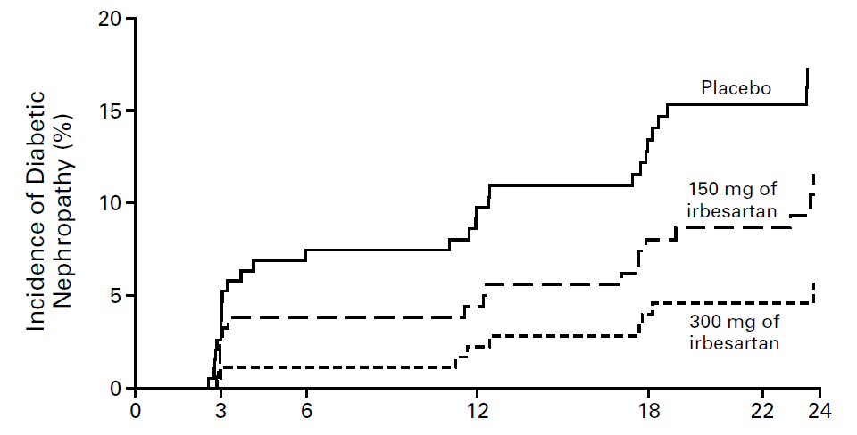
ARBs and Progression of Diabetic Nephropathy
Most placebo-controlled studies in type 2 DM have been in patients with either “microalbuminuria” or established nephropathy treated with ARB
ARB and ACEi appear to be equivalent for “microalbuminuria” and proteinuria reduction
Parving HH, et al. N Engl J Med. 2001
Notes:
IRMA II Incidence of Progression to Diabetic Nephropathy
The primary efficacy measure in the IRMA II study was the time from the baseline visit to the first detection of overt nephropathy, defined by a urinary albumin excretion rate in an overnight specimen that was >200 µg per minute and at least 30% higher than the baseline rate on at least two consecutive visits. During this 24-month study, overt nephropathy developed in 30 patients in the placebo group, as compared with 19 patients in the 150 mg group (P=0.08) and 10 patients in the 300 mg group (P<0.001). The Kaplan–Meier curves for the placebo group and the 300 mg group separated at the 3 month visit and continued to diverge. The unadjusted hazard ratio for diabetic nephropathy was 0.61 (P=0.08) in the 150 mg group and 0.30 (P<0.001) in the 300 mg group. After adjustment for the baseline level of microalbuminuria and the blood pressure achieved during the study, the hazard ratio for diabetic nephropathy was 0.56 in the 150 mg group (P=0.05) and 0.32 in the 300 mg group (P<0.001).
Reference:
Parving HH, Lehnert H, Brochner-Mortensen J, Gomis R, Andersen S, Arner P. The effect of irbesartan on the development of diabetic nephropathy in patients with type 2 diabetes. N Engl J Med. 2001;345(12):870-878.

Slide 25
Managing Hyperglycemia
Hyperglycemia is a fundamental cause of vascular complications, including CKD
Poor glycemic control has been associated with albuminuria in type 2 diabetes.
Risk of hypoglycemia increases as kidney function becomes impaired.
Declining kidney function may necessitate changes to diabetes medications and renally-cleared drugs.
Target HbA1c ~7.0%
  Can be extended above 7.0% with comorbidities or limited life expectancy, and risk of hypoglycemia.
NKF KDOQI. Diabetes and CKD: 2012 Update.
Am J Kidney Dis. 2012 60:850-856.

Slide 26
Other Goals of CKD Management
Limit sodium intake to < 90 mmol (2 gm; 5 gm salt) per day
CVD management: lipids, ASA (secondary prevention), etc

Slide 27
Lipid Disorders in CKD
Use statin alone or statin + ezetimibe in adults > 50 yrs with CKD 3-5(ND)
Use statin alone in adults > 50 yrs with CKD 1-2
In adults < 50 yrs use statin alone if history of known CAD, MI, DM, stroke
Treat according to a “fire and forget” rather than “treat to target” strategy
  Treat CKD patients (Non dialysis) with statins or Statin/exterminate combinations without the need for follow up blood tests.
Kidney Disease: Improving Global Outcomes (KDIGO) Lipid Work Group. Kidney Int Suppl. 2013;3:259-305.
http://kdigo.org/home/2013/11/04/kdigo-announces-publication-of-guideline-on-lipid-management/
Notes:
KDIGO Lipid Guidelines FIRE and FORGET approach: Treat CKD patients (Non dialysis) with statins or Statin/ exterminate combinations without the need for follow up blood tests.
http://kdigo.org/home/2013/11/04/kdigo-announces-publication-of-guideline-on-lipid-management/

Slide 28
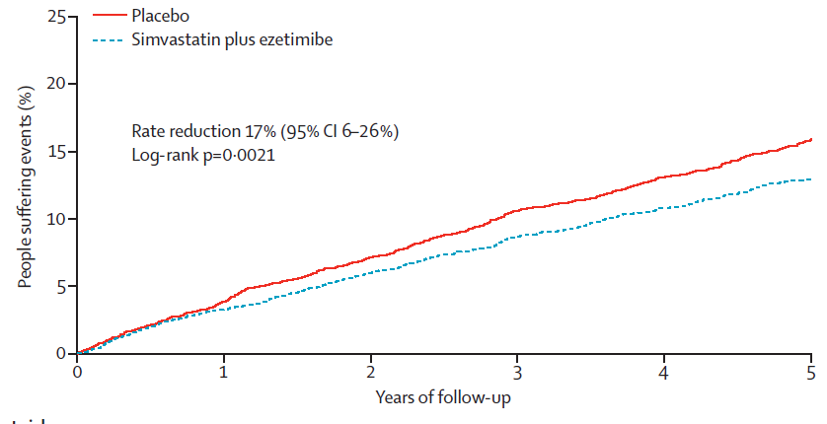
Lipid Disorders in CKD
A 32% reduction in LDL→17% reduction in primary outcome (nonfatal MI, coronary death, nonhemorrhagic stroke, arterial revascularization)
No reduction in CKD progression, overall or CAD mortality, other individual CAD end-points
Baigent C, et al. Study of Heart and Renal Protection (SHARP). Lancet. 2011;11:60739-60743.

Slide 29
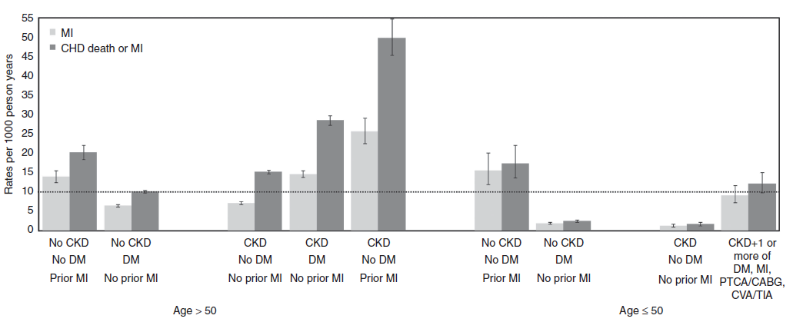
10-Year Coronary Risk Based on Age and Other Patient Characteristics
Future 10-year coronary risk based on various patient characteristics. Data are unadjusted rates from 1,268,029 participants in the Alberta Kidney Disease cohort.^{1,2}
CABG, coronary artery bypass grafting; CHD, coronary heart disease; CKD, chronic kidney disease; CVA, cerebrovascular accident; DM, diabetes mellitus; MI, myocardial infarction; PTCA, percutaneous transluminal coronary angioplasty; TIA, transient ischemic attack.
1) Kidney Disease: Improving Global Outcomes (KDIGO) Lipid Work Group. Kidney Int Suppl. 2013;3:259-305.
2) Hemmelgarn BR, et al. Overview of the alberta kidney disease network. BMC Nephrol. 2009:30:10.

Slide 30
Overview of Managing CKD Complications

Slide 31
Complications of Kidney Failure Start in Stage 3 and Progress
Fluid overload
Water overload
Acid Base Imbalance
Acidic Blood
Electrolyte Abnormalities
Malnutrition
Kidney Failure
Bone Disease
Brittle bones
And fractures
Hypertension
Cardiac Disease
Vascular Disease
Anemia/blood loss
Decrease production
Of red blood cells
Notes:
Many CKD complications, such as anemia and CKD-MBD, are typically managed by the nephrologist, particularly in the cases of advanced CKD and kidney failure. It is important to check these if and when referring, but in many cases managing them can be more the role of the nephrologist.

Slide 32
Anemia in CKD
Initiate iron therapy if TSAT ≤ 30% and ferritin ≤ 500 ng/mL (IV iron for dialysis, Oral for non-dialysis CKD)
Individualize ESA therapy – Start ESA if Hb <10 g/dl, and maintain Hb <11.5 g/dl. Ensure adequate Fe stores.
  Appropriate iron supplementation is needed for ESA to be effective
ESA usually not required for nephrogenic anemia until late CKD 4/CKD 5
Diagnostic workup of anemia is particularly important if severity of anemia is disproportionate to CKD staging
Important to avoid transfusion in transplant candidates
  If transfused use leukocyte filter to reduce HLA sensitization

Slide 33
CKD-MBD Testing
CKD Stage | Calcium, Phosphorus | PTH | 25(OH)D
Stage 3 | Every 6-12 months | Once then based on CKD progression | Once, then based on level and treatments
Stage 4 | Every 3-6 months | Every 6-12 months
Stage 5 | Every 1-3 months | Every 3-6 months
Use CKD progression, presence or absence of abnormalities, treatment response and side effects to guide testing frequency.

Slide 34
CKD-MBD
Treat with D3 as indicated to achieve normal serum levels
2000 IU po qd is cheaper and better absorbed than 50,000 IU monthly dose.
Limit phosphorus in diet, with emphasis on decreasing packaged products - Refer to renal RD
May need phosphate binders
DEXA doesn’t predict fracture risk in CKD 3-5

Slide 35
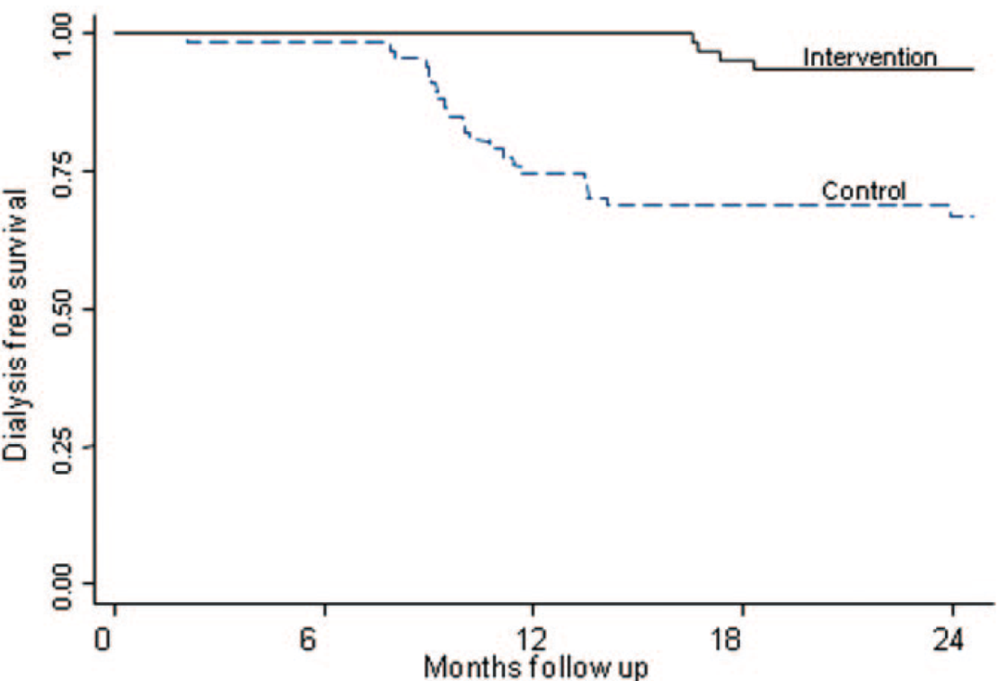
Metabolic Acidosis
Often becomes apparent at GFR < 25-30 ml/min
  More severe with higher protein intake
May contribute to bone disease, protein catabolism, and progression of CKD
Correction of metabolic acidosis may slow CKD progression and improve patients functional status^{1,2}
Adults with CKD (eGFR 15-30 ml/min/1.73m²) with bicarbonate 16-20 mmol/L; treated with sodium bicarbonate for 2 years to normalize serum bicarbonate concentration²
Mahajan, et al. Kidney Int. 2010;78:303-309.
de Brito-Ashurst I, et al. J Am Soc Nephrol. 2009;20:2075-2084.
Notes:
Correction of metabolic acidosis may slow CKD progression and improve patients functional status^{1,2}
1) Mahajan A, Simoni J, Sheather S, Broglio K, Rajab M, Wesson D. Daily oral sodium bicarbonate preserves glomerular filtration rate by slowing its decline in early hypertensive nephropathy. Kdney Int. 2010;78:303-309.
2) de Brito-Ashurst I, Varagunam M, Raftery M, Yaqoob M. Bicarbonate supplementation slows progression of CKD and improves nutritional status. J Am Soc Nephrol. 2009;20:2075-2084.

Slide 36
Metabolic Acidosis
Maintain serum bicarbonate > 22 mmol/L
  Start with 0.5-1 mEq/kg per day
  Sodium bicarbonate tablets
    325mg, 625 mg tablets; 1 g = 12 mEq
  Sodium citrate solution
    1 mEq/ml
    Avoid if on aluminum phosphate binders
  Baking soda
    54 mmol/level tsp
Notes:
Correction of metabolic acidosis may slow CKD progression and improve patients functional status^{1,2}
1) Mahajan A, Simoni J, Sheather S, Broglio K, Rajab M, Wesson D. Daily oral sodium bicarbonate preserves glomerular filtration rate by slowing its decline in early hypertensive nephropathy. Kdney Int. 2010;78:303-309.
2) de Brito-Ashurst I, Varagunam M, Raftery M, Yaqoob M. Bicarbonate supplementation slows progression of CKD and improves nutritional status. J Am Soc Nephrol. 2009;20:2075-2084.

Slide 37
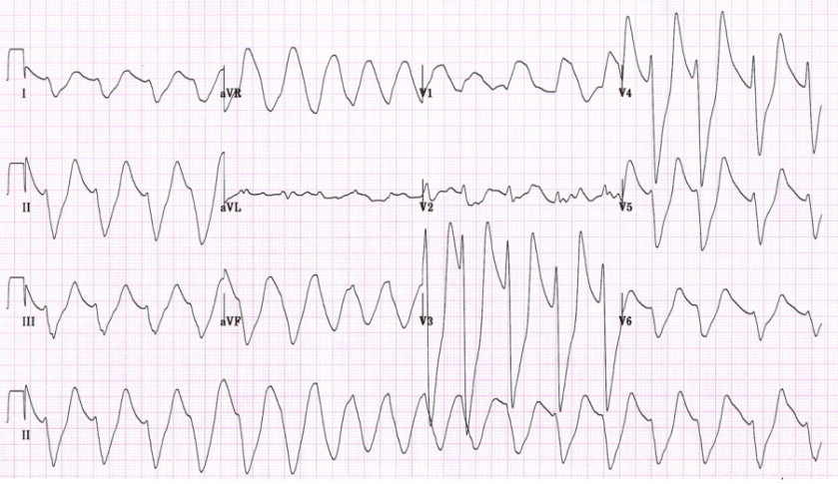
Hyperkalemia
First try reduction of dietary potassium
Stop NSAIDs, COX-2 inhibitors
Stop potassium sparing diuretics
  Aldactone
Stop or reduce beta blockers
Stop or reduce ACEi/ARBs
Avoid salt substitutes that contain potassium

Slide 38
Acute Management of Hyperkalemia
Treatment | Expected serum K+ ↓ | Peak effect | Duration | Mechanism
IV Calcium chloride | None | Instant | Transient | Stabilize myocardium
Insulin + dextrose | 0.5-1 mEq/L | 30-60 mins | 4-6 hrs | Cellular shift
B2-adrenergic agonists | 0.5-1 mEq/L | 30 mins | 2 hrs | Cellular shift
Sodium bicarbonate | Variable depending on acidosis | 4h |  | Cellular shift
Loop/ thiazide diuretics |  | Hours |  | ↑ renal K+ excretion
Kamel KS, Wei C. Nephrol Dial Transplant. 18:2215-18, 2003.

Slide 39
Chronic Management of Hyperkalemia
Loop or thiazide diuretics
Laxatives
  As effective as cation exchange resins in sorbitol
  Those that induce secretory diarrhea may be more effective (e.g. bisacodyl)
  Diphenolic laxatives may stimulate colonic K+ secretion
Cation exchange resins
  Sodium polystyrene sulfonate
  Mechanism
    Theoretical: Bound Na+ exchanged for K+ in colonic/ rectal lumen
    Likely: Accompanying sorbitol induces diarrhea
  Usually requires multiple doses
  Risk of bowel necrosis or perforation

Slide 40
Risk Factors for Infection in People with CKD
Advanced age
High burden of coexisting illnesses (e.g., diabetes)
Hypoalbuminuria
Immunosuppressive therapy
Nephrotic syndrome
Uremia
Anemia and malnutrition
High prevalence of functional disabilities
Kidney Disease: Improving Global Outcomes (KDIGO) CKD Work Group. Kidney Int Suppls. 2013;3:1-150.

Slide 41
Vaccination in CKD
Annual influenza vaccine for all adults with CKD, unless contraindicated.
Polyvalent pneumococcal vaccine when eGFR < 30 ml/min/1.73m² and at high risk of pneumococcal infection (e.g., nephrotic syndrome, diabetes, receiving immunosuppression), unless contraindicated. Offer revaccination within 5 years.
Hepatitis B immunization when GFR < 30 ml/min/1.73 m². Confirm response with appropriate serological testing.
Use of a live vaccine should consider the patient’s immune status (e.g., immunosuppression).
Kidney Disease: Improving Global Outcomes (KDIGO) CKD Work Group. Kidney Int Suppls. 2013;3:1-150.

Slide 42
Malnutrition and CKD
Malnutrition or protein energy wasting (PEW) is common in CKD and is associated with poor patient outcomes.
Malnutrition in CKD begins as early as stages 3 and 4. Risk increases with progression of the disease.
Preventing PEW or malnutrition may require clinical interventions to assess nutritional status, individualize strategies for prevention and treatment, provide patient instruction, and promote patient adherence.
A specialty-trained registered dietician can help address the nutritional aspects so that protein wasting can be diminished.
NKF KDOQI. Am J Kidney Dis. 2000;35(suppl 2):S1-S3.
NKF KDOQI. Am J Kidney Dis. 2007;49(suppl 2):S1-S179.

Slide 43
A Balanced Approach to Nutrition in CKD:
Macronutrient Composition and Mineral Content*
Adapted from DASH (dietary approaches to stop hypertension) diet.
*Adjust so total calories from protein, fat, and carbohydrate are 100%. Emphasize such whole-food sources as fresh vegetables, whole grains, nuts, legumes, low-fat or nonfat dairy products, canola oil, olive oil, cold-water fish, and poultry.
*(CKD Stages 1-4)
NKF KDOQI. Am J Kidney Dis. 2007;49(suppl 2):S1-S179.

Slide 44
Education and Counseling
Ethical, psychological, and social care (e.g., social bereavement, depression, anxiety)
Dietary counseling and education on other lifestyle modifications (e.g., exercise, smoking cessation)
Involve the patient, family and children if possible
Offer literature in both traditional and interactive formats
Use educational materials written in the patient’s language
Assess the need for low-level reading materials
Use internet resources and smartphone apps as appropriate
Use visual aids such as handouts, drawings, CDs, and DVDs
Involve other health care professionals in educating patients/families
Be consistent in the information provided

Slide 45
Mental Health Counseling
Psychiatric illnesses like depression are associated with many chronic diseases.
Depression is linked to early CKD, progressive CKD, kidney failure, hospitalization and increased mortality. ¹⁻⁴
Patients with GFR <60 mL/min/1.73m² should undergo regular assessment for impairment of functioning and well-being.⁵
Palmer S, et al. Am J Kidney Dis. 2013;62:493-505.
Hedayati S, et al. Am J Kidney Dis. 2009 Sep;54(3):424-32.
Kimmel P, et al. Kidney Int. 2000;57:2093-2098.
Tsai Y, et al. Am J Kidney Dis. 2012;60:54-61.
NKF KDOQI. Am J Kidney Dis. 2002;39(2 Suppl 1):S1-266.
Notes:
Hedayati SS, Minhajuddin AT, Toto RD, Morris DW, Rush AJ. Prevalence of major depressive episode in CKD. Am J Kidney Dis. 2009 Sep;54(3):424-32.
Palmer SC, Vecchio M, Craig JC, Tonelli M, Johnson DW, Nicolucci A, Pellegrini F, Saglimbene V, Logroscino G, Hedayati SS, Strippoli GF. Association between depression and death in people with CKD: a meta-analysis of cohort studies. Am J Kidney Dis. 2013 Sep;62(3):493-505.
Kimmel PL, Peterson RA, Weihs KL, Simmens SJ, Alleyne S, Cruz I, Veis JH. Multiple measurements of depression predict mortality in a longitudinal study of chronic hemodialysis outpatients. Kidney Int. 2000 May;57(5):2093-8.
Tsai YC, Chiu YW, Hung CC, Hwang SJ, Tsai JC, Wang SL, Lin MY, Chen HC. Association of symptoms of depression with progression of CKD.
Am J Kidney Dis. 2012 Jul;60(1):54-61.

Slide 46
CKD Care Among Special Populations

Slide 47
Considerations for CKD Management in Older Adults
More than 36 million adults are now over the age of 65 and some 50% have two or more chronic diseases.¹
Management requires an individualized approach with attention to unique considerations for older adults.
Treatment of hypertension in older adults has been shown to reduce CV morbidity and mortality. However, older frail adults should be monitored for risk of hypotension.^{2,3}
Less stringent glycemic goals can be appropriate for older adults with other comorbidities, or those at higher risk for hypoglycemia.⁴
Exercise can have multiple benefits. A weight control program should be individually tailored to preserve body cell mass and function, while losing fat mass.^{5,6}
U.S. Census Bureau. Population by age and gender 2008. www.census.gov.
Katz P, Gilbert J. Geriatrics and Aging. 2008;11:509-514.
Aronow W. Clin Geriatr Med. 2008; 11(8):457-463.
NKF KDOQI. Am J Kidney Dis. 2012 60:850-856.
Hornick T, Aron D. Clev Clin J Med. 2008;75:70-78.
NHLBI. ww.nhlbi.nih.gov.

Slide 48
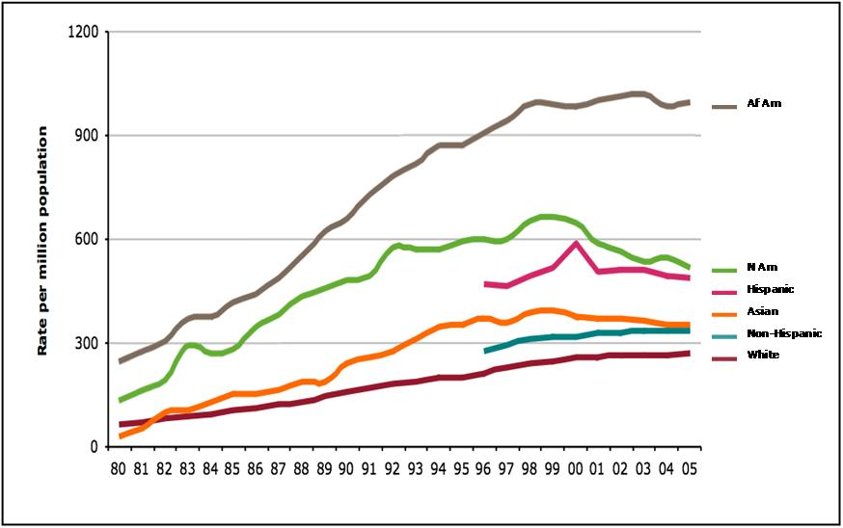
Incidence of ESRD Varies Widely by Race and Ethnicity
Incident ESRD patients; rates adjusted for age & gender.
USRDS
Notes:
Ethnicity has been associated with advanced CKD, poorly controlled diabetes and high risk of cardiovascular disease.

Slide 49
Additional Online Resources for CKD Learning
National Kidney Foundation: www.kidney.org
United States Renal Data Service: www.usrds.org
CDC’s CKD Surveillance Project: http://nccd.cdc.gov/ckd
National Kidney Foundation: www.kidney.org
United States Renal Data Service: www.usrds.org
National Kidney Disease Education Program (NKDEP): http://nkdep.nih.gov

