Slide 1
Renal Replacement Therapy: What the PCP Needs to Know

Slide 2
Learning Objectives
Describe treatment options for renal replacement therapy to improve awareness and understanding.
Use evidence-based strategies to manage patients with kidney failure in need of renal replacement therapy to improve outcomes.
Manage patients receiving dialysis or living with a kidney transplant, from a primary care perspective.

Slide 3
Question 1
A patient with progressive CKD has opted for hemodialysis for renal replacement therapy. Which type of vascular access is associated with better outcomes in hemodialysis patients?
A. Central venous cuffed catheter
B. Arteriovenous graft
C. Arteriovenous fistula
D. Temporary central venous catheter
Notes:
The correct answer is C.
Arteriovenous fistulas are associated with better outcomes in hemodialysis patients.

Slide 4
Question 2
Another patient with progressive CKD is considering a kidney transplant. Which one of the following statements is correct?
A. CKD patients can be referred to a transplant center when their GFR is < 20 mL/min/1.73m²
B. Pre-emptive and live kidney transplants are associated with better graft survival
C. Most common cause of kidney transplant loss is death with a functional transplant
D. All of the above
Notes:
The correct answer is D.
All of these statements are correct.

Slide 5
Renal Replacement Therapy Overview and Considerations for the PCP

Slide 6
Indications for Renal Replacement Therapy
Hyperkalemia
Metabolic acidosis
Fluid overload (recurrent CHF admissions)
Uremic pericarditis (rub)
Other non specific uremic symptoms: anorexia and nausea, impaired nutritional status, increased sleepiness, and decreased energy level, attentiveness, and cognitive tasking, …

Slide 7
Treatment Options for Renal Replacement Therapy
ESRD
Comfort Care
Hemodialysis
Peritoneal Dialysis
Kidney Transplant
Notes:
There are essentially three options to a patient facing ESRD:
1- Dialysis
2- Transplantation, which has been clearly shown to be the best treatment option
3- or no renal replacement therapy leading to a certain death over time (an average of 10 to 90 days).
The relationship between the different renal replacement options is illustrated in this figure. Patients can start either PD or HD and switch to either modalities then receive a kidney transplant or they can also receive a pre-emptive kidney transplant.

Slide 8
Treatment Options for Renal Replacement Therapy
ESRD
Comfort Care
Hemodialysis
Peritoneal Dialysis
Kidney Transplant
Notes:
There are essentially three options to a patient facing ESRD:
1- Dialysis
2- Transplantation, which has been clearly shown to be the best treatment option
3- or no renal replacement therapy leading to a certain death over time (an average of 10 to 90 days).
The relationship between the different renal replacement options is illustrated in this figure. Patients can start either PD or HD and switch to either modalities then receive a kidney transplant or they can also receive a pre-emptive kidney transplant.

Slide 9
Dialysis Options
Dialysis
Hemodialysis
Peritoneal Dialysis
In-Center HD (3 x week)
Home HD (short daily, nocturnal)
Manual (CAPD)
Cycler (CCPD)
Home
Notes:
They have to choose between hemodialysis and
peritoneal dialysis.
Hemodialysis can be done at home with a machine that is smaller than the traditional in-hospital/outpatient clinic machine.
Peritoneal dialysis can either be done with a cycler or manually

Slide 10
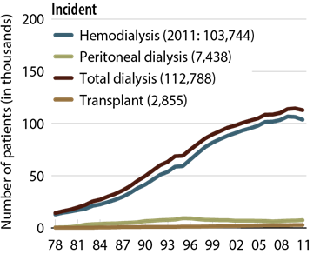
Incident Patient Counts (USRDS) by 1st Modality
USRDS 2013 ADR
Notes:
Of note, peritoneal dialysis is cheaper than HD
Transplant should always be the gold standard for RRT

Slide 11
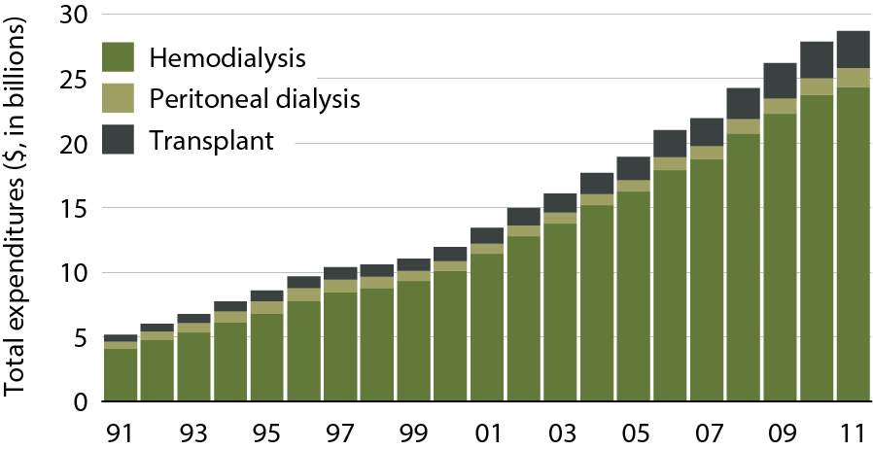
Total Medicare ESRD expenditures, by modality
Period prevalent ESRD patients.
USRDS 2013 ADR

Slide 12
Referral and Education for Patients with Progressive CKD
Refer patients early, when eGFR < 30 ml/min/1.73 m²
Education about types of renal replacement therapy:
  Hemodialysis (vascular access +++)
  Peritoneal Dialysis (QOL advantage +++)
  Kidney Transplantation
    Refer when eGFR < 20 ml/min/1.73 m²
    Living kidney transplant (family, friends)
    Build time on list before dialysis initiation
    Even transplant before dialysis initiation (pre-emptive)
No PICC lines for patients with eGFR < 45 mL/min/1.73m²

Slide 13
Advantages of Timely Referral in Patients with Progressive CKD
Improves patient preparation for RRT
Greater use of permanent vascular access
Avoidance of emergent hemodialysis initiation
Greater utilization of transplantation and self-care dialysis (i.e., peritoneal dialysis or home hemodialysis)
Management of medications which may help to delay the need for RRT
Gives the nephrologist adequate time to counsel patients through this challenging transition in their lives
KDIGO Transplant Guidelines

Slide 14
Medical Health and Wellness: Components of Multidisciplinary Care in Progressive CKD
Education and counseling about different RRT modalities, transplant options, and vascular access surgery
Protocols for laboratory and clinic visits; with attention to CKD and CVD-associated comorbidities (e.g., high blood pressure)
Ethical, psychological, and social care (e.g., social bereavement, depression, anxiety)
Dietary counseling and education on other lifestyle modifications (e.g., exercise, smoking cessation)
Vaccination program
KDIGO Transplant Guidelines

Slide 15
Early Vaccination for Hepatitis B: Too Often Forgotten!
Patients with ESRD have ↓ response to vaccination
(Secondary to general suppression of immune system)
After Hepatitis B vaccination in ESRD patients:
  50 – 60 % develop antibodies, compared to > 90% in patients without renal failure
  Have Lower titers
  Have protective levels for shorter duration
Stevens CE et al. NEJM 1984; 311: 496
Buti M et al. Am J Nephrol 1992; 112: 144

Slide 16
Other Considerations for Vaccination in Patients with Progressive CKD
Influenza vaccine annually, unless contraindicated.
Polyvalent pneumococcal vaccine:
  eGFR <30 ml/min/1.73m²
  High risk of pneumococcal infection (e.g., nephrotic syndrome, diabetes, receiving immunosuppression), unless contraindicated.
  Offer revaccination within 5 years.
KDIGO Transplant Guidelines

Slide 17
High Blood Pressure
Common in both dialysis and transplant populations
Target blood pressure:
  Dialysis:
    Predialysis: <140/90 mm Hg
    Postdialysis: <130/80 mm Hg
  Transplantation: 130/80 mm Hg
Managing high blood pressure in dialysis requires attention to fluid status and antihypertensive medications, while minimizing intradialytic fluid accumulation
Can be impacted by certain immunosuppressants in kidney transplantation recipients. Monitor for adverse effects and drug–drug interactions
KDIGO. Am J Transplant. 2009:9(suppl 3):S1-S155.
NKF KDOQI. Am J Kidney Dis. 2000; 35(suppl 2):S1-S3.
Alborzi et al. Clin J Am Soc Nepohrol. 2007;2:1228-1234

Slide 18
Hemodialysis (HD)

Slide 19
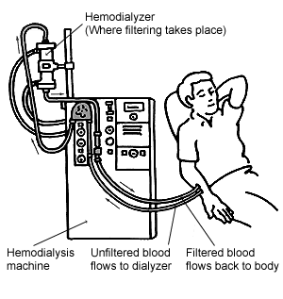
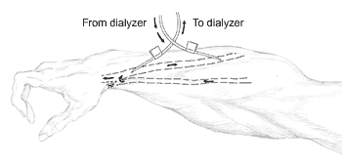
Principle of Hemodialysis
Vein
Artery
Notes:
Currently, patients on hemodialysis typically dialyze 3 to 4 hours, 3 times a week usually in an outpatient dialysis center. They need to have a permanent vascular access, optimally an AV fistula.

Slide 20
Urea Mass Transfer During Hemodialysis
HD
Solids
ICF
ECF
IV
Harmon W, Jabs K: Hemodialysis (chap 77) in Pediatric Nephrology, 4th ed
Barratt, Avner, Harmon (ed) Lippincott, 1999

Slide 21
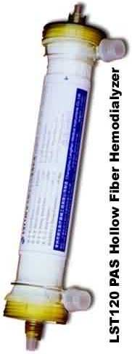
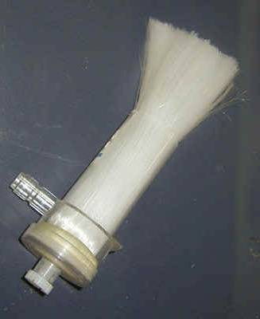
Dialyzer

Slide 22
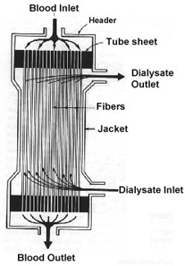
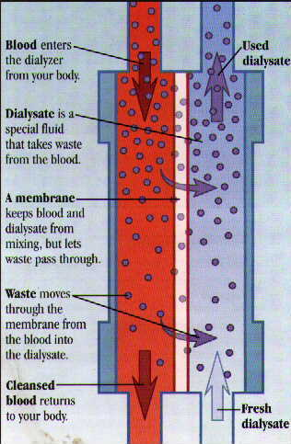
Hemodialysis Filter (Dialyzer)

Slide 23
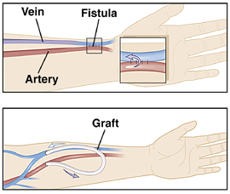
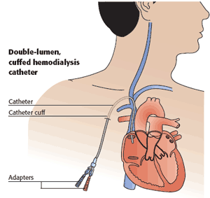
Hemodialysis Vascular Access
Polytetrafluoroethylene

Slide 24
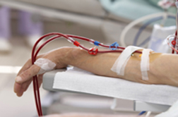
Arteriovenous (AV) Fistula

Slide 25
Which Vascular Access and When Should It Be Placed?

Slide 26
Dialysis Access
Provides location for easy access to patient’s blood for dialysis
Bane of dialysis physician’s existence
Higher flows and cannulation can lead to stenosis or thrombosis
Maintenance of dialysis access patency is critical, at times life-saving
  Patency is assessed while patient is on HD by multiple parameters
Early detection of stenosis can lead to intervention before thrombosis occurs

Slide 27
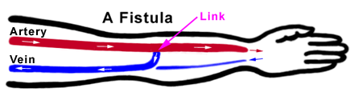
Dialysis Access
AV Fistula
  Vein cross-cut, attached end-to-side to artery
  High-pressure flow dilates and thickens vein
  Best alternative:
    Lowest infectious risk
    Longest lasting with least thromboses
  Drawbacks
    Takes 2-4 months to mature
    Only about 50% ever mature
  Goal for all dialysis patients

Slide 28
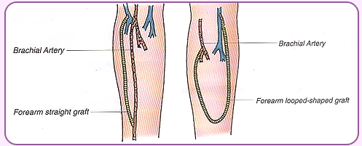
Dialysis Access
AV Graft
  Tube made of biocompatible material (gortex) attached end-to-side to artery and vein
  Often required in patients with vascular disease, occluded distal veins
  Advantages
    Ready to use when swelling resolves (~2 weeks)
    Able to use in most patients
  Disadvantages
    High stenosis/thrombosis rate
    Moderate infectious risk

Slide 29
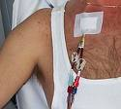
Dialysis Access
Catheter (IJ most common)
  Tunnelled under skin to reduce communication from skin flora with blood
  Advantages
    Ready for use immediately
  Disadvantages
    High infectious risk
    High thrombosis risk
    A/W increased mortality
      Can be a sign of poor pre-dialysis care or extensive vascular disease

Slide 30
Vascular Access Guidelines
Arm veins suitable for placement of vascular access should be preserved, regardless of arm dominance. Arm veins, particularly the cephalic veins of the non-dominant arm should not be used.
  Avoid PICC lines
Dorsum of the hand could be used for IV.
A Medic Alert bracelet should be worn to inform hospital staff to avoid IV cannulation of essential veins.
Subclavian vein catheterization should be avoided for temporary access in all patients with CKD (➔ stenosis ➔ preclude use of ipsilateral arm for vascular access)
Notes:
Move up

Slide 31
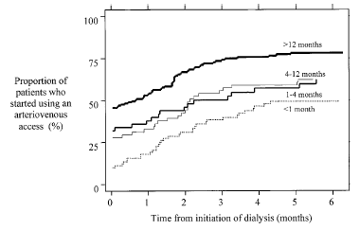
Patients who started using an AV access by timing of first referral to a nephrologist
N=356 hemodialysis patients
Astor B. et al. Am J Kidney Dis. 2001; 38:494-501.

Slide 32
SAVE the Non-Dominant ARM for Vascular Access
When GFR < 30 mL/min
  No BP measurement
  No IV
  No Blood Draws
Place vascular access within a year of hemodialysis anticipation …
On Non-Dominant Arm

Slide 33
Peritoneal Dialysis (PD)

Slide 34
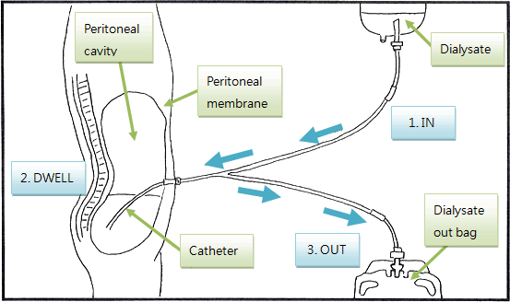
Principle of PD Treatment
Notes:
On the other hand, peritoneal dialysis is a continuous treatment, performed daily over several hours of the day, either manually or using a machine called a cycler. This cartoon describes the principle of PD. Dialysate is placed in the peritoneal cavity, left in place for 3 to 4 hours then drained out, and the cycle restarts.

Slide 35
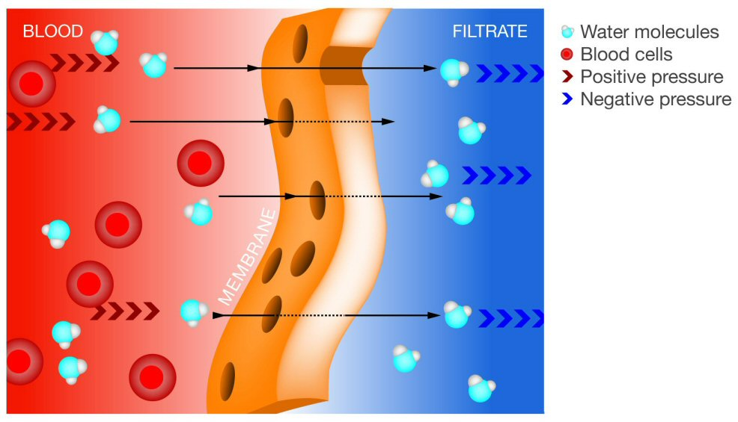
PD Treatment
Abdominal cavity is lined by a vascular peritoneal membrane which acts as a semi-permeable membrane
Diffusion of solutes (urea, creatinine, …) from blood into the dialysate contained in the abdominal cavity
Removal of excess water (ultrafiltration) due to osmotic gradient generated by glucose in dialysate

Slide 36
Peritoneal Dialysis (PD)
PD
Continuous
Intermittent
Notes:
They have to choose between hemodialysis and peritoneal dialysis.

Slide 37
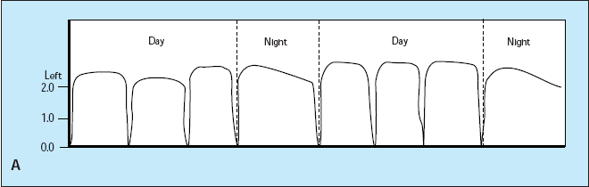
Continuous PD Regimens
Multiple sequential exchanges are performed during the day
and night so that dialysis occurs 24 hours a day, 7 days a week
CAPD: Continuous
Ambulatory PD
CCPD: Continuous
Cyclic PD

Slide 38
Intermittent PD Regimens
PD is performed every day but only during certain hours
DAPD: Daytime
Ambulatory PD.
Multiple manual exchanges
during waking hours
NPD: Nightly PD.
Performed while patient
asleep using an automated
cycler machine.
Sometimes,
1 or 2 day-time manual
exchanges are added to
enhance solute clearances `

Slide 39
Is Timing of Dialysis Initiation Important in ESRD Patients?
(Controversial)

Slide 40
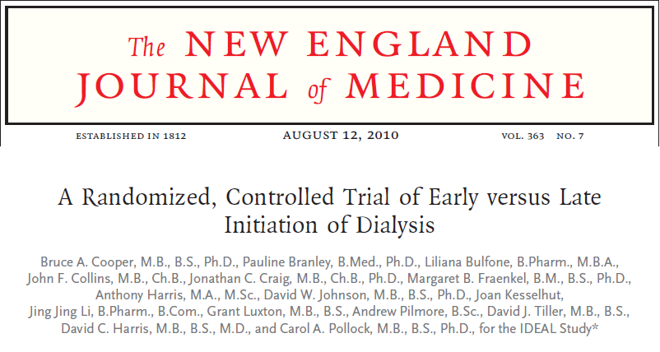

Slide 41
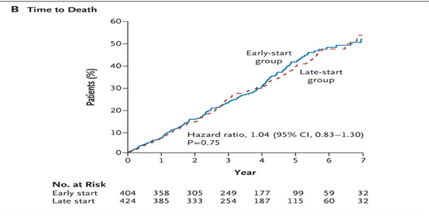
IDEAL Study: K–M Curves for Time to the Initiation of Dialysis & for Time to Death
Between July 2000 & November 2008
Australia / New Zealand
828 adults
  Early start:
  eGFR 10-14 cc/min
  Late start:
  eGFR 5-7 cc/min
Mean age 60.4 years
542 men & 286 women
355 with diabetes
Median follow-up 3.6 years
Cooper BA et al. N Engl J Med 2010;363:609-619
Notes:
Figure 2 Kaplan–Meier Curves for Time to the Initiation of Dialysis and for Time to Death. The data for time to the initiation of dialysis (Panel A) were censored at the time of death, transplantation, or withdrawal of consent or at the time a patient transferred to a nonparticipating hospital, emigrated, or could not be contacted. The curves for time to death (Panel B) are truncated at 7 years of follow-up and a cumulative hazard of 60%.

Slide 42
Implications
Total of 75.9% of the patients in the late-start group started dialysis when eGFR was > 7.0 mL/min/1.73m², owing to the development of symptoms!
In this study, planned early initiation of dialysis in patients with stage V CKD was not associated with an improvement in survival or clinical outcomes (QOL)
➔ OK to delay initiation of dialysis (eGFR < 7-10 mL/min/1.73m²)
➔ Dialysis initiation should be based upon clinical factors (symptoms) rather than eGFR alone
Cooper BA et al. N Engl J Med. 2010;363:609-619.

Slide 43
Why is Residual Renal Function Important in Dialysis Patients?

Slide 44
Why is baseline residual renal function important?
Remaining GFR at start of dialysis make a significant contribution to the removal of potential uremic toxins
Also facilitates regulation of fluid, electrolytes, and may enhance nutritional status and QOL
Offers survival advantage in both HD and PD
Suda T et al. Nephrol Dial Transplant. 2000; 15:396.
Shemin D et al. Am J Kidney Dis.2001; 38: 85.
Szeto C et al. Nephrol Dial Transplant 2003;18.7

Slide 45
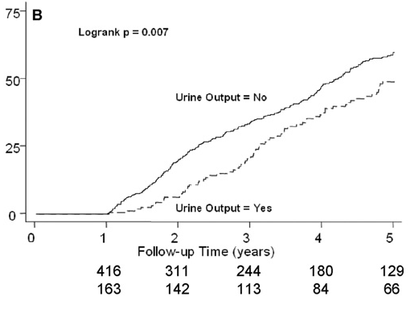
Cumulative Incidence of All-Cause Mortality in 579 HD Patients by Urine Status at 1 Year (CHOICE)
Adjusted Hazard Ratio: 0.70 (0.52-0.93) p = 0.02
Shafi T., Jaar B., et al. Am J Kidney Dis. 2010;56:348-58
Notes:
Urine Output > 500 ml/day

Slide 46
Implications
Try to preserve residual renal function in dialysis patients!
➔ Less dietary restriction
➔ Better quality of life
➔ Better survival
Try to avoid nephrotoxins if your dialysis patient still makes urine!

Slide 47
Kidney Transplantation

Slide 48
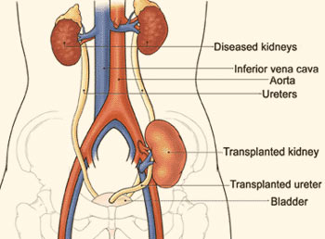
Principle of Kidney Transplantation
Iliac Fossa

Slide 49
Eligibility
Able to be evaluated once GFR <20 mL/min
Need just one listing less than 20 mL/min to remain active
With GFR 15-19 mL/min- can be transplanted if live donor or if six antigen match
If GFR <15 mL/min- open to all offers
Why starting early- if certain blood types with long wait time, no potential live donors

Slide 50
Absolute contraindications
Active malignancy
Advanced lung disease
  Chronic O2 needs
  FEV 1<1
Ongoing infections
Life expectancy less than 2 years
Active substance abuse
Ischemic Cardiac disease
  Not amenable to revascularization
Severe peripheral vascular disease
Liver cirrhosis/primary oxalosis- unless combined liver/kidney
Poorly controlled psychiatric illness
Minimal rehabilitative potential
Morbid obesity – BMI>40

Slide 51
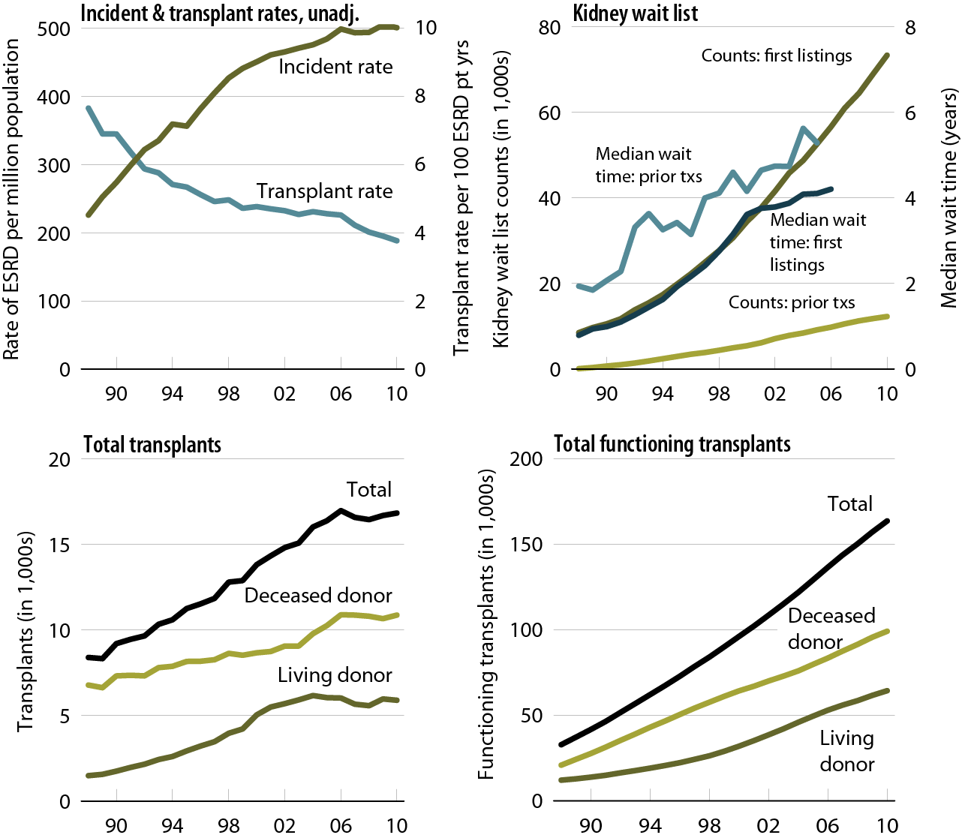

Trends in Transplantation: patients age 20 years & older
USRDS ADR 2012

Slide 52
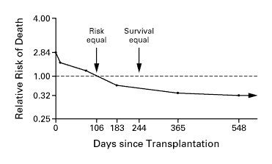
Adjusted Relative Risk of Death among 23,275 Recipients of a 1st Cadaveric Transplant
Wolfe RA et al. N Engl J Med. 1999;341:1725-1730
Notes:
Figure 2. Adjusted Relative Risk of Death among 23,275 Recipients of a First Cadaveric Transplant. The reference group was the 46,164 patients on dialysis who were on the waiting list (relative risk, 1.0). Patients in both groups had equal lengths of follow-up since placement on the waiting list. Values were adjusted for age, sex, race, cause of end-stage renal disease, year of placement on the waiting list, geographic region, and time from first treatment for end-stage renal disease to placement on the waiting list. The points at which the risk of death and the likelihood of survival were equal in the two groups are indicated. A log scale was used.

Slide 53
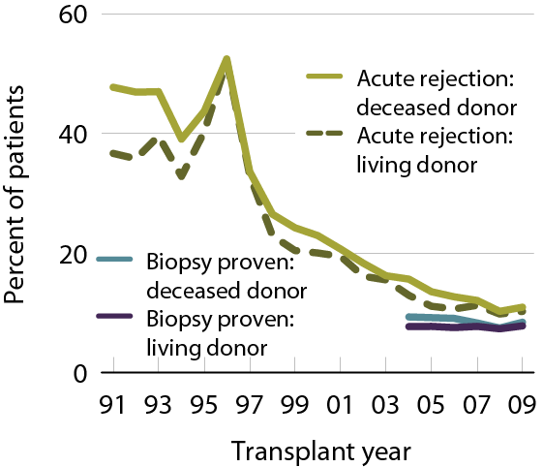
Acute Rejection within the 1st Year Post-Transplant
Patients age 18 & older with a functioning graft at discharge.
USRDS ADR 2012

Slide 54
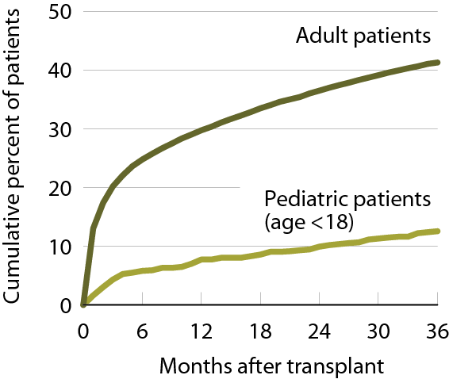
Cumulative incidence of post-transplant diabetes
Patients receiving a first-time, kidney-only transplant, 2003–2007 combined.
USRDS ADR 2012

Slide 55
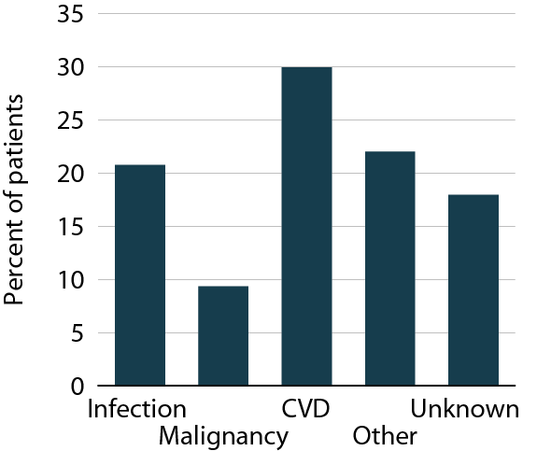

Causes of Death in Kidney Transplant Patients with Functioning Graft 2006–2010
First-time, kidney-only transplant recipients, age 18 & older, 2006–2010, who died with functioning graft.
USRDS ADR 2012

Slide 56
Post-transplant Malignancy
Risk is 4X to 100X compared rates of malignancy in the general population (especially skin cancer)
No comprehensive reporting system
Available data suggesting 2- to 3-fold under-reporting
The precise rate is UNKNOWN
Accounts for 10% of deaths in kidney recipients with functioning graft
➔ SCREENING is KEY!
  Threshold for screening should be low.

Slide 57
Immunization for Kidney Transplant Recipients
Recommended
Not Recommended
Influenza types A and B (yearly)
Pneumovax (every 3-5 years)
Diphteria-Pertussis-Tetanus
Haemophilus influenza B
Hepatitis A and B
Inactivated polio
Meningococcus
Varicella zoster
Intranasal influenza
BCG
Live oral typhoid
Measles, Mumps, Rubella
Oral polio
Yellow fever
Smallpox
Live Japanese B encephalitis vaccine

Slide 58
Key Concepts
Kidney transplantation is the most cost-effective modality of renal replacement
Transplanted patients have a longer life and better quality of life
Early transplantation (before [pre-emptive] or within 1 year of dialysis initiation) yields the best results
Living donor kidney outcomes are superior to deceased donor kidney outcomes
Early transplantation is more likely to occur in patients that are referred early to nephrologists
Refer for transplant evaluation when eGFR < 20 mL/min/1.73m²

Slide 59
Key Concepts
The most common cause of transplant loss is death with a functional transplant due to
  Heart disease +++
  Infections
  Malignancies
Immunosuppressants are essential to prevent immunological loss of the transplant, but side effects can also lead to potential loss of transplant

Slide 60
What About No Renal Replacement Therapy Option?

Slide 61
Starting Dialysis in the Elderly…Or Not?
Among patients > 75 yrs with stage 5 CKD who chose NOT to start dialysis:
  Overall, more likely to die over next 1-2 years
  But if they had ischemic heart disease or other significant comorbidity → NO DIFFERENCE in survival
Active disease management and supportive care may be appropriate without starting dialysis in the ill elderly
Must have end-of-life discussions!
Murtagh, et al. Nephrol Dial Transplant. 2007; 22(7): 1955-1962.

Slide 62
The Future …

Slide 63
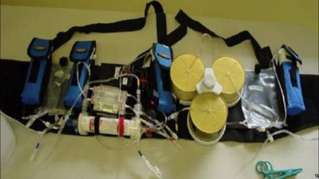
Regenerative Medicine …
Stem Cell Therapy …
Wearable Artificial Kidney

Slide 64
Additional Online Resources for CKD Learning
National Kidney Foundation: www.kidney.org
United States Renal Data Service: www.usrds.org
CDC’s CKD Surveillance Project: http://nccd.cdc.gov/ckd
Dialysis Outcomes and Practice Patterns Study (DOPPS): http://www.dopps.org
Organ Procurement and Transplantation Network: http://optn.transplant.hrsa.gov
United Network for Organ Sharing: http://www.unos.org

