Slide 1
Council of Advanced
Practice Providers
Kidney Disease Education
Kidney Disease Education
Part 2: Treatment Options
Notes:
This is an educational program created by the National Kidney Foundation Council of Advanced Practitioners (NKF-CAP), adapted from the NKF/RPA program “Your Treatment, Your Choice.” It is for people with kidney disease who need treatment for kidney failure – and for their families. The program is presented at an 8th grade level but feel free to embellish it with the suggested references if needed.
The educational slides set is abbreviated from its source material and divided into two parts: Overview of Kidney Disease and Treatment Options
Part 2: Treatment Options discusses the types of dialysis, transplantation, and the option of medical management
The original legislation on Kidney Disease Education (KDE) classes is:
Federal Register. 2009;74(226):62003

Slide 2
Treatment for Kidney Failure
Kidney Failure
Medical
Management
Transplant
Peritoneal
Dialysis
Hemodialysis
Notes:
Review that patients are presently in medical management. Explain that many patients do many types of treatment in their lifetimes and all are the patient's choice. Many options are available.
Explain that you are going to review the types of RX starting with dialysis…otherwise the 2nd slide is a big jump. We took out the transition slides so you need to do the transition orally

Slide 3
What is Dialysis?
Two main types:
  Peritoneal Dialysis
  Hemodialysis
Does some of the work of healthy kidneys
  Removes waste from your blood
  Removes fluid from your blood
  Keeps body’s chemicals balanced
Does Not:
  Cure kidney disease

Slide 4
What Happens in Dialysis?
Dialysis can be compared to how a coffee filter works
Notes:
The dialysis process can be compared to making tea:
The coffee filter is: The blood vessels in the kidney or peritoneal membrane (like the healthy kidney)
Coffee grounds: The blood flowing through the kidney (remember, blood contains cells, waste products, potassium, calcium, water, protein, etc.)
Water : The special fluid that cleans the blood during dialysis.
Making Coffee and the Dialysis Process:
When the hot water flows through the coffee grounds, the flavor and color of coffee passes through the filter and make coffee
The coffee grounds cannot pass through the holes in the filter. This is similar to the way the dialysis filter holds back some of the things in your blood, like red blood cells while allowing smaller waste products (BUN, creatinine) to pass through.
Before dialysis: blood has a higher concentration of waste products.
During dialysis: the fluid and waste products are removed from the blood.
After dialysis: the blood has a lower concentration of waste products.

Slide 5

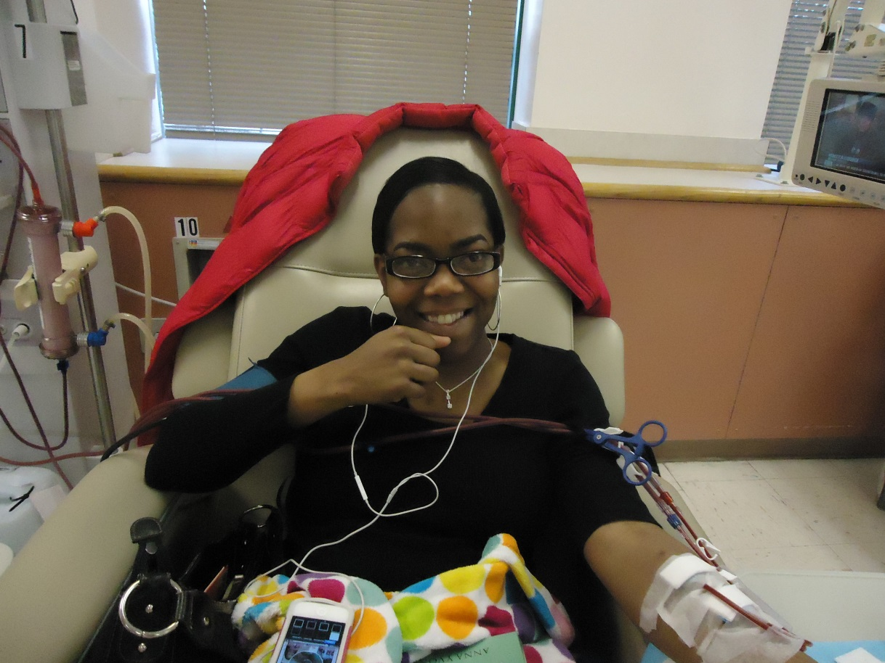
Types of Dialysis
Peritoneal Dialysis (PD)
uses the peritoneal lining to filter the blood
Hemodialysis (HD)
uses a machine and filters the blood outside the body

Slide 6
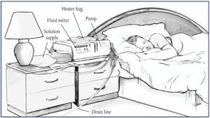
What is Peritoneal Dialysis (PD)
Takes place inside the body
Must be done every day
Done at home, but is mobile
Gives more steady dialysis
Can use gravity and no machine (about 4x/day)
Uses the peritoneal lining as a filter. This lining covers all of your abdominal organs
Everyone learns to do PD by gravity (CAPD)
OR…
Can use a machine (Cycler) for night (8 hours/day
Notes:
If you have any queries from patients or their families you cannot answer, the International Society of Peritoneal Dialysis (http://ispd.org/) link is a great resource. Use it freely and give it out to anyone who wishes it! All the information on the website is peer reviewed, expert opinion, and you can feel confident that accurate information is shared

Slide 7
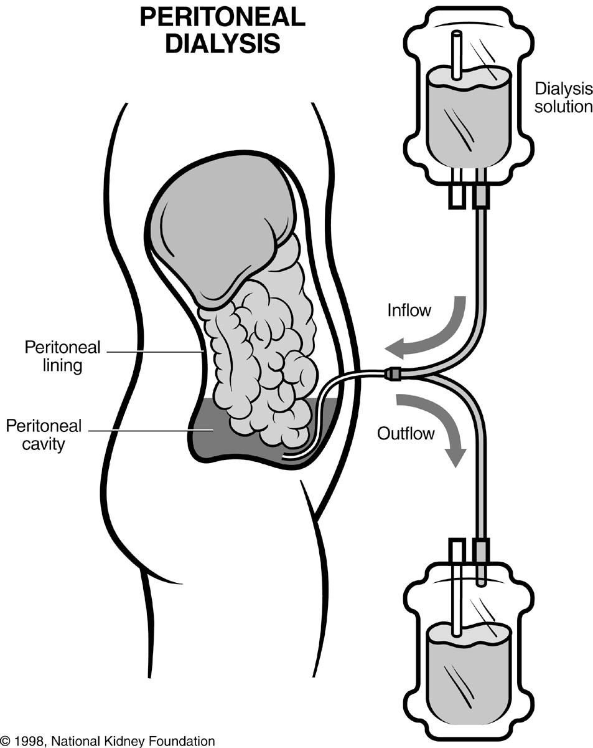
How Does PD Work?
Exchanges:
Fill
Dwell
Drain
About 30 min/fill/drain
Average 4 times/day
Notes:
Add explanation of what a peritoneal cavity and lining is
While we know that you will need to drain before you fill, trials of this slide with actual patients showed that they were confused by the correct sequence (drain, fill, dwell). So, we used the more common fill/dwell/drain version and count on our practitioners to explain the difference!

Slide 8
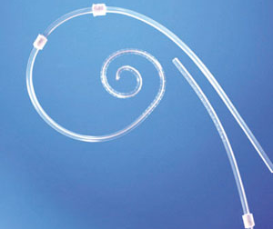
PD Catheters
Outpatient Surgery
Can be done in operating room or radiology
Placed 2-4 weeks before needed
You will come to the PD center for one-on-one teaching by a trained PD nurse

Slide 9
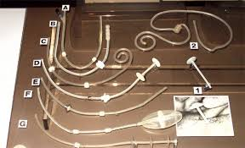
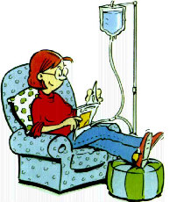
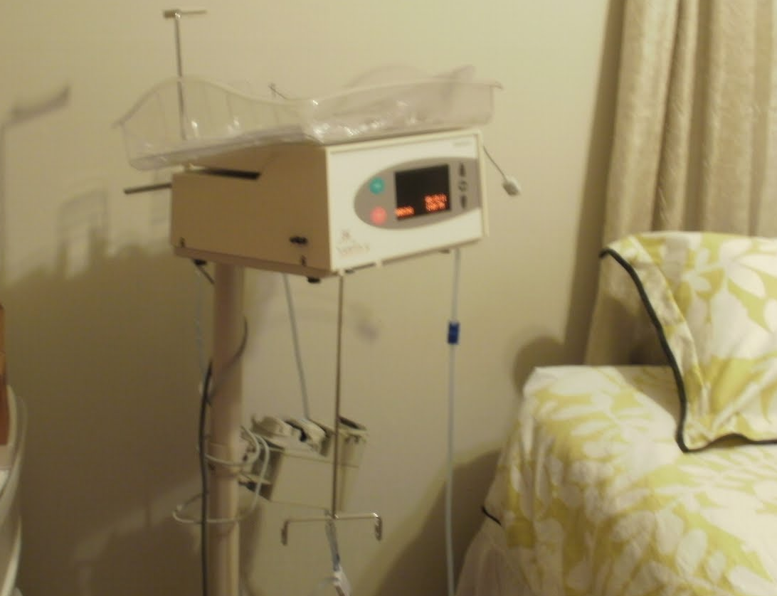
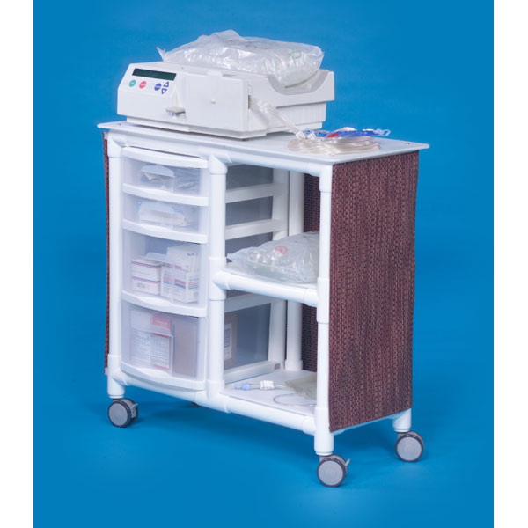
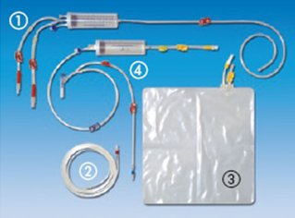

PD Supplies

Slide 10
Pros and Cons of PD
Pros
Cons
May live longer & healthier
Mobility and flexibility
Easier to travel
Continuous dialysis can improve well-being
No machine necessarily required
May have fewer fluid and diet restrictions
No needles required
Saves some kidney function
Usually done more days than 3 days a week
Catheter is always present
Swimming/bathing may be limited (showering okay)
Blood sugar fluctuations possible due to glucose (sugar) in dialysis fluid
Storage space needed at home for supplies
Potential for infection in the catheter

Slide 11
How Does Hemodialysis Work?
Blood is filtered outside your body
  Your blood flows through soft tubes to a filter on the dialysis machine
  Blood is pumped back into your bloodstream after it’s filtered
Only a small amount of blood is outside your body at one time
Can be done at home or in a center

Slide 12
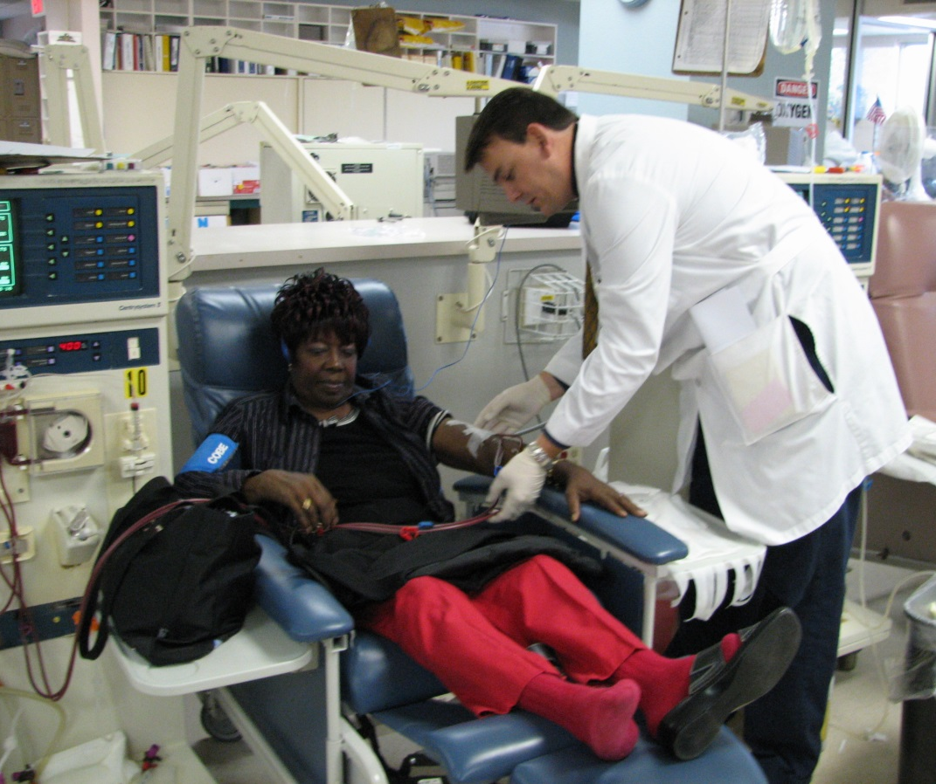
Typical Hemodialysis
3 times a week
  Monday/Wednesday/Friday OR
  Tuesday/Thursday/Saturday
Average 4 hours/dialysis
2-3 different shifts/day
Nocturnal
Home hemo
Notes:
The 4 hours/RX comes from DOPPs data although standards are different in different areas of the country. We used the US standard for the slides.

Slide 13
How Does the Blood Get to the Dialysis Machine?
A connection or access is made by joining two blood vessels.
A fistula is the best choice of access for most people.

Slide 14
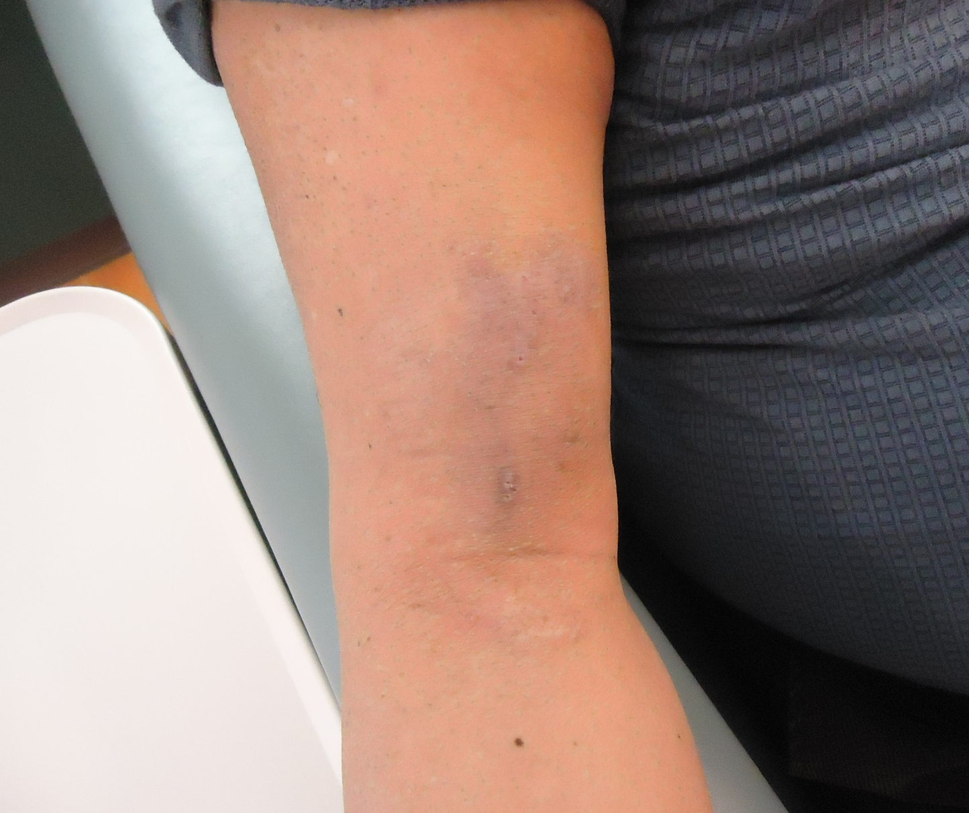
Fistula
Vessel mapping (ultrasound) done first to pick which artery and vein to use
Joins an artery and vein in the arm
Artery and vein will grow so they can be used for dialysis
Best if made at least 6 months before hemodialysis begins
Notes:
We had a discussion about adding the need for vessel mapping via ultrasound to this slide. However, it is not standard in all areas of the country even though the Fistula First (http://esrdncc.org/ffcl/) group encourages use of vessel mapping. You can refer to the website if you have any questions regarding access or share the website. It has a large number of great tools for patients.

Slide 15
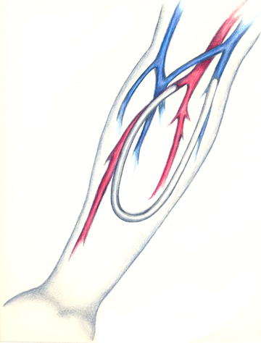
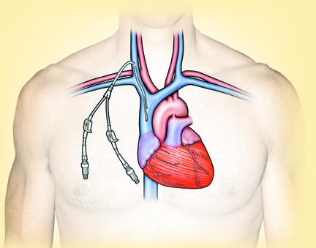
Graft and Catheter
Graft
  Connects an artery and nearby vein with a piece of man-made material. Used only if surgeon cannot find vessels for fistula
Catheter
  A plastic tube placed into a vein in your neck or chest. Choice of last resort. Highest infection rate for any type of dialysis. Can be used in emergency situations.
Notes:
The catheter tip is in the right atrium although it does not quite look like that on this sketch!
A graft connects an artery and nearby vein with a piece of man-made vein. After a fistula, it is the next preferred choice of access. A catheter reaches the bloodstream with a plastic tube placed into a large vein in your neck or chest. A catheter can have many problems compared with a fistula. However, for some people in whom a fistula or graft is not possible, a catheter could be a good access option. HD can work well with a catheter.
You may want to emphasize once again here that catheters are temporary access and should not be considered unless other methods have failed.
You may wish to explain that patients with catheters have 40-70% higher mortality. You may also wish to go into more detailed explanation of how infection gets in, etc. or mention that many patients who choose PD will also have a fistula placed as a backup.

Slide 16
PD vs. Hemodialysis
PD
Hemodialysis
Less diet restrictions
No needles
More flexibility and independence
More privacy and family time
Greater sense of control
Need space for supplies
Medical staff on site
Friendship and socializing
Limited privacy
More diet restrictions
Limited scheduling
Cost of travel to center
What they have in Common:
Both need outpatient surgery to place access
Both clean your blood
Notes:
Mention home hemodialysis as an option

Slide 17
You Can Travel on Dialysis
Carry your PD or home hemo supplies or have them shipped
You can have treatment in other hemodialysis units
Special cruises and camps are available
Medicare will not cover international hemodialysis
You Can Work on Dialysis
Many employers are flexible
Consider alternative work schedules
Consider alternative dialysis options/schedule
Americans with Disability (ADA) protects you
Notes:
Please emphasize that cruises and camps may be costly
Travel to some locations may require cash payments for treatment

Slide 18
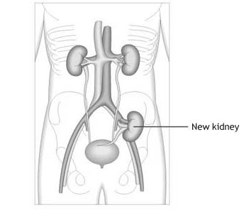
What Is A Kidney Transplant?
A healthy kidney is placed in your body
The kidney can come from
  A living donor
  A deceased donor

Slide 19
Who Can Have a Kidney Transplant?
Upper age restriction can differ between centers
Your eGFR must be 20 or lower
You must have a full medical evaluation
You do not have to already be on dialysis
Each center has different requirements

Slide 20
Advantages of Kidney Transplant
Longer improved quality of life
Easier to work, study, travel, exercise and remain active
Fewer restrictions (diet, fluid, etc.)
Better energy & fewer hospital admissions
Better control of chronic kidney disease
Freedom from dialysis routine

Slide 21
Disadvantages of Transplant
Out-of-pocket costs can be very high
Surgery has risks
Rejection of the kidney is always a risk.
Medicines must be taken for as long as you have the transplant – no days off
Medicines have side effects
Anti-rejection medicines increase the risk for diabetes, infections & some cancers
You may need another transplant or dialysis

Slide 22
Where Does the Kidney Come From?
A healthy person who wishes to donate one kidney
  A family member (e.g. sibling, parent, cousin or other blood relative)
  A friend, spouse or acquaintance (non-related)
  An anonymous donor
A person who has died and becomes an organ donor
It is illegal to buy or sell organs

Slide 23
Advantages of a Living Donor
Outcome could be better because:
Medical history is known
Surgery can be planned
May have less rejection
Kidney may last longer
Can be done before having to start dialysis
Less wait time than for a deceased donor
Do you have a living donor? Have you asked?
Notes:
Please refer to the NKF’s Big Ask, Big Give

Slide 24
Disadvantages for the Living Donor
Kidney is taken from a healthy person
No medical benefit to the person donating
Surgery can have complications
Risk of death is small but present
Long term risk to donors may exist
Notes:
Research Finds Low Risk of Renal Failure for Kidney Donors
In the largest study ever conducted of kidney disease risk in living kidney donors, the lifetime rate of kidney failure in donors was 90 per 10,000 vs. 326 per 10,000 in the general population of non-donors. In individuals who were as healthy as donors but did not donate, the risk was only 14 per 10,000. After 15 years, the risk of kidney failure associated with donating a kidney was 51 per 10,000 in African American donors and 23 per 10,000 in white donors. The JAMA, 2014 study included information on 96,217 US kidney donors and 20,024 NHANES III participants.

Slide 25
Facts About The Waiting List
You can be on more than one list
No one can tell you exactly how long you will wait for a kidney
Wait time depends on many factors
The list is not a rank order but a group of eligible candidates
Younger patients are given priority on the list

Slide 26

What happens with no dialysis or no transplant?
Using medications to control symptoms of kidney failure
Some people want dialysis;
others may not be so sure
You will lose function over time
We will keep you comfortable with medication and hospice/palliative care
Dialysis or transplant is not for everyone
Notes:
Suggestions of articles that may help you to discuss medical management: (add some new articles here)
Alvin Moss
Christine Corbett

Slide 27
Choosing Medical Management for Kidney Failure
Medical Management may be the choice for you
With severe medical problems such as a stroke or dementia or a very bad heart, dialysis may be not be the best option
Every patient is different and every situation is unique
Tell your family your decision
You can always change your mind
Notes:
We are referring medical management as no dialysis no transplant

Slide 28
Common Questions
Is deciding not to have dialysis suicide?
  No, many religions believe in a person’s right to refuse medical treatment like dialysis if they feel it will not help them or be burdensome
How long will I live?
  It varies from person to person
Is dying from kidney failure painful?
  Not usually
Notes:
If you need to explain to a patient or family, you can talk about how dying is pretty painless. Review how the toxins build up in the body and the patient becomes more confused. How they slip into a coma and die. A book that highlights how we never know when we are going to lose a patient is Art Buchwald’s ‘Too Soon to Die’ in which he talks about being told of his end stage kidney disease by the nephrologists at Georgetown University. So, he checks into hospice and does interviews with NPR and the Washington Post to say goodbye. However, he doesn’t die and after 6 months, he checks out of hospice. He decides to go spend the summer at Martha’s Vineyard and write a book about dying. He returns to DC after the summer and dies a year after he was told he had just weeks to live. Thus, we never can really predict the future. If one decides not to do dialysis, there are no food/water limits. Most patients will die of either the toxins or the hyperkalemia. Reassure them that when one stops dialysis, the average survival is 7-10 days but there have been patients who have lived up to a month.

Slide 29
Advance Directive or Living Will
Tells WHO will make your medical decisions if you’re unable to make them yourself
Tells WHAT you want for health and medical care
Outlines WHAT type of care you want…from CPR to a feeding tube to intubation to medications to dialysis
Makes all decisions easier on your family
Notes:
Make sure you review that it is vitally important to choose your medical proxy carefully. You
need to make sure they understand exactly what you want and that they follow your wishes.
It is important to consider this even when you are not sick

Slide 30
Advance Directive or Living Will
You can change what you say in your Advance Directive at any time
You can get an Advance Directive form that follows your state’s law
  Contact the National Hospice and Palliative Care Organization (800-658-8898)
  Go online to www.abanet.org/aging
  Visit your library
Notes:
Check other resources
WJU direct link

Slide 31
Hospice vs. Palliative Care
Hospice:
Support people in all aspects of the dying process
Provides family support
Provides pain management
Can be done in:
  Your home
  A hospice facility
  Hospital
Palliative Care:
Manages symptoms of chronic disease
Supports family and patient
Can be used at any time (not only at end of life)
Shown to extend life spans

Slide 32

Questions and Discussions
This Photo by Unknown Author is licensed under CC BY-NC

