Slide 1
NKF CRN Executive Committee 2020 Update
Notes:
Click to add notes

Slide 2
National Kidney Foundation
The National Kidney Foundation is the leading organization in the U.S. dedicated to the awareness, prevention and treatment of kidney disease for hundreds of thousands of healthcare professionals, millions of patients and their families, and tens of millions of Americans at risk.

Slide 3
Council on Renal Nutrition (CRN)
Our Goals
Promote & encourage quality nutrition care for all patients with CKD
Support the profession of the nephrology dietitian and promote professional education
Develop & promote patient and public education
Stimulate, support, encourage & disseminate nutrition-related research
Impact regulatory & legislative issues
Maintain & increase Council membership
Maintain fiscal accountability within the NKF structure in support of CRN goals

Slide 4
Why Be a Member?
Discount registration to Spring Clinical Meetings
Subscription to the JRN
Free online CEUs through PERC
Subscription to RenaLink
1-time copy of the “Pocket Guide to Nutrition Assessment”
Reduced subscription rate to AJKD & ACKD
Discounts on the NKF Store
Professional stipends
Leadership opportunities

Slide 5
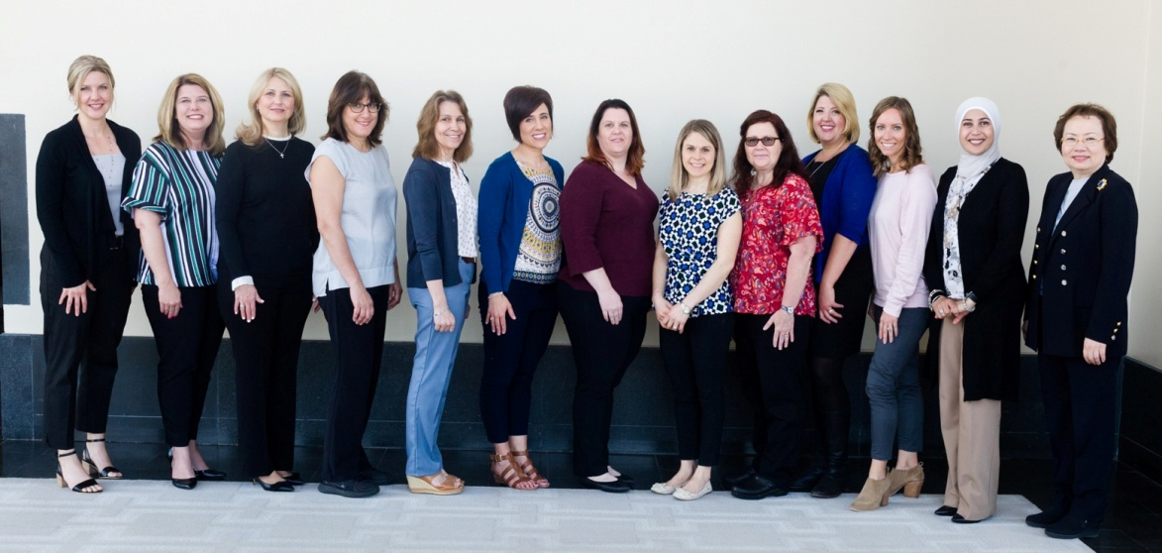
2020-2021 CRN Executive Committee
Chair
Beth Shanaman, RD, FNKF
(206) 720-3988
beth.shanaman@nwkidney.org
Chair-Elect
Karen Greathouse, RD
(313) 575-8503
greatkar@med.umich.edu
Immediate Past Chair
Kristen Nonahal, RD, FNKF
(313) 916-2705
knonaha1@hfhs.org
Publications Editor
Haewook Han, PHD, RD, CSR, LDN, FNKF
(617) 320-2804
hhan1@comcast.net
SCM Program Chair
Melissa Prest, DCN, RDN, CSR, LDN
(312) 342-9968
melissa.rdld@gmail.com
SCM Program Co-Chair
Brittany Sparks, RDN, CSR
916-300-6904
info@nutritionbybrittany.com

Slide 6
2020-2021 CRN Executive Committee
Judy R. Kirk, MS, RDN, CDN, CSR, FNKF
Region I Representative/Patient & Public Education Chair
(585) 794-0226
judith.kirk@rochesterregional.org
Ruba Jibreen, MS, RD, CSR, LD, MBA
Region II Representative/Awards Chair
(770) 608-5129
rjibreen@hotmail.com
Jill Hoyt, RD, CD
Region III Representative/CyberNephrology Chair
(715) 838-3988
hoyt.jill@mayo.edu
Matilde Ladnier, RD, LD, MBA
Region IV Representative/Membership Chair
(281) 277-0692
matilde.ladnier@davita.com
Nikki Nygren, RD, CD
Region V Representative/Research, Professional Education Chair
(206) 799-7273
nikki.nygren@nwkidney.org
Dana Trotta, MS, RD, CSR, LDN, FNKF
Region I Alternate Representative
(401) 714-9823
danatrotta1@gmail.com
Scott Kimner, MPH, RD, LD
Region II Alternate Representative
(678) 773-3429
skimner1@gmail.com
Heidi Hass, MS, RD, LD
Region III Alternate Representative
(563) 589-4033
hjhaas@gmail.com
Carol Lim, RD, LD
Region IV Alternate Representative
clim2002@hotmail.com
Lara Haddad, RD
Region V Alternate Representative
(313) 817-8303
larahdd51@gmail.com

Slide 7
Collaboration with the Academy’s Renal Practice Group (RPG)
National Renal Diet Update
KDOQI Nutrition Guidelines Update
“A Clinical Guide to Nutrition Care in Kidney Disease” Update
Renal Dietitian Standards of Practice (SOP)/Standards of Professional Performance (SOPP) Update

Slide 8
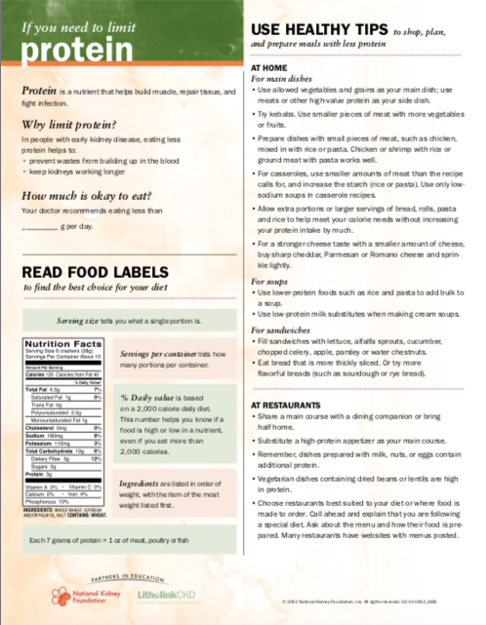
CRN Projects
CKD (pre-dialysis) Dietitian Directory creation
“Pocket Guide to Nutrition Assessment of the Patient with Kidney Disease” Update
Proposed completion 2020-2021
Updating nutrition education content
and handouts on www.kidney.org/atoz
Goals:
PDF/printer-friendly
Multiple language options
Development of a Global Renal Internet Course for Dietitians: a program that can be accessed world wide and give developing countries an education program for dietitians, a collaboration with Dr. Kopple
Development of a new, streamlined CEU Process and Review for Local Chapter meetings

Slide 9
CRN Projects
“Getting Ready for a New Normal” education series update with added nutrition component
Complete Re-affiliation for Local Chapters in 2020
Due every 2 years
CRN Handbook updates
Awarded $78,000 in Research Grants to RDs in 2018
Awarded 9 stipends to attend NKF SCM Boston 2019
Participation with NKF’s Public Policy Committee
Assisting with the development of new Pediatric CKD Guidelines
Improving support & communication with our Local Councils
Kidney-Friendly Recipe Contest

Slide 10
Are you a dietitian that specializes in pre-dialysis CKD education?
This directory provided by the NKF’s Council on Renal Nutrition is a free resource to individuals looking for dietitians that treat pre-dialysis chronic kidney disease patients.
Excellent free marketing tool for your small business
Listed by NKF Regions
If you are interested in being listed, reach out to your Region Representative with the following information:
Name, Credentials, Address, Contact information, Website, CDR/NPI number, Services provided, and Payment options offered.
www.kidney.org/ckdrd

Slide 11
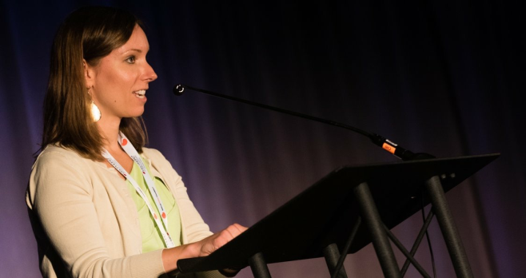
Need Speakers?
CRN has a Speaker Bureau for your Local CRN meetings
Contact our Region 1 Representative, Judy Kirk at Judith.Kirk@rochesterregional.org for the updated list of topics and speakers
Advertise your program in our RenaLink newsletter
Contact our Region 3 Representative, Jill Hoyt, at hoyt.jill@mayo.edu

Slide 12
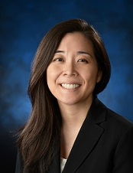
Awards
Current Dietitian Awards
Joel D. Kopple Award
Outstanding Service Award
Susan C. Knapp Excellence in Education Award
Recognized Renal Dietitian
Regional Recognized Renal Dietitian
New Local Council Awards!
Small (≤20 members) & Large (>20 members)
Nominations begin during SCMs
Due end of June 2020
Contact our Region 2 Rep, Ruba Jibreen at rjibreen@hotmail.com
Dr. Connie Rhee
2020 Kopple Winner

Slide 13
RenaLink
Introduced in 2000, RenaLink is NKF’s joint newsletter for the professional Councils:
Council of Nephrology Nurses and Technicians (CNNT)
Council of Nephrology Social Work (CNSW)
Council on Renal Nutrition (CRN)
If you are interested in:
Writing an article
Submitting a case study or best practice
Submitting a letter to the editor
Contact us at renalink@kidney.org or the CRN Editor, Haewook Han, at Haewook_Han@atriushealth.org
www.kidney.org/professionals/resources/renalink

Slide 14
CRN Research Grant
$10,000 for a dietitian researcher
Awarded in 2018
Rotates between the NKF Professional Councils
Next application due 2023!
Nikki Nygren, RD, CD
Research Chair, Region 5 Representative
Nikki.Nygren@nwkidney.org

Slide 15
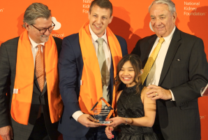
NKF Initiatives
PERC
The Big Ask, The Big Give
Online Communities
NKF Cares
NKF Peers
Advocacy
H.R. 1224 - Living Donor Protection Act
Drive for Dialysis
NKF Career Center
Discount Rx Card partnership with Watertree
My Food Coach App
Patient Articles & Recipes Needed for Kidney.org
Contact Kelli.Collins@kidney.org
AmazonSmile
Choose the National Kidney Foundation as your non-profit!
smile.amazon.com

Slide 16
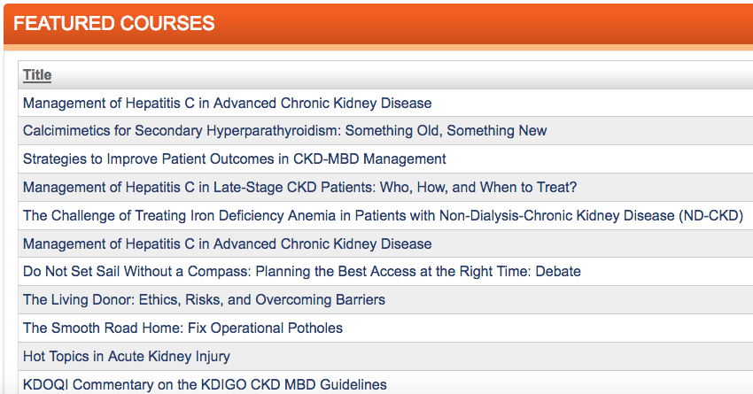
Professional Education Resource Center
education.kidney.org
Live-streaming & recorded webinars
Select articles from JRN for CEUs
Currently >30 Courses available for RDs
1-1.5 CEUs per course
Free for CRN members
Offer a live webinar to
your local council

Slide 17
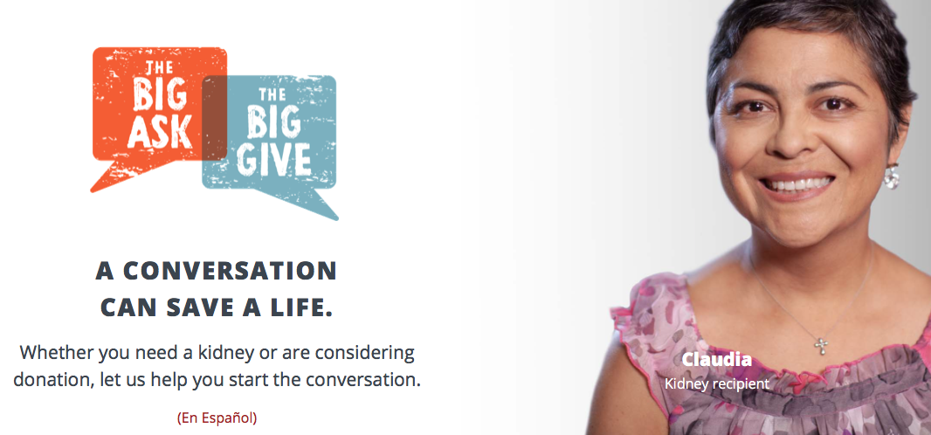
www.kidney.org/livingdonation
Encourage patients to ask for lifesaving kidneys for transplant
Inspire the everyday person to consider donating
https://www.kidney.org/transplantation/livingdonors
Notes:
NKF’s website on living donation has lots of information for you.
We have many tips and tools to help you find a living donor.
We also have extensive information for people who are thinking about donating a kidney.

Slide 18
NKF Online Communities
A safe & supportive social media platform where patients and caregivers can connect to share experiences, ask questions and get answers related to kidney health, kidney disease, transplantation and living organ donation.
Forum is monitored by NKF
Participation is free & anonymous
5 Communities Available
Kidney Disease
Dialysis
Transplant
Living Donation
Parents of Children with Kidney Disease
https://www.kidney.org/online-communities
Notes:
You can remain anonymous if you wish and get answers and support from other patients, caregivers, and living donors in an online forum monitored by the National Kidney Foundation.

Slide 19
NKF Cares
A Help Line offering support for people affected by kidney disease, organ donation or transplantation.
Speak with a trained specialist who will answer your questions and listen to your concerns.
Call toll-free at 1.855.NKF.CARES
(1.855.653.2273) or email nkfcares@kidney.org
English and Spanish
Monday - Friday from
9:00 am - 5:00 pm Eastern Time

Slide 20
For Kidney Patients
Were you told you need dialysis or a transplant?
Are you interested in receiving a transplant?
Living Kidney Donation
Are you considering donating a kidney to someone?
Talk to someone who’s been there! Speak with a trained peer mentor who will offer support and share their experiences with you.
Call 855-653-7337 (855-NKF-PEER) or email nkfpeers@kidney.org today!

Slide 21
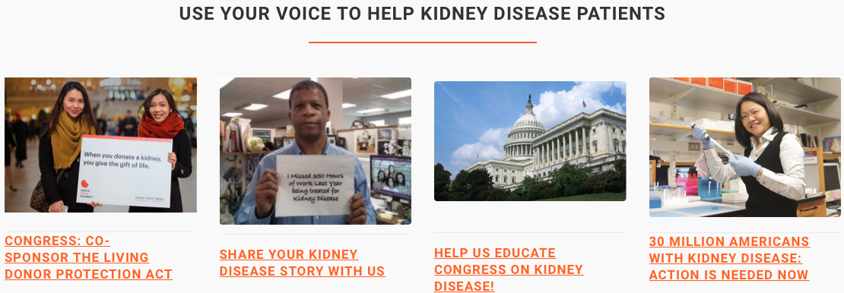
Visit advocacy.kidney.org to make a difference
Learn about your state’s laws related to living donation at www.kidney.org/sites/default/files/LD_Tax_Ded_Leave_6_23_18.pdf
Join a local Kidney Walk
Notes:
You can also help by being an advocate for living donation!
Visit https://advocacy.kidney.org to make a difference.
Learn about your state’s laws related to living donation at www.kidney.org/sites/default/files/LD_Tax_Ded_Leave_6_23_18.pdf

Slide 22
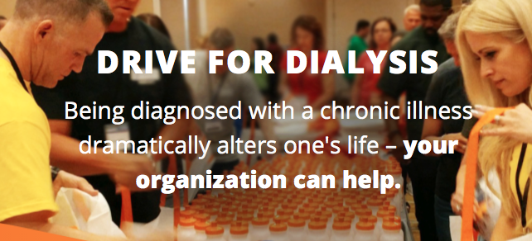
Challenge your staff to join the fight against kidney disease with a hands-on, team-building activity to assemble care packages for dialysis patients in the community where you live and work.
Inspire & engage employee volunteers
Pair your organization with a local dialysis clinic
Enhance your wellness program with access to NKF resources
Notes:
Health Screening Volunteers Needed KEEP Healthy is the NKF's free community-based kidney disease screening program. We are recruiting Clinical and non-clinical volunteers are needed at our upcoming Attleboro YMCA kidney screening.
Become a ’Your Kidneys & You’ Presenter
Ongoing opportunity Volunteer on an ongoing basis to deliver a short presentation on kidney health to groups in your community. One-on-one and group volunteer training available.

Slide 23
NKF Career Center
Connect with your dream job opportunity
Assists nephrology companies to find elite talent
Manage your account:
Set job alerts
Manage your resumes
NKF assists in:
Help your resume stand out
Interview preparation
Navigate the digital world
Tips on how to advance your current career
careers.kidney.org

Slide 24
Discount Rx Card
Free discount Rx Card
Allows lower negotiated prices
Up to 75% savings on name brand & generic Rx
As well as OTC meds & some DM supplies
Look up lowest price at: Wtree.us/SavingsTool
95% of pharmacies accept the card
Save money on Rx, and Watertree Health donates to the NKF
Call 844-728-3667, email KidneyRx@WatertreeHealth.com, or go to WatertreeHealthCard.com/KidneyRx

Slide 25
My Food Coach App
Helps you understand & manage your nutritional requirements
App includes:
Personalized nutrition information
Recipes
Designated for Diabetes, CKD, HTN
Ingredients
Full Meal Plans
And More…

Slide 26
March 25 - 29, 2020, Earnest N. Morial Convention Center, New Orleans, LA
April 6 - 10, 2021, Walt Disney World Swan and Dolphin, Orlando, FL
April 6 - 10, 2022, Hynes Convention Center, Boston, MA
www.nkfclinicalmeetings.org
Applied Insight with Essential CME/CE
Keep up to date on trends
Meet colleagues facing similar challenges
Bring home best practices
Renew your commitment to kidney care

Slide 27
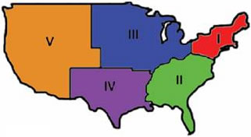
Get Involved! Have questions?
Reach out to your Region Representatives!
Jill Hoyt, MS, RD, LD
Heidi Hass, MS, RD, LD
Judy Kirk,
MS, RD, CDN, CSR, FNKF
Dana Trotta, MS, RD, CDR, LDN, FNKF
Nikki Nygren,
RD, CD
Lara Haddad, RD
Ruba Jibreen, MS, RD, CSR, LD, MBA
Scott Kimner, RD, LD
Matilde Ladnier, RD, LD
Carol Lim, RD, LD

