Slide 1
KIDNEY DISEASE EDUCATION
Part 1: CKD Overview

Slide 2
Why Learn About Kidney Disease?
Part 1: CKD Overview
For more informed choices
Better quality of life
Handle the physical, emotional and financial changes ahead
Learn about:
Stages of kidney disease
What you can do to help
What to expect

Slide 3
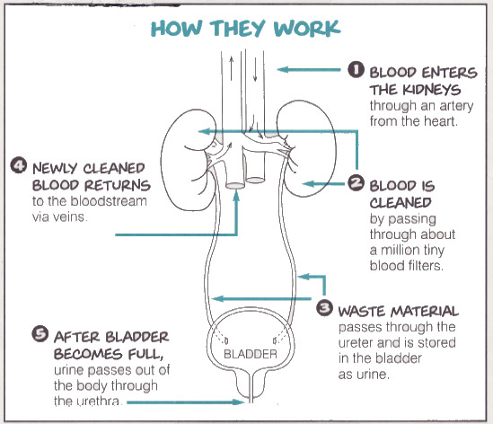
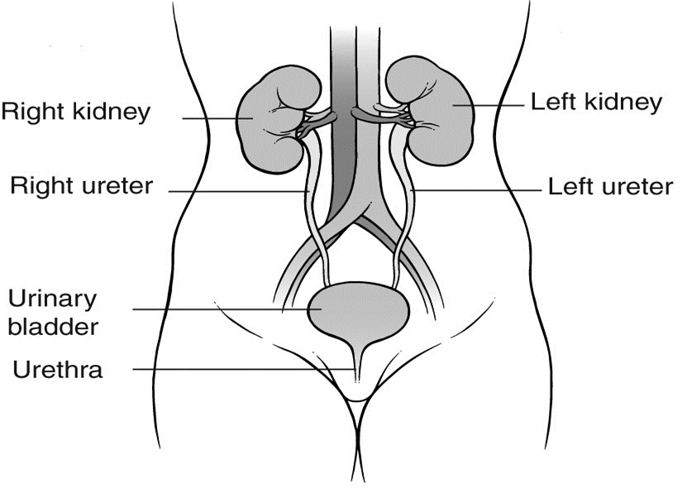
How Do Kidneys Work?
Part 1: CKD Overview
Notes:
In presentation mode, there are two diagrams – one basic, one more detailed. Click to have the more detailed photo animate in.
Comparing the kidneys to a Brita filter or a water treatment site seems to work well.

Slide 4
What Do Your Kidneys Do?
Part 1: CKD Overview
Remove waste products
Balance fluids
Help control blood pressure
Regulate hormones
Keep bones healthy
Balance minerals in the body
Help make red blood cells
Notes:
We repeat this when we talk about the symptoms of uremia.

Slide 5
What is Chronic Kidney Disease?
Part 1: CKD Overview
Your kidneys are losing their ability to filter blood or do their other jobs well enough to keep you healthy

Slide 6
What Causes Kidney Disease?
Part 1: CKD Overview
Diabetes (leading cause of CKD in the U.S.)
Hypertension (2nd leading cause of CKD in the U.S.)
Inherited
Drugs
Autoimmune Diseases
Congenital
Glomerular Nephritis (GN)
Other
Notes:
You will have patients who do not fall into the big categories but just tell them these are the most common but not all the causes.
Examples of others would be hepatitis and HIV

Slide 7
How is CKD Diagnosed?
Part 1: CKD Overview
Ways to diagnose kidney disease include:
Urine tests
Blood tests
Ultrasound or other imaging tests
Biopsy
Other tests may be needed
Notes:
Reiterate the importance of UACR or UPCR spot checks, 24 urine collection may be used
Blood tests such as eGFR, serum creatinine, BUN, and others dependent upon presentation and potential etiology
eGFR is currently under review regarding race-based calculations- stay tuned for more info
There are multiple eGFR calculations currently available
* Please see NKF website for easy to use calculators

Slide 8
CKD for the Ages
Part 1: CKD Overview
Since everyone loses kidney function as they get older, how do I know what is normal for me?
Is kidney function different based on gender?
Is one of my kidneys working better than the other?
Notes:
The concept for this slide is to review the GFR calculations before we get to staging. A chance for you to share the GFR is dependent on age/gender and SCr before you share the patient's GFR. Commonly patients think 1 kidney is 100% and 1 kidney is 0% for a total of 50%. Also, you will often have nephrectomies. This is a chance for you to explain that function is measured after the fact so rarely can we know how much function each kidney has….(unless, of course, there is only 1 kidney or there is an anatomic difference, i.e.: nephrectomy, renal artery stenosis or on ultrasound, one shrunken kidney)

Slide 9
GFR (Glomerular Filtration Rate)
Part 1: CKD Overview
Normal is 90 or higher
Helps your health care professional to know how well your kidneys are working
Gets lower with age
Gets lower as kidney disease gets worse
Helps determine stage of kidney disease
Notes:
Use the ‘cheat’ info of 1% loss/year of life above age 30 (although it is actually 0.8%, 1% makes it easier for patient calculation) and remind patients that we are all losing kidney function. Remember that GFR uses a standard 70kg patient with normal muscle and so it is not as precise as we tell patients.

Slide 10
Stages of Kidney Disease
Part 1: CKD Overview
Notes:
Red is bad, green is good!!
Your stage, and progression, is primarily dependent on both your GFR and how much albumin you have in your urine…again, mention the UACR and how important it is to follow that too.
Reference link:
http://kdigo.org/home/guidelines/ckd-evaluation-management/
Kidney Disease: Improving Global Outcomes (KDIGO) CKD Work Group. KDIGO 2012 Clinical Practice Guideline for the Evaluation and Management of Chronic Kidney Disease. Kidney inter., Suppl. 2013; 3: 1-150.

Slide 11
What is Your GFR?
Part 1: CKD Overview
Do You Have Albumin (a type of protein) in Your Urine?
Notes:
No matter how well you thought you covered this, we often find that the patients cannot answer these 2 simple questions. Since this is the goal of the whole talk, we thought it helped to stop and go over it again.

Slide 12
Stage 4 CKD (GFR 15 – 29)
Part 1: CKD Overview
Goal of treatment
Prevent or slow loss of kidney function
Treat the complications of CKD
Learn
What you can do to keep CKD from getting worse– and do it!
About options for treatment of kidney failure, so you’re prepared to choose the one that’s best for you
About your treatment plan

Slide 13
Stage 4 CKD: Diet and Fluid (GFR 15 – 29)
Part 1: CKD Overview
Prevent build-up of harmful waste products and extra fluid
Dietary changes
Sodium (Salt)
Protein
Carbohydrates
Fat
Fluid
Potassium
Phosphorus
Notes:
A useful factoid is that Stage = days to get NACL out of your system as taught by Charlies Foulks, MD, who helped develop the KDOQI dietary guidelines. Stage 4 means 4 days to get NACL out of your system. Helps for trying to convince patients to cut back on pork.
Double check the K level and the meds (spironolactone/ACE/ARB) and mention the common K-heavy foods (bananas, avocados, citrus fruits, potatoes, tomatoes).

Slide 14
Malnutrition in CKD
Part 1: CKD Overview
Happens when your body does not get important nutrients and energy
Watch for symptoms:
Tiredness
Dizziness
Weight loss

Slide 15
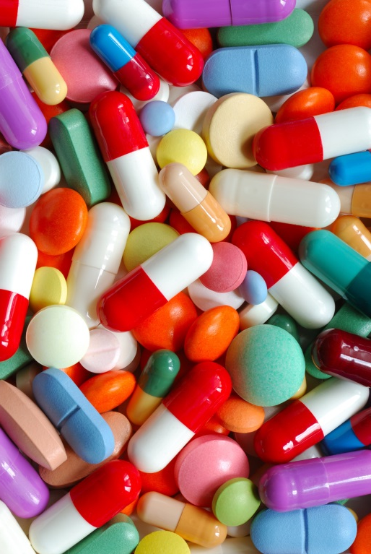
Stage 4 CKD: Medications (GFR 15 – 29)
Part 1: CKD Overview
Balance vitamins and minerals
Control high blood pressure
Control cholesterol
Treat anemia
Treat high acid in blood
Keep bones strong/prevent bone disease
Notes:
Since Na bicarb has been shown to slow progression of CKD, mention the need for monitoring metabolic acidosis.

Slide 16
Stage 4 CKD: Caution
Part 1: CKD Overview
Check with your provider before use of:
Over the counter medications
Herbs
Dietary supplements
Energy drinks/Sports drinks
Designer diets

Slide 17
Stage 4 CKD: Exercise (GFR 15 – 29)
Part 1: CKD Overview
Increases strength
Lowers blood pressure
Reduces sleeplessness
Builds bone strength
Improves weight control
Lowers level of blood fats
Feel better
Notes:
Suggest non-weight bearing exercise when your w/c bound total knee replacement diabetics balk at exercise. Orthopedics (AAOS) feels that water exercises are safe for any orthopedic problem by removing the joint compression. It may be worth researching handicapped accessed pools in your area to refer patients. You may need a cardiac referral for clearance for exercise.

Slide 18
What if Your Cholesetrol Levels Are Not at Target?
Part 1: CKD Overview
Lifestyle changes
Eat a diet low in saturated fats and cholesterol
Lose weight if necessary
Get regular physical activity and exercise
Don’t smoke
Limit alcohol
Medicine may be needed
Notes:
The newest KDIGO guidelines were published in 2013:
http://kdigo.org/home/guidelines/lipids/
Kidney Disease: Improving Global Outcomes (KDIGO) Lipid Work Group. KDIGO Clinical Practice Guideline for Lipid Management in Chronic Kidney Disease. Kidney inter., Suppl. 2013; 3: 259–305.
Reinforce importance of having all medication dosed appropriately to degree of kidney function (esp. fenofibrate, statins, and others)

Slide 19
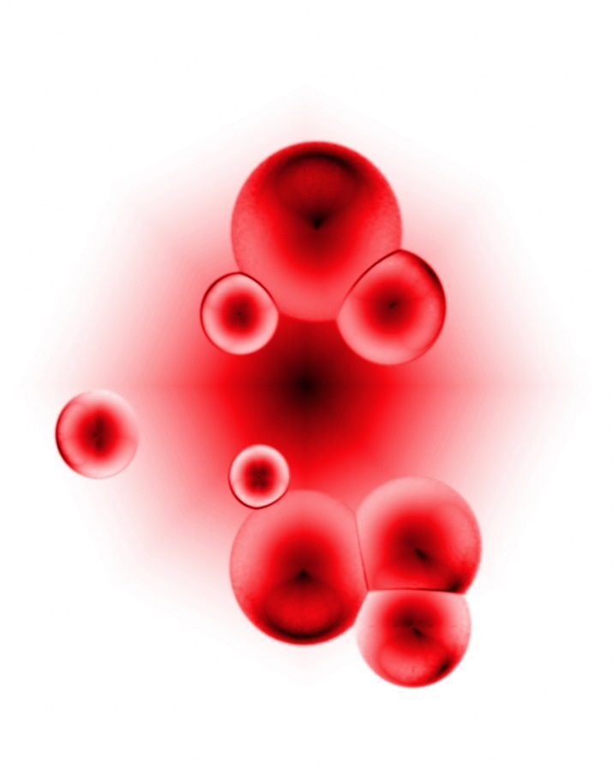
Anemia in CKD
Part 1: CKD Overview
Your red blood cell count is too low
This is common in CKD
Know your hemoglobin level
AND
Know the symptoms:
Tired
Low energy
Poor appetite
Confusion
Dizzy
Headaches
Fast heartbeat
Short of breath, chest pain
Might feel cold
Notes:
We didn’t have room on the slide to review what hemoglobin was. You may need to explain the point
http://kdigo.org/home/guidelines/anemia-in-ckd/
Kidney Disease: Improving Global Outcomes (KDIGO) Anemia Work Group. KDIGO Clinical Practice Guideline for Anemia in Chronic Kidney Disease. Kidney inter., Suppl. 2012; 2: 279–335

Slide 20
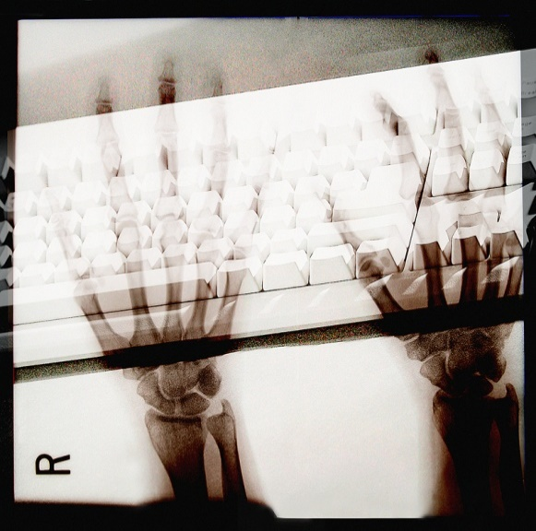
Mineral & Bone Problems in CKD
Part 1: CKD Overview
Monitor early in CKD
Your kidneys cannot balance calcium, phosphorus and vitamin D
Some foods can make this worse: Dark Sodas, Nuts, Processed Foods, and Dairy
This is important for bone and blood vessel health!!!
Notes:
A see-saw suggestion to explain balance in CKD works for patients to understand.
http://kdigo.org/home/mineral-bone-disorder/
Kidney Disease: Improving Global Outcomes (KDIGO) CKD–MBD Work Group. KDIGO clinical practice guideline for chronic kidney disease–mineral and bone disorder (CKD–MBD) 2017.

Slide 21
Depression in CKD
Part 1: CKD Overview
Affects many people with CKD
Can affect people in many ways
Watch for symptoms of depression
Sadness or irritability
Crying more than usual
Less interest in things that you used to enjoy
Loss of appetite
Thoughts of “giving up”
Feeling overwhelmed
Can be treated
Notes:
State of course depression affects everyone differently and the symptoms may be different for your patients.

Slide 22
Your Overall Plan of Care
Part 1: CKD Overview
Work with your health care team to create an overall plan of care that can help you:
Keep blood pressure controlled
Keep blood sugar under control
Lower high cholesterol levels
Manage anemia
Lower risk of mineral and bone problems
Prevent or manage malnutrition
Prevent or manage depression
Notes:
This is just the synopsis of the last 7 slides to go over one more time…

Slide 23
Stage 5 CKD: Kidney Failure
Part 1: CKD Overview
Despite the best treatment and your best efforts, kidneys can still fail
This is called “kidney failure”
When 85 – 90% of kidney function is gone
GFR falls below 15ml/min
Treatment Includes
Transplant, Peritoneal Dialysis, Hemodialysis and Palliative/Hospice
Notes:
Some patients will ask when you start dialysis. Review current literature for most current recommendations (early vs. late start)

Slide 24
Stage 5 CKD: Symptoms
Part 1: CKD Overview
Nausea
Trouble sleeping
Poor appetite
Tired
Dry, itchy skin
Urinary changes
Weight loss
Cramping
Abnormal bleeding
Swelling
Skin color changes
Trouble breathing
Confusion
Notes:
These are some of the more common signs of uremia.

Slide 25
Common Worries about Kidney Disease
Part 1: CKD Overview
What is life like with CKD?
What type of treatments are available?
How will I pay for treatment?
Medicare
Private Insurance
Medicaid
Notes:
Let your patients know that these are topics that are covered in the 2nd PPT of this series. Remind patients that Medicare only pays 80% and has both co-payments and deductibles. If you feel comfortable with it, Medicare part A is hospital, part B is outpatient (including dialysis…all types), part C is Medicare Advantage plans (you join an HMO or PPO) and part D is the drug benefit. Always remind patients that all insurances cover all treatments, including medical management.
Often you will be asked ‘when will I need to start dialysis’ which is really hard to predict for anyone but the UACR ratio is the most predictive factor:

Slide 26
Common Worries about Kidney Disease
Part 1: CKD Overview
Can I travel?
Can I work?
Will it hurt?
How will I know my kidneys are getting worse?
What can I eat?

Slide 27
Questions and Discussions
Part 1: CKD Overview
Come Back for Part 2: Kidney Treatment Options Class!
Notes:
Note there are a lot of web charlatans out there.
Encourage further reading on the websites that are reliable:
NKF (kidney.org)
NKDEP (NKDEP.gov),
KDIGO (KDIGO.org)
Renal Support Network (RSN.hope.org)

